Slide 1
Statistics
Chapter 9: Further Testing

Slide 2
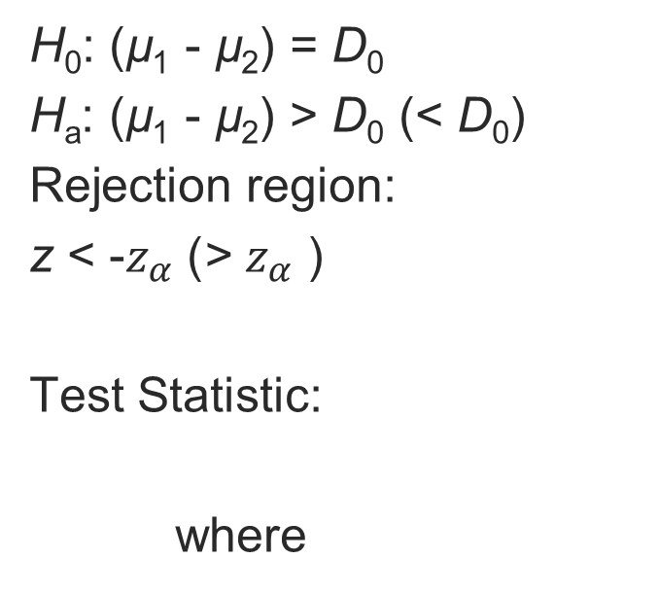
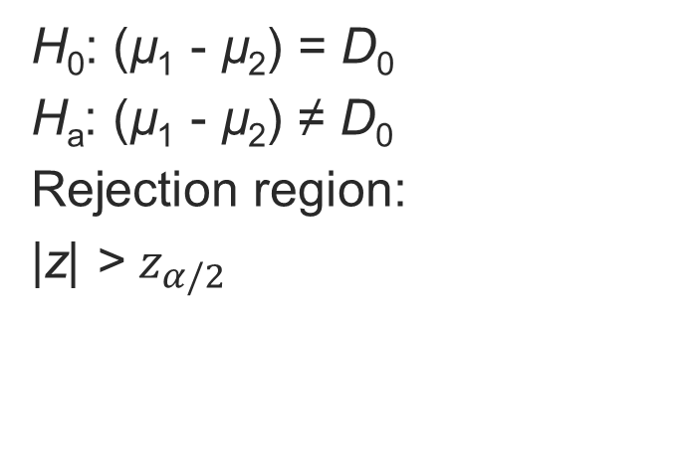
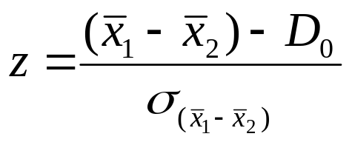
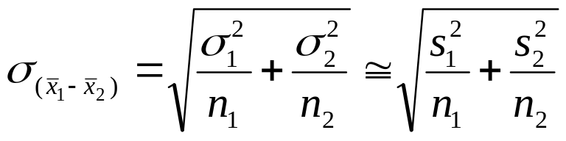
9.1: Comparing Two Population Means: Independent Sampling
One-Tailed Test
Two-Tailed Test

Slide 3
9.1: Comparing Two Population Means: Independent Sampling
Conditions Required for Valid Large-Sample Inferences about (µ₁ - µ₂)
1. The two samples are randomly and independently selected from the target populations.
2. The sample sizes are both ≥ 30.

Slide 4
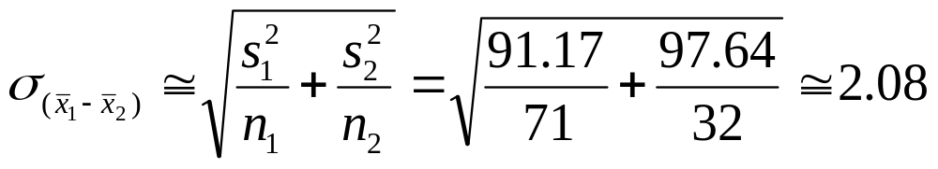
9.1: Comparing Two Population Means: Independent Sampling
Let’s go back to the retention data and test the hypothesis that there is no significant difference in retention at privates and publics.
Private Colleges
Public Universities
n: 71
Mean: 79.47
Standard Deviation: 9.35
Variance: 91.17
n: 32
Mean: 84
Standard Deviation: 9.88
Variance: 99.34

Slide 5
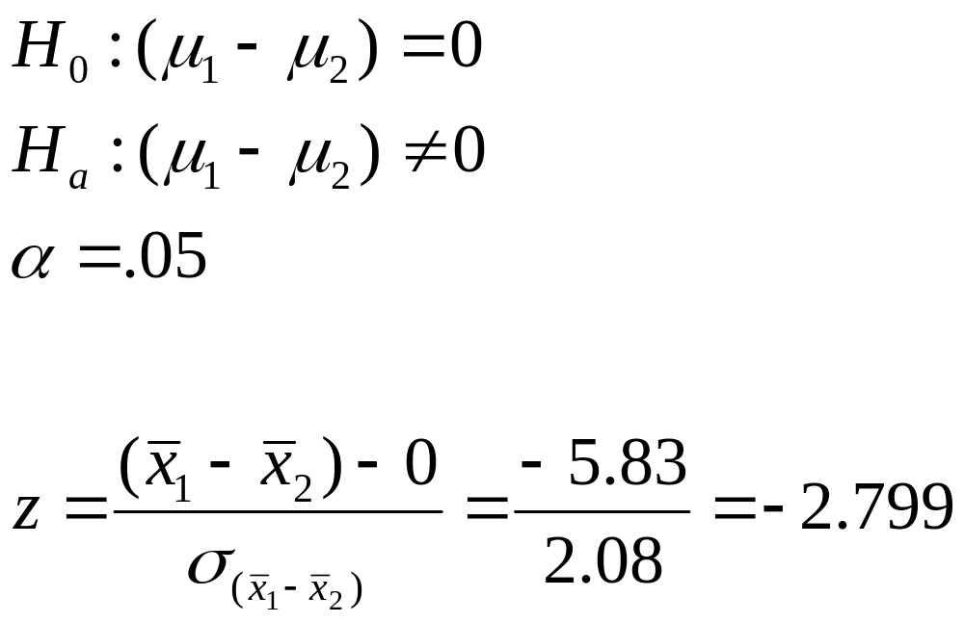
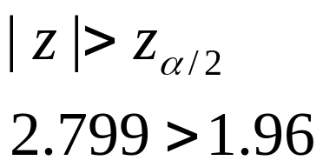
9.1: Comparing Two Population Means: Independent Sampling
Test statistic:
Reject the null hypothesis:

Slide 6
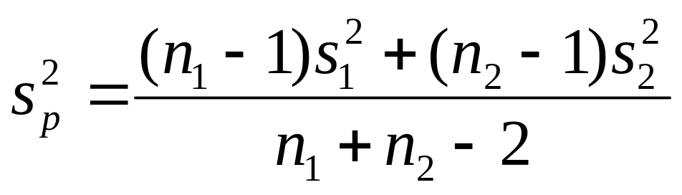
9.1: Comparing Two Population Means: Independent Sampling
For small samples, the t-distribution can be used with a pooled sample estimator of σ², s_{p}²

Slide 7
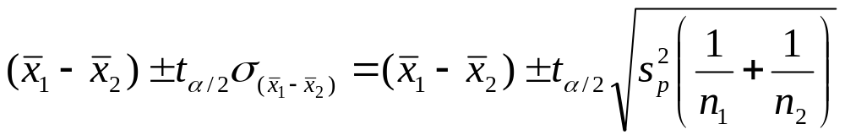
9.1: Comparing Two Population Means: Independent Sampling
Small Sample Confidence Interval for (µ₁ - µ₂ )
The value of t is based on (n₁ + n₂ -2) degrees of freedom.

Slide 8
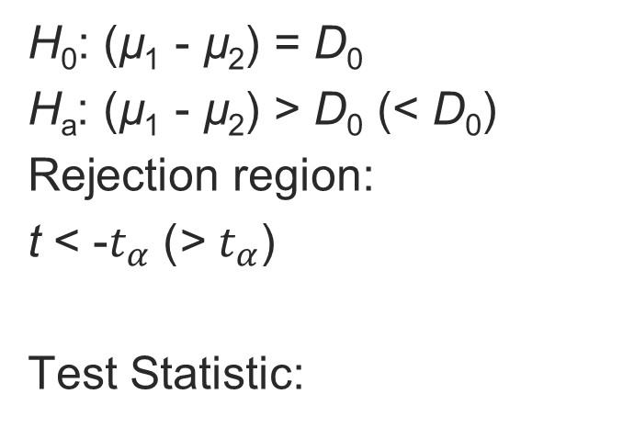

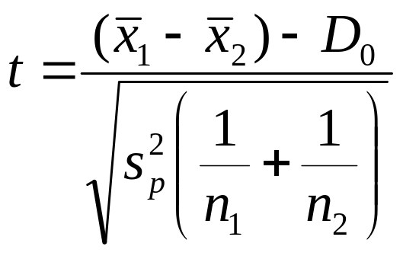
9.1: Comparing Two Population Means: Independent Sampling
One-Tailed Test
Two-Tailed Test

Slide 9
9.1: Comparing Two Population Means: Independent Sampling
Conditions Required for Valid Small-Sample Inferences about (µ₁ - µ₂)
1. The two samples are randomly and independently selected from the target populations.
2. Both sampled populations have distributions that are approximately normal.
3. The population variances are equal.

Slide 10
9.1: Comparing Two Population Means: Independent Sampling
Does class time affect performance?
  The test performance of students in two sections of international trade, meeting at different times, were compared.
8:00 a.m. Class
Mean: 78
Standard Deviation: 14
Variance: 196
n: 21
9:30 a.m. Class
Mean: 82
Standard Deviation: 17
Variance: 289
n: 21
With α = .05, test H₀ : µ₁ = µ₂

Slide 11
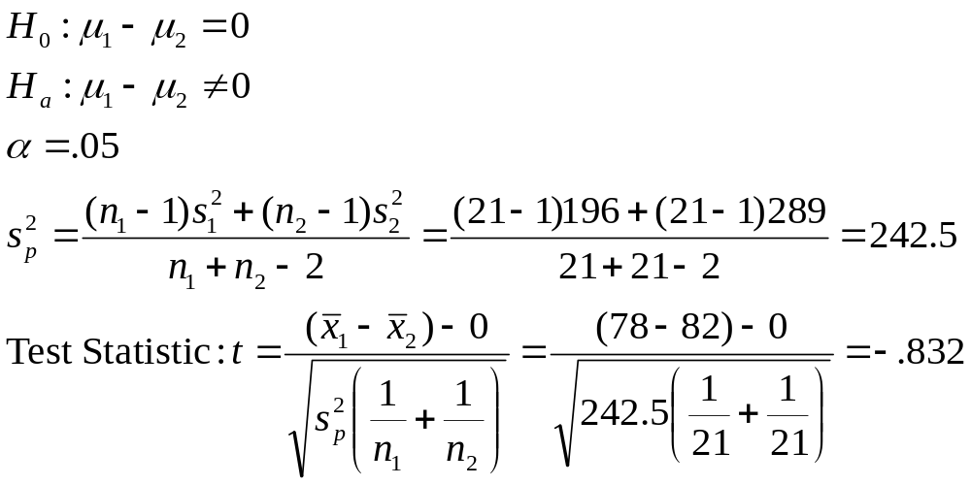
9.1: Comparing Two Population Means: Independent Sampling
8:00 a.m. Class
Mean: 78
Variance: 196
n: 21
9:30 a.m. Class
Mean: 82
Variance: 289
n: 21

Slide 12
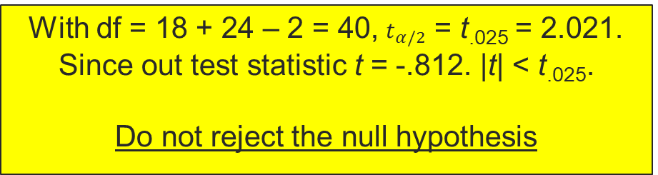
9.1: Comparing Two Population Means: Independent Sampling
8:00 a.m. Class
Mean: 78
Variance: 196
n: 21
9:30 a.m. Class
Mean: 82
Variance: 289
n: 21

Slide 13
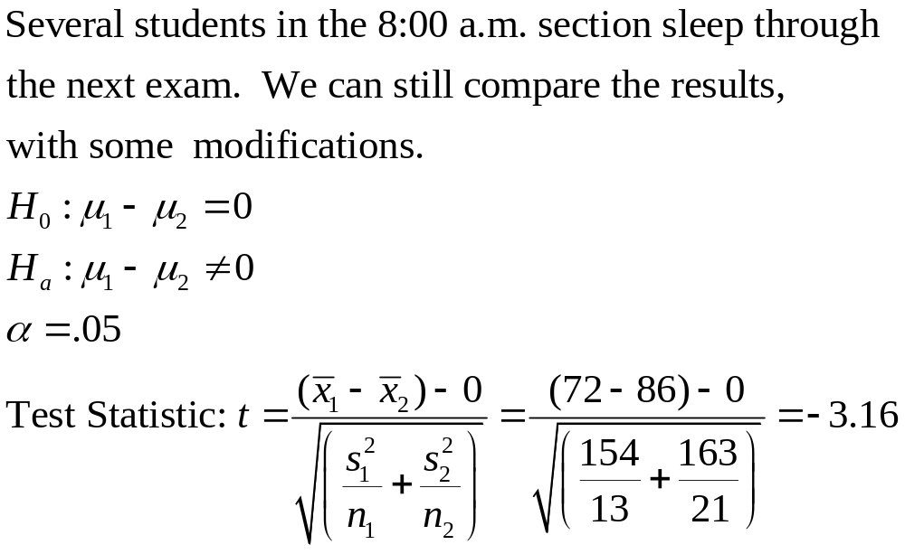
9.1: Comparing Two Population Means: Independent Sampling
8:00 a.m. Class
Mean: 72
Variance: 154
n: 13
9:30 a.m. Class
Mean: 86
Variance: 163
n: 21

Slide 14
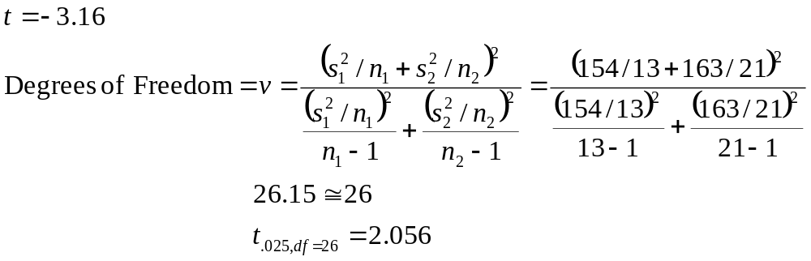
9.1: Comparing Two Population Means: Independent Sampling
8:00 a.m. Class
Mean: 72
Variance: 154
n: 13
9:30 a.m. Class
Mean: 86
Variance: 163
n: 21

Slide 15
9.1: Comparing Two Population Means: Independent Sampling
8:00 a.m. Class
Mean: 72
Variance: 154
n: 13
9:30 a.m. Class
Mean: 86
Variance: 163
n: 21
Since |t| > t_{.025,df=26}
reject the null hypothesis.

Slide 16
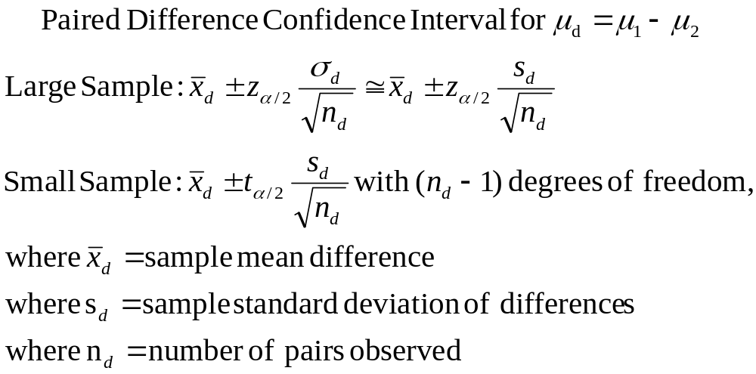
9.2: Comparing Two Population Means: Paired Difference Experiments

Slide 17
9.2: Comparing Two Population Means: Paired Difference Experiments
Suppose ten pairs of puppies were housetrained using two different methods: one puppy from each pair was paper-trained, with the paper gradually moved outside, and the other was taken out every three hours and twenty minutes after each meal. The number of days until the puppies were considered housetrained (three days straight without an accident) were compared. Nine of the ten paper-trained dogs took longer than the other paired dog to complete training, with the average difference equal to 4 days, with a standard deviation of 3 days.
What is a 90% confidence interval on the difference in successful training?

Slide 18
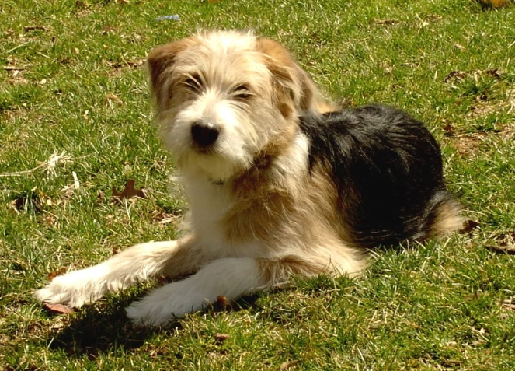
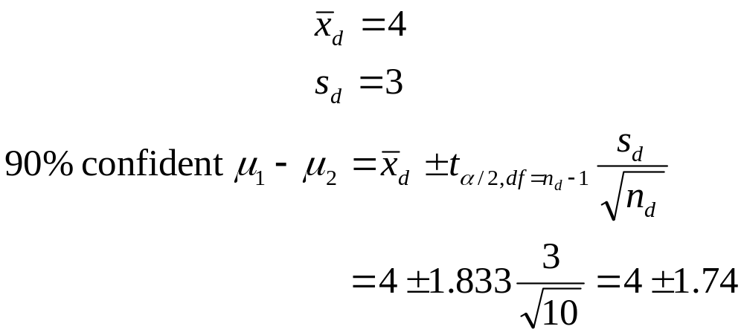
9.2: Comparing Two Population Means: Paired Difference Experiments
Since 0 is not in the interval, one program does seem to work more effectively.

Slide 19
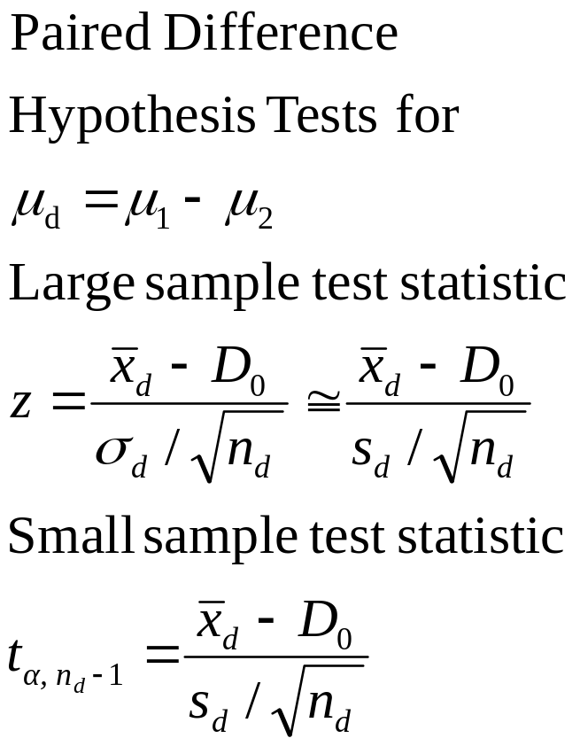
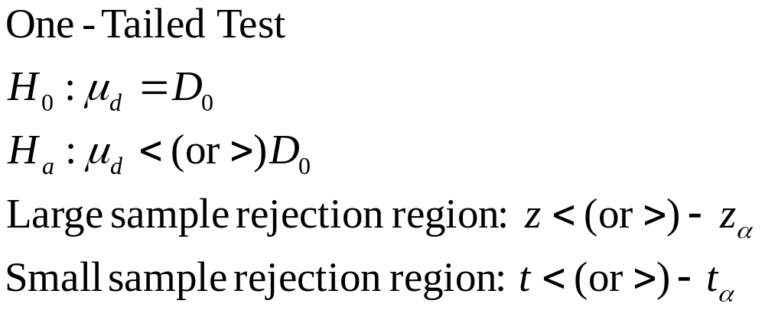
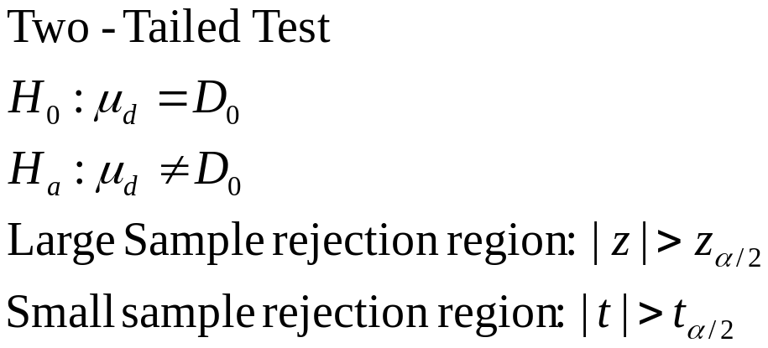
9.2: Comparing Two Population Means: Paired Difference Experiments

Slide 20
9.2: Comparing Two Population Means: Paired Difference Experiments
Suppose 150 items were priced at two online stores, “cport” and “warriorwoman.”
  Mean difference: $1.75
  Standard Deviation: $10.35
  Test at the 95% level that the difference in the two stores is zero.

Slide 21
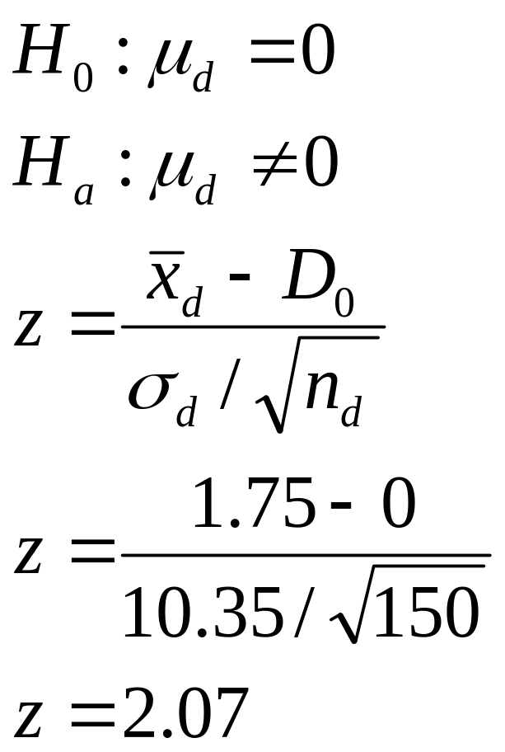
9.2: Comparing Two Population Means: Paired Difference Experiments
Suppose 150 items were priced at two online stores, “cport” and “warriorwoman.”
  Mean difference: $1.75
  Standard Deviation: $10.35
   = .05

Slide 22
9.2: Comparing Two Population Means: Paired Difference Experiments
Suppose 150 items were priced at two online stores, “cport” and “warriorwoman.”
  Mean difference: $1.75
  Standard Deviation: $10.35
   = .05
The critical value of z_{.05} is 1.96, so we would reject this null hypothesis.

Slide 23
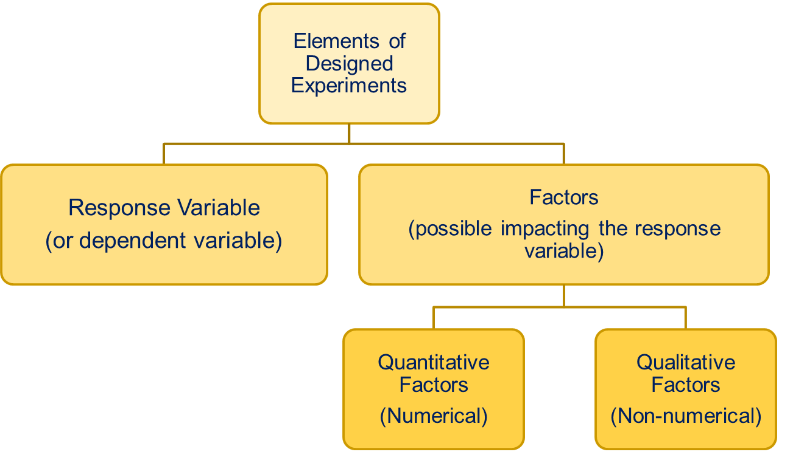
9.3: Comparing Three or More Population Means: Analysis of Variance

Slide 24
9.3: Comparing Three or More Population Means: Analysis of Variance
Treatments are the factor-level combinations
  In the example above, a variety of different GPA – Hours Studied combinations could occur within each subset (Yes or No) of the Study Group factor

Slide 25
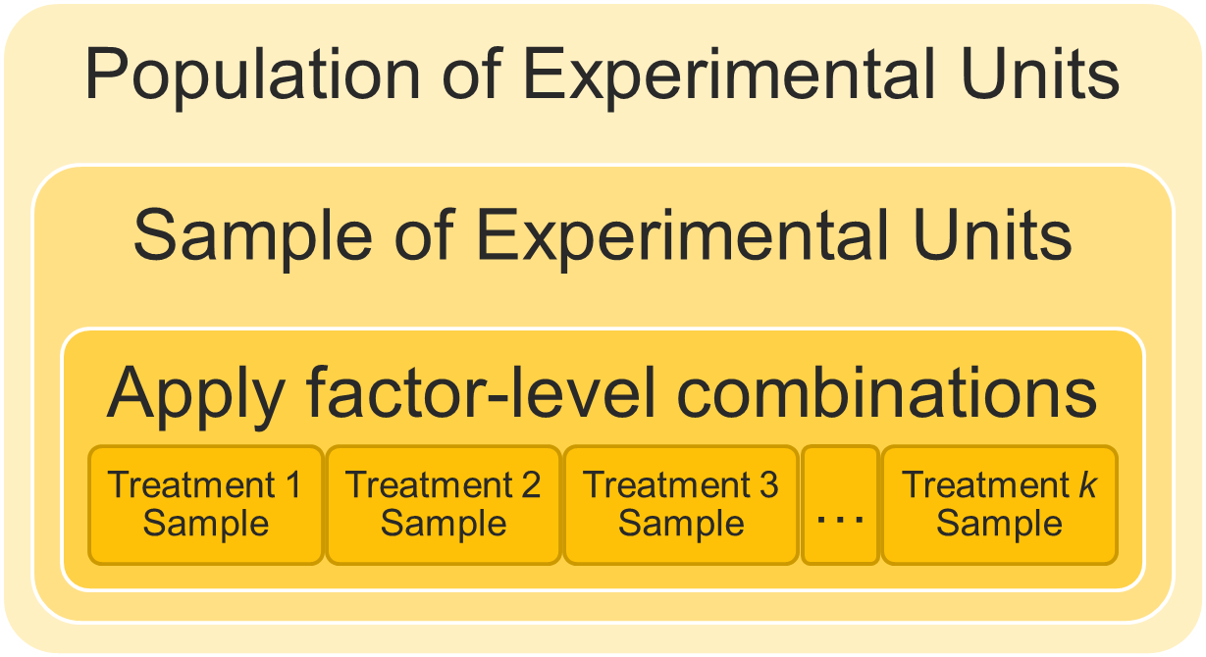
9.3: Comparing Three or More Population Means: Analysis of Variance

Slide 26
9.3: Comparing Three or More Population Means: Analysis of Variance
Very often the object is to determine whether the varying treatments result in different means:
H₀: µ₁ = µ₂ = µ₃ = µ₄ = ··· = µ_{k}
H_{a}: At least two of the k treatment means differ

Slide 27
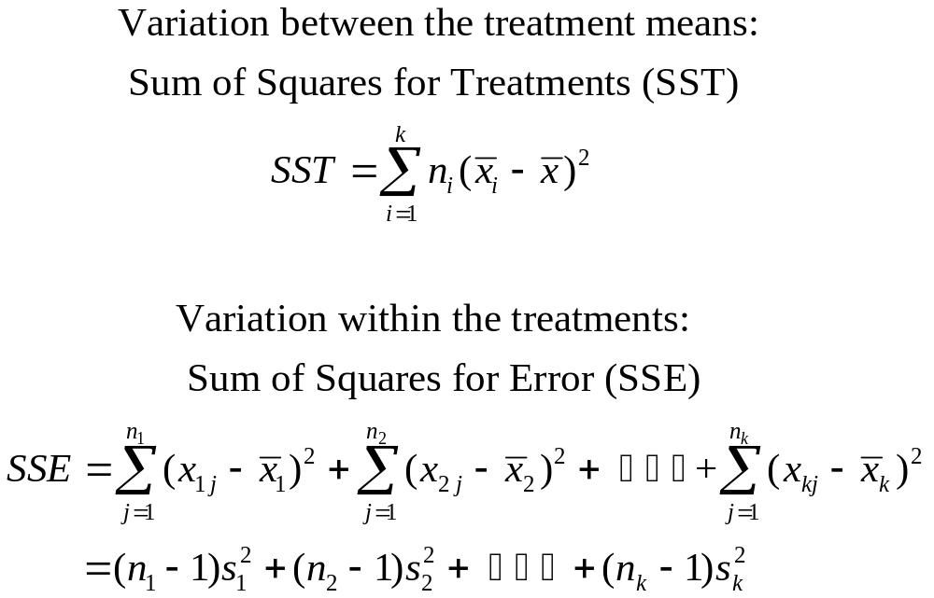
9.3: Comparing Three or More Population Means: Analysis of Variance
Testing the equity of the means involves comparing the variability among the different treatments as well as within the treatments, adjusted for degrees of freedom.

Slide 28
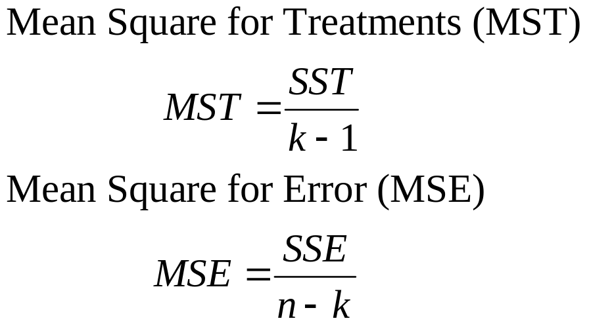
9.3: Comparing Three or More Population Means: Analysis of Variance
Adjusting for degrees of freedom produces comparable measures of variability

Slide 29
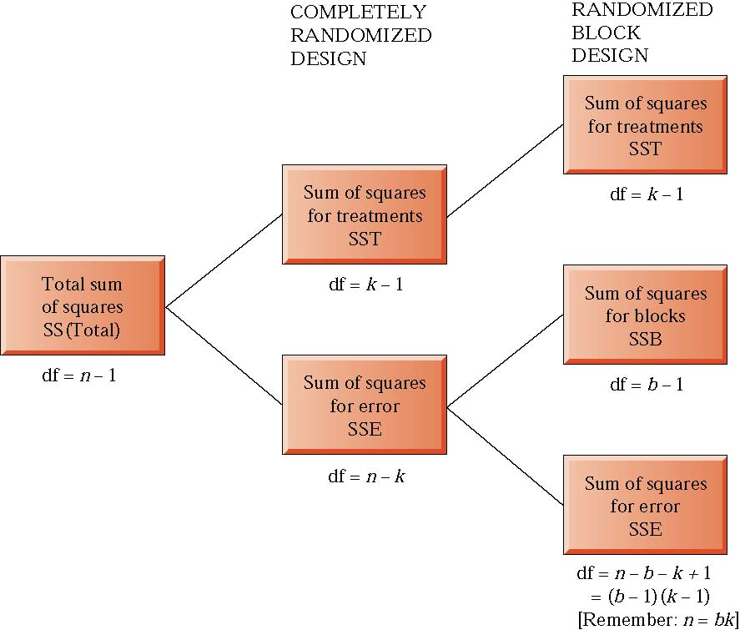
9.3: Comparing Three or More Population Means: Analysis of Variance

Slide 30
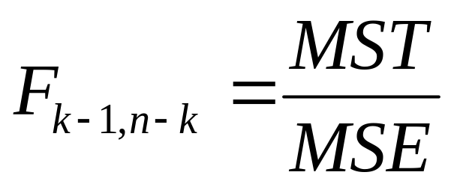
9.3: Comparing Three or More Population Means: Analysis of Variance
The ratio of the variability among the treatment means to that within the treatment means is an F -statistic:
with k-1 numerator and n-k denominator degrees of freedom.

Slide 31
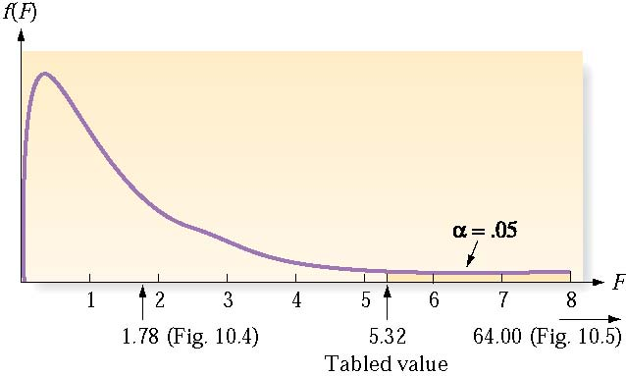
9.3: Comparing Three or More Population Means: Analysis of Variance
If F*  1, the difference between the treatment means may be attributable to sampling error.
If F* > 1 (significantly), there is support for the alternative hypothesis that the treatments themselves produce different results.

Slide 32
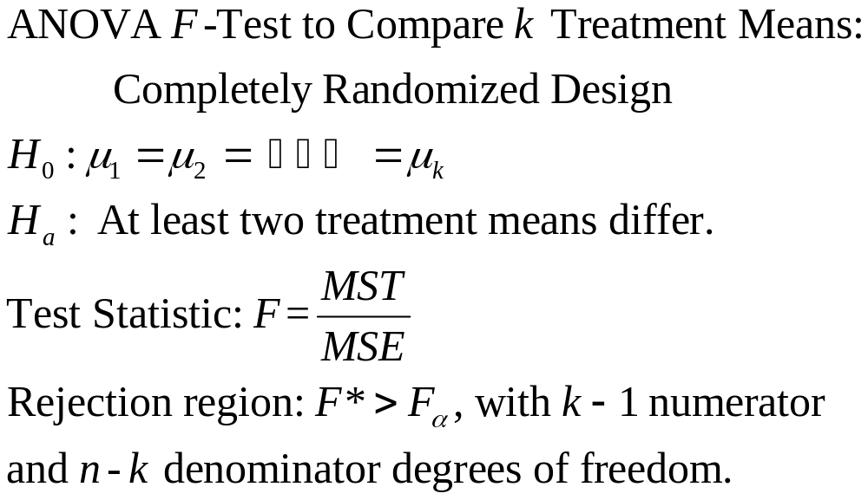
9.3: Comparing Three or More Population Means: Analysis of Variance

Slide 33
9.3: Comparing Three or More Population Means: Analysis of Variance
Conditions required for a Valid ANOVA F-Test: Completely Randomized Design
  The samples are randomly selected in an independent manner from the k treatment populations.
  All k sampled populations have distributions that are approximately normal.
  The k population variances are equal.

Slide 34
9.3: Comparing Three or More Population Means: Analysis of Variance
The USGA compares the driving distance of four brands of golf balls.
  H₀: µ₁ = µ₂ = µ₃ = µ₄
  H_{a}: The mean distances differ for at least two of the brands
   = .10
  Test Statistic: F = MST/MSE
  Rejection region: F > 2.25 = F_{.10 with v1 = 3 and v2 = 36}

Slide 35
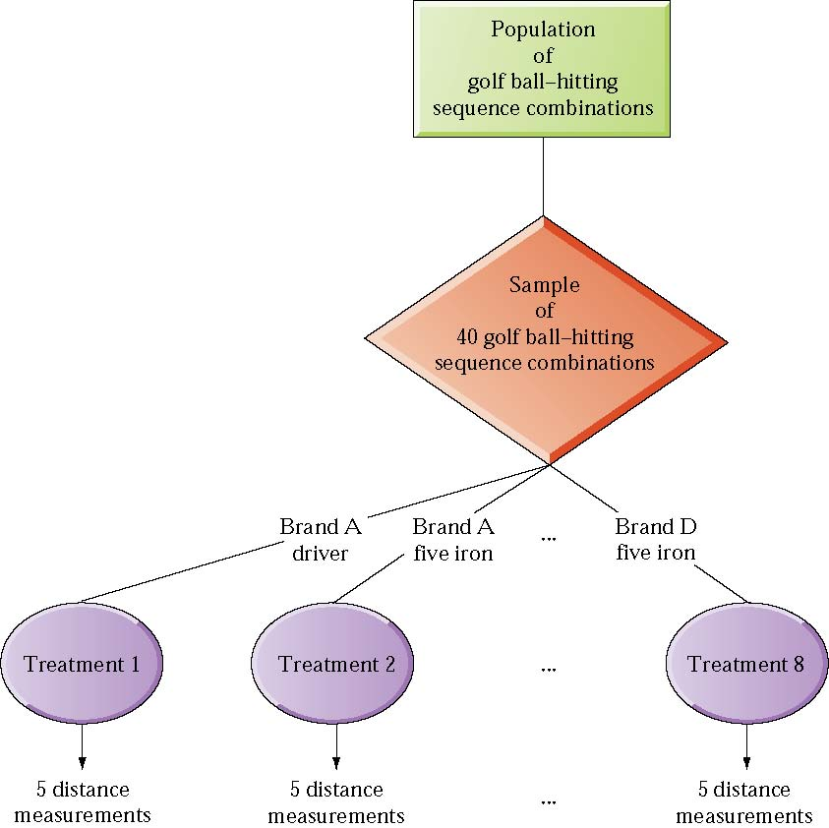
9.3: Comparing Three or More Population Means: Analysis of Variance

Slide 36
9.3: Comparing Three or More Population Means: Analysis of Variance
The USGA compares the driving distance of four brands of golf balls.
  H₀: µ₁ = µ₂ = µ₃ = µ₄
  H_{a}: The mean distances differ for at least two of the brands
   = .10 Test Statistic: F = MST/MSE
  Rejection region: F > 2.25 = F_{.10 with v1 = 3 and v2 = 36}
Source | Degrees of Freedom | Sum of Squares | Mean Square | F | p-value
Brands | 3 | 2,794.39 | 931.46 | 43.99 | .000
Error | 36 | 762.30 | 21.18

Slide 37
9.3: Comparing Three or More Population Means: Analysis of Variance
The USGA compares the driving distance of four brands of golf balls.
  H₀: µ₁ = µ₂ = µ₃ = µ₄
  H_{a}: The mean distances differ for at least two of the brands
   = .10 Test Statistic: F = MST/MSE
  Rejection region: F > 2.25 = F_{.10 with v1 = 3 and v2 = 36}
Since the calculated
F > 2.25, we reject the null hypothesis.
Source | Degrees of Freedom | Sum of Squares | Mean Square | F | p-value
Brands | 3 | 2,794.39 | 931.46 | 43.99 | .000
Error | 36 | 762.30 | 21.18

Slide 38
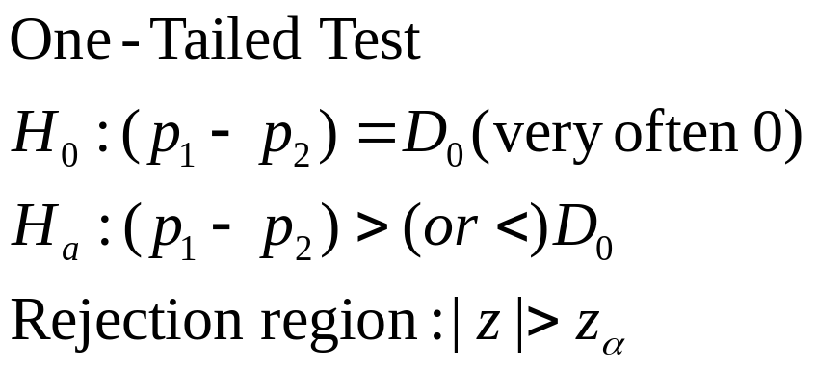
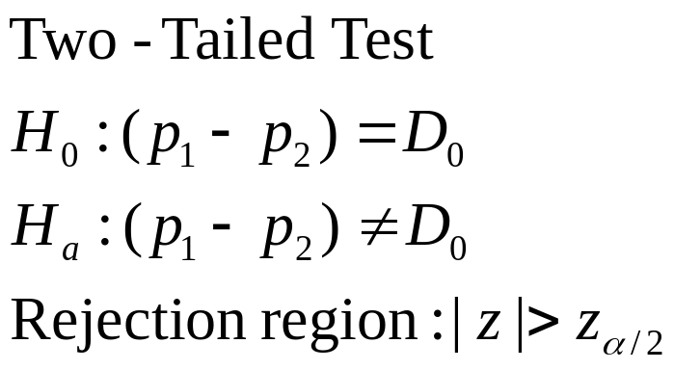
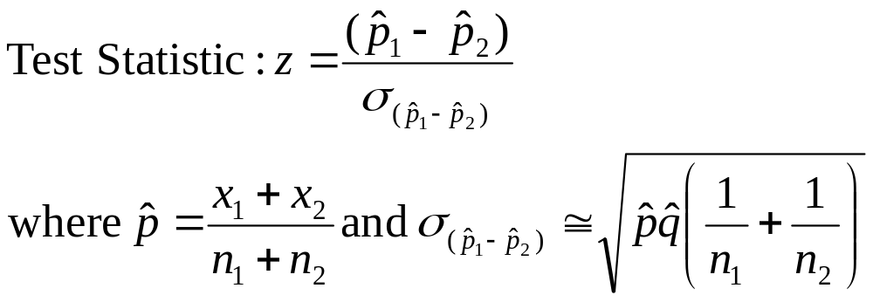
9.4: Comparing Two Population Proportions: Independent Sampling

Slide 39
9.4: Comparing Two Population Proportions: Independent Sampling
Randy Stinchfield of the University of Minnesota studied the gambling activities of public school students in 1992 and 1998 (Journal of Gambling Studies, Winter 2001). His results are reported below:
Do these results represent a statistically significant difference at the α = .01 level?
 | 1992 | 1998
Survey n | 21,484 | 23,199
Number who gambled | 4.684 | 5,313
Proportion who gambled | .218 | .229

Slide 40
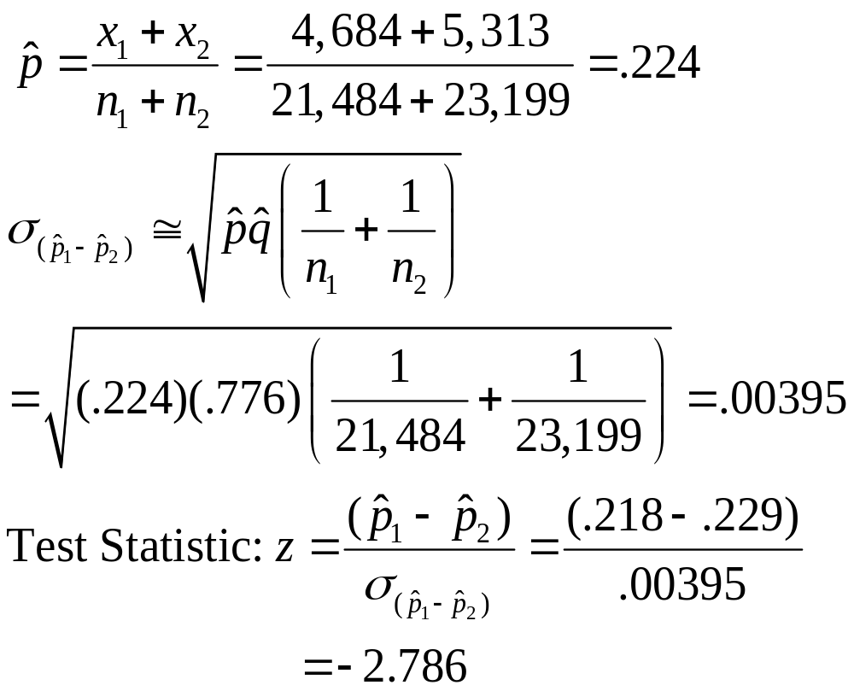
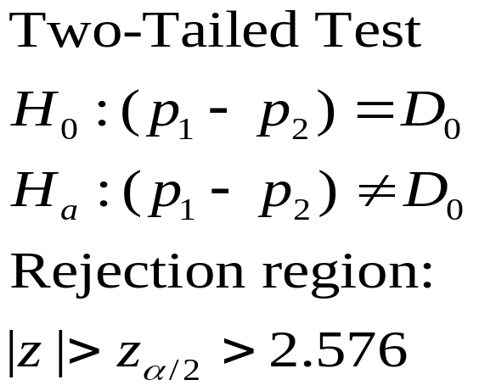
9.4: Comparing Two Population Proportions: Independent Sampling
 | 1992 | 1998
Survey n | 21,484 | 23,199
Number who gambled | 4.684 | 5,313
Proportion who gambled | .218 | .229

Slide 41
9.4: Comparing Two Population Proportions: Independent Sampling
 | 1992 | 1998
Survey n | 21,484 | 23,199
Number who gambled | 4.684 | 5,313
Proportion who gambled | .218 | .229
Since the computed value of z, -2.786, is of greater magnitude than the critical value, 2.576, we can reject the null hypothesis at the α = .01 level.

Slide 42
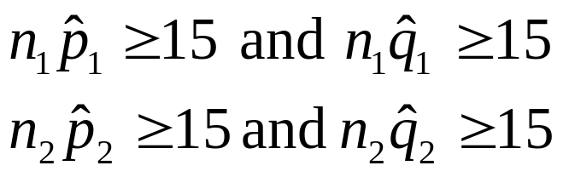
9.4: Comparing Two Population Proportions: Independent Sampling
For valid inferences
  The two samples must be independent
  The two sample sizes must be large:

Slide 43
9.5 Testing Categorical Probabilities:Multinomial Experiment
Properties of the Multinomial Experiment
  The experiment consists of n identical trials.
  There are k possible outcomes (called classes, categories or cells) to each trial.
  The probabilities of the k outcomes, denoted by p₁, p₂, …, p_{k}, where p₁+ p₂+ … + p_{k} = 1, remain the same from trial to trial.
  The trials are independent.
  The random variables of interest are the cell counts n₁, n₂, …, n_{k} of the number of observations that fall into each of the k categories.

Slide 44
9.5: Testing Categorical Probabilities: Multinomial Experiments
Suppose three candidates are running for office, and 150 voters are asked their preferences.
  Candidate 1 is the choice of 61 voters.
  Candidate 2 is the choice of 53 voters.
  Candidate 3 is the choice of 36 voters.
Do these data suggest the population may prefer one candidate over the others?

Slide 45
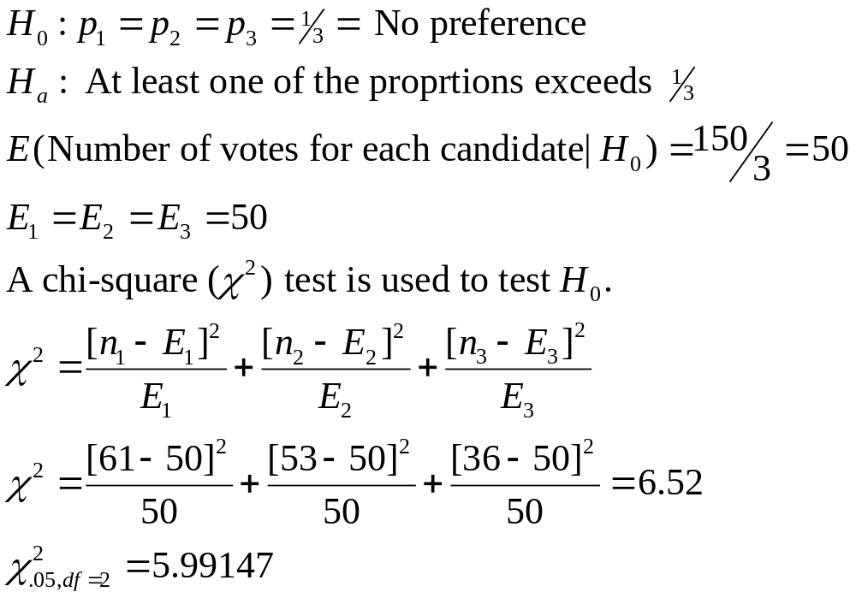
9.5: Testing Categorical Probabilities: Multinomial Experiments
  Candidate 1 is the
  choice of 61 voters.
  Candidate 2 is the
  choice of 53 voters.
  Candidate 3 is the
  choice of 36 voters.
  n =150

Slide 46
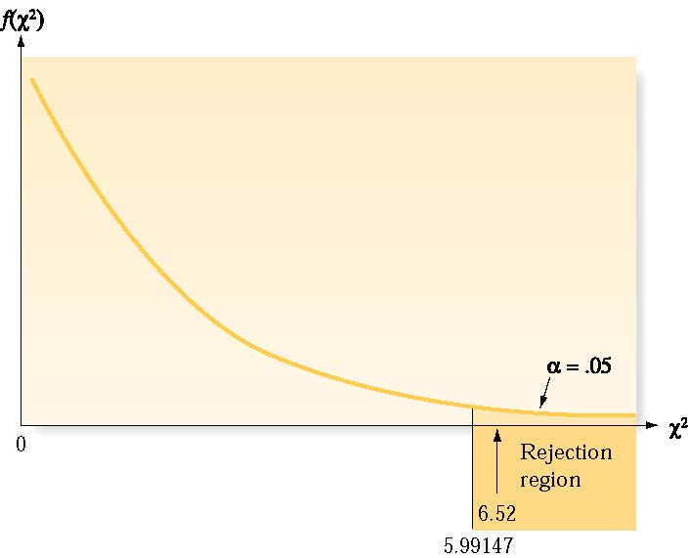
9.5: Testing Categorical Probabilities: Multinomial Experiments
Reject the null hypothesis

Slide 47
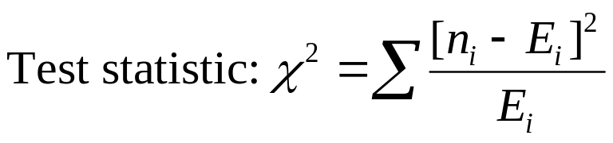
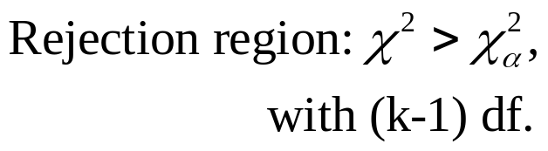
9.5: Testing Categorical Probabilities: Multinomial Experiments
Test of a Hypothesis about Multinomial Probabilities:
One-Way Table
H₀: p₁ = p_{1,0}, p₂ = p_{2,0}, … , p_{k} = p_{k,0}
where p_{1,0}, p_{2,0}, …, p_{k,0} represent the hypothesized values of the multinomial probabilities
H_{a}: At least one of the multinomial probabilities does not equal its hypothesized value
where E_{i} = np_{1,0}, is the expected cell count given the null hypothesis.

Slide 48
9.5: Testing Categorical Probabilities: Multinomial Experiments
Conditions Required for a Valid ² Test:
One-Way Table
A multinomial experiment has been conducted.
The sample size n will be large enough so that, for every cell, the expected cell count E(n_{i}) will be equal to 5 or more.

Slide 49
9.5: Testing Categorical Probabilities: Multinomial Experiments
Example 9.5: Distribution of Opinions About Marijuana
Possession Before Television Series has Aired
Legalization | Decriminalization | Existing Law | No Opinion
7% | 18% | 65% | 10%
Table 9.5: Distribution of Opinions About Marijuana
Possession After Television Series has Aired
Legalization | Decriminalization | Existing Law | No Opinion
39 | 99 | 336 | 26

Slide 50
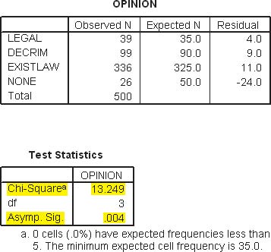
9.5: Testing Categorical Probabilities: Multinomial Experiments

Slide 51
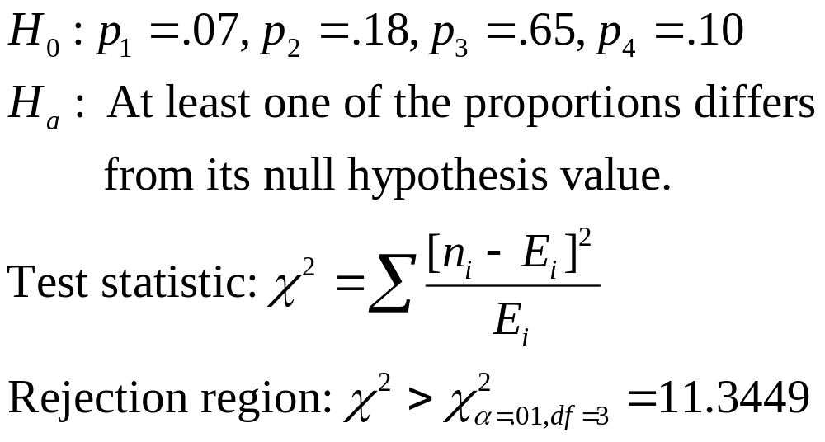
9.5: Testing Categorical Probabilities: Multinomial Experiments
Expected Distribution of 500 Opinions About Marijuana
Possession After Television Series has Aired
Legalization | Decriminalization | Existing Law | No Opinion
500(.07)=35 | 500(.18)=90 | 500(.65)=325 | 500(.10)=50

Slide 52
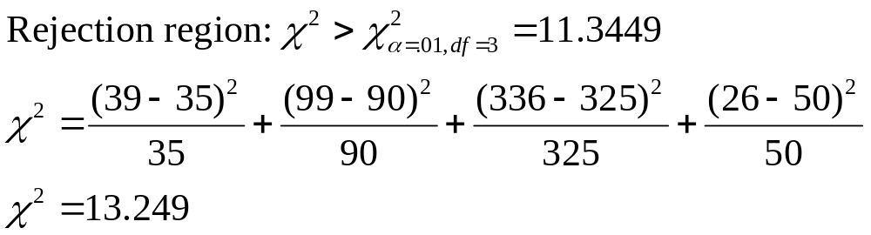
9.5: Testing Categorical Probabilities: Multinomial Experiments
Expected Distribution of 500 Opinions About Marijuana
Possession After Television Series has Aired
Legalization | Decriminalization | Existing Law | No Opinion
500(.07)=35 | 500(.18)=90 | 500(.65)=325 | 500(.10)=50

Slide 53
9.5: Testing Categorical Probabilities: Multinomial Experiments
Expected Distribution of 500 Opinions About Marijuana
Possession After Television Series has Aired
Legalization | Decriminalization | Existing Law | No Opinion
500(.07)=35 | 500(.18)=90 | 500(.65)=325 | 500(.10)=50
Reject the null hypothesis

Slide 54
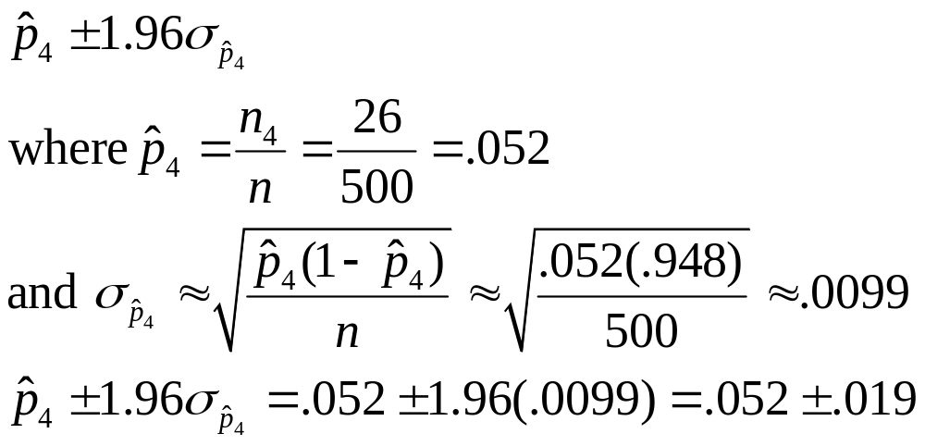
9.5: Testing Categorical Probabilities: Multinomial Experiments
Inferences can be made on any single proportion as well:
  95% confidence interval on the proportion of citizens in the viewing area with no opinion is

Slide 55
9.6: Testing Categorical Probabilities: Two-Way Table
Chi-square analysis can also be used to investigate studies based on qualitative factors.
  Does having one characteristic make it more/less likely to exhibit another characteristic?

Slide 56
9.6: Testing Categorical Probabilities: Two-Way Table
The columns are divided according to the subcategories for one
qualitative variable and the rows for the other qualitative variable.
 |  |  | Column
 |  | 1 | 2 |  | c | Row Totals
 | 1 | n₁₁ | n₁₂ |  | n_{1c} | R₁
Row | 2 | n₂₁ | n₂₂ |  | n_{2c} | R₂
 |  |  |  |  |  | 
 | r | n_{r1} | n_{r2} |  | n_{rc} | R_{r}
Column Totals |  | C₁ | C₁ |  | C₁ | n

Slide 57
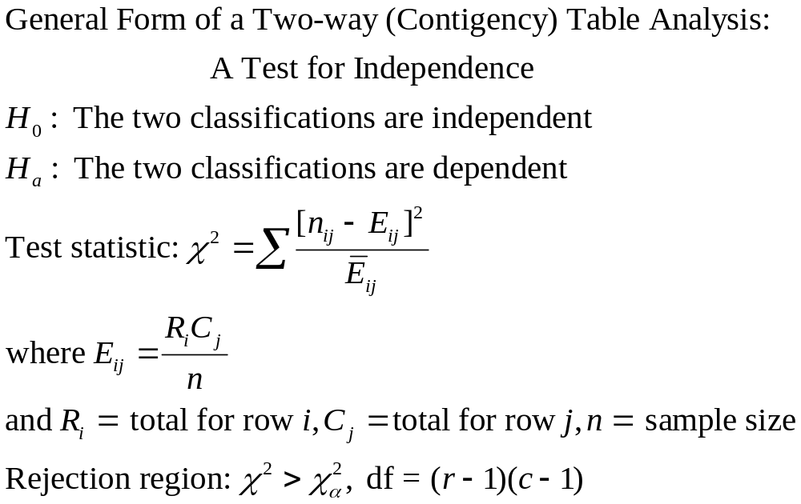
9.6: Testing Categorical Probabilities: Two-Way Table

Slide 58
9.6: Testing Categorical Probabilities: Two-Way Table
The results of a survey regarding marital status and religious affiliation are reported below.
Religious Affiliation
 | A | B | C | D | None | Totals
Divorced | 39 | 19 | 12 | 28 | 18 | 116
Married, never divorced | 172 | 61 | 44 | 70 | 37 | 384
Totals | 211 | 80 | 56 | 98 | 55 | 500
Marital
Status
H₀: Marital status and religious affiliation are independent
H_{a}: Marital status and religious affiliation are dependent

Slide 59
9.6: Testing Categorical Probabilities: Two-Way Table
The expected frequencies are included below:
Religious Affiliation
 | A | B | C | D | None | Totals
Divorced | 39 (48.95) | 19 (18.56) | 12 (12.99) | 28 (27.74) | 18 (12.76) | 116
Married, never divorced | 172 (162.05) | 61 (61.44) | 44 (43.01) | 70 (75.26) | 37 (42.24) | 384
Totals | 211 | 80 | 56 | 98 | 55 | 500
Marital
Status
The chi-square value computed with SAS is 7.1355, with p-value = .1289.
Even at the α = .10 level, we cannot reject the null hypothesis.

Slide 60
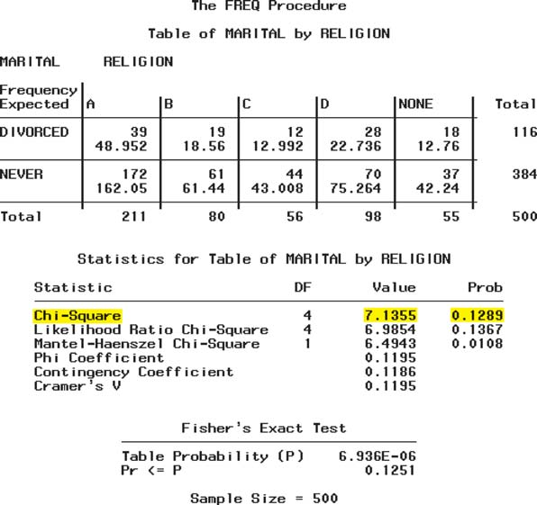
9.6: Testing Categorical Probabilities: Two-Way Table

