Slide 1
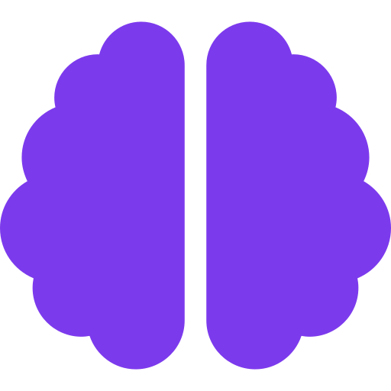
Deep Learning
Optimizers ⚡ Activation Functions 🚀 Applications
No PhD required. Just vibes & curiosity! 🎓
1st Year BTech — The Fun Version

Slide 2
🤔 So... What IS Deep Learning?
🧠 The Analogy
🏗️ The Structure
Imagine your BRAIN is learning to play a video game. At first you're terrible 🎮 You fail, you learn, you adjust. Deep Learning = computer doing
the same thing!
INPUT
HIDDEN
HIDDEN
OUTPUT
Each layer learns features,
just like YOUR brain learns!

Slide 3
⚡ Optimizers — The GPS of Deep Learning
🏔️ THE MOUNTAIN ANALOGY
Imagine you're blindfolded on a hilly mountain and you want to reach the LOWEST VALLEY (minimum loss). The Optimizer is your strategy for getting down!
🐢 SGD
🏎️ Adam
🏍️ RMSProp
Stochastic Gradient Descent
Adaptive Moment Estimation
Root Mean Square Prop
"The Tortoise"
"The Sports Car"
"The Motorbike"
Takes one step at a time, looking at 1 example. SLOW but steady. Like reading every single review before buying earphones.
Smart + fast! Adjusts its speed based on terrain. The most popular optimizer. The Tesla of optimizers! 🔥
Adapts learning rate for each parameter. Great for bumpy loss landscapes. The middleground hero!

Slide 4
🔥 Learning Rate — The Gas Pedal
Learning Rate (α) = How BIG of a step you take down the mountain. Too big → overshoot! Too small → takes forever!
✅ Just Right!
⚠️ Too Large!
🐌 Too Small!
α = 0.001
α = 10
α = 0.0000001
Loss over Time
Loss over Time
Loss over Time
Steps down steadily and reaches the valley. Your model LEARNS properly! Like walking carefully down stairs.
Jumps so far it flies OVER the valley and up the other side. Never converges! Like a kangaroo on a pogo stick.
Takes baby steps. Will eventually get there... in 10 million years. Like moving in traffic at 1 km/h.

Slide 5
🎛️ Activation Functions — The Decision Makers
Without Activation Functions → Network = just a fancy calculator (linear)
With them → Network can understand ANYTHING (non-linear magic!)
🧠 ANALOGY: Activation Function = Your brain deciding whether a neuron should FIRE or stay QUIET. Like deciding: 'Is this important enough to pay attention to?'
🌊 Sigmoid
📊 Tanh
⚡ ReLU
🎲 Softmax
Squishes output to 0–1.
Used in old-school nets.
Like a probability meter!
Squishes to -1 to +1.
Better than Sigmoid.
Zero-centered!
The KING of activations!
If x>0: pass it through.
If x<0: output ZERO.
Converts to probabilities.
All outputs sum to 1.
Used in final layer!

Slide 6
⚡ ReLU — The King of Activation Functions
ReLU = Rectified Linear Unit
📈 ReLU Graph
f(x)
The Formula: f(x) = max(0, x) In English: ✅ Positive number? Keep it! ❌ Negative number? Make it ZERO! 🎮 ANALOGY: Like a bouncer at a club. Positive vibes in → allowed. Negative vibes → BLOCKED! ⭐ Why it's the GOAT: Fast + simple + works amazingly!
95% of hidden layers use ReLU
Linear (x) for positive
✅ Simple & Fast
⚠️ Can die (neg grad)
0
x
ZERO for negative x

Slide 7
🚀 Real-World Applications — It's Everywhere!
📸 Image Recognition
🎵 Music & Audio AI
💬 ChatGPT & LLMs
Google Photos, Face Unlock on your phone
Spotify recommendations, noise cancellation
ChatGPT, Claude AI, Google Gemini
CNN — Identifies cats, dogs, your face!
RNN/Transformer — Understands time sequences
Transformers — The tech behind AI chatbots!
🚗 Self-Driving Cars
🏥 Medical Diagnosis
🎮 Game AI
Tesla Autopilot, Waymo robotaxis
Detecting cancer from X-rays
AlphaGo beat world champions!
Detects lanes, pedestrians, signals in real time
CNN finds tumors doctors might miss!
RL + DL — Learned chess, Go from scratch

Slide 8
🔗 How It All Connects Together
📥
⚡
📉
🔄
✅
Data In
Layers + Activation
Loss Calculated
Optimizer Steps
Better Model!
Images, text, numbers — raw data enters the network
Each layer transforms data with activation functions
How wrong is the model? Computed by loss function
Adam/SGD adjusts weights to reduce the error
Repeat 1000s of times = trained model!
→
→
→
→
🎯 THE BIG PICTURE: Training a Neural Network = playing a video game on HARD mode.
You (the optimizer) keep trying, learning from mistakes (loss), until you're the CHAMPION! 🏆

Slide 9
😂 If Deep Learning Were Life...
🎓 Overfitting
😴 Underfitting
Memorizing the exam questions but failing when the professor changes them. You learned the ANSWERS, not the CONCEPTS!
Sleeping through class and scoring 10/100. The model didn't learn ANYTHING useful at all!
🏋️ Training vs Testing
📦 Batch Size
Training = practicing cricket in nets. Testing = playing the actual match. One is controlled, one is real!
Showing your model 32 examples at a time before updating. Like reading 32 reviews before deciding on a restaurant.
🔁 Epoch
🎲 Dropout
One full pass through ALL your training data. Studying the ENTIRE textbook once = 1 Epoch!
Randomly IGNORING some neurons during training. Like covering your left eye to train your right eye. Makes model stronger!

Slide 10
🏗️ Types of Neural Networks
🧠 ANN — Artificial Neural Network
👁️ CNN — Convolutional Neural Network
The basic one! Layers of neurons connected to each other. Like a simple assembly line in a factory.
Built for images! Uses filters to detect edges, shapes, then objects. Like your eye scanning a photo.
📍 Use: Tabular data, basic predictions 💡 Like a basic calculator with many steps
📍 Use: Face recognition, medical imaging 💡 Like a detective looking for clues in a photo
🔄 RNN — Recurrent Neural Network
🎨 GAN — Generative Adversarial Network
Has memory! Processes sequences - remembers what came before. Perfect for language and time series.
Two networks competing! Generator makes fake images, Discriminator tries to catch the fake. Together they create MAGIC.
📍 Use: Translation, speech recognition 💡 Like reading a sentence word-by-word, remembering context
📍 Use: Deepfakes, AI art, image synthesis 💡 Artist vs Art Critic — competition makes both better!

Slide 11
🧠 Quick Recap — Don't Forget This!
⚡ Optimizer
📉 Learning Rate
The strategy for reducing error (like GPS guiding you down the mountain). Adam is the most popular.
How big your steps are. Too big = overshoot. Too small = too slow. Just right = success!
🎛️ Activation Function
⚡ ReLU
Decides if a neuron should fire. Adds non-linearity so the network can learn complex patterns.
Best activation function. f(x) = max(0,x). Simple, fast, widely used.
🌊 Sigmoid
🔗 Training Loop
Outputs 0 to 1. Good for probability outputs. Used in binary classification.
Data → Forward Pass → Loss → Backward Pass → Optimizer Update → Repeat 1000x

Slide 12

You now know Deep Learning! 🎉
Well... the fun basics at least 😄
⚡
🎛️
🚀
Optimizers
Activations
Applications
Adam, SGD, RMSProp
ReLU, Sigmoid, Tanh
Vision, NLP, Cars
Next step: Try building your first neural network with Python & TensorFlow/PyTorch! 💻

