Slide 1
FACIAL IDENTIFICATION FOR USER CUSTOMIZATION
TEAM:
spf_beaches

Slide 2
ABOUT US
We use Facial Recognition AI solutions to provide:
User-Based Customization
Family Friendly Usage
Performance

Slide 3
PROBLEM
IDENTITY THEFT
CUSTOMIZATION COST
Want a secure system allowing only specific people to drive your car?
Want specific settings such as Routine GPS Routes, Seat Inclination, AC and Music preference?
USABILITY
Want an easy usage? simple registration for new members?

Slide 4
What are we doing?
creating database of family users and their preferences
facial recognition to identify driver
MQTT implementation to set the preferences

Slide 5
MQTT Protocol
Message Queuing Telemetry Transport (MQTT) is a messaging protocol.
The protocol requires a minimal amount of code and consumes very less power.
The MQTT protocol is energy-efficient and easy to deploy for millions of devices.The protocol for IoT ensures speedy communication between cloud servers and IoT devices in remote areas.

Slide 6
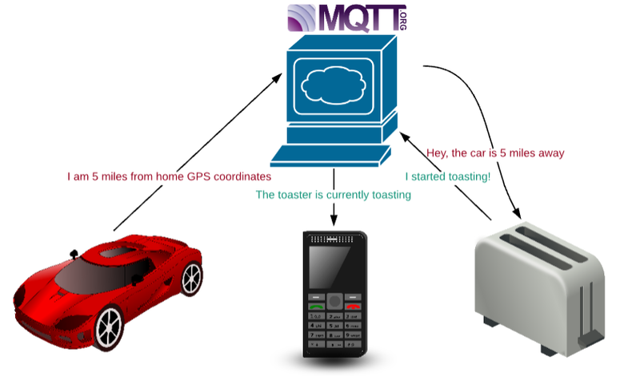

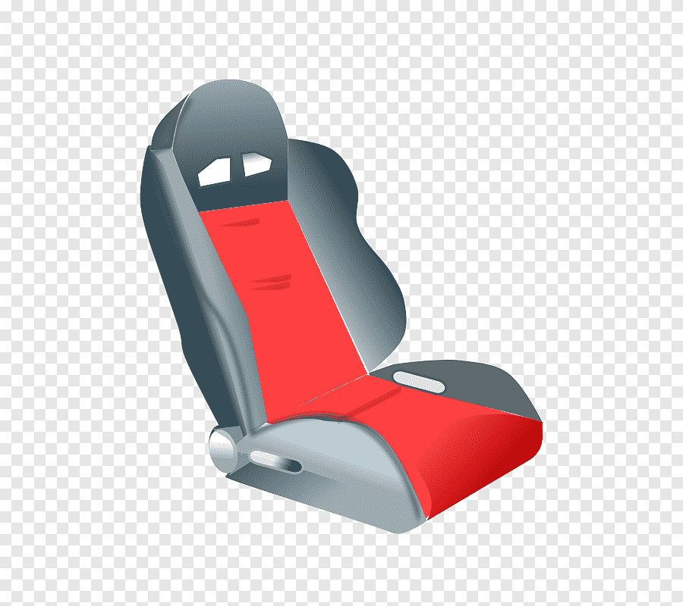
MQTT in use for GPS , seat inclination, and music preferences

Slide 7
THANK YOU

