Slide 1

Automata Theory
Tutorial 2

Slide 2
Table of Contents
Programming Assignment 1
Introduction to Cellular Automata
Introduction to Conway's Game of Life

Slide 3
Programming Assignment
The First Programming Assignment will be released tonight
It is going to be based on cellular automaton, you will be required to simulate a grid based cellular automaton and make custom rules for getting specific states.

Slide 4
What's Automata?
The word "Automata" means "self-acting", it refers to a program that is able to act on its own based on a certain set of rules.
Cellular Automata is an example of a system that is able to act on its own based on a set of rules and an initial state.

Slide 5
Cellular Automata Put in simple words

Slide 6
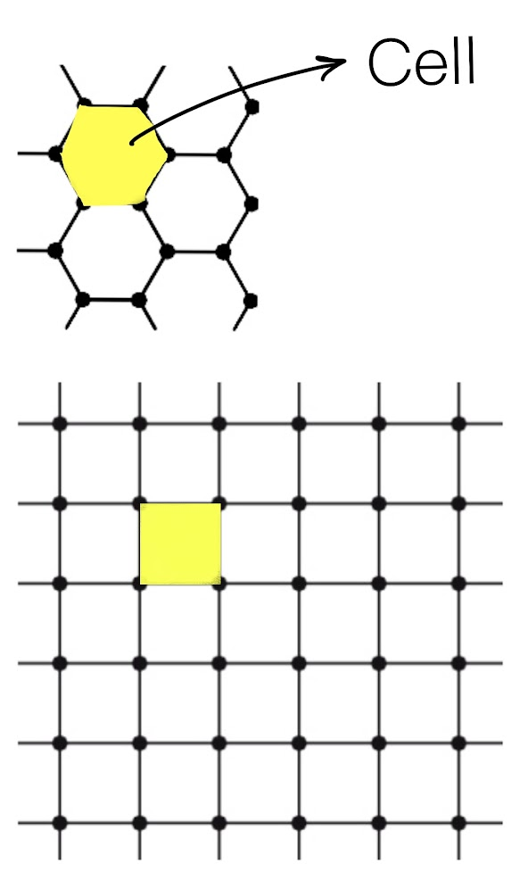
Lattice
A lattice of specific shapes in a fixed dimension where each shape is referred as a cell.
The lattice has n neighbours and each cell can take k distinct values.

Slide 7
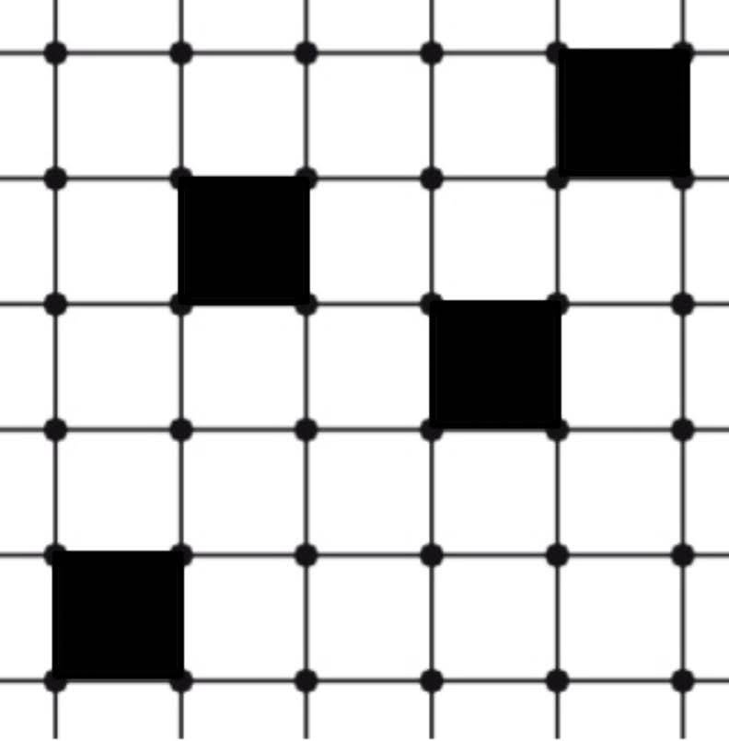
Initial Value
One can set the initial lattice by choosing the values for each cell.
For a given system, this is the sole input.
Example for n = 4 and k = 2

Slide 8
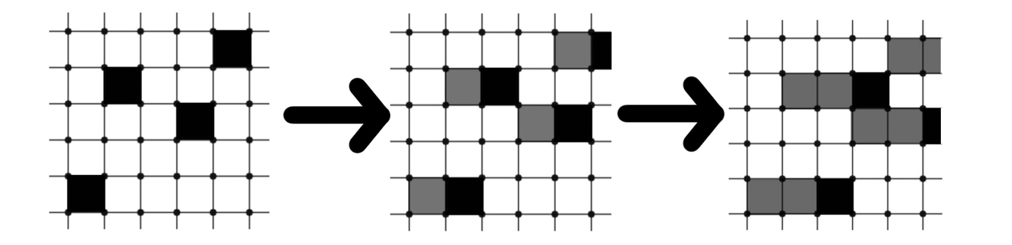
Evolution
A simple initial lattice with simple rule
The evolution is discrete and depends only on the current state
*The different shade is just for visualization, in reality, the grey is the same as the black cell

Slide 9
Rules
Can you guess the set of rules used in the last slide?
Similar to Finite State Machine, The rules can only use the current state to determine the next state I.e. memoryless.
To limit the complexity of the rules, the rules can only use the information of the state of the cell itself and the neighboring cells.
Even after all these limitations, Cellular Automata is able to find its application in plenty of fields and gives rise to beautiful patterns!

Slide 10
Some interesting Applications
Cryptography
Pseudorandom number generators – initialize the state as a seed and each state can be a new number
One way functions – A complex enough cellular automata is proven to be one way I.e. you can determine the future states but not the previous ones.
Applied in simulation and understanding of other fields such as physics, chemistry, and biology.

Slide 11
Complex Patterns from very simple rules
Conway's Game of Life

Slide 12
Conway's Game of Life
Specific case of cellular automaton with n = 4 and k = 2
Grid of squares that can take 2 values, for understanding they are referred to as live and dead cells
A grid with a certain set of rules which create a simplistic model of a population
Only input is the initial configuration/seed of the system.
Rules are applied simultaneously to all cells to create the next generation/configuration.
Each generation is a function of the previous generation.

Slide 13
Game's set of rules
Any live cell with fewer than two live neighbours dies, as if by underpopulation.
Any live cell with two or three live neighbours lives on to the next generation.
Any live cell with more than three live neighbours dies, as if by overpopulation.
Any dead cell with exactly three live neighbours becomes a live cell, as if by reproduction.
Simulator

Slide 14


Patterns
Stiill Lifes – Do not change
Oscillators – Return to seed state after few iterations
Spaceships – Translate across the grid

Slide 15
References
https://en.wikipedia.org/wiki/Conway%27s_Game_of_Life
http://pi.math.cornell.edu/~lipa/mec/lesson6.html
Weisstein, Eric W. "Cellular Automaton." From MathWorld--A Wolfram Web https://mathworld.wolfram.com/CellularAutomaton.html

