Slide 1

PowerPoint Slides
Computer Organisation and Architecture
Smruti Ranjan Sarangi, IIT Delhi
Chapter 4 ARM Assembly Language
PROPRIETARY MATERIAL. © 2014 The McGraw-Hill Companies, Inc. All rights reserved. No part of this PowerPoint slide may be displayed, reproduced or distributed in any form or by any means, without the prior written permission of the publisher, or used beyond the limited distribution to teachers and educators permitted by McGraw-Hill for their individual course preparation. PowerPoint Slides are being provided only to authorized professors and instructors for use in preparing for classes using the affiliated textbook. No other use or distribution of this PowerPoint slide is permitted. The PowerPoint slide may not be sold and may not be distributed or be used by any student or any other third party. No part of the slide may be reproduced, displayed or distributed in any form or by any means, electronic or otherwise, without the prior written permission of McGraw Hill Education (India) Private Limited.
1

Slide 2

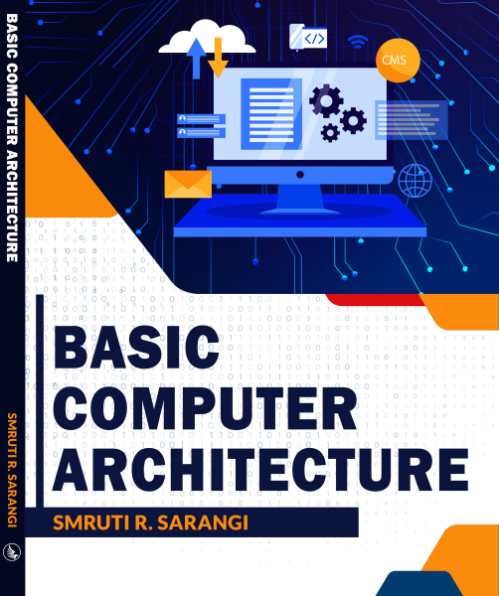


2nd version
www.basiccomparch.com
Download the pdf of the book
videos
Slides, software, solution manual
The pdf version of the book and all the learning resources can be freely downloaded from the website: www.basiccomparch.com
Print version
(Publisher: WhiteFalcon, 2021)
Available on e-commerce sites.

Slide 3
ARM Assembly Language
One of the most popular RISC instruction sets in use today
Used by licensees of ARM Limited, UK
ARM processors
Some processors by Samsung, Qualcomm, and Apple
Highly versatile instruction set
Floating-point and vector (multiple operations per instruction) extensions

Slide 4

Outline
Basic Instructions
Advanced Instructions
Branch Instructions
Memory Instructions
Instruction Encoding

Slide 5
ARM Machine Model
16 registers – r0 … r15
The PC is explicitly visible
Memory (Von Neumann Architecture)
Register
Abbrv.
Name
r11
fp
frame pointer
r12
ip
intra-procedure-call scratch register
r13
sp
stack pointer
r14
lr
link register
r15
pc
program counter

Slide 6
Data Transfer Instructions
Semantics
Example
Explanation
mov r1, r2
r1 ← r2
mov reg, (reg/imm)
mov r1, #3
r1 ← 3
mvn r1, r2
r1 ← ∼ r2
mvn reg, (reg/imm)
mvn r1, #3
r1 ← ∼ 3
mov and mvn (move not)

Slide 7
Arithmetic Instructions
Semantics
Example
Explanation
add reg, reg, (reg/imm)
sub reg, reg, (reg/imm)
rsb reg, reg, (reg/imm)
add r1, r2, r3
sub r1, r2, r3
rsb r1, r2, r3
r1 ← r2 + r3
r1 ← r2 - r3
r1 ← r3 - r2
add, sub, rsb (reverse subtract)

Slide 8
Example
Write an ARM assembly program to compute: 4+5 - 19. Save the result in
r1.
Answer: Simple yet suboptimal solution.
mov r1, #4
mov r2, #5
add r3, r1, r2
mov r4, #19
sub r1, r3, r4
Optimal solution.
mov r1, #4
add r1, r1, #5
sub r1, r1, #19

Slide 9
Logical Instructions
Semantics
and reg, reg, (reg/imm)
eor reg, reg, (reg/imm)
orr reg, reg, (reg/imm)
bic reg, reg, (reg/imm)
Example
and r1, r2, r3
eor r1, r2, r3
orr r1, r2, r3
bic r1, r2, r3
Explanation
r1 ← r2 AND r3
r1 ← r2 XOR r3
r1 ← r2 OR r3
r1 ← r2 AND (∼ r3)
and, eor (exclusive or), orr (or), bic(bit clear)

Slide 10
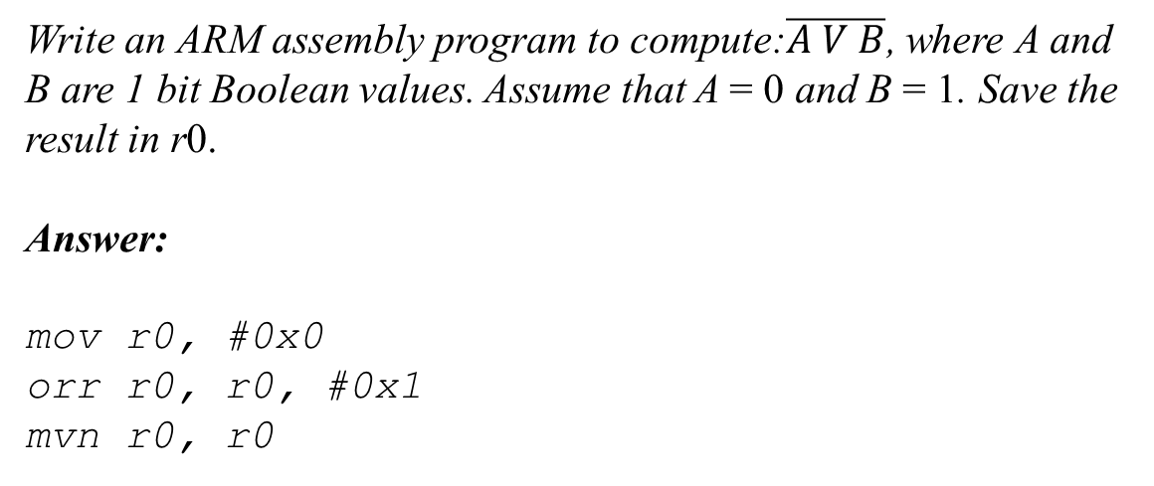
Example
Write an ARM assembly program to compute:$\overline{A V B}$, where A and B are 1 bit Boolean values. Assume that A = 0 and B = 1. Save the result in r0.
Answer:
mov r0, #0x0
orr r0, r0, #0x1
mvn r0, r0

Slide 11
Multiplication Instruction
Semantics
mul reg, reg, (reg/imm)
mla reg, reg, reg, reg
smull reg, reg, reg, reg
umull reg, reg, reg, reg
Example
mul r1, r2, r3
mla r1, r2, r3, r4
smull r0, r1, r2, r3
umull r0, r1, r2, r3
Explanation
r1 ← r2 × r3
r1 ← r2 × r3 + r4
r1 r0← r2 ×_{signed} r3
₆₄
r1 r0← r2 ×_{unsigned} r3
₆₄
smull and umull instructions can hold a 64 bit operand

Slide 12
Example
Compute 12³ + 1, and save the result in r3.
Answer:
/* load test values */
mov r0, #12
mov r1, #1
/* perform the logical computation */
mul r4, r0, r0 @ 12*12
mla r3, r4, r0, r1 @ 12*12*12 + 1

Slide 13
Outline
Basic Instructions
Advanced Instructions
Branch Instructions
Memory Instructions
Instruction Encoding

Slide 14
Shifter Operands
Generic format
reg1
,
lsl
#shift_amt
lsr
reg2
asr
ror
Examples
1 0 1 1 0
lsl #1
0 1 1 0 0
1 0 1 1 0
lsr #1
0 1 0 1 1
1 0 1 1 0
asr #1
1 1 0 1 1
1 0 1 1 0
ror #1
0 1 0 1 1

Slide 15
Examples of Shifter Operands
Write ARM assembly code to compute: r1 = r2 / 4.
Answer:
mov r1, r2, asr #2
Write ARM assembly code to compute: r1 = r2 + r3 × 4.
Answer:
add r1, r2, r3, lsl #2

Slide 16
Compare Instructions
Semantics
cmp reg, (reg/imm)
cmn reg, (reg/imm)
tst reg, (reg/imm)
teq reg, (reg/imm)
Example
cmp r1, r2
cmn r1, r2
tst r1, r2
teq r1, r2
Explanation
Set flags after computing (r1 - r2)
Set flags after computing (r1 + r2)
Set flags after computing (r1 AND r2)
Set flags after computing (r1 XOR r2)
Sets the flags of the CPSR register
CPSR (Current Program Status Register)
N (negative) , Z (zero), C (carry), F (overflow)
If we need to borrow a bit in a subtraction, we set C to 0, otherwise we set it to 1.

Slide 17
Instructions with the 's' suffix
Compare instructions are not the only instructions that set the flags.
We can add an s suffix to regular ALU instructions to set the flags.
An instruction with the 's' suffix sets the flags in the CPSR register.
adds (add and set the flags)
subs (subtract and set the flags)

Slide 18
Instructions that use the Flags
Semantics
adc reg, reg, reg
sbc reg, reg, reg
rsc reg, reg, reg
Example
adc r1, r2, r3
sbc r1, r2, r3
rsc r1, r2, r3
Explanation
r1 = r2 + r3 + Carry Flag
r1 = r2 - r3 - NOT(Carry Flag)
r1 = r3 - r2 - NOT(Carry Flag))
add and subtract instructions that use the value of the carry flag

Slide 19
64 bit addition using 32 bit registers
Add two long values stored in r2,r1 and r4,r3.
Answer:
adds r5, r1, r3
adc r6, r2, r4
The (adds) instruction adds the values in r1 and r3. adc(add with carry) adds r2, r4, and the value of the carry flag. This is exactly the same as normal addition.

Slide 20
Outline
Basic Instructions
Advanced Instructions
Branch Instructions
Memory Instructions
Instruction Encoding

Slide 21
Simple Branch Instructions
Semantics
b label
beq label
bne label
Example
b .foo
beq .foo
bne .foo
Explanation
Jump unconditionally to label .foo
Branch to .foo if the last flag setting
instruction has resulted in an equality
and (Z flag is 1)
Branch to .foo if the last flag setting
instruction has resulted in an inequality
and (Z flag is 0)
b (unconditional branch)
b<code> (conditional branch)

Slide 22
Branch Conditions
Number
Suffix
Meaning
Flag State
0
eq
equal
Z = 1
1
ne
notequal
Z = 0
2
cs/hs
carry set/ unsigned higher or equal
C = 1
3
cc/lo
carry clear/ unsigned lower
C = 0
4
mi
negative/ minus
N = 1
5
pl
positive or zero/ plus
N = 0
6
vs
overflow
V = 1
7
vc
no overflow
V = 0
8
hi
unsigned higher
(C = 1) ∧ (Z = 0)
9
ls
unsigned lower or equal
(C = 0) ∨ (Z = 1)
10
ge
signed greater than or equal
N = 0
11
lt
signed less than
N = 1
12
gt
signed greater than
(Z = 0) ∧ ( N = 0)
13
le
signed less than or equal
(Z = 1) ∨ (N = 1)
14
al
always
15
–
reserved

Slide 23
Example
Write an ARM assembly program to compute the factorial of a positive
number (> 1) stored in r0. Save the result in r1.
Answer:
ARM assembly
mov r1, #1 /* prod = 1 */
mov r3, #1 /* idx = 1 */
.loop:
mul r1, r3, r1 /* prod = prod * idx */
cmp r3, r0 /* compare idx, with the input (num) */
add r3, r3, #1 /* idx ++ */
bne .loop /* loop condition */

Slide 24
Branch and Link Instruction
Semantics
Example
Explanation
bl
label
bl .foo
(1) Jump unconditionally to the function at .foo
(2) Save the next PC (PC + 4) in the lr register
We use the bl instruction for a function call

Slide 25
Example
Example of an assembly program with a function call.
ARM assembly
C
foo:
mov r0, #2
mov pc, lr
main:
mov r1, #3 /* x = 3 */
bl foo /* invoke foo */
/* y = x + foo() */
add r2, r0, r1
int foo() {
return 2;
}
void main() {
int x = 3;
int y = x + foo();
}

Slide 26
The bx Instruction
Semantics
Example
Explanation
bx reg
bx r2
(1) Jump unconditionally to the address contained in register, r2
This is the preferred method to return from a function.
Instead of : mov pc, lr Use : bx lr

Slide 27
Example
foo:
mov r0, #2
bx lr
main:
mov r1, #3 /* x = 3 */
bl foo /* invoke foo */
/* y = x + foo() */
add r2, r0, r1

Slide 28
Conditional Variants of Normal Instructions
Normal Instruction + <condition>
Examples : addeq, subne, addmi, subpl
Also known as predicated instructions
If the condition is true
Execute instruction normally
Otherwise
Do not execute at all

Slide 29
Write a program in ARM assembly to count the number of 1s in a 32 bit number stored in r1. Save the result in r4.
Answer:
mov r2, #1 /* idx = 1 */
mov r4, #0 /* count = 0 */
/* start the iterations */
.loop:
/* extract the LSB and compare */
and r3, r1, #1
cmp r3, #1
/* increment the counter */
addeq r4, r4, #1
/* prepare for the next iteration */
mov r1, r1, lsr #1
add r2, r2, #1
/* loop condition */
cmp r2, #32
ble .loop

Slide 30
Outline
Basic Instructions
Advanced Instructions
Branch Instructions
Memory Instructions
Instruction Encoding

Slide 31
Basic Load Instruction
ldr r1, [r0]
ldr r1, [r0]
memory
register
file
r0
r1

Slide 32
Basic Store Instruction
str r1, [r0]
str r1, [r0]
memory
register
file
r0
r1

Slide 33
Memory Instructions with an Offset
ldr r1, [r0, #4]
r1 ← mem[r0 + 4]
ldr r1, [r0, r2]
r1 ← mem[r0 + r2]

Slide 34
Table of Load/Store Instructions
Semantics
ldr reg, [reg]
ldr reg, [reg, imm]
ldr reg, [reg, reg]
ldr reg, [reg, reg, shift imm]
Example
ldr r1, [r0]
ldr r1, [r0, #4]
ldr r1, [r0, r2]
ldr r1, [r0, r2, lsl #2]
Explanation
r1 ← [r0]
r1 ← [r0 + 4]
r1 ← [r0 + r2]
r1 ← [r0 + r2 << 2]
Addressing Mode
register-indirect
base-offset
base-index
base-scaled-index
str reg, [reg]
str reg, [reg, imm]
str reg, [reg, reg]
str reg, [reg, reg, shift imm]
str r1, [r0]
str r1, [r0, #4]
str r1, [r0, r2]
str r1, [r0, r2, lsl #2]
[r0] ← r1
[r0 + 4] ← r1
[r0 + r2] ← r1
[r0 + r2 << 2] ← r1
register-indirect
base-offset
base-index
base-scaled-index
Note the base-scaled-index addressing mode

Slide 35
Example with Arrays
C
void addNumbers(int a[100]) {
int idx;
int sum = 0;
for (idx = 0; idx < 100; idx++){
sum = sum + a[idx];
}
}
Answer:
ARM assembly
/* base address of array a in r0 */
mov r1, #0 /* sum = 0 */
mov r2, #0 /* idx = 0 */
.loop:
ldr r3, [r0, r2, lsl #2]
add r2, r2, #1 /* idx ++ */
add r1, r1, r3 /* sum += a[idx] */
cmp r2, #100 /* loop condition */
bne .loop

Slide 36
Advanced Memory Instructions
Consider an array access again
ldr r3, [r0, r2, lsl #2] /* access array */
add r2, r2, #1 /* increment index */
Can we fuse both into one instruction
ldr r3, [r0], r2, lsl #2
Equivalent to :
r3 = [r0]
r0 = r0 + r2 << 2
Post-indexed addressing
mode

Slide 37
Pre-Indexed Addressing Mode
Consider
ldr r0, [r1, #4]!
This is equivalent to:
r0 ← mem [r1 + 4]
r1 ← r1 + 4
Similar to i++ and ++i in Java/C/C++

Slide 38
Example with Arrays
C
void addNumbers(int a[100]) {
int idx;
int sum = 0;
for (idx = 0; idx < 100; idx++){
sum = sum + a[idx];
}
}
Answer:
ARM assembly
/* base address of array a in r0 */
mov r1, #0 /* sum = 0 */
add r4, r0, #400 /* set r4 to address of a[100] */
.loop:
ldr r3, [r0], #4
add r1, r1, r3 /* sum += a[idx] */
cmp r0, r4 /* loop condition */
bne .loop

Slide 39
Memory Instructions in Functions
Instruction
Semantics
ldmfd sp!, {list of registers }
Pop the stack and assign values to registers
in ascending order. Update sp.
stmfd sp!, {list of registers }
Push the registers on the stack in descending
order. Update sp.
stmfd → spill a set of registers
ldmfd → restore a set of registers

Slide 40
Example
Write a function in C and implement it in ARM assembly to compute x^{n},
where x and n are natural numbers. Assume that x is passed through r0, n
through r1, and the return value is passed back to the original program via
r0. Answer:
ARM assembly
power:
cmp r1, #0 /* compare n with 0 */
moveq r0, #1 /* return 1 */
bxeq lr /* return */
stmfd sp!, {r4, lr} /* save r4 and lr */
mov r4, r0 /* save x in r4 */
sub r1, r1, #1 /* n = n - 1 */
bl power /* recursively call power */
mul r0, r4, r0 /* power(x,n) = x * power(x,n-1) */
ldmfd sp!, {r4, pc} /* restore r4 and return */

Slide 41
Outline
Basic Instructions
Advanced Instructions
Branch Instructions
Memory Instructions
Instruction Encoding

Slide 42
Generic Format
Generic Format
4
2
cond
type
32
29
28
27
cond → instruction condition (eq, ne, … )
type → instruction type

Slide 43
Data Processing Instructions
4
2
4
4
4
12
cond
0 0
I
opcode
S
rs
rd
shifter operand/
32
29
28
27
26
25
22
21
20
17
16
13
immediate
12
1
Data processing instruction type : 00
I → Immediate bit
opcode → Instruction code
S → 'S' suffix bit (for setting the CPSR flags)
rs, rd → source register, destination register

Slide 44

Encoding Immediate Values
ARM has 12 bits for immediates
12 bits
What do we do with 12 bits ?
It is not 1 byte, nor is it 2 bytes
Let us divide 12 bits into two parts
8 bit payload + 4 bit rot

Slide 45
Encoding Immediates - II
The real value of the immediate is equal to : payload ror (2 * rot)
The programmer/ compiler writes an assembly instruction with an immediate: e.g. 4
The assembler converts it in to a 12 bit format (if it is possible to do so)
The processor expands 12 bits → 32 bits
4
8
rot
payload

Slide 46
Encoding Immediates - III
Explanation of encoding the immediate in lay man's terms
The payload is an 8 bit quantity
A number is a 32 bit quantity.
We can set 8 contiguous bits in the 32 bit number while specifying an immediate
The starting point of this sequence of bits needs to be an even number such as 0, 2, 4, ...

Slide 47
Examples
Encode the decimal number 42.
Answer:
42 in the hex format is 0x2A, or alternatively 0x 00 00 00 2A. There is no right rotation involved. Hence, the immediate field is 0x02A.
Encode the number 0x2A 00 00 00.
Answer:
The number is obtained by right rotating 0x2A by 8 places. Note that we need to right rotate by 4 places for moving a hex digit one position to the right. We need to now divide 8 by 2 to get 4. Thus, the encoding of the immediate: 0x42A

Slide 48
Encoding the Shifter Operand
5
2
4
Shift type
shift imm
shift type
0
rt
12
8
7
6
5
4
1
lsl
00
(a)
lsr
4
2
4
01
asr
10
shift reg
shift type
1
rt
ror
11
12
9
8
7
6
5
4
1
(b)
(c)

Slide 49
Load/Store Instructions
4
2
6
4
4
12
cond
0 1
I
P
U
B
W
L
rs
rd
shifter operand/
32
29
28
27
20
17
16
13
immediate
12
1
Memory instruction type : 01
rs, rd, shifter operand
Connotation remains the same
Immediates are not in (rot + payload format) : They are standard 12 bit unsigned numbers

Slide 50
I, P, U, B, W, and L bits
Bit
Value
Semantics
0
last 12 bits represent an immediate value
I
1
last 12 bits represent a shifter operand
0
post-indexed addressing
P
1
pre-indexed addressing
0
subtract offset from base
U
1
add offset to base
0
transfer word
B
1
transfer byte
0
do not use pre or post indexed addressing
W
1
use pre or post indexed addressing
0
store to memory
L
1
load from memory

Slide 51
Branch Instructions
4
3
24
cond
101
L
offset
32
29
28
26
25
24
1
L bit → Link bit
offset → branch offset (in number of words, similar to SimpleRisc)

Slide 52
Branch Instructions - II
What does the processor do
Expands the offset to 32 bits (with proper sign extensions)
Shifts it to the left by 2 bits (because offset is in terms of memory words)
Adds it to PC + 8 to generate the branch target
Why, PC + 8 ?
Read chapter 9

Slide 53
THE END

