Slide 1

Capture the Flag 🚩

Slide 2
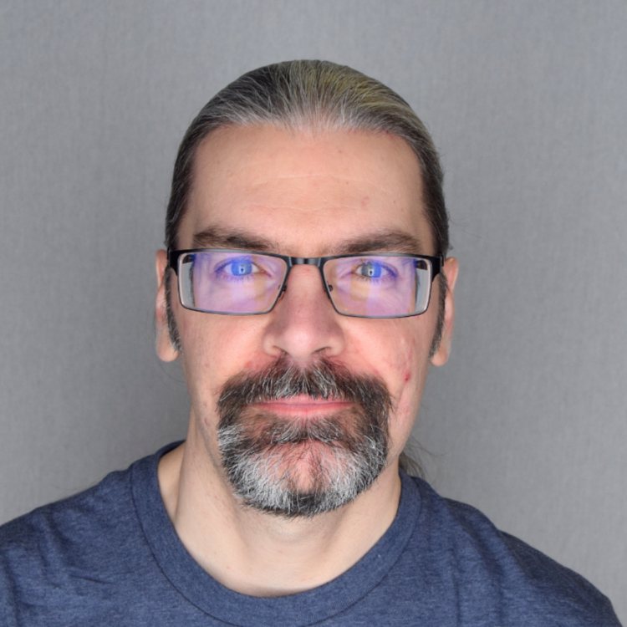
whoami?
Clayton Smith
@argilo
VE3IRR
SDR hobbyist

Slide 3
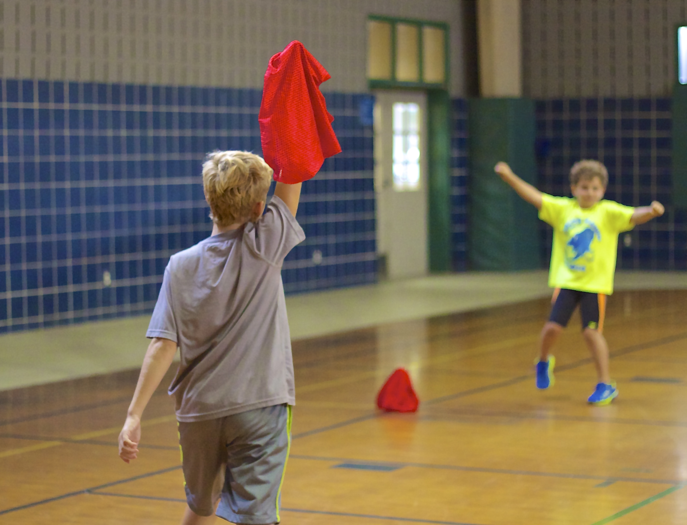

Slide 4
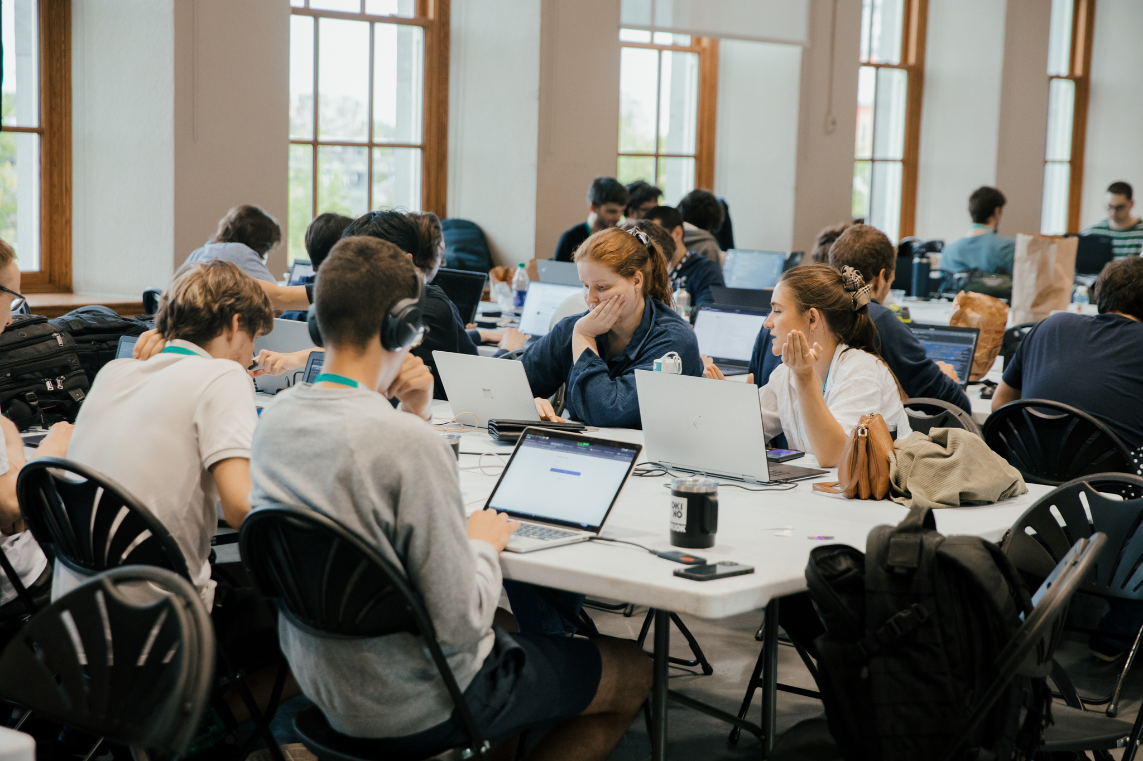

Slide 5
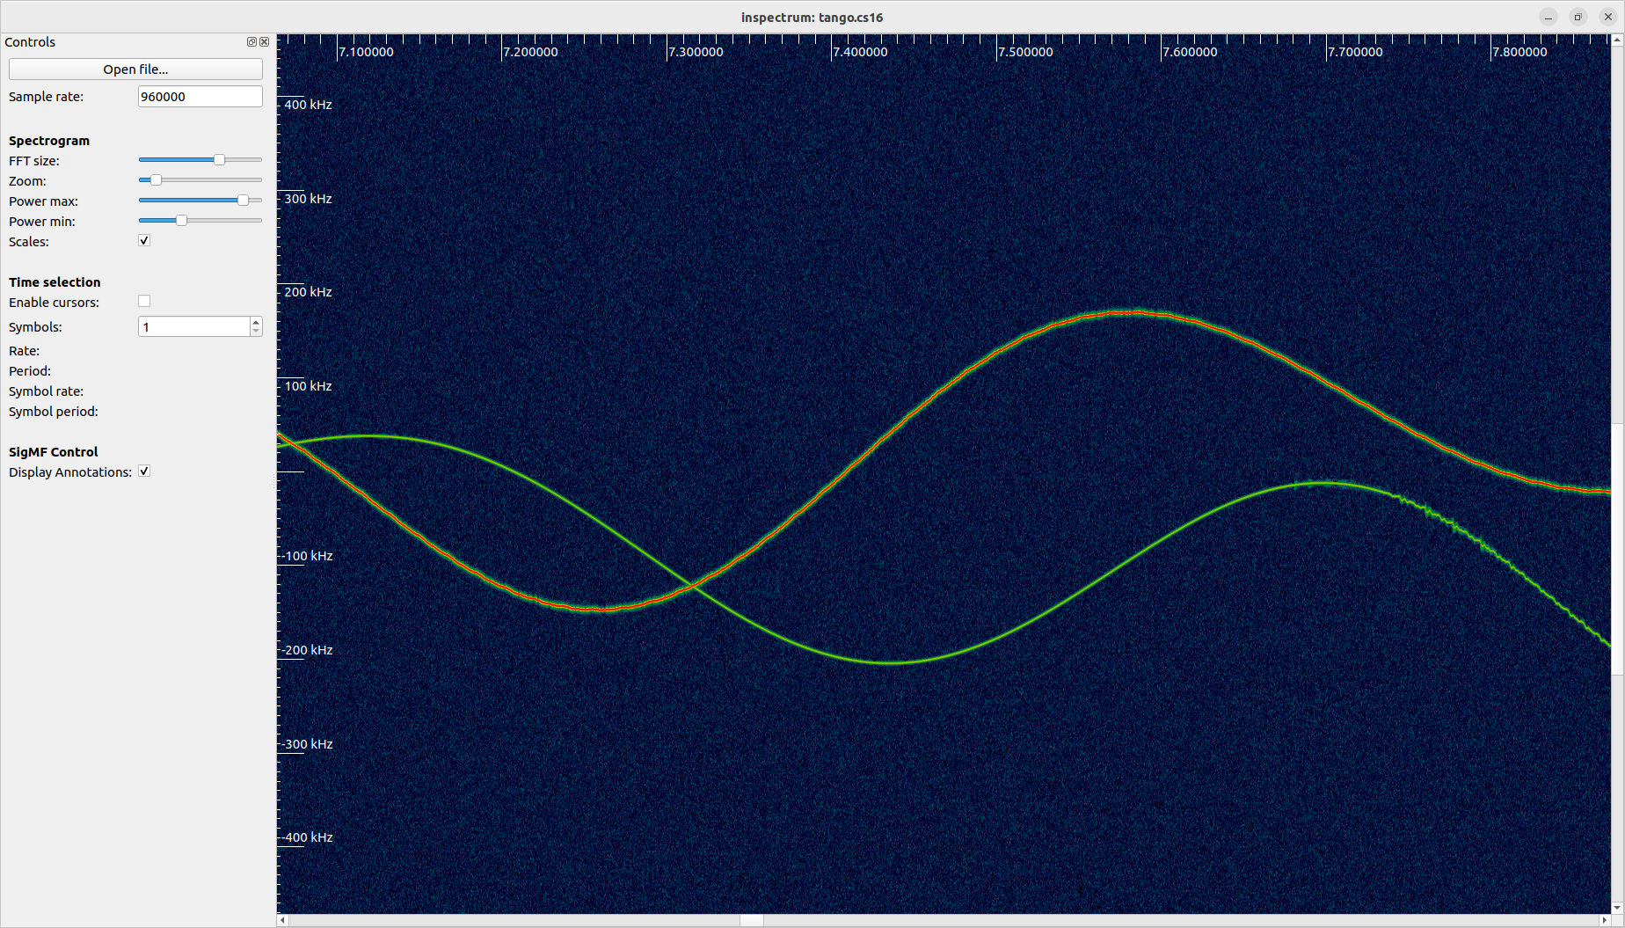

Slide 6
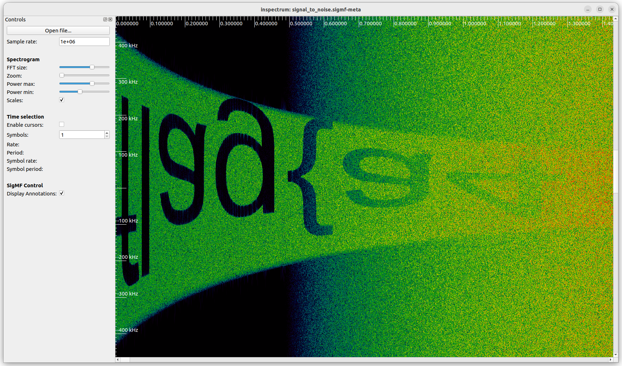

Slide 7
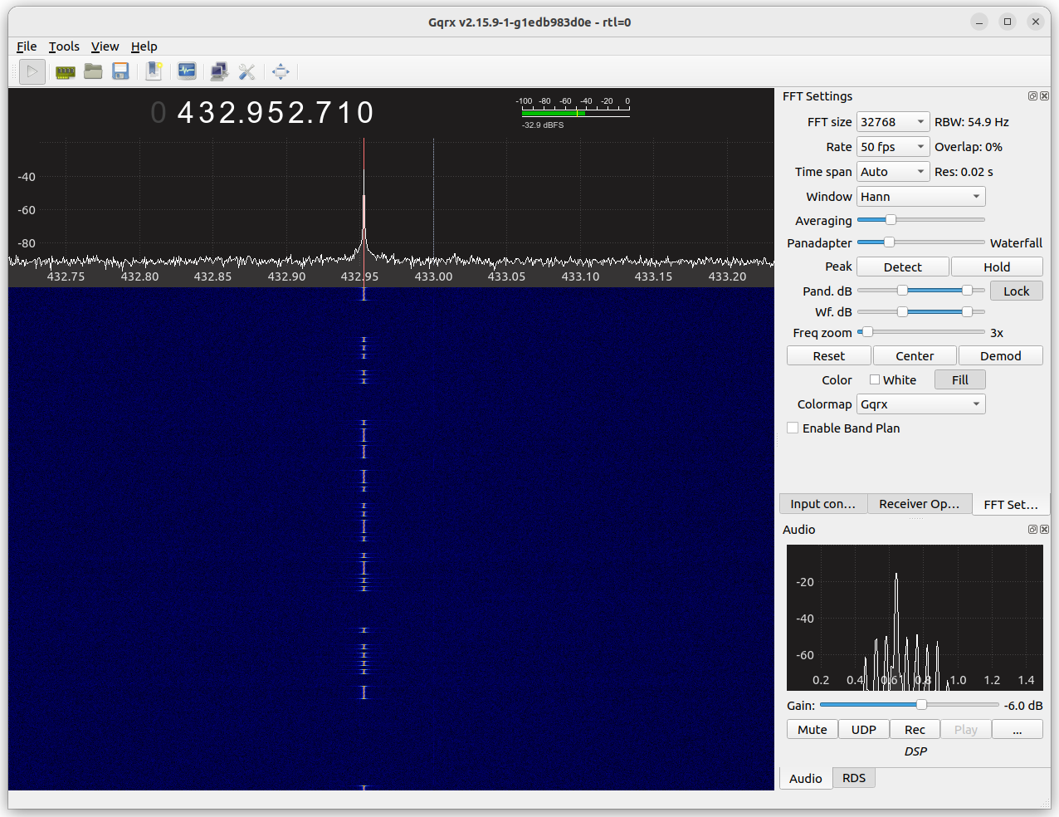

Slide 8
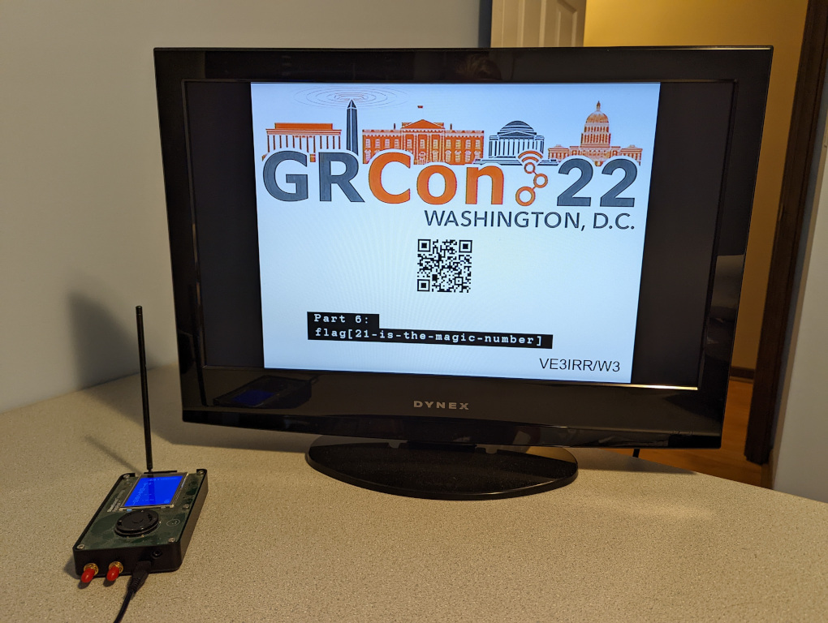

Slide 9
Where?
Matrix chat:
  GRCon23 Capture the Flag
On-site:
  Plata (210)

Slide 10
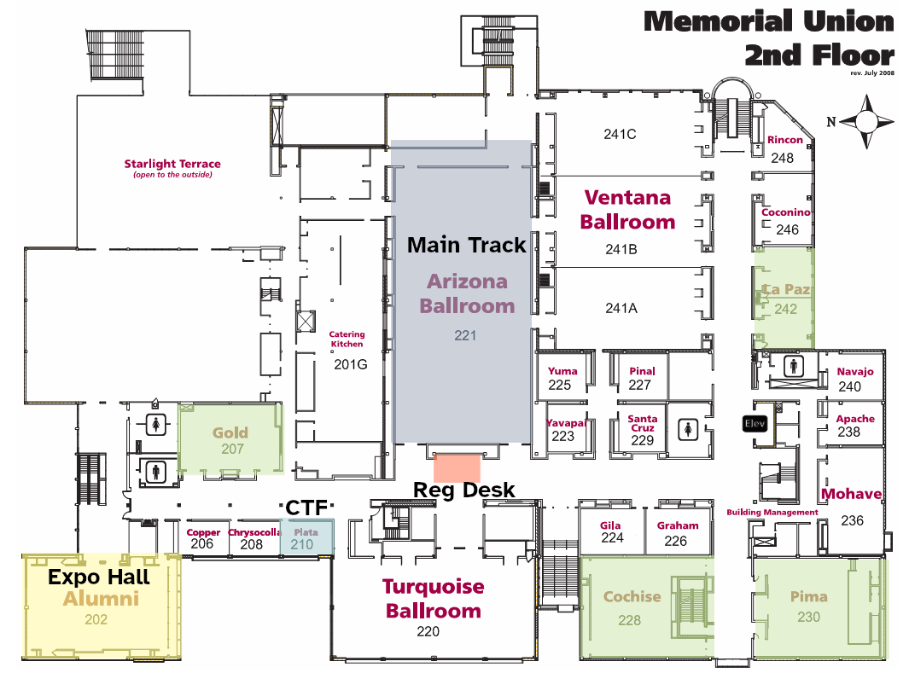

Slide 12
When?
Start:
  Tuesday, 13:00 MST (20:00 UTC)
End:
  Friday, 16:00 MST (23:00 UTC)
Demos:
  Saturday, 14:00 MST (21:00 UTC)

Slide 13
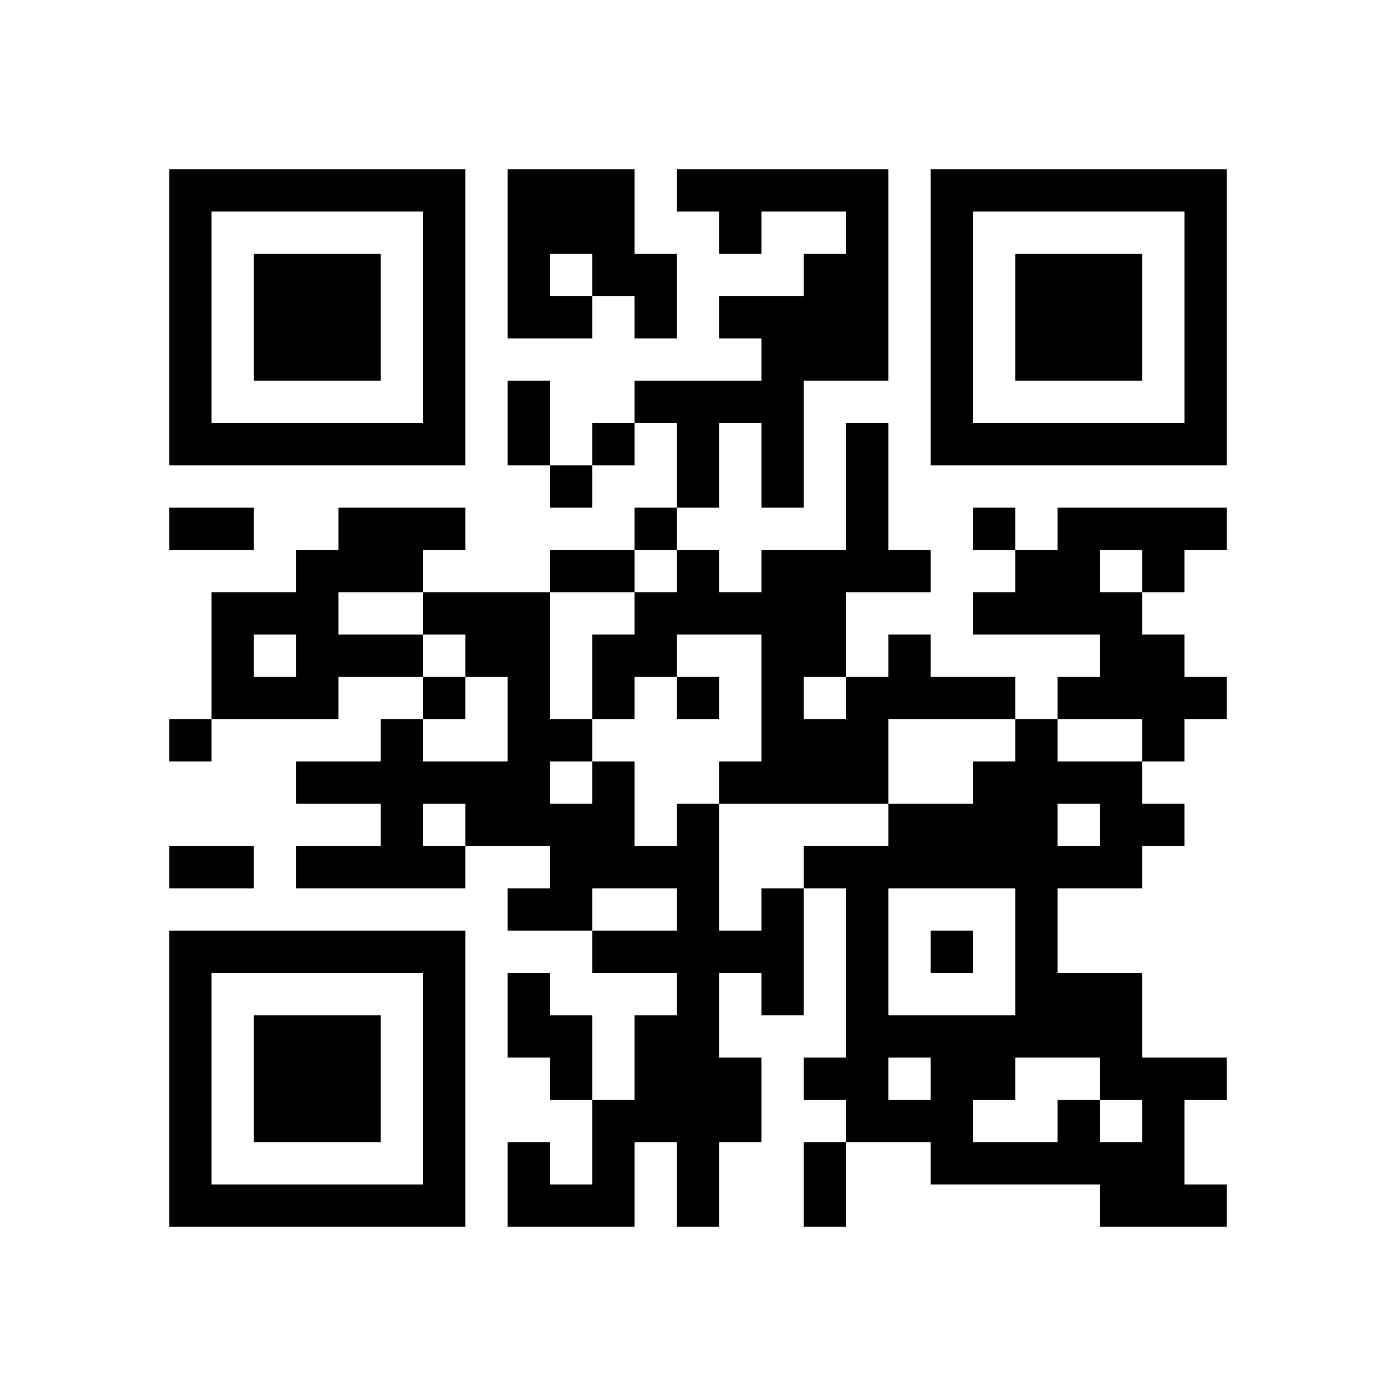
ctf.gnuradio.org

