Slide 1

Capture the Flag 🚩

Slide 2
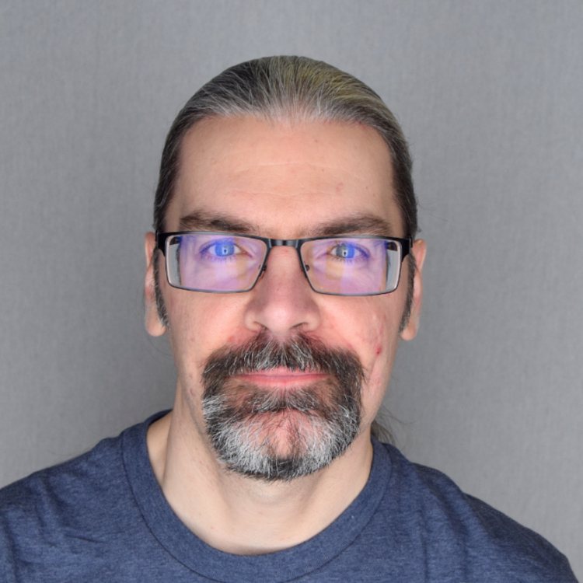
whoami?
Clayton Smith
@argilo
VE3IRR
SDR hobbyist

Slide 3
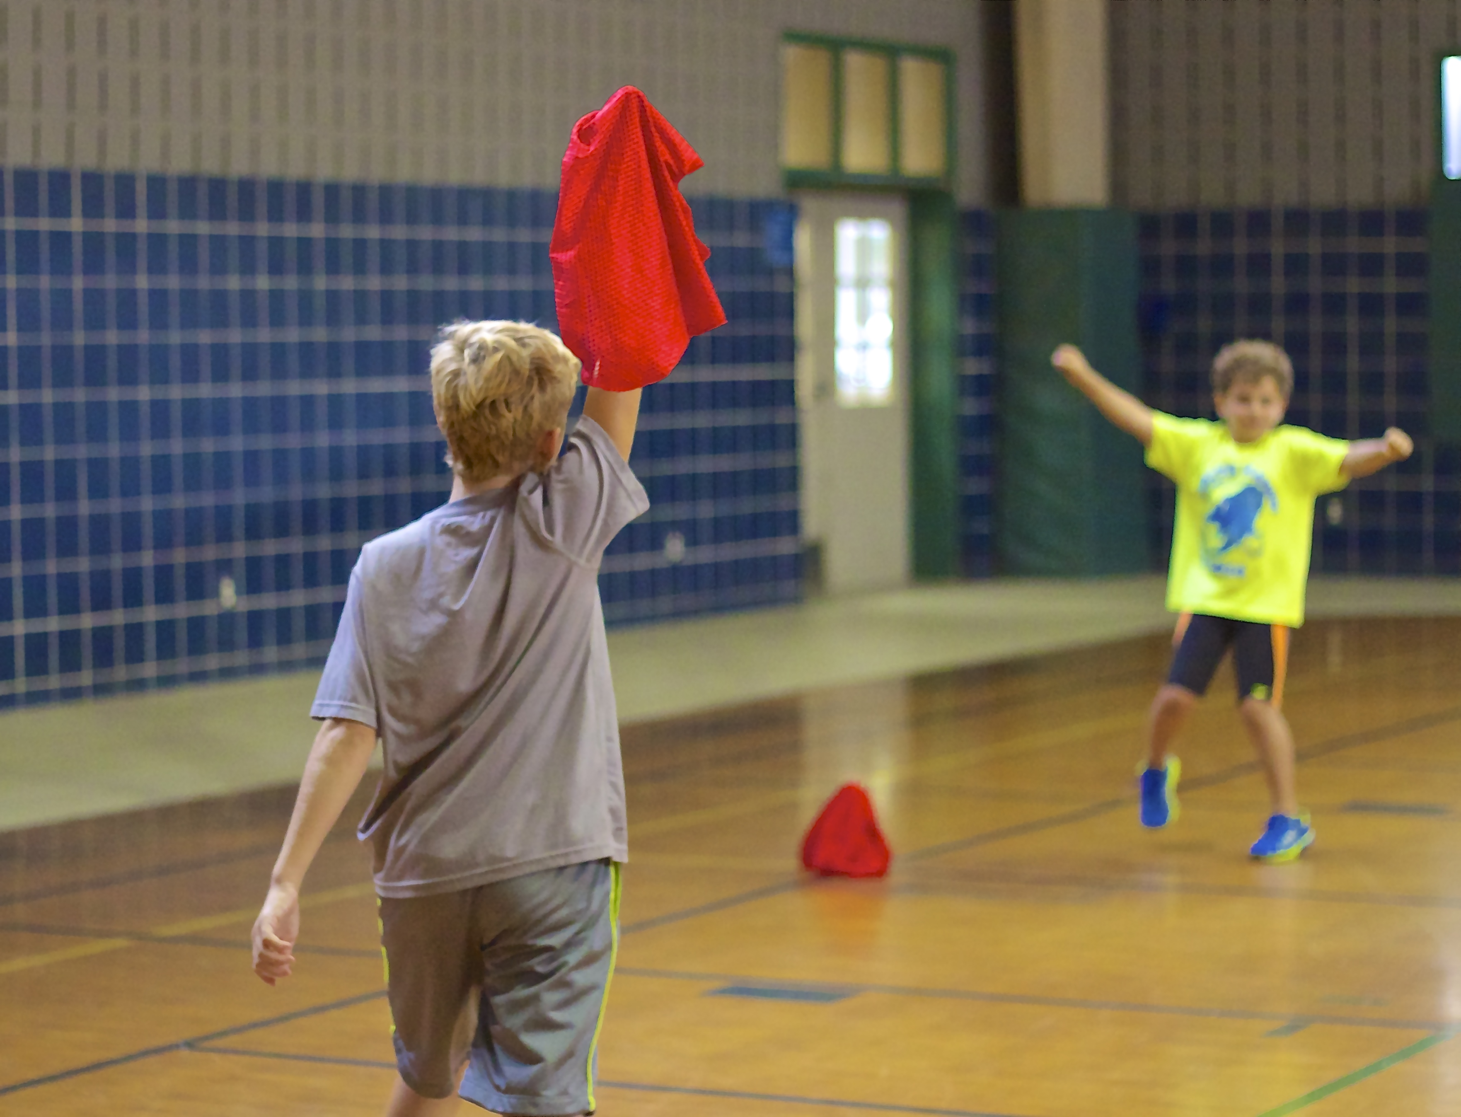

Slide 4
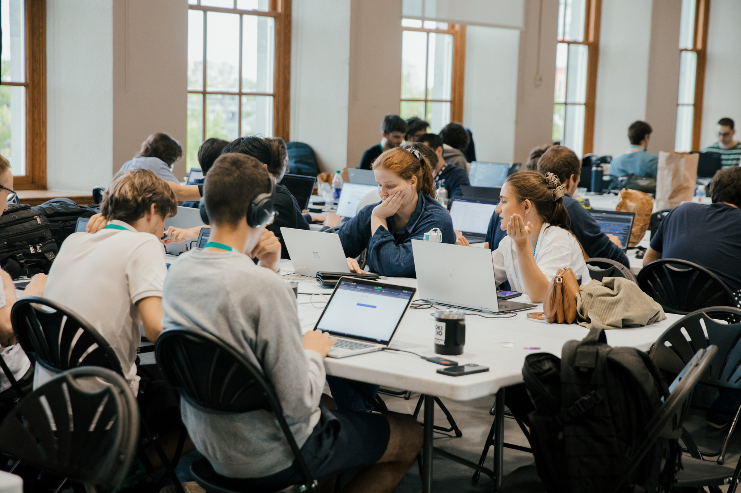

Slide 5
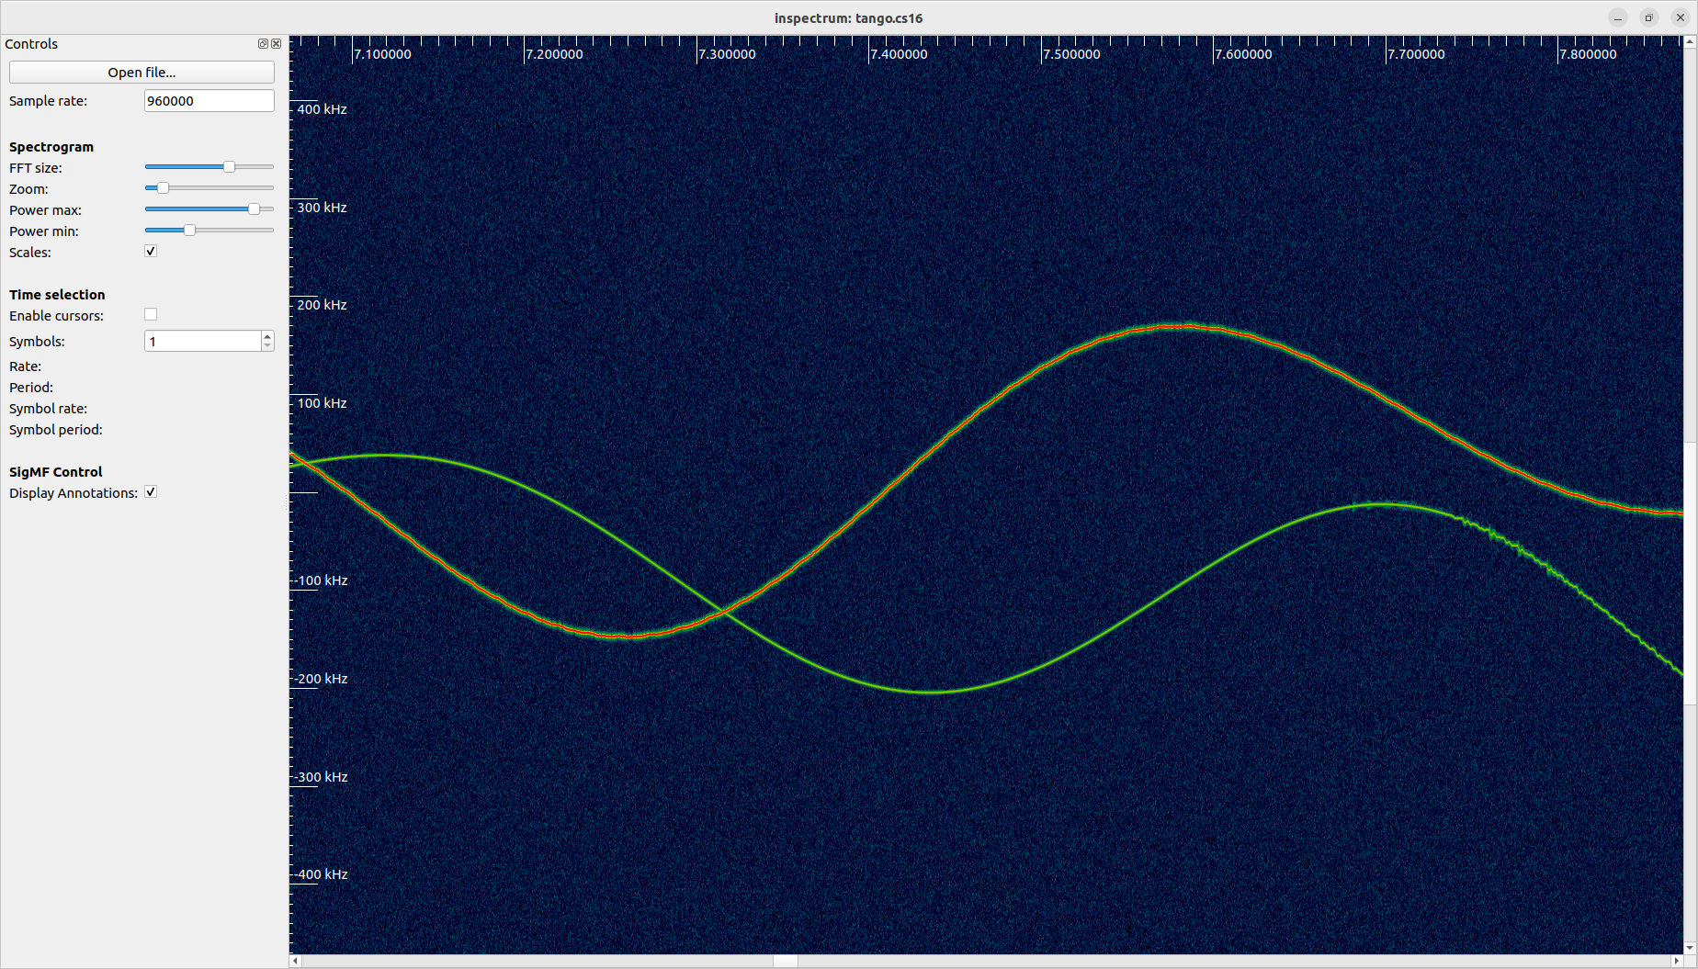

Slide 6
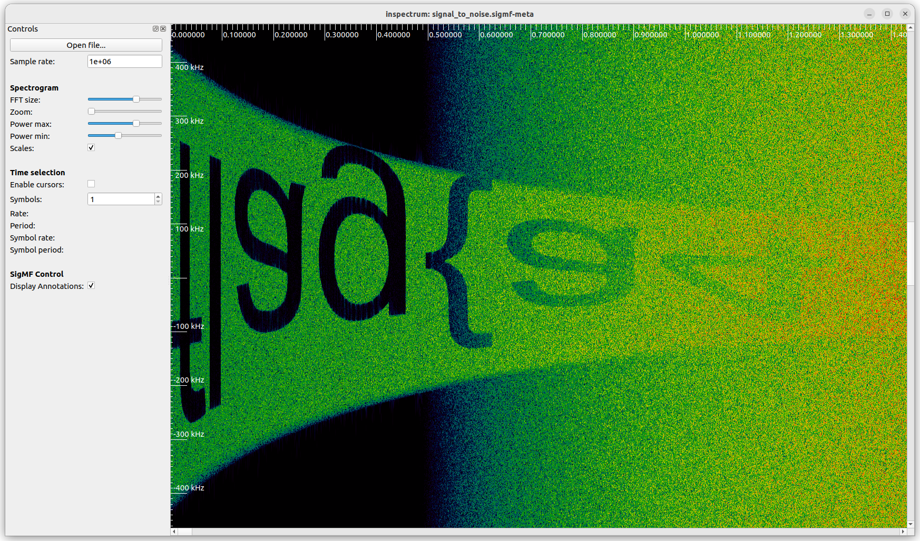

Slide 7
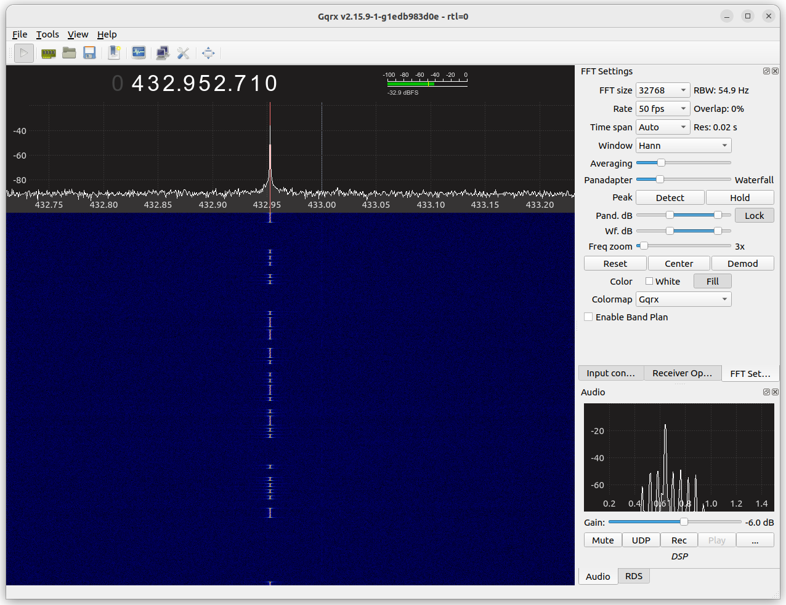

Slide 8
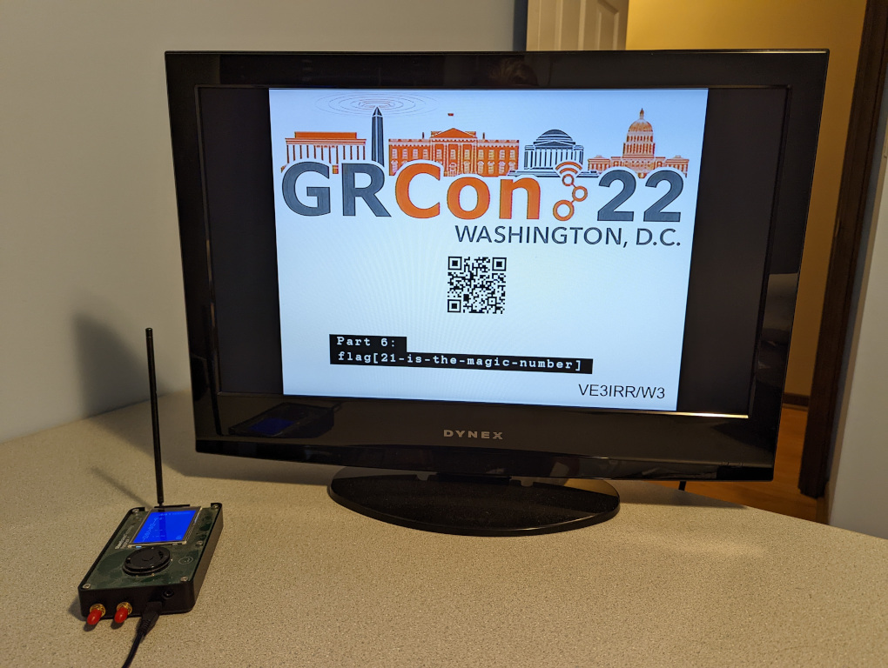

Slide 9
Where?
Matrix chat:
  GRCon24 Capture the Flag
On-site:
  Room 301A

Slide 10
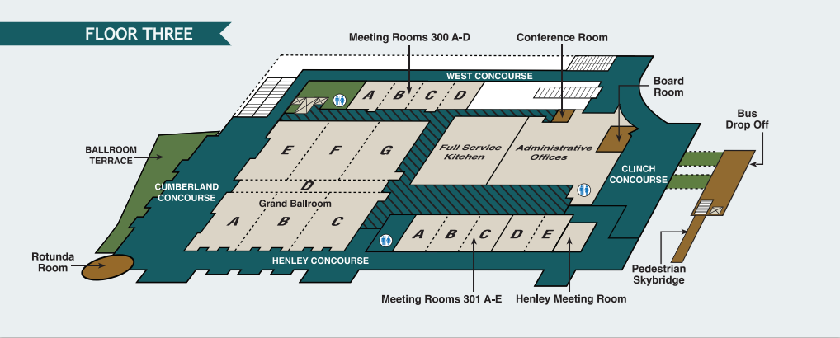

Slide 12
When?
Start:
  Tuesday, 13:00 EDT (17:00 UTC)
End:
  Thursday, 16:00 EDT (20:00 UTC)
Demos:
  Friday, 14:00 EDT (18:00 UTC)

Slide 13
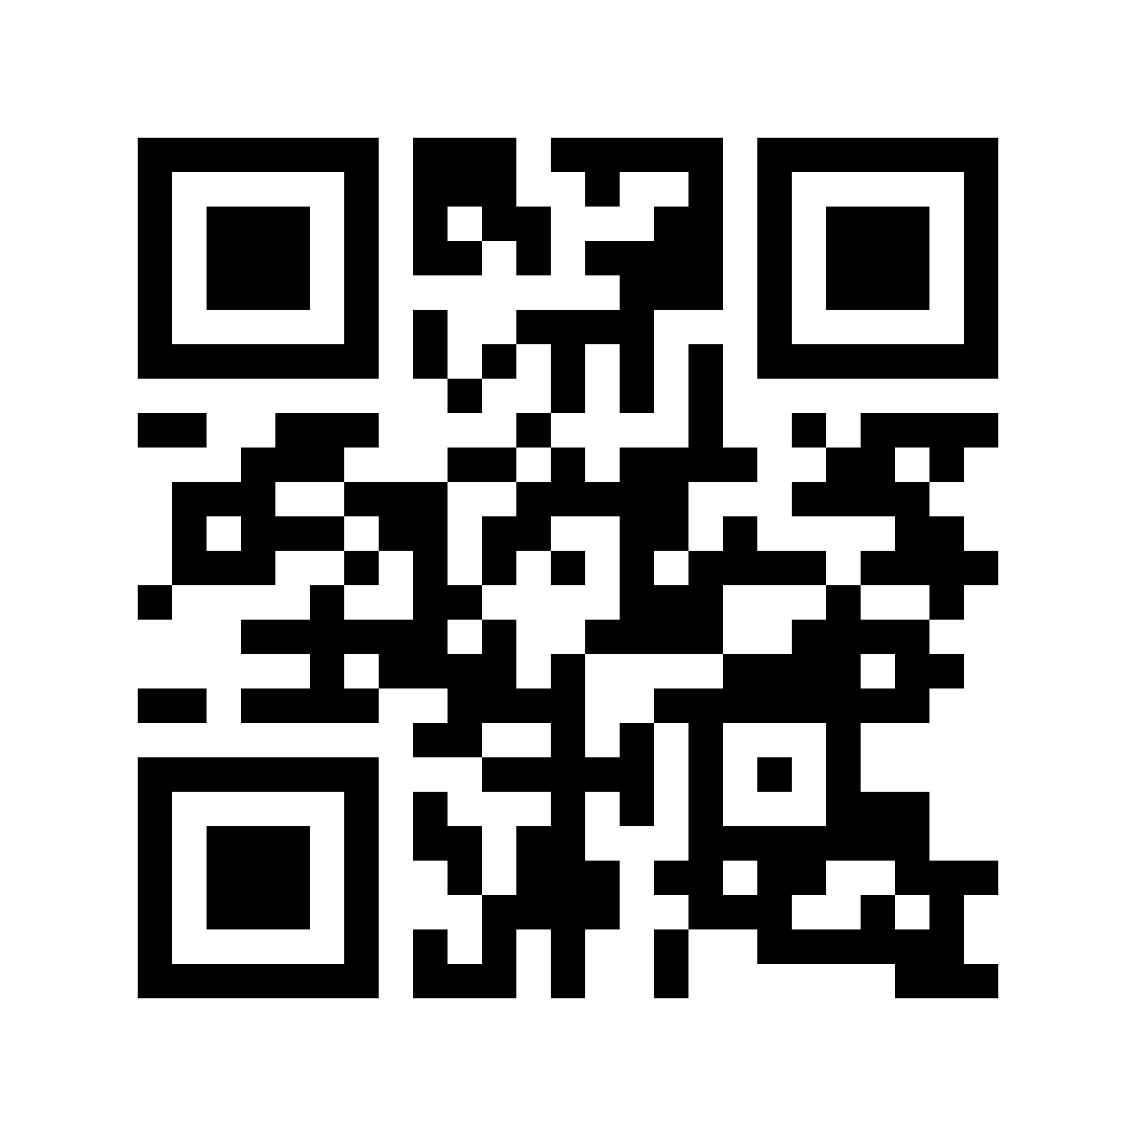
ctf.gnuradio.org

