Slide 1
Appointment System
Wind Team

Slide 2
Summary
UML Class Diagram
Architectural Design and Definitions
Person Flow
Session Flow
Appointment Flow
E-mail AOP

Slide 3
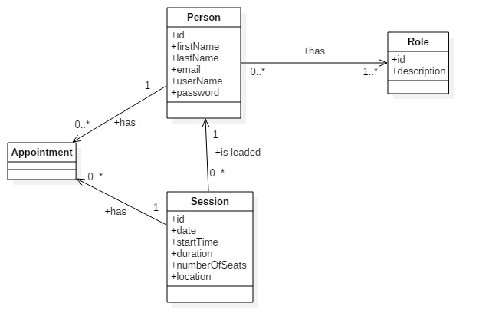
UML Class Diagram

Slide 4
Architectural Design and Definitions
Service Oriented Architecture
RESTful Microservices
JSON for request/response
Spring Framework (Boot, Security, Validation, Data):
MVC (Front Controller/REST Controllers)
DI (Singleton/Eager/Annotated Beans)
AOP (Proxy Weaving)
XA Transactions (2 Phase Commit, Service Propagation, Isolation Level Customization)
E-mail sending (AOP with Async approach)
Hibernate ORM (Session Factory Singleton, Thread Local Pattern)
MySQL Database

Slide 5
Person Flow
POST /persons
ADMIN
PasswordEncoder
GET /persons/{id}
ALL
Validation: Principal (UnauthorizedPersonException)
GET /persons
ADMIN
PUT /persons/{id}
ALL
Validation: Principal (UnauthorizedPersonException)
DELETE /persons/{id}
ADMIN

Slide 6
Session Flow
POST /sessions
ADMIN
Validation: Past Date
GET /sessions/{id}
ALL
GET /sessions
ALL
PUT /sessions/{id}
ADMIN
Validation: Past Date
DELETE /sessions/{id}
ADMIN
Validation: Past Date

Slide 7
Appointment Flow
POST /appointments/persons/{personId}/sessions/{sessionId}
ADMIN
Validation: Past Session Date, Full Capacity
POST /appointments/sessions/{sessionId}
CUSTOMER
Principal
Validation: Past Session Date, Full Capacity
DELETE /appointments/persons/{personId}/sessions/{sessionId}
ADMIN
Validation: Less than 48 Hours
DELETE /appointments/sessions/{sessionId}
CUSTOMER
Principal
Validation: Less than 48 Hours

Slide 8
E-mail AOP
AppointmentAdvice
@AfterReturning
AppointmentService.addAppointment
AppointmentService.removeAppointment
EmailService
Spring JavaMailSender
Spring SimpleMailMessage

