Slide 1

LAPORAN EXECUTIVE SERVICE LEVEL MTM
Analisis Performa Pengiriman, Realisasi, dan Pareto Unfulfill
PERIODE FILTER: Bulan = AGU-2026 | MTM = KA

Slide 2

1. EXECUTIVE KPI SUMMARY & TREND (AGU-2026)
📌 Filter Aktif: Bulan = AGU-2026 | MTM = KA
SERVICE LEVEL KIRIM
90.2%
Target Acuan: 85.0%
SERVICE LEVEL REALISASI
89.5%
Target Acuan: 85.0%
GAP REALISASI VS KIRIM
-0.7%
Selisih Performa

Slide 3
1.1 SERVICE LEVEL PER GRUP BRAND (AGU-2026)
📌 Filter Aktif: Bulan = AGU-2026 | MTM = KA | Performa Pengiriman (SL Kirim) & Realisasi (SL Realisasi) Per Grup Brand
Grup Brand | Total Order | Total Kirim | SL Kirim | SL Real. | GAP
GB 1 | 1,813,076,750 | 1,715,607,960 | 94.6% | 94.3% | -0.3%
GB 2 | 7,895,205,508 | 7,134,192,718 | 90.4% | 89.9% | -0.4%
GB 3 | 1,389,719,660 | 1,202,327,230 | 86.5% | 85.8% | -0.8%
GB 4 | 3,243,563,020 | 2,940,846,220 | 90.7% | 90.2% | -0.5%
GB 5 | 5,735,865,938 | 4,762,043,730 | 83.0% | 82.2% | -0.8%
GB 6 | 5,053,507,178 | 4,894,161,572 | 96.8% | 96.4% | -0.4%
GB ET | 351,842,500 | 341,985,000 | 97.2% | 84.4% | -12.8%

Slide 4
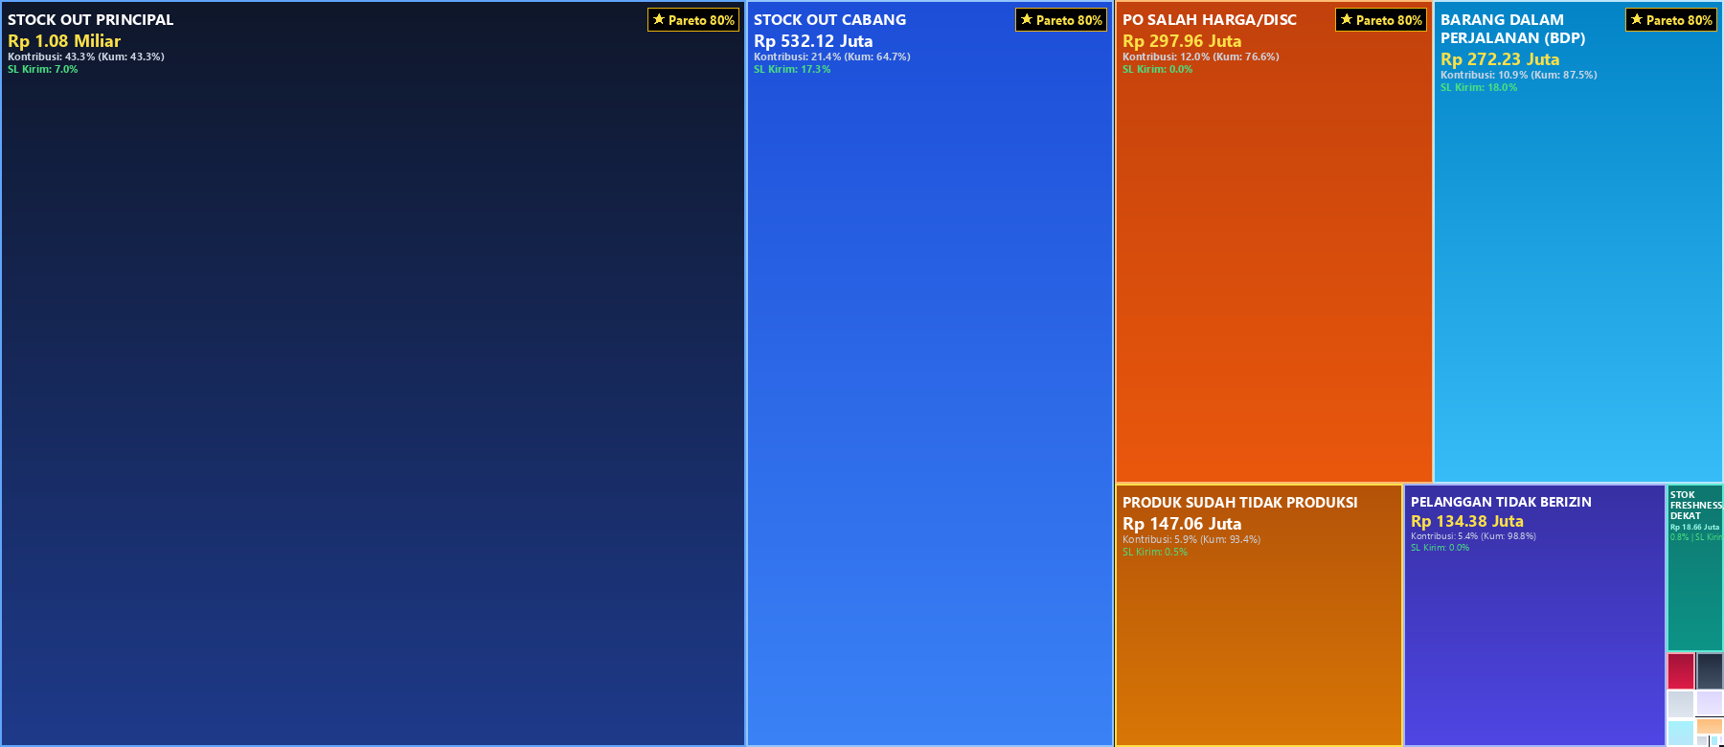
2.1 ANALISIS PARETO UNFULLFILL - ALASAN KETERLAMBATAN (AGU-2026)
📌 Filter Aktif: Bulan = AGU-2026 | MTM = KA | Pareto 80% (1 - 4 dari 4 Alasan)

Slide 5
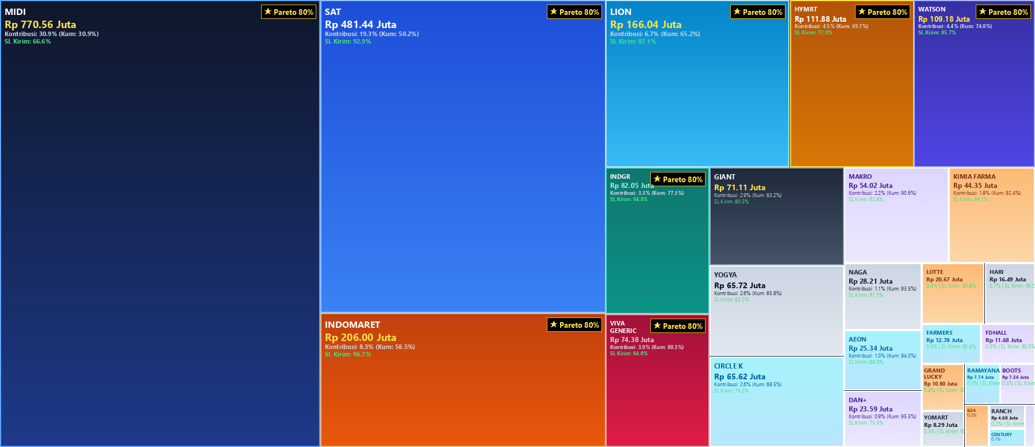
3.1 ANALISIS PARETO UNFULLFILL - AKUN MTM ALIAS (AGU-2026)
📌 Filter Aktif: Bulan = AGU-2026 | MTM = KA | Pareto 80% (1 - 8 dari 8 Akun MTM)

Slide 6
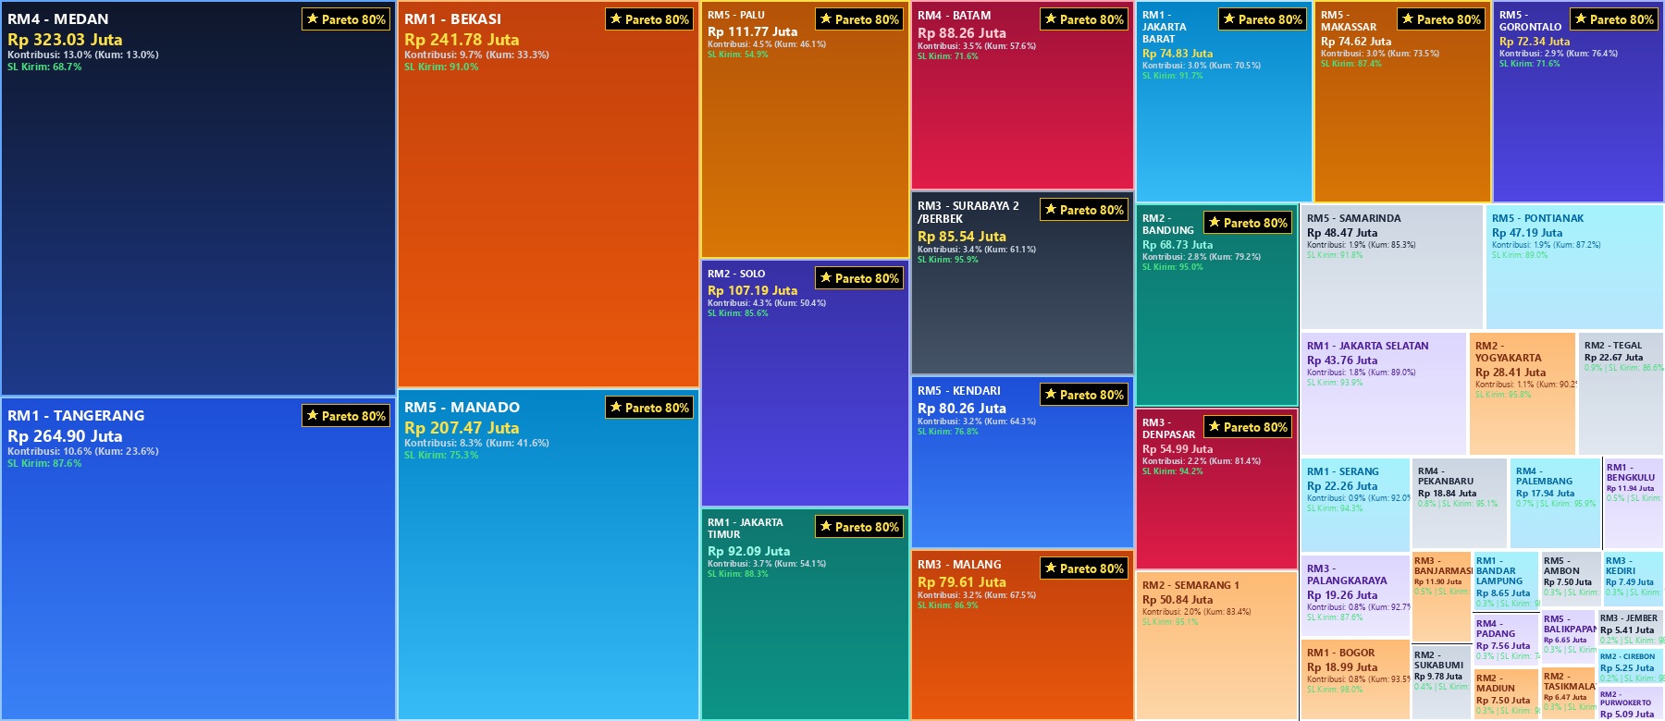
4.1 ANALISIS PARETO UNFULLFILL - NAMA CABANG (AGU-2026)
📌 Filter Aktif: Bulan = AGU-2026 | MTM = KA | Pareto 80% (1 - 16 dari 16 Cabang)

Slide 7
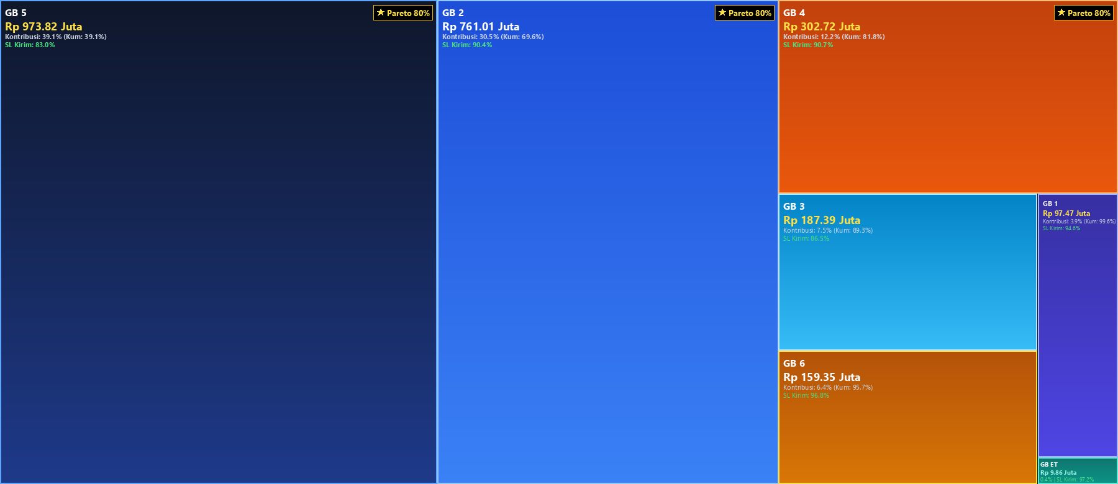
5.1 ANALISIS PARETO UNFULLFILL - GRUP BRAND (AGU-2026)
📌 Filter Aktif: Bulan = AGU-2026 | MTM = KA | Pareto 80% (1 - 3 dari 3 Grup Brand)

Slide 8
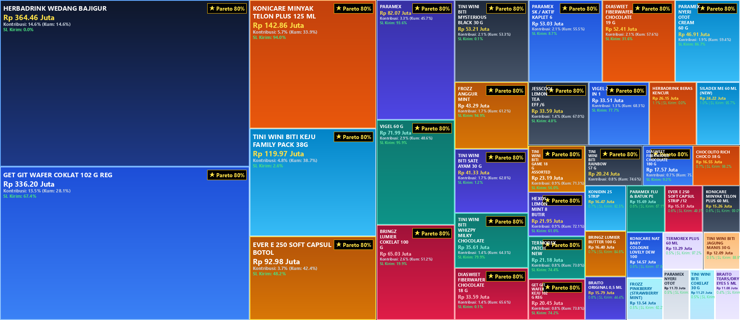
6.1 ANALISIS PARETO UNFULLFILL - ITEM / PRODUK SKU (AGU-2026)
📌 Filter Aktif: Bulan = AGU-2026 | MTM = KA | Pareto 80% (1 - 34 dari 34 Item SKU)

Slide 9


