Slide 1



Fuel Your Sales with Trust using LouderVoice customer reviews
www.loudervoice.com

Slide 2
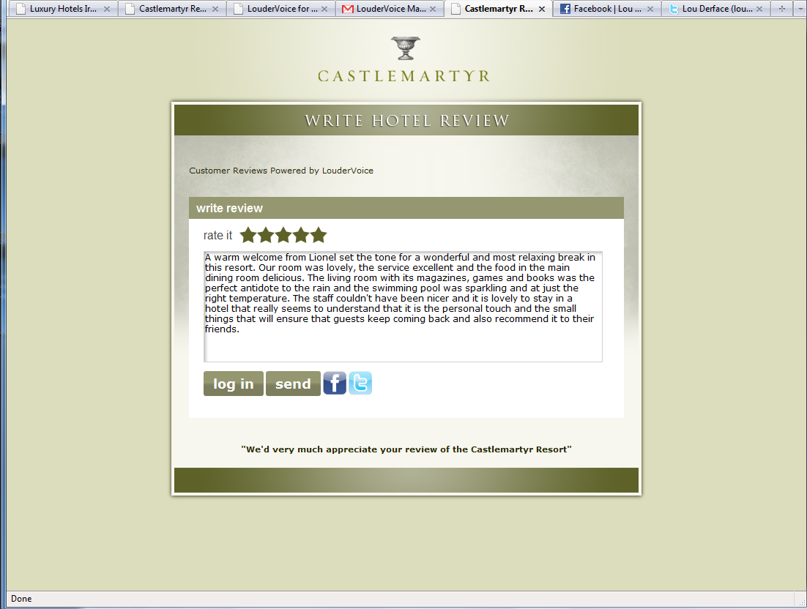

Slide 3
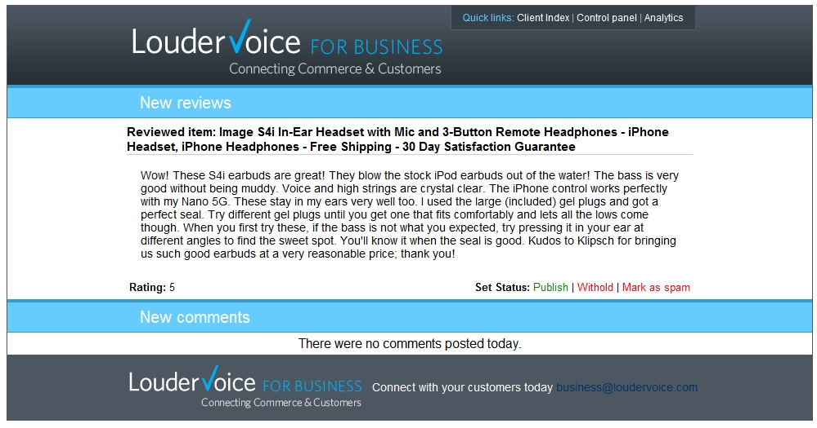

Slide 4
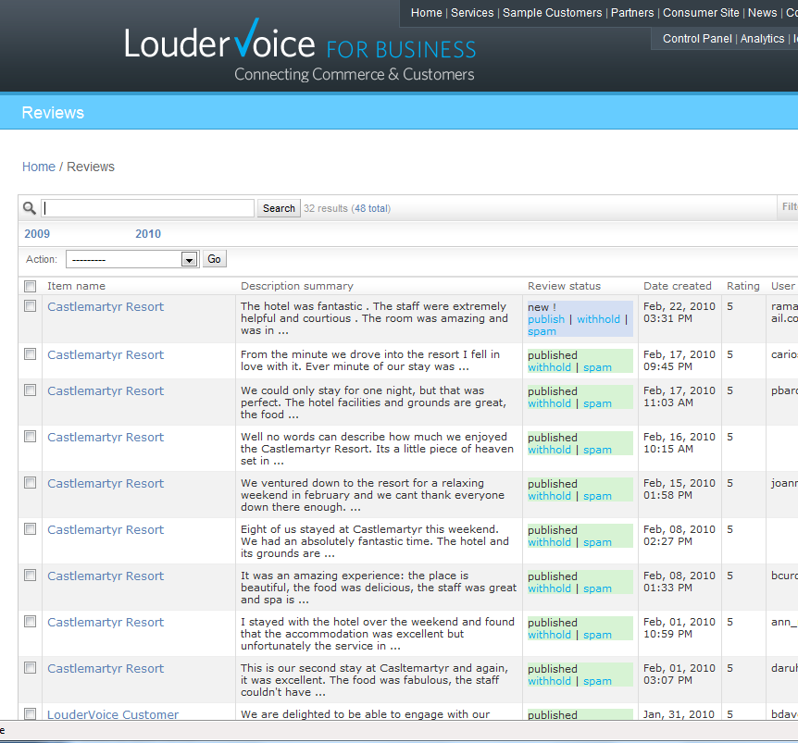

Slide 5
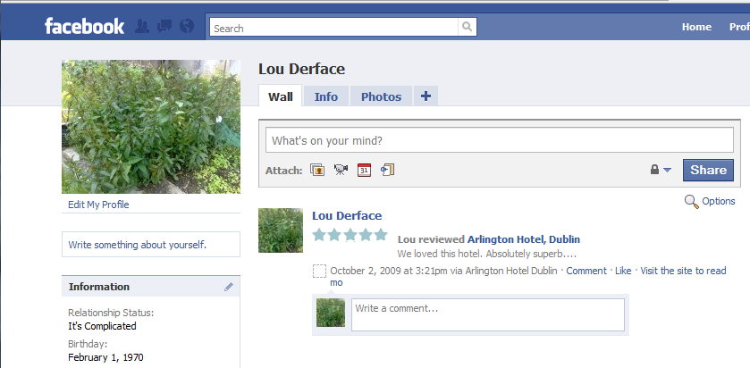

Slide 6
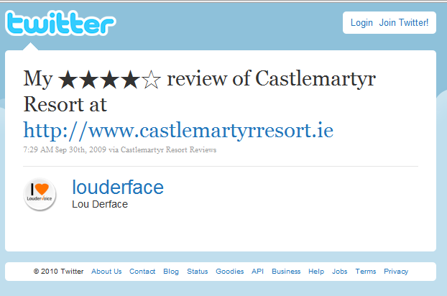

Slide 7
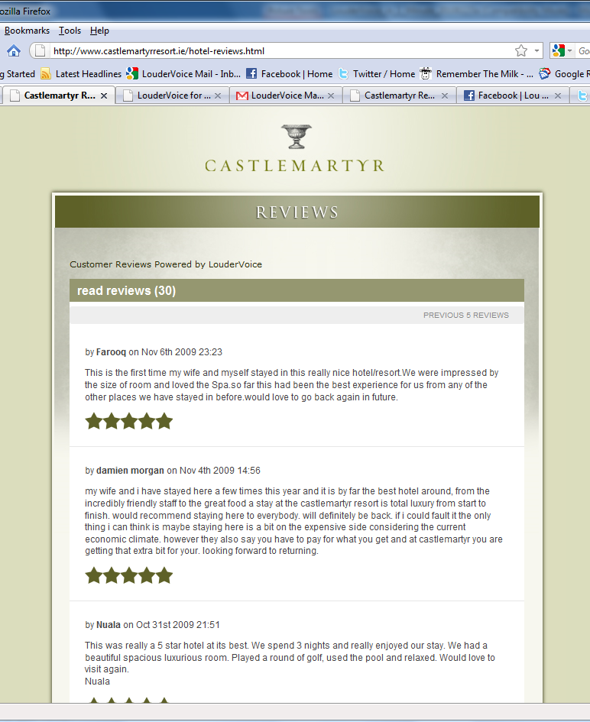

Slide 8
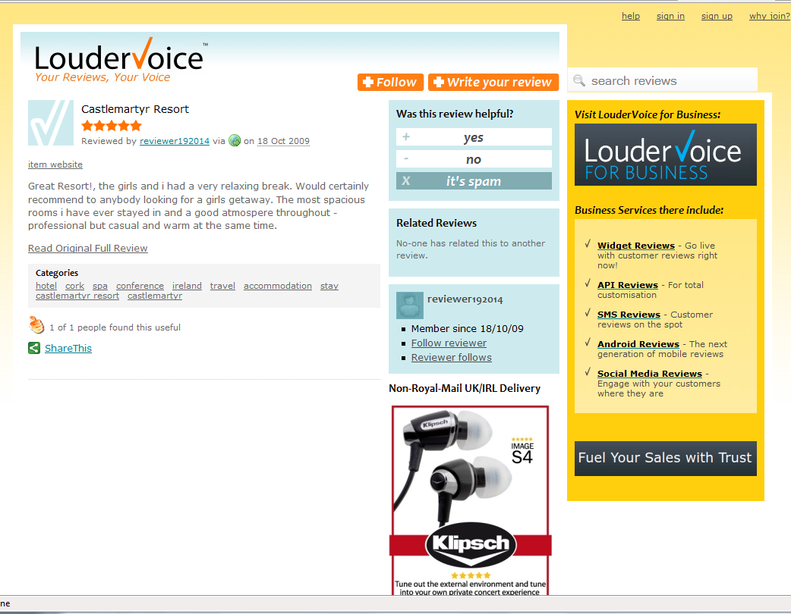

Slide 9
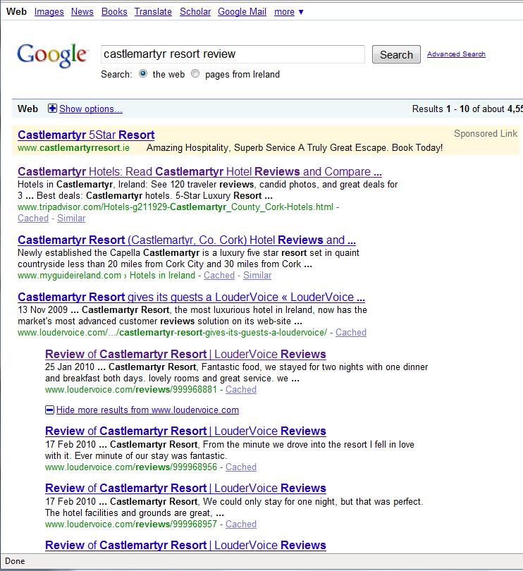

Slide 10
LouderVoice
Tell your web people to contact us today at
www.loudervoice.com
To get your LouderVoice review & rate tool

