Slide 1
LouderVoice Deck
4 Slides for you to include in your
Company presentation

Slide 2
Why Should I let my customers Review?
‘No single element drives online sales like personal recommendations’
  Two absolute outcomes:
    GREATER CUSTOMER TRUST & INCREASED TRAFFIC
26% of US e-business (surveyed) use a Review & Rate tool
72% of online shoppers trust and are influenced by reviews
    Nielsen Company 2009
    ______________________________________________________________
This is the must have web tool for 2010 for all serious consumer web businesses. Over 55% of US B2C sites use an R&R tool.
    Essential for:
    Hospitality Leisure
    E-tail Speciality retail
    And new web businesses looking for SEO

Slide 3
What is a Review & Rate Tool?
Pioneered by Amazon, and made popular by sites like EBay and TripAdvisor
Gives customers the ability to post a review and rating for your products or services directly on your website.
R&R tools are seen by market analysts as one of the most important tools for any website serious about online business.
Watch this 2 minute video:
  http://www.loudervoice.com/go/123guaranteedvideo

Slide 4
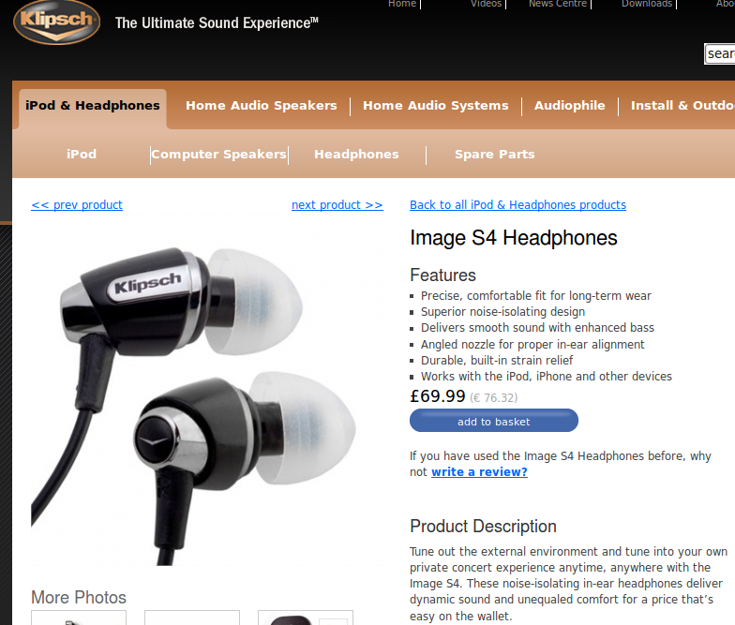
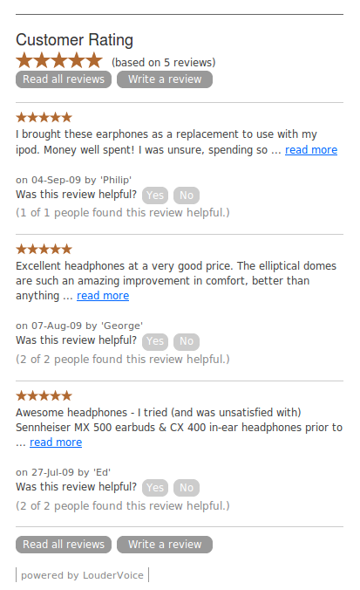
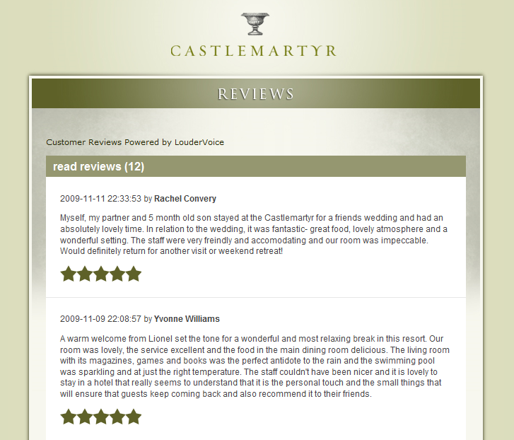

Why use LouderVoice?
Only €49.00 per month
Ireland’s largest provider
Fully supported
Simple widget installation
Live receiving reviews within 24 hours 24 hours
Fully Guaranteed
Improved Search Engine Results
Greater sales conversion
Invaluable customer feedback
In 60 days...or your money back

Slide 5
How do I get started?
See LouderVoice in action at:
  Klipsch USA
  Castlemartyr Resort Cork
  Puddleducks
See reviews by LouderVoice’s clients here
Get started – just complete the order form
Live, receiving your first reviews within 24 hours!

