Slide 1



1,2,3
Guaranteed Results
Or your money back!

Slide 2
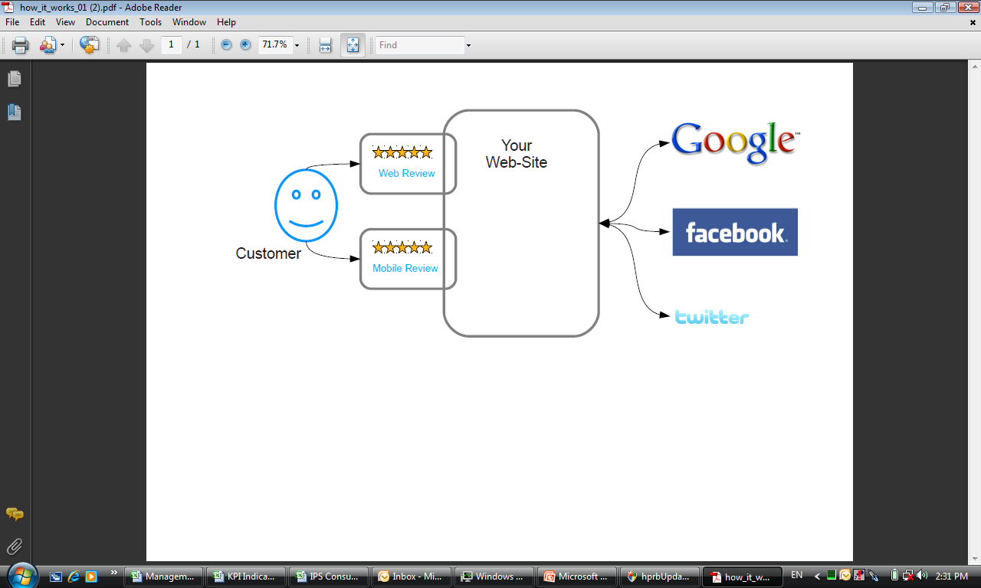
How it works...

Slide 3
  Generating qualified...
Trust
&
Traffic

Slide 4
1: Improved Search Engine results
Within one week:
1 review gets picked up by many places
Google and all major search engines
Social media Facebook and Twitter
Save on expensive CPC adwords
Get powerful organic traffic
IDEAL for new websites to get noticed

Slide 5
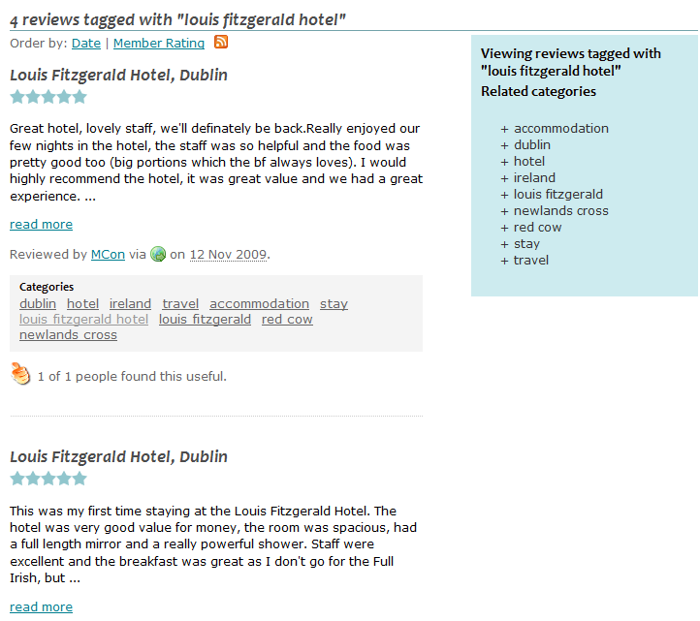
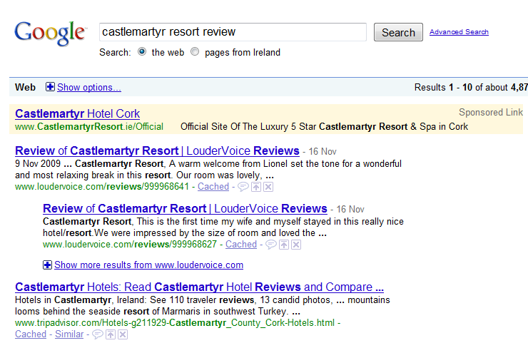
Search Engine Optimisation (SEO)

Slide 6
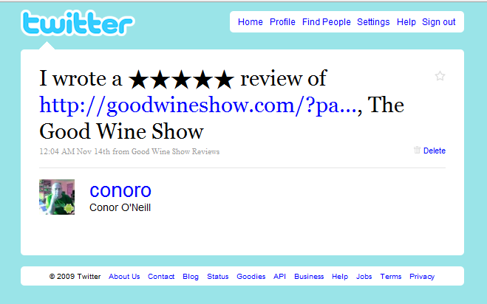
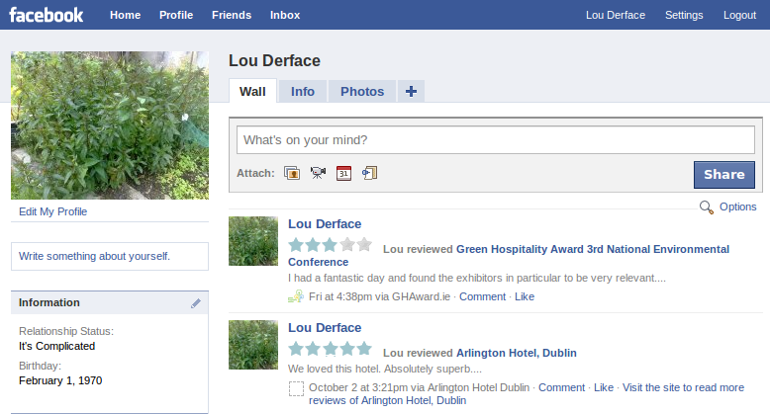
Facebook & Twitter – get your customers out selling!

Slide 7
2: A Proven Sales Converter
Within one month:
You will see an increase in sales conversion
  72% of online shoppers trust and are influenced by reviews
  Up to 40% increase in sales conversion
  Nielsen Company 2009
What would a 40% conversion improvement mean to you?

Slide 8
3:Invaluable Customer Feedback
From the very first review:
Easy and simple
Invaluable information on how to improve
Collect limitless reviews over time
Automatically grouped by product to drive even more customer sales
Use reviews offline ..in-store, brochures, press, etc...

Slide 9
LouderVoice
‘No single element drives web sales like personal recommendations’
Nielsen Company
Ireland’s largest provider
Fully supported
Simple widget installation
Live receiving reviews within 24 hours

Slide 10
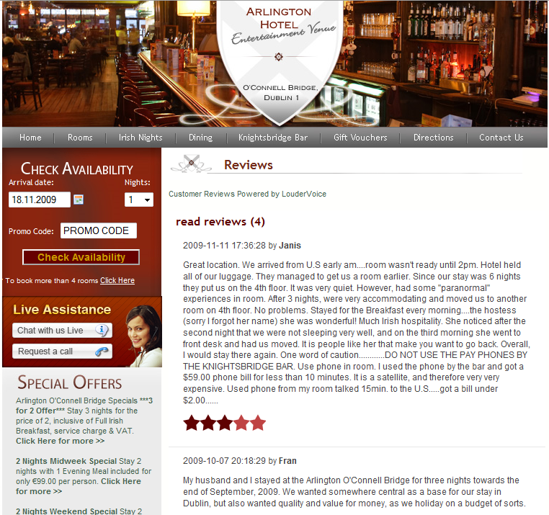
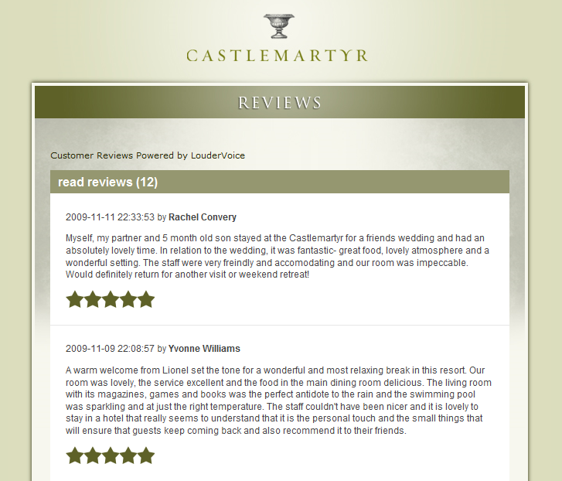
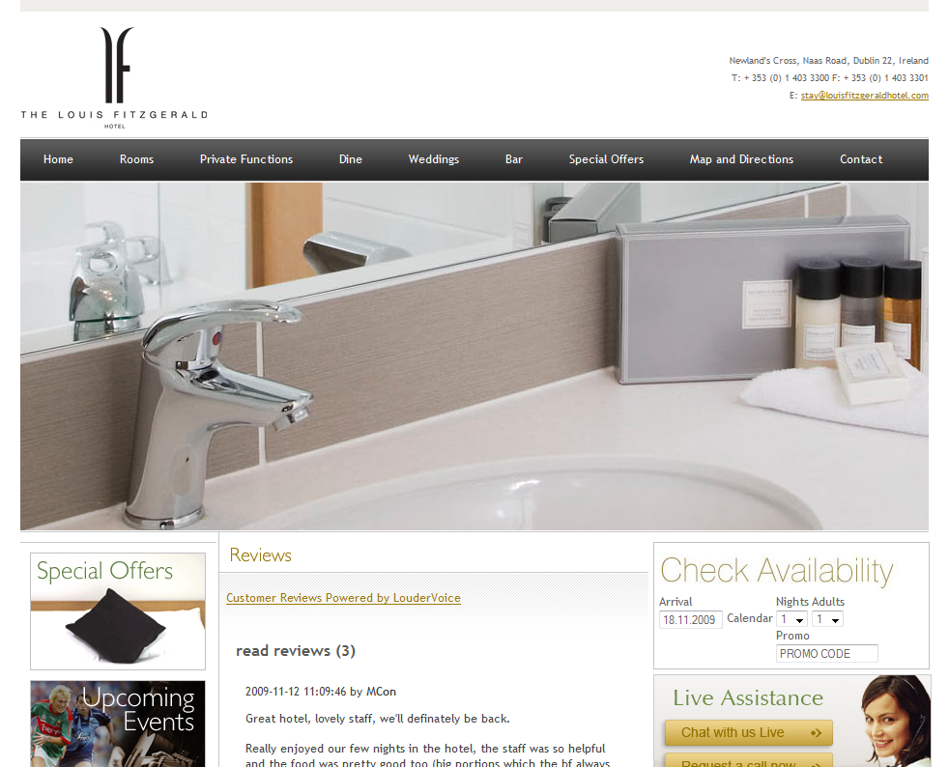
Your Review & Rate Tool, instantly

Slide 11
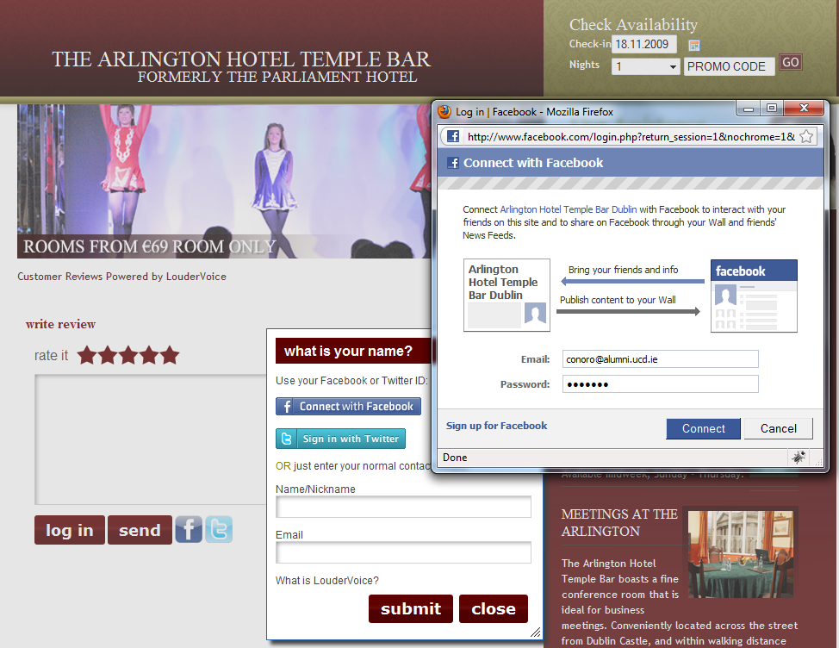
Your Review & Rate Tool, instantly

Slide 12
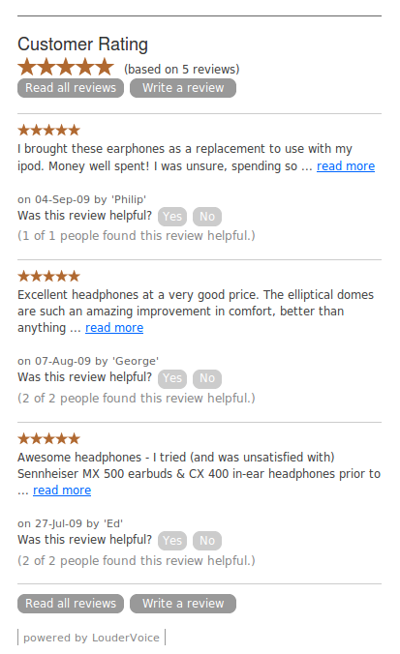
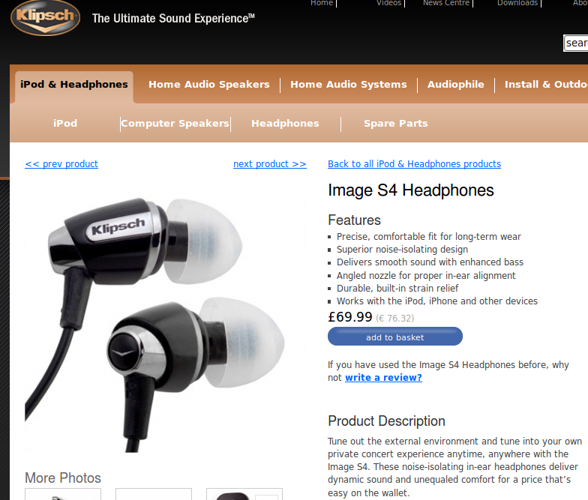
Klipsch

Slide 13









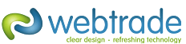






Join lots of happy customers

Slide 14
1,2,3 Guaranteed
Improved Search Engine Results
Greater sales conversion
Invaluable customer feedback
In 60 days...
or your money back
See full details on our no quibble money back guarantee at www.loudervoice.com

Slide 15
LouderVoice...Get it TODAY
Collecting reviews within 24 hours...
all for as little as €49.00 +vat per month
Have your web developers contact us today at
www.loudervoice.com/contact/
To get your LouderVoice review & rate tool

