Slide 1
OPTIMIZER
Topic: Minimizing total cost function using the principles of black box optimization
Team Name – EDITH
Team ID – OP-63
Members:
JAYDEV ZAVERI,
Dept. of Chemical Engineering, Vellore Institute of Technology, Vellore
ARRUN SIVASUBRAMANIAN
Dept. of Artificial Intelligence Engineering, Amrita School of Engineering, Coimbatore
Notes:
JD

Slide 2
PROBLEM STATEMENT
T depends only on two independent variables,
C (Cost variable), a measure of cost and
R (Risk variable), a measure of risk.
The objective is to minimize function T for the given range of C [250, 300] & R [50, 60] (T, C, and R have the same units). and also find the corresponding values of variables C & R.
Notes:
JD

Slide 3
CHOICE OF POINTS
The initial guess of the points were the 4 extreme bounds of the range of values provided which were (200,25); (200,75); (350,25) and (350,75). Then compass search algorithm was used
The advantage of compass search is that it is a derivative-free approach.
We noticed that the minimum value of the 4 points is at (200, 75). Thus, from there, we took points which were North, South, East, and West of the above points.
Later we found the new minimum point for that iteration (least value of the four points) and we took that improved point as our new local minima.
Notes:
JD

Slide 4
CHOICE OF POINTS
Nature of contour descent approach used in compass method
Notes:
JD

Slide 5
MOORE-PENROSE EQUATION (PSEUDOINVERSE)
The Moore-Penrose pseudo-inverse is an approach to calculate the solution of the system of linear equations expressed as:
Where A is the operator matrix consisting of linearly independent vectors of both c and r like (c, r2, r3, sin(c), r, cos(c), r2, sin(c2) etc.) where c and r stand for the cost variable and risk variable respectively and f is the output of function at those values.
We try to approximate the solution by projecting onto the best linear combination vectors in the feature column space.
Thus, the above equation can be written as:
In the custom polyfit function which we generated for optimization, we set convergence of leading coefficients if the L2-norm of predicted and true value is below a threshold score or if coefficients don’t change due to which predictions won’t be affected.
Notes:
Arrun

Slide 6
OUR APPROACH
From the Fourier transform, we know that any signal can be approximated as the linear combination of infinite sines and cosines of different frequencies.
But, we found that points on the extremes don’t satisfy the curve equation.
Also, there were rapid sinusoid fluctuations in the derivatives with an exponential envelope, indicating there could be multiple local minima.
The orthogonal sine and cosine bases of Fourier Series
The partial derivative sinusoid under an exponential envelope.
Notes:
Arrun

Slide 7
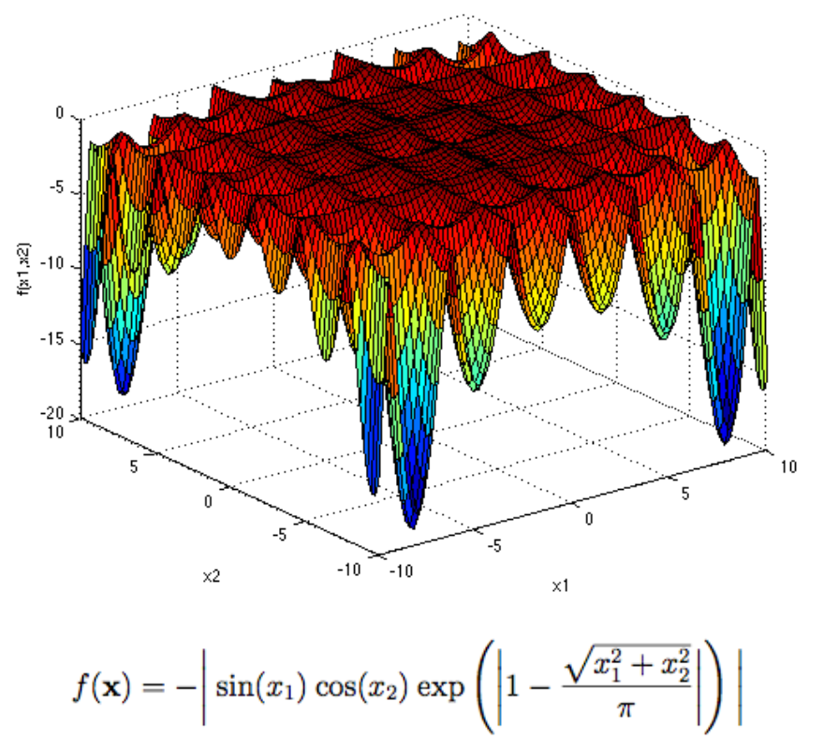
OUR APPROACH
While doing the literature survey, we were inspired to include an exploding or vanishing gradient part.
We also wanted a function that considers only the absolute value as a part of the combination as the final total cost can never be negative.
All this inspired us to choose combinations by the holder table function which contains a lot of local minima's and only one global minima
Yet, we decided to consider a logarithmic component (since exponentials lead to failure of convergence of SVD in pseudoinverse.
Notes:
Arrun

Slide 8
REMOVAL OF REDUNDANT COEFFICIENTS
The coefficients of certain bases were found to be too small compared to the other coefficients. This implies that projecting on that base has a very low energy.
Hence, we decided to eliminate the coefficients which are of the order 10⁻² to maintain a neat equation.
This idea was also inspired from principal component analysis where we take the Eigen vectors corresponding to the higher magnitude eigen values as the principal components.
This helps in getting a good prediction and simultaneously avoid overfitting of the curve.
Notes:
Arrun

Slide 9
ADVANTAGES OVER OTHER METHODS
For finding the global minima, the initial approach was to take the partial derivative of the function wrt. C and R and then find the values, but it didn’t ensure convergence at global minima. Now that we also knew the function has multiple local minima, we wrote a function that computed the global minima in a Brute force approach.
The fit was found to be accurate, but new points don’t necessarily satisfy the curve equation and yield a minimal error. This is because the compass method cannot efficiently converge to a global minina within 20 iterations. But it had converged to a minima close to the global minima.
There are a few techniques like Newton Raphson methods and ADMM that converges to the global minima very accurately. Looking at other such SOTA methods for black box optimization, our method converged to the minima within fewer iterations.
Thus, an efficient and reproducible optimizer has been used to reduce the total cost!
Notes:
JD

Slide 10
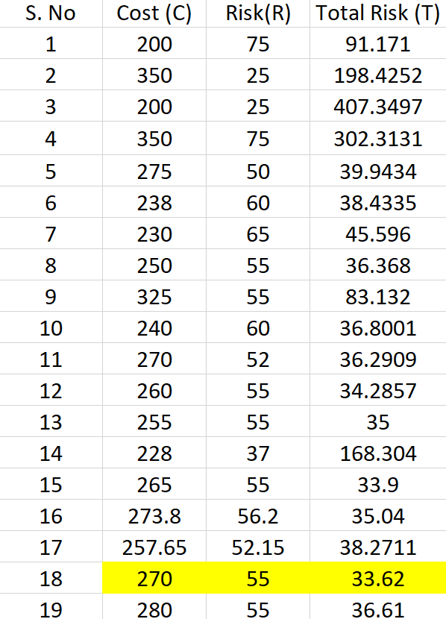
RESULTS
FINAL ANSWER:
C = 270 R = 55
T = 33.62
Notes:
JD

Slide 11

THANK YOU
We are open to answer questions!
Notes:
JD

