Slide 1
Argonaut Scheduling
04/12/2017
Eric Haas
Brett Marquard

Slide 2
Overview
Welcome and Introductions
Timelines
Formalize scope
R2 vs R3

Slide 3
Timelines
March Project Launch!
April
Finalize scope & scenarios
May-June
Draft initial profiles & solicit feedback
July
Virtual Connectathon
and/or ‘Sprints’
August
Solid API draft
September
HL7 in-person Connectathon
October
Finalized IG & publication

Slide 4
Project Tasks
Confirm Initial Scope
Develop basic appointment and scheduling scenarios
Draft supporting profiles
Host a virtual connectathon to test the new functionality
Formalization of the Scheduling and Appointments profiles into the FHIR/Argonaut publication framework

Slide 5

Initial Use Cases
Support basic patient access to a provider's calendar and appointment requests. APIs and guidance:
Retrieve existing patient appointments
Search a provider's schedule for an open appointment*
Request an appointment
Amend an appointment
Cancel or reschedule an appointment
*provider = individual, organization, healthcare service

Slide 6
Additional Use Cases
Support basic provider access to a provider's calendar and appointment requests. APIs and guidance for
Same functionality as patient appointments
Provider scheduling on behalf of patient
+ Retrieve their existing appointments for all patients

Slide 7
In Scope
Existing patient
New patients
Primary Care
Referral/Specialty
Diagnostics (lab/xrays)
Cardiology
Etc.
Notes:
Combine with old slide set

Slide 8
Future
Prior approvals
Estimated out of pocket patient costs
Scheduling physical (rooms, modalities, etc.) resources
Initiating Transitions of Care
Language support
Scheduling surgery room in one organization with an external provider
Notes:
Combine with old slide set

Slide 9
Potential Resources to Profile
Appointment
AppointmentResponse
Schedule
Slot
…Others? HealthcareService?

Slide 10
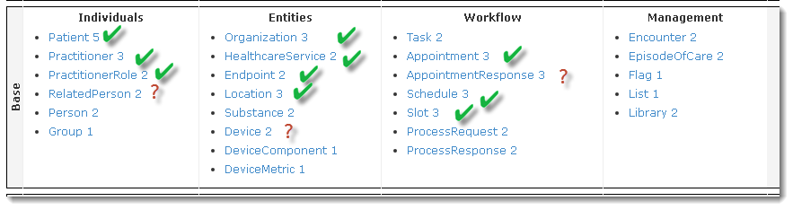
FHIR Scheduling Related Resources
We don’t need to profile them all – can leverage Argonaut Data Query and/or US Core
Notes:
We don’t need to profile them all – can leverage Argonaut Data Query and/or US Core

Slide 11
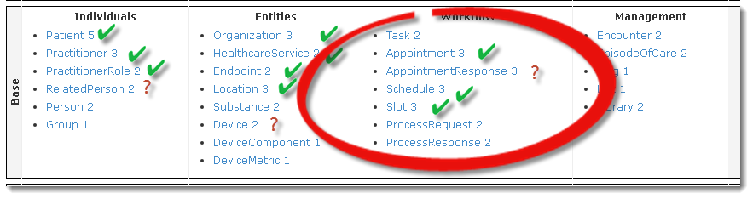
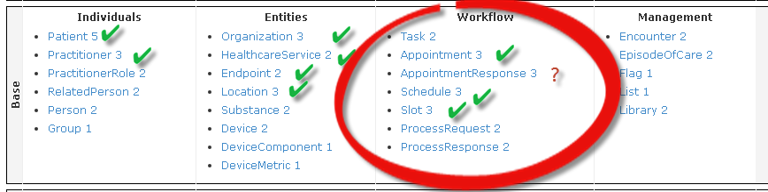
Focus on These Scheduling Resources

Slide 12
R2 v R3
Review of the changes between FHIR R2 and R3 for these resources:
Note:
R2 = FHIR DSTU2 at http://hl7.org/fhir/DSTU2/index.html
R3= FHIR STU3 at http://hl7.org/fhir/STU3/index.html

Slide 13
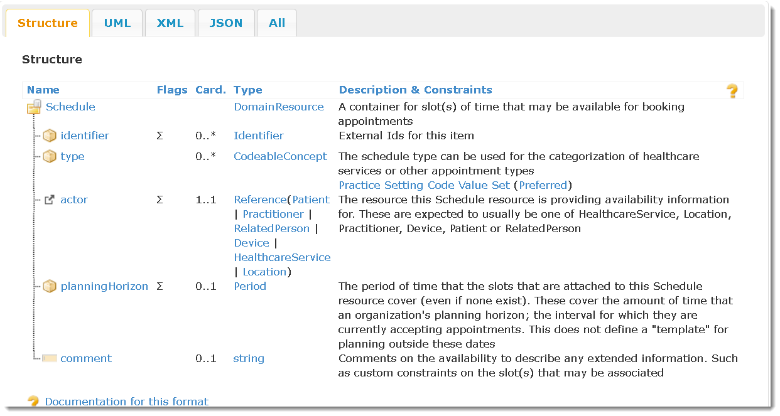
Schedule Resource – R2
Notes:
The real-world, non-automated analogue of the schedule described above is a standard appointment book. These books are generally organized with rows of time slots, during which a service or resource is available.

Slide 14
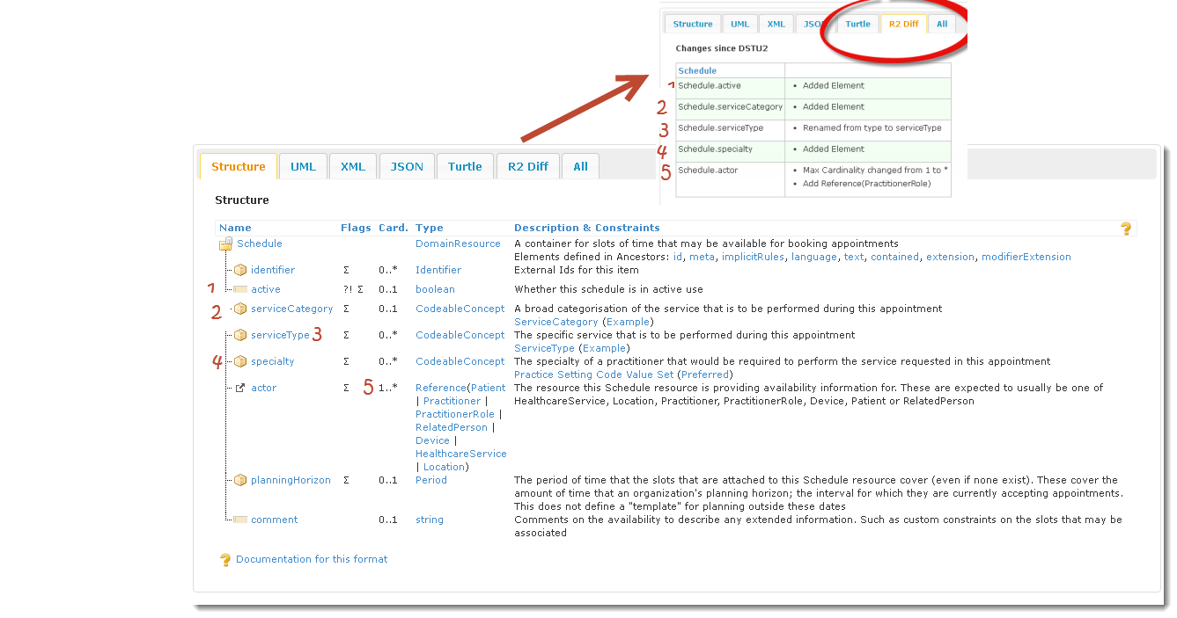
Schedule Resource – R2/R3 Differences
Notes:
Go in depth for each change….
The real-world, non-automated analogue of the schedule described above is a standard appointment book. These books are generally organized with rows of time slots, during which a service or resource is available.
Status element
Categories: useful for search see http://hl7.org/fhir/STU3/valueset-service-category.html
Rename
specialty overlaps with category? Source HITSP C80 Table 2-149 Clinical Specialty Value Set Definition.
Update to include PractitionerRole and “ The capacity to support multiple referenced resource types should be used in cases where the specific resources themselves cannot be scheduled without the other, and thus only make sense to the system exposing them as a group. Common examples of this are where the combination of a pracitioner and a room(location) are always required by a system.”

Slide 15
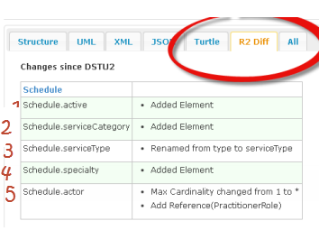
Schedule Resource – Difference Summary
Notes:
Go in depth for each change….
The real-world, non-automated analogue of the schedule described above is a standard appointment book. These books are generally organized with rows of time slots, during which a service or resource is available.
Status element
Categories: useful for search see http://hl7.org/fhir/STU3/valueset-service-category.html
Rename
specialty overlaps with category? Source HITSP C80 Table 2-149 Clinical Specialty Value Set Definition.
Update to include PractitionerRole and “ The capacity to support multiple referenced resource types should be used in cases where the specific resources themselves cannot be scheduled without the other, and thus only make sense to the system exposing them as a group. Common examples of this are where the combination of a pracitioner and a room(location) are always required by a system.”

Slide 16
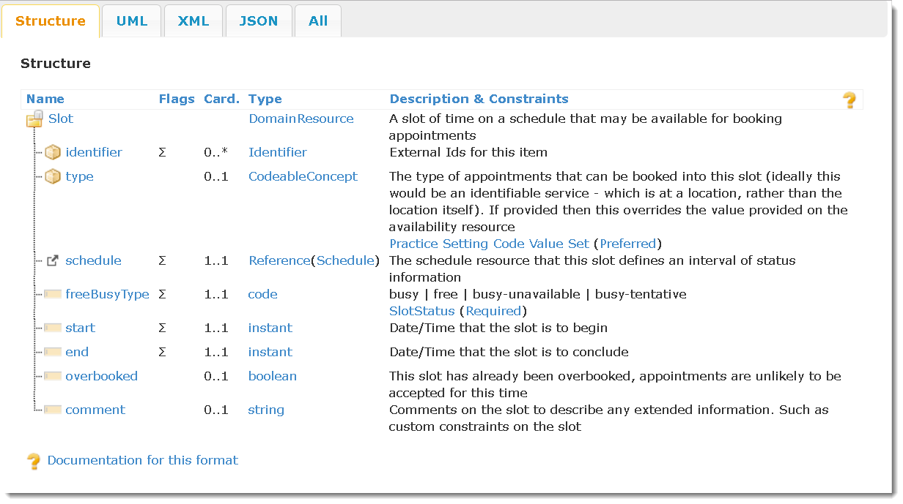
Slot – R2

Slide 17
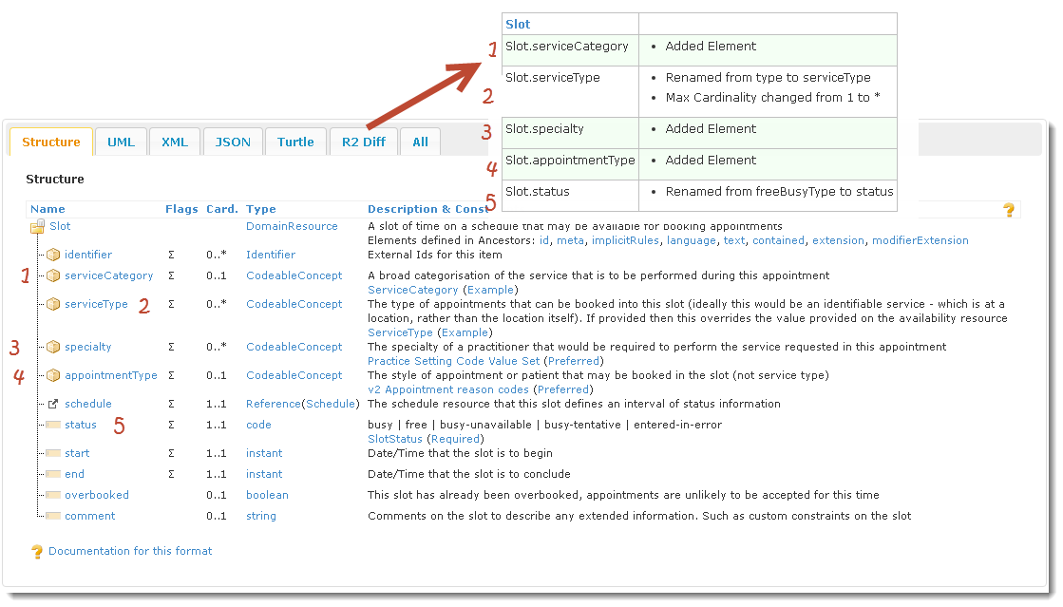
Slot – R2/R3 Differences
Notes:
A slot of time on a schedule that may be available for booking appointments.
1 already covered in schedule slide
2 Again this overlaps with category: Rename and change in cardinality service type codes : http://hl7.org/fhir/STU3/valueset-service-type.html
3 already covered in schedule slide
Classifies the type of appointment that can be made.
rename

Slide 18
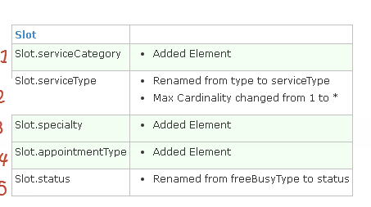
Slot – Difference Summary
Notes:
A slot of time on a schedule that may be available for booking appointments.
1 already covered in schedule slide
2 Again this overlaps with category: Rename and change in cardinality service type codes : http://hl7.org/fhir/STU3/valueset-service-type.html
3 already covered in schedule slide
Classifies the type of appointment that can be made.
rename

Slide 19
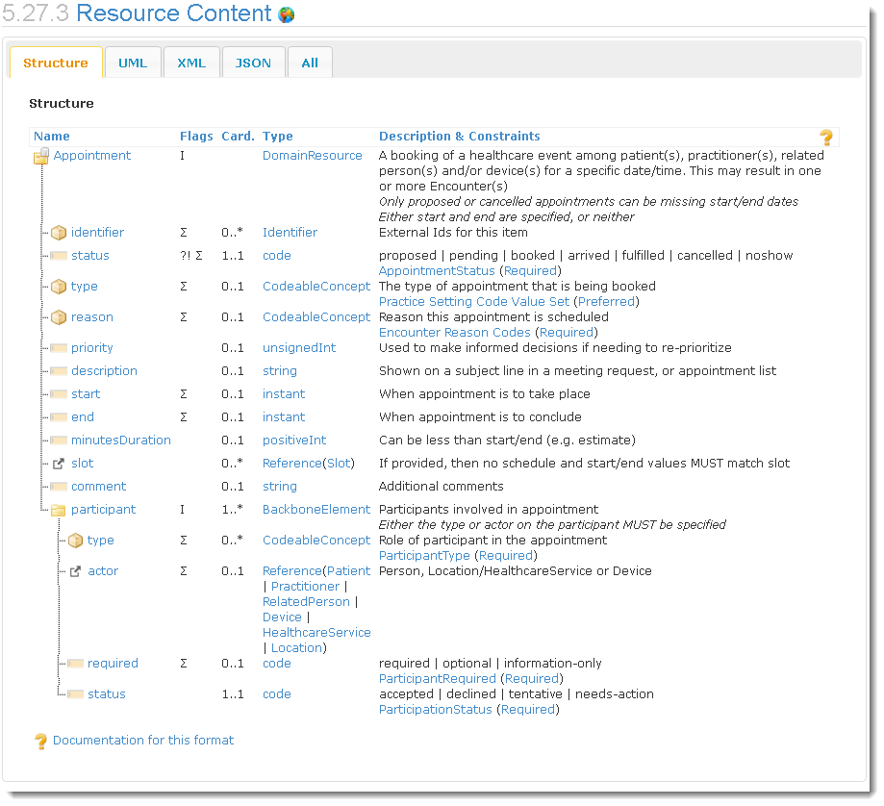
Appointment – R2

Slide 20
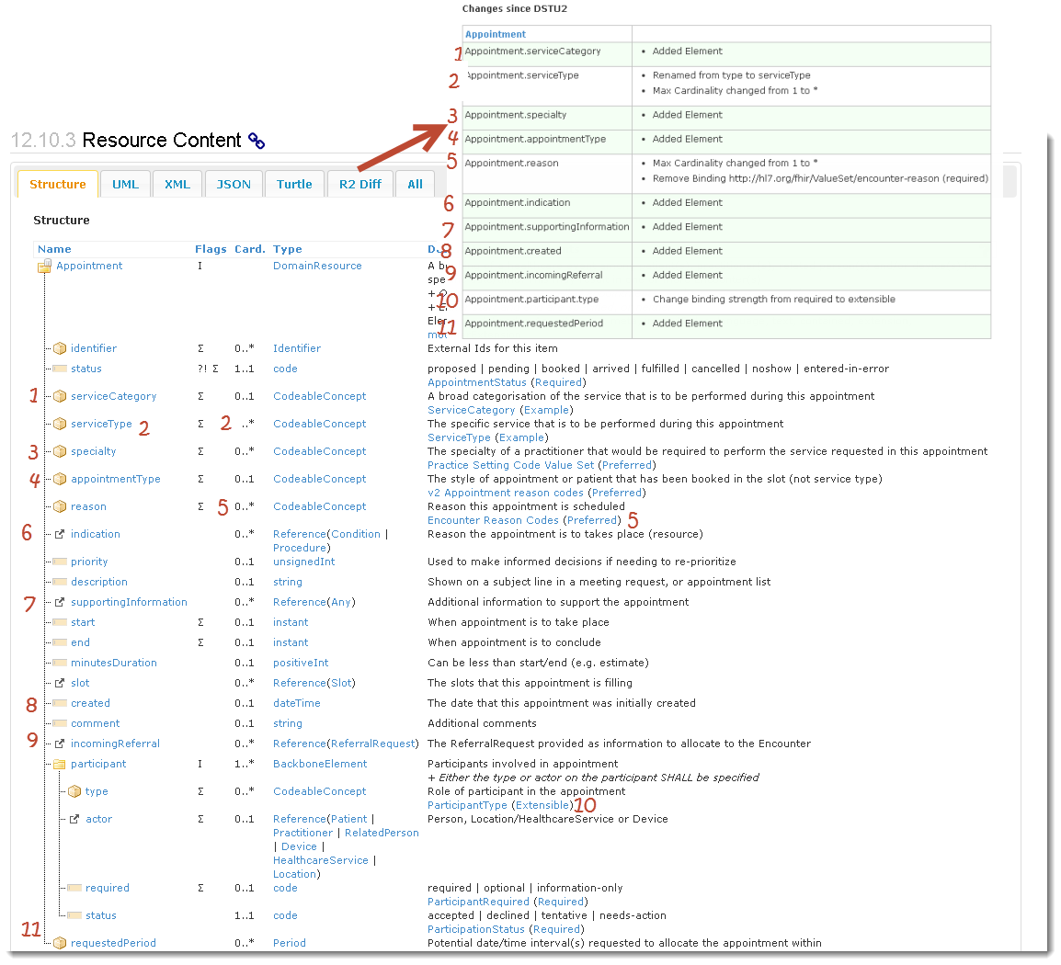
Appointment – R2/R3 Differences
Notes:
A booking of a healthcare event among patient(s), practitioner(s), related person(s) and/or device(s) for a specific date/time.
already covered in schedule slide
already covered in slot slide
already covered in schedule slide
already covered in slot slide
reason = reasonCode Reason for visit – aka chief complaint codes.
Indication = reasonReference Reason for visit – aka chief complaint codes.
SupportingInformation as references to other resources (part of the FHIR request pattern alignment)
see resources notes - bit of provenance
Link to ReferralRequest resource. ( This should be ProcedureRequest as well. See GF [#13196]
10 (part of the FHIR request pattern alignment)
11 ? (part of the FHIR request pattern alignment)

Slide 21
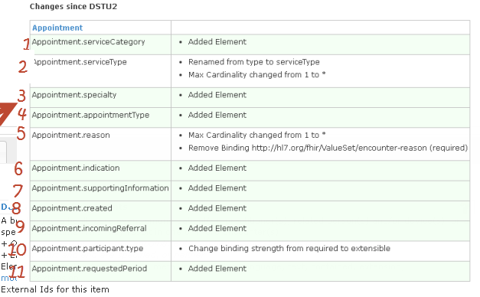
Appointment – Difference Summary
Notes:
A booking of a healthcare event among patient(s), practitioner(s), related person(s) and/or device(s) for a specific date/time.
already covered in schedule slide
already covered in slot slide
already covered in schedule slide
already covered in slot slide
reason = reasonCode Reason for visit – aka chief complaint codes.
Indication = reasonReference Reason for visit – aka chief complaint codes.
SupportingInformation as references to other resources (part of the FHIR request pattern alignment)
see resources notes - bit of provenance
Link to ReferralRequest resource. ( This should be ProcedureRequest as well. See GF [#13196]
10 (part of the FHIR request pattern alignment)
11 ? (part of the FHIR request pattern alignment)

Slide 22
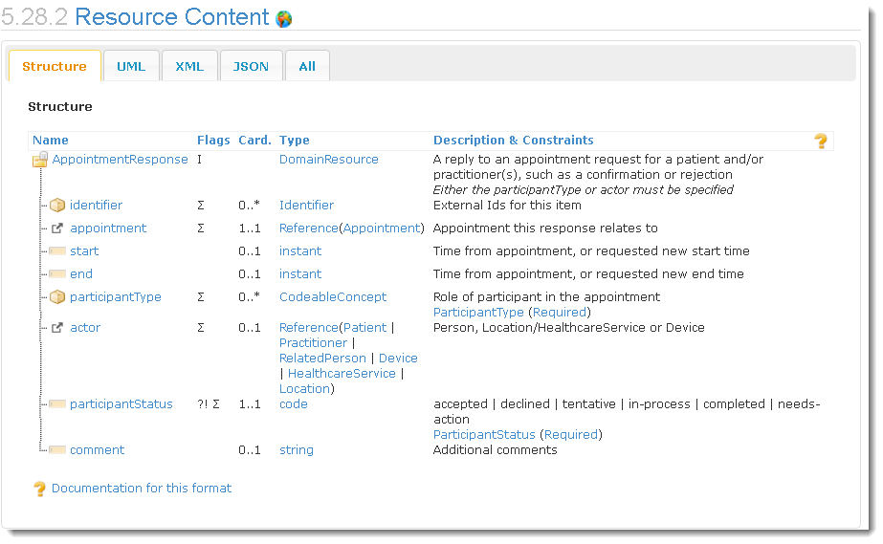
AppointmentResponse – R2

Slide 23
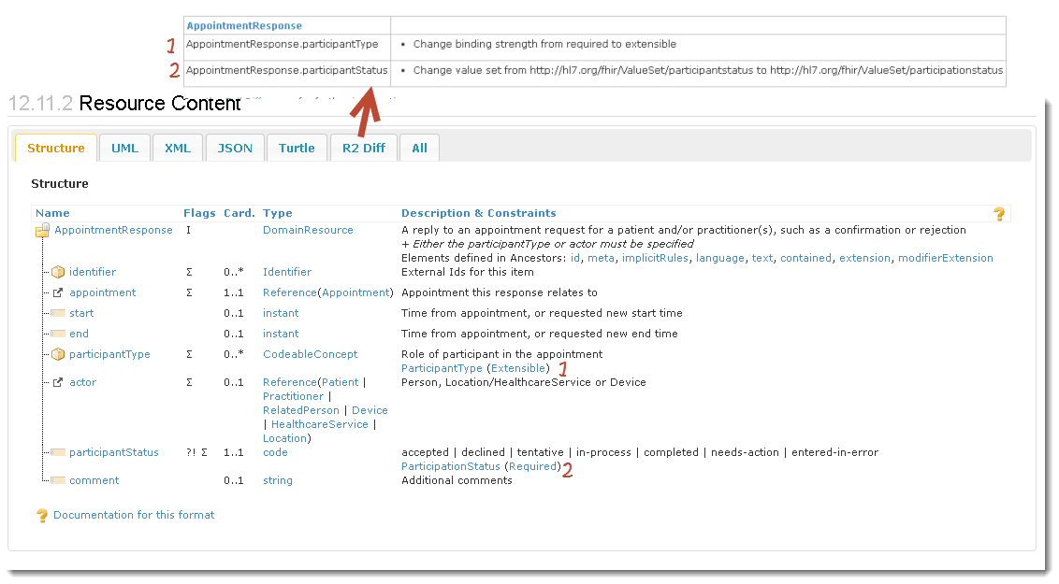
AppointmentResponse – R2/R3 Differences

Slide 24
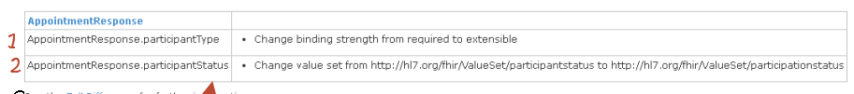
AppointmentResponse – Difference Summary

Slide 25
Big Differences R2 vs R3
Endpoint Resource in R3
Do we need it?
ProviderRole Resource in R3
Inline element in Provider in R2
New elements in R3
Can be handled as extensions in R2 if needed
Other?

Slide 26
Best Approach
Options
Create R2 IG only (with extension as needed)
Create R3 IG only
Create R2 and after publication determine if necessary, and budget, to create an R3 IG (as part of Argonaut)

Slide 27
Prior Art
Norway presentation at FHIR developer days
HL7 connectathon scenarios
NHS GP Connect
Section on their HTML Design Decisions
https://nhsconnect.github.io/gpconnect/tag_design.html
Others to consider?

Slide 28
Next Steps
Subscribe to new Google group
Set recurring meeting time
Draft scenarios and formalize scope
Planned development repo: https://github.com/argonautproject/scheduling
Google Group:
https://groups.google.com/forum/#!forum/argonaut-scheduling-workgroup

