Slide 1
Argonaut Scheduling (Annotated (in red) with Meeting Notes)
04/26/2017
Eric Haas
Brett Marquard

Slide 2
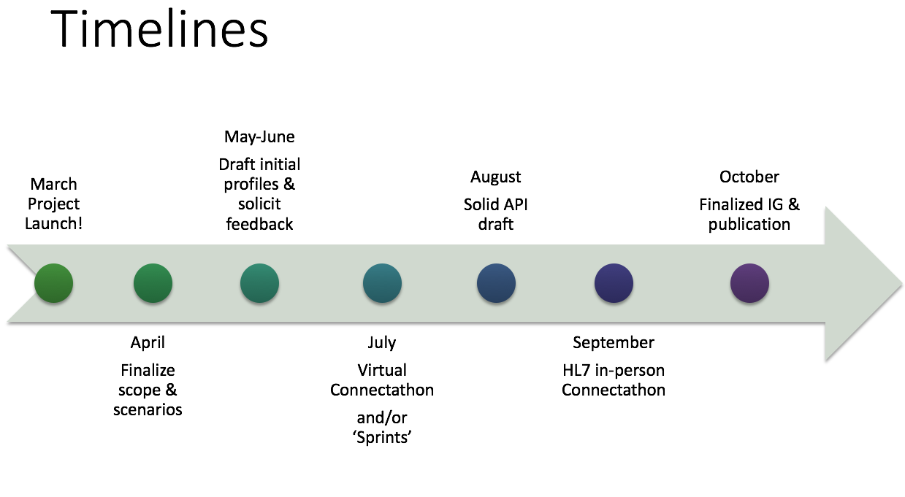
Overview
Welcome and Introductions
Review of last call
Walkthrough simple use case

Slide 3
Summary from last call
DECISION to Work in R3 and create an R2 version after publishing if demand and budget is there
Assumptions for sprints to be in R3
Cerner no R3 prod environment for sprints
Sprints are RD environment
Cons are partner will have backwards compatability issues from R&D to prod
Agreed to following Phases
Base patient access
Base provider access
Advanced provider/patient/both
Note - meeting agenda and notes are archived at: https://github.com/argonautproject/scheduling/tree/master/meeting-notes

Slide 4

Base patient access = Initial Use Cases
Support basic patient access to a provider's calendar and appointment requests. APIs and guidance:
Retrieve existing patient appointments
Search a provider's schedule for an open appointment*
Request an appointment
Amend an appointment
Cancel or reschedule an appointment
*provider = individual, organization, healthcare service

Slide 5
Base provider access
Support basic provider access to a provider's calendar and appointment requests. APIs and guidance for
Same functionality as patient appointments
Provider scheduling on behalf of patient
+ Retrieve their existing appointments for all patients

Slide 6
In Scope
Existing patient
New patients
Primary Care
Referral/Specialty
Diagnostics (lab/xrays)
Cardiology
Etc.
Notes:
Combine with old slide set

Slide 7
Advanced provider/patient/both
Prior approvals
Estimated out of pocket patient costs
Scheduling physical (rooms, modalities, etc.) resources
Initiating Transitions of Care
Language support
Scheduling surgery room in one organization with an external provider
Notes:
Combine with old slide set

Slide 8
Scheduling Walk-Through

Slide 9



Simple Scenario: Patient Scheduling for single provider
Prerequisites:
Single Provider (Single Specialty, Location, Service, Endpoint, etc )
Single System
Schedule
Assume system has available Schedule resource
Patient
New or Existing
Other scenarios: Update/Cancel/Change Appointments – out of scope for this scenario

Slide 10
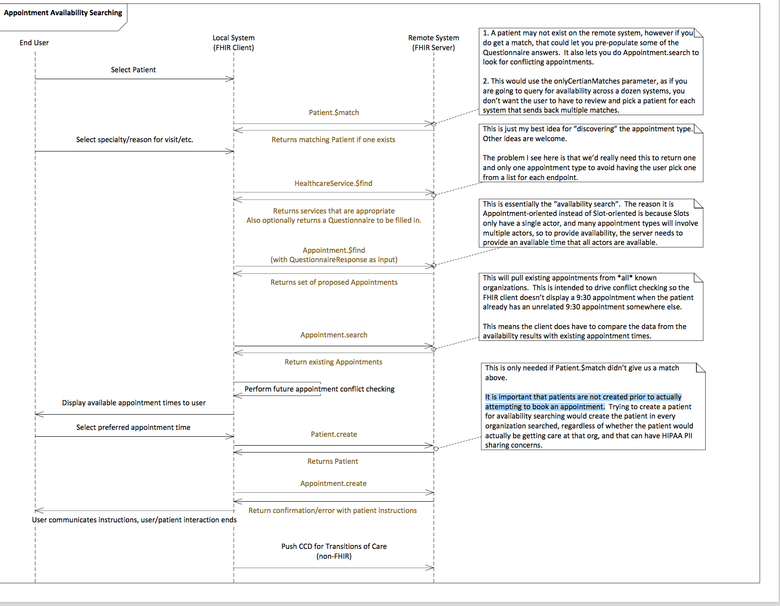
Interaction Diagram by Cooper

Slide 11

Use Case: Overview of Steps
1. Login and Patient Lookup
3. Lookup appointments by date range.
5. Choose an Appointment.
7. Other steps?
2.Search for or create* a Patient resource
4. Provide list of available appointments
6. Accept Appointment for the chosen Slot and Patient

Slide 12
Use Case: Overview of Steps
?. Login and Patient Lookup
3. Lookup appointments by date range.
5. Choose an Appointment.
7. Other steps?
?.Search for or create* a Patient resource
4. Provide list of available appointments
6. Accept Appointment for the chosen Slot and Patient

Slide 13
After discussing Step 1
jumped to 3

Slide 14
Use Case: Overview of Steps
1. Login and Patient Lookup
3. Lookup appointments by date range.
5. Choose an Appointment.
7. Other steps?
2.Search for or create* a Patient resource
4. Provide list of available appointments
6. Accept Appointment for the chosen Slot and Patient

Slide 15
Step 1: Login and Patient Authentication
Login: assume client has access and not going to discuss today
Is this safe to assume right now? ESSENTIALLY NO
Need to identify “access patterns”
New Patient
Existing Patient
Don’t Care ( e.g. ZocDoc)
If no credentials vs credential drive different use cases
If more than one system then changes significantly
and Login can happen at end.
Patient Authentication ( to get to next step )
Existing Patient
need to provide some identifying information
Name
Password
ID?
Other
New Patient
need to provide some identifying information
SKIP Steps 1 and 2 and jump to 3

Slide 16

Use Case: Overview of Steps
1. Login and Patient Lookup
3. Lookup appointments by date range.
5. Choose an Appointment.
7. Other steps?
2.Search for or create* a Patient resource
4. Provide list of available appointments
6. Accept Appointment for the chosen Slot and Patient

Slide 17

Step 2: (Server) Patient Matching or create new Patient
Patient is logged in – now what?
Does server identify patient based on user login
(Patient.$match?)
If Not how is the patient identified
New Patient: how do to deal with this?
‘It is important that new patients are not created prior to actually attempting to book an appointment.’ (Cooper)
What, if anything, needs to be returned back to client in step 2:
Patient?

Slide 18
Use Case: Overview of Steps
1. Login and Patient Lookup
3. Lookup appointments by date range.
5. Choose an Appointment.
7. Other steps?
2.Search for or create* a Patient resource
4. Provide list of available appointments
6. Accept Appointment for the chosen Slot and Patient

Slide 19
Step 3: (Client) Patient Searches for Availability (Availability Discovery)
What are the operations or queries we need? Need to continue off-line of pros vs cons
See Cooper’s OperationDefinition Appointment $find https://simplifier.net/Scheduling/Appointment-find/rendered
List of input parameters needed
Returns proposed ‘prefilled’ Appointments (this is a request). Vs returning a bundle of slots (see below)
Using Appts can bundle things together and allow the Server to figure this out.
see NHS $gpc.getschedule https://nhsconnect.github.io/gpconnect/appointments_use_case_search_for_free_slots.html#request-headers
Returns a bundle of slots and other information
What are basic search requirements for client
Available slots for the Provider Schedule
Any?
Within time range
Maximum? e.g NHS limited to 2 week period
Other search parameters see NHS design decision: https://nhsconnect.github.io/gpconnect/appointments_design.html#search-parameters
Chief Complaint here or in Step 5?

Slide 20
Stopped Here
Next Time :
Will focus on Presenting Our list of Use Cases
Continue Discussion on Appointments v Slots and other Details Offline

Slide 21
Step 3: (Client) Patient Searches for Availability
What are basic search requirements for client if more than one Provider to choose from
Specialty
Location
Provider
(ID id want to rebook)

Slide 22
Use Case: Overview of Steps
1. Login and Patient Lookup
3. Lookup appointments by date range.
5. Choose an Appointment.
7. Other steps?
2.Search for or create* a Patient resource
4. Provide list of available appointments
6. Accept Appointment for the chosen Slot and Patient

Slide 23
Step 4: (Server) Fetches and Returns Available Appointments Based on Client Supplied Parameters
Based the operations or queries from step 3
Return a Searchset Bundle
Errors
e.g. No slots available
Appointment
Status = ‘proposed’

Slide 24
Assume the system has Schedule and Slots resources for Dr. X:
Dr Haas Appointment Calendar |  | Date: | 9/11/17
Time | Appointment | Patient | Client | Comment | Type
8:30am |  |  |  |  | SX
9:00am |  |  |  |  | SX
9:30am |  |  |  |  | SX
10:00am |  |  |  |  | SX
10:30am |  |  |  |  | SX
11:00am |  |  |  |  | SX
11:30am
12:00pm
12:30pm
1:00pm |  |  |  |  | LU
1:30pm |  |  |  |  | LU
2:00pm |  |  |  |  | DC
2:30pm |  |  |  |  | DC
3:00pm
3:30pm
4:00pm |  |  |  |  | RC
4:30pm |  |  |  |  | RC
5:00pm
5:30pm
6:00pm
6:30pm
ClosedSlots
Open Slots
ClosedSlots
Open Slots

Slide 25
Server selects some and returns as proposed Appointment resources
Does the Appointment resource need an ‘intent’ extension? See: http://build.fhir.org/request-definitions.html#Request.intent
Appointment
Status = ‘proposed’

Slide 26
Use Case: Overview of Steps
1. Login and Patient Lookup
3. Lookup appointments by date range.
5. Choose an Appointment.
7. Other steps?
2.Search for or create* a Patient resource
4. Provide list of available appointments
6. Accept Appointment for the chosen Slot and Patient

Slide 27
Step 5: (Client) Choose an Appointment time
What are the operations/queries we need to request an appointment?
POST /Appointment with updated status for participants
See NHS example https://nhsconnect.github.io/gpconnect/appointments_use_case_book_an_appointment.html
What data is required to choose an appointment slot
Chief Complaint here or in Step 2 ?
Alternatively asks for more slots – back to step 3

Slide 28
Use Case: Overview of Steps
1. Login and Patient Lookup
3. Lookup appointments by date range.
5. Choose an Appointment.
7. Other steps?
2.Search for or create* a Patient resource
4. Provide list of available appointments
6.Accept Appointment for the chosen Slot and Patient

Slide 29
Step 6: (Server) Accepts Appointment request from Client
Verify and Accept Appointment Request
Stuff to return to Client
Appointment resource with updated status Appointment
See NHS example https://nhsconnect.github.io/gpconnect/appointments_use_case_book_an_appointment.html#request-operation
Do we use AppointmentResponse or some other workflow pattern (Tags?)
See NHS decision: https://nhsconnect.github.io/gpconnect/appointments_design.html#do-we-need-to-use-the-appointmentresponse-resource
Create Patient here?
‘It is important that new patients are not created prior to actually attempting to book an appointment.’ (Cooper)
Error Handling
Slots busy, bad info etc

Slide 30
Use Case: Overview of Steps
1. Login and Patient Lookup
3. Lookup appointments by date range.
5. Choose an Appointment.
7. Other steps?
2.Search for or create* a Patient resource
4. Provide list of available appointments
6.Confirm Appointment for the chosen Slot and Patient

Slide 31
Other Steps?

Slide 32
Key Points
Exchange of Appointment resource only
References to Schedule, Slots, Provider, Patient, etc
Creating a new Patient resource after Appointment made

Slide 33
Next Time: Other Use Cases
Get all appointments for a Patient
Patient View
Provider View
Cancelling and Rescheduling Appointments
Keep old cancelled and new booked Appointments

