Slide 1
Milestone planning
Team Argonauts - EnerNOC
Team: Matt, Dandan, Rui, Sid and Tharanga
Mentors: Bradley, Grace and Mel

Slide 2
Agenda
Project TimeLine
WBS
Milestones

Slide 3

Client Enoc
Energy
Suppliers
Demand Response Event
Peak energy usage
Emergency load reduction
Notifications
Demand Response
Network
Grocery Stores
Factories
Office buildings
Execute Energy Reduction Plans
Reduce energy use
Meet reduction goals

Slide 4
Project goals
  Architecture is central to the entire project
    Systemic properties
    Trade spaces
    Traceability to an existing standard
  Implementation provides credence to architecture
    Seeing is believing
    Designs will be copied or adopted in part

Slide 5
Project Timeline
SEP’11
OCT’11
NOV’11
DEC’11
JAN’12
FEB’12
MAR’12
SOW
SRS
Notional
Architecture
Architectural Spike on
Multiple Protocol
Kickoff
Business Goals
Identify Architectural Drivers
Architecture Refinement and Prototyping
Phase 1
Phase 2
EOSP
MOSP

Slide 6
Project Timeline
APR’12
MAY’12
JUN’12
JUL’12
AUG’12
…
DEC’12
Baseline
Architecture
Reference
Impl.
Final
Delivery
Architecture Refinement and Prototyping
Detailed Design, Construction, Integration, and Testing
Transition, Post-Mortem, White Paper
… Phase 2
Phase 3
Phase 4
EOSP
EOSP
EOSP

Slide 7
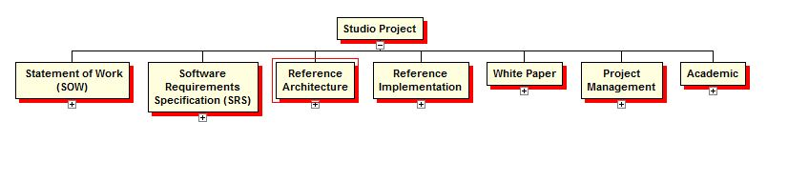
WBS Overview

Slide 8
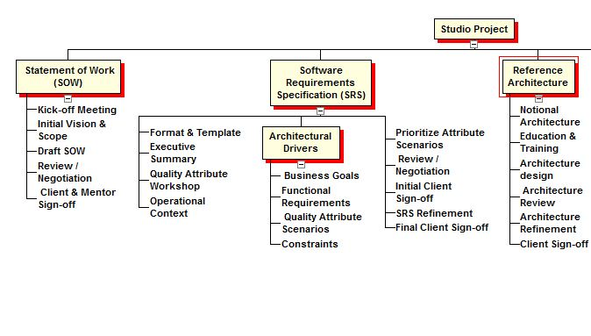
WBS: SOW SRS Architecture

Slide 9
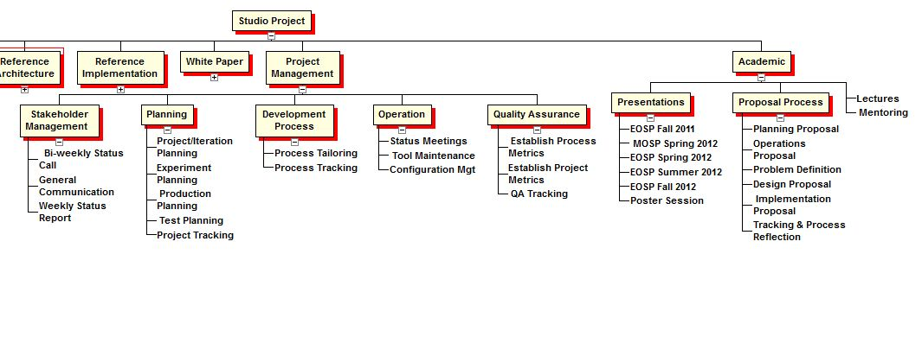
WBS: Project Management & Academic

Slide 10
Project Milestones – Phase 1
Milestones | Date | Description | Owner
 | Sep 23 | 1. Project Kick-off | Dev. Lead
 | Oct 28 | 2. Quality Attributes Identified | Dev. Lead
 | Nov 30 | 3. Functional Requirements Captured | Architect
 | Dec 09 | 4. SRS v1.0 Sign-off | Project Mgr.
 | Dec 09 | 5. SOW Sign-off | Team Lead
 | Dec 15 | 6. EOSP | Team Lead
1
2
3
5
4
6

Slide 11
Project Milestones – Phase 2
Milestones | Week | Description | Owner
 | 1 | 1. Kick-off, QAW | Dev. Lead
 | 3 | 2. Notional Architecture Review Architectural Drivers Captured | Architect
 | 7 | 3. Architectural Spike on Multiple Protocols | Architect
 | 8 | 4. MOSP | Team Lead
 | 13 | 5. Baseline Architecture | Architect
 | 14 | 6. Production Decision | Architect
 | 16 | 7. EOSP | Team Lead
1
2
4
3
5
6
7

Slide 12
Project Milestones – Phase 3
Milestones | Week | Description | Owner
 | 1 | 1. Kick-off | Dev. Lead
 |  | 2. Production Planning Complete | Project Mgr.
 |  | 3. Technology Selection Complete | Architect
 |  | 4. Critical Design Review | QA Lead
 |  | 5. Integration Complete | Dev. Lead
 |  | 6. Test Complete | QA Lead
 |  | 7. EOSP | Team Lead
1
2
3
4
5
7
6

Slide 13
Project Milestones – Phase 4
Milestones | Week | Description | Owner
 | 1 | 1. Kick-off | Dev. Lead
 |  | 2. Post-Mortem Complete | QA Lead
 |  | 3. Poster Session | Team Lead
 |  | 4. Whitepaper | Architect
 |  | 5. Final Delivery | Project Mgr.
 |  | 6. EOSP | Team Lead
1
2
3
4
5
6

