Slide 1


OpenADR 2.0 Multiple Transport
Reference Architecture
Spring 2012 EOSP Argonauts Team
Presented by
Dandan Zheng
Tharanga Gamaethige

Slide 2
Spring 2012 EOSP Agenda
Team
Project
Progress
Approach
Lessons
Roadmap

Slide 3





Argonauts Team
Siddharth Subramanian
Planning Manager
Matt Lenzo
Development Lead
Rui Li
Team Lead
Dandan Zheng
Chief Architect
Tharanga Gamaethige
Quality Assurance Lead

Slide 4



Studio Mentors
Grace
Lewis
Mel Rosso-
Llopart
Bradley
Schmerl

Slide 5

Client – EnerNOC, Inc.
A leading provider of energy management
applications for the smart grid
www.enernoc.com
Jake Thompson
Mgr. of Advanced Technology
EnerNOC, Inc.

Slide 6
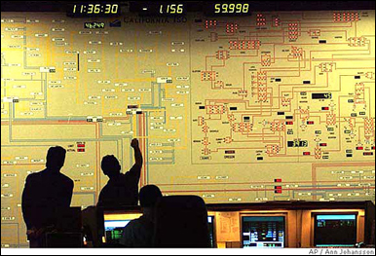





Project Context – Demand Response
1
Demand Response Event
Peak energy usage
Emergency curtailment
Utility/Grid Operator
2
Notification
Execute Energy Reduction Plans
3
Industrial
Institutional
Commercial
Feedback
4
Notes:
- Our system will reside with energy aggregators, such as EnerNOC to handle notification and feedback

Slide 7

Project Scope – Automated Demand Response
Feedback
Notification
VEN
Lighting
HVAC
<OpenADR 2.0 />
Machinery
Virtual Top Node
(EnerNOC)
Virtual End Node (Customer)
1,000 Nodes
Large Industrial
Business Goals
Untapped demand response markets
Lower implementation costs
Real-time monitoring and control
100,000 Nodes
Small Commercial
1,000,000 Nodes
Residential
Notes:
- Project scope is denoted by the grey dotted box

Slide 8
Project Objectives
Design an architecture for the VTN in accordance with the OpenADR 2.0 standard that supports multiple transport protocols
Evaluate this architecture in terms of its performance and scalability
Produce a reference implementation to demonstrate key design decisions and serve as a model for developers in the OpenADR community

Slide 9


Spring 2012 – Semester Goals
Stabilize requirements by mid-semester
Start architecture design by mid-semester
Reach “period of certainty” by end of semester

Slide 10
Project Milestones
1st Semester - 2011
2nd Semester - 2012
3rd Semester - 2012
4th Semester - 2012
Sep | Oct | Nov | Dec | Jan | Feb | Mar | Apr | May | Jun | Jul | Aug | Sep | Oct | Nov | Dec
Identify, define, and refine architectural drivers in iterative manner
Implement, integrate, and verify the architecture
Transition activities,
Postmortem
Create and refine architecture through evaluation and experimentation
“Go decision”
“Go decision”
Kickoff
Sep 23
Protocol Selection
ADD*
V1.0
Core Implementation
Reference Implementation
SOW
ADD*
White Paper
*Architecture Design Document
Notes:
System wide architecture design is in place, but we verified it through just informal reasoning. This project requires harder evidence. Therefore we need to get more confidence on the design through experimentation or formal modeling.
Our process is based on ACDM

Slide 11
Spring 2012 Milestones
January
February
March
April
May
1 | 2 | 3 | 4 | 5 | 6 | 7 | 8 | 9 | 10 | 11 | 12 | 13 | 14 | 15 | 16 | 17
ACDM Stages
Stage 1: Discovered architectural drivers
Stage 2: Confirmed project scope
ACDM Stages (Iteratively)
Stage 3: Created/Refined architecture
Stage 4: Evaluated the architecture design
Stage 5: Made production decisions
Stage 6: Conducted few experiments
Arch.
Evaluation
Arch.
Evaluation
“Go Decision”
Protocols Selected
QAW
MOSP
EOSP
ADD v1.0
5
6
7
10
8
9
Iterations

Slide 12
Approach
Requirements / Design / Management / Quality / Risk
Requirements Management
Architecture Design
Project Management
Quality Assurance
Risk Management

Slide 13
Requirements Strategy
Requirements / Design / Management / Quality / Risk
Elicit
Analyze
Document
Verify
Operational requirements
Business and technical constraints
Quality attribute requirements
Clarify
Prioritize
Model
Architecture Drivers
Specification
Architecture design
Experimentation
Usage scenarios

Slide 14
Summary of Architectural Drivers
Requirements / Design / Management / Quality / Risk
High Priority Quality Attributes
Scalability
Protocol Extensibility
Service Extensibility
Medium Priority Quality Attributes
Performance (latency, throughput)
Deployability
Reliability (fault detection)
Low Priority QAs
Security (confidentiality)
Availability (recovery)
Category | #
Quality Attribute Scenarios | 10
Functional Use Cases | 16
Technical Constraints | 11
Business Constraints | 9
Functional Requirements
Core message exchange patterns
OpenADR services
System configuration
Front-end command and control

Slide 15
Approach
Requirements / Design / Management / Quality / Risk
Requirements Management
Architecture Design
Project Management
Quality Assurance
Risk Management

Slide 16
Architecture Design Process
Requirements / Design / Management / Quality / Risk
Design
Peer Review
Client Feedback
Architecture Design Evaluation Workshop
Documentation and Issue Analysis
Short design iterations
Breadth first vs. depth first
Low-fidelity to higher fidelity
Notes:
Short design iterations: ensure convergence of designs and gather client feedback

Slide 17
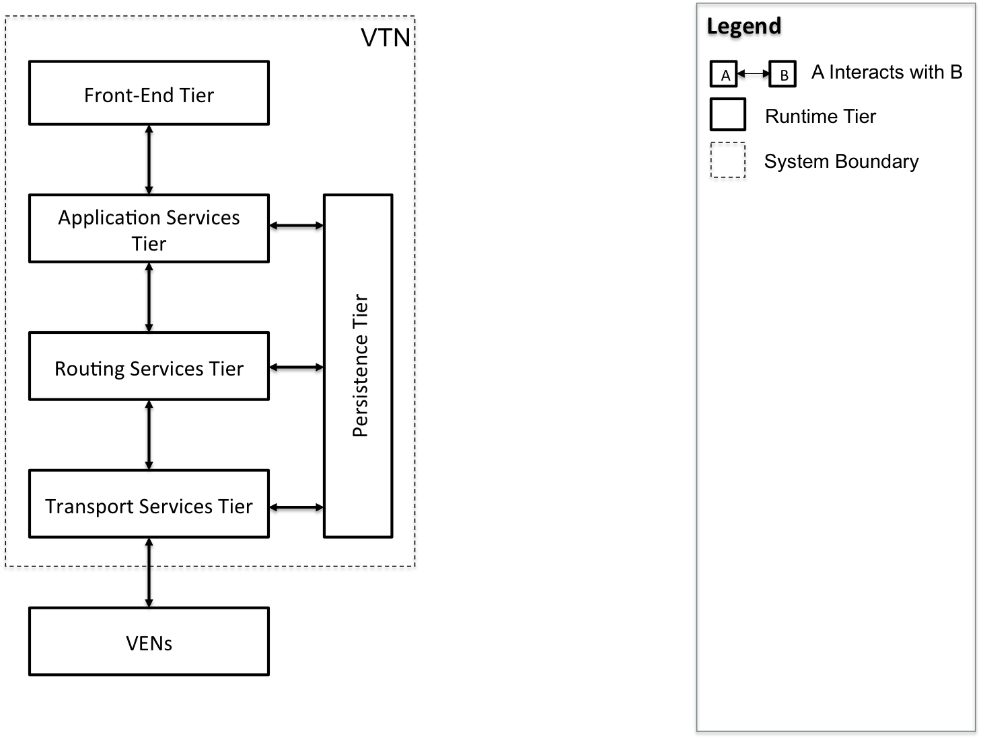
Dynamic Perspective, High-Level Context
Requirements / Design / Management / Quality / Risk

Slide 18
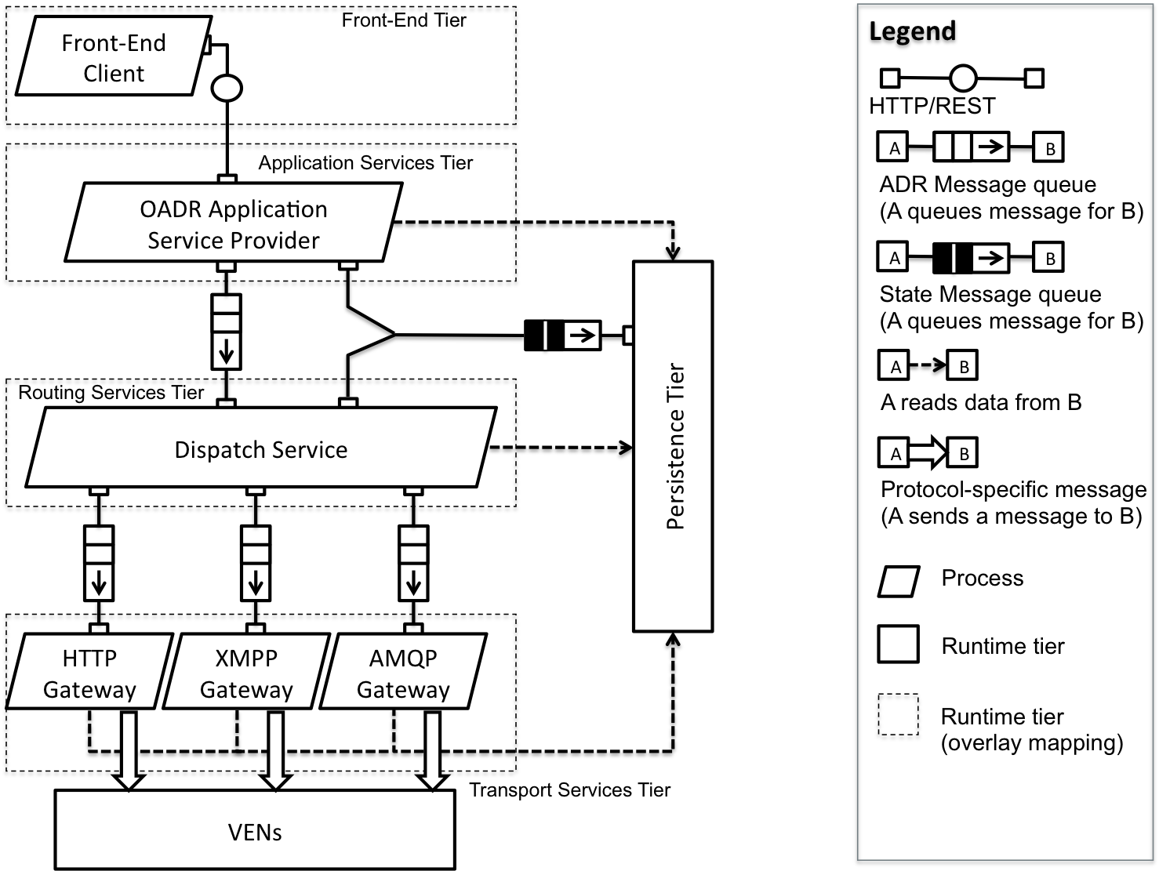
Dynamic Perspective, Outbound Message Flow
Requirements / Design / Management / Quality / Risk

Slide 19
Dynamic Perspective, Outbound Message Flow
Requirements / Design / Management / Quality / Risk

Slide 20
Dynamic Perspective, Outbound Message Flow
Requirements / Design / Management / Quality / Risk

Slide 21
Dynamic Perspective, Outbound Message Flow
Requirements / Design / Management / Quality / Risk

Slide 22
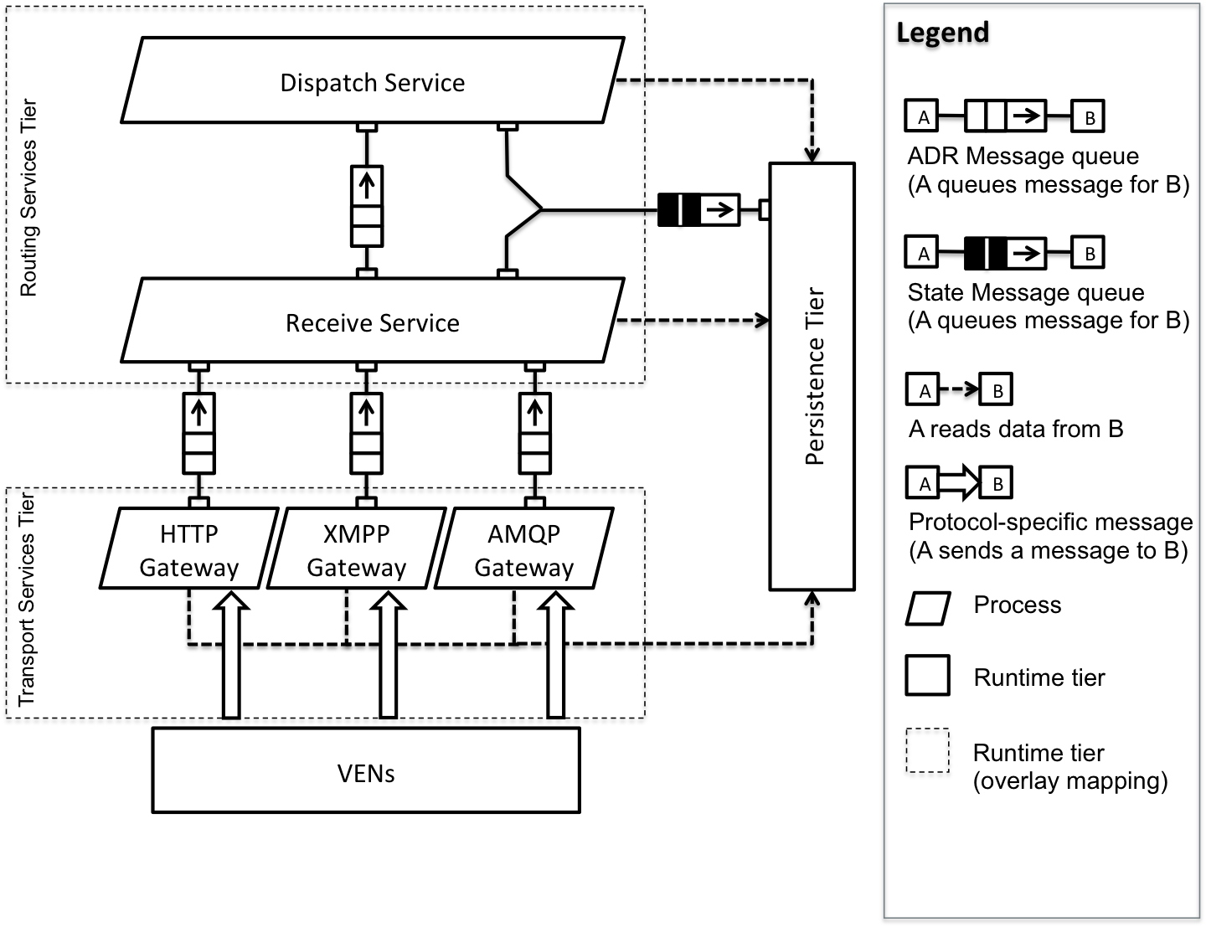
Dynamic Perspective, Inbound Message Flow
Requirements / Design / Management / Quality / Risk

Slide 23
Dynamic Perspective, Inbound Message Flow
Requirements / Design / Management / Quality / Risk

Slide 24
Dynamic Perspective, Inbound Message Flow
Requirements / Design / Management / Quality / Risk

Slide 25
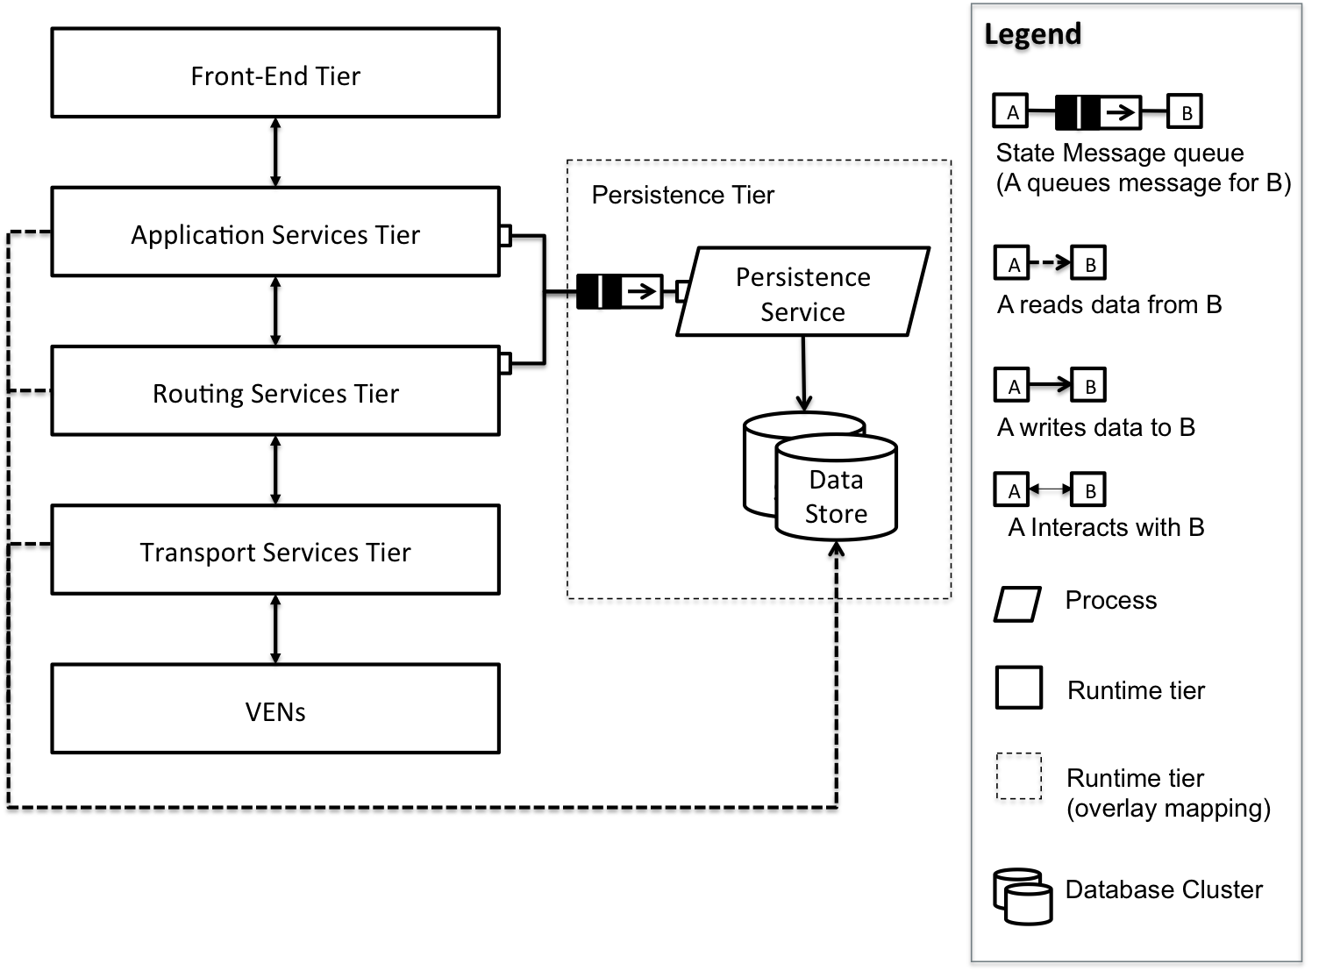
Dynamic Perspective, Persistence Tier
Requirements / Design / Management / Quality / Risk

Slide 26
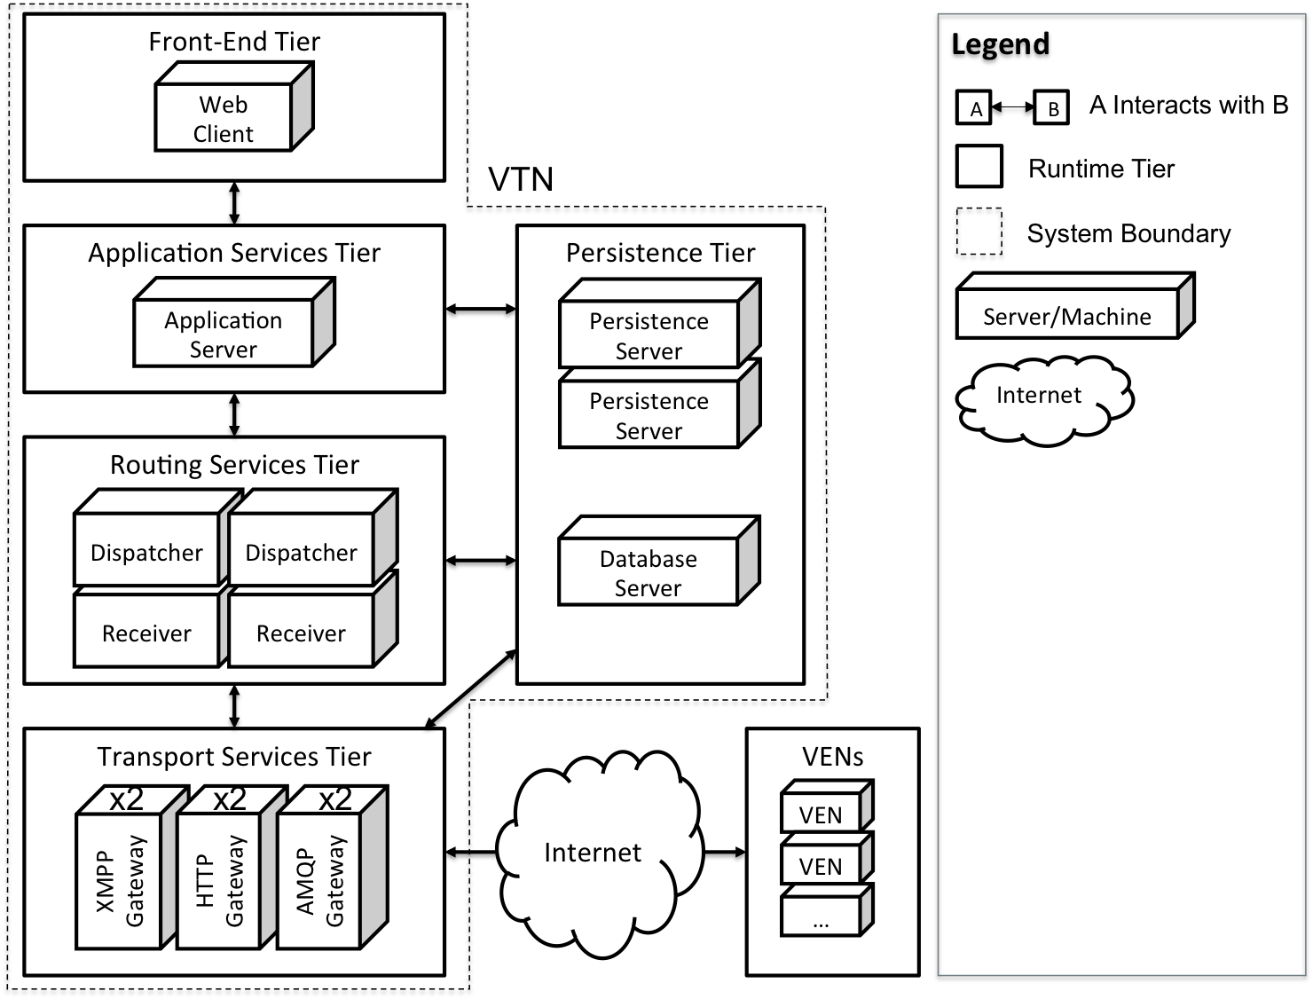
Physical Perspective, Allocation View
Requirements / Design / Management / Quality / Risk

Slide 27
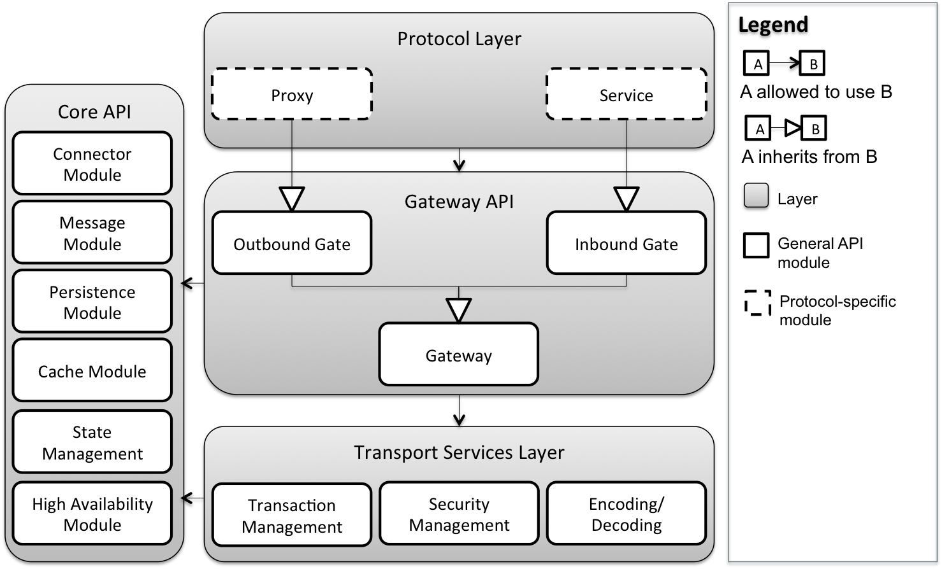
Static Perspective, Protocol Gateway API
Requirements / Design / Management / Quality / Risk

Slide 28
Static Perspective, Protocol Gateway API
Requirements / Design / Management / Quality / Risk

Slide 29
Static Perspective, Protocol Gateway API
Requirements / Design / Management / Quality / Risk

Slide 30
Approach
Requirements / Design / Management / Quality / Risk
Requirements Management
Architecture Design
Project Management
Quality Assurance
Risk Management

Slide 31
Change in Planning Process
Requirements / Design / Management / Quality / Risk
Old Planning Process
Planning, estimation, and tracking using Excel sheets
Estimation at the task-level in person-hours
Lengthy planning meetings and overhead activities
Goals
Maximize effort spent on design activities
Minimize the effort spent on overhead and unplanned activities
Accommodate creative design process and technical uncertainties
Provide more visibility into the plan and the planning process

Slide 32

Change in Planning Process
Requirements / Design / Management / Quality / Risk
Solutions:
Time-boxed planning and reflection meetings
Shorter iterations: Plan more, plan often
Work package estimation through planning poker
Tracking through velocity points
Accountability through standup meetings and constant communication
Online planning and tracking tool –

Slide 33
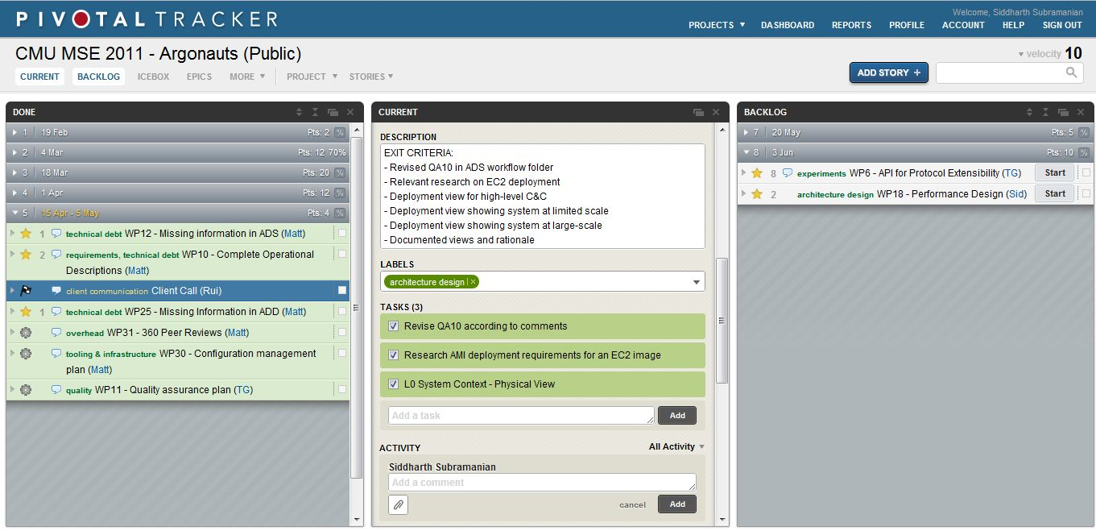
Pivotal Tracker Features
Requirements / Design / Management / Quality / Risk
Notes:
Estimated velocity for an iteration, which stabilizes after 3-4 iteration.
Estimation at the work-package level, as compared to task level using planning poker
Tasks enumerated under every work package
Clear entry and exit criteria for every work package

Slide 34
Planning Reflections
Requirements / Design / Management / Quality / Risk
Measuring overhead and unplanned activities gave an indication to change the process.
Planning more, planning often is very useful when there are technical uncertainties.
Pivotal Tracker increases the visibility of project management.
Pivotal Tracker works well for tracking small work packages consisting of few tasks.
Pivotal Tracker will not work in summer due to the expected increase in the number of work packages and tasks. More granularity is needed in summer.

Slide 35
Approach
Requirements / Design / Management / Quality / Risk
Requirements Management
Architecture Design
Project Management
Quality Assurance
Risk Management

Slide 36
Quality Assurance
Requirements / Design / Management / Quality / Risk
“Quality is free” – Philip Crosby
“When there is no notion of quality, productivity is infinite” - Argonauts
Notes:
- Phil Crosby used the quote “Quality is free” to explain the definition of quality to executives in terms they can understand. We are using how productivity and quality are related to explain why we didn’t get the initial productivity we planned as we figure out the importance of quality.

Slide 37
Goals
Requirements / Design / Management / Quality / Risk
To ensure quality of the reference architecture and related deliverables – All attributes of the architecture are verified before the final delivery
To ensure the quality of internal processes which are used to produce key deliverables – Continuously measuring and observing the health and status of internal processes
Notes:
- Phil Crosby used the quote “Quality is free” to explain the definition of quality to executives in terms they can understand. We are using how productivity and quality are related to explain why we didn’t get the initial productivity we planned as we figure out the importance of quality.

Slide 38
Activities in Spring 2012
Requirements / Design / Management / Quality / Risk
Product Quality
Requirement reviews
Peer reviews
Architecture Design Evaluation Workshop (ADEW)
Process Quality
Process quality metrics
ETVX* for planned tasks
Managing technical debt
*Entry-Task-Validation-Exit

Slide 39
Architecture Design Evaluation Workshop (ADEW)
Requirements / Design / Management / Quality / Risk
Conducted at the end of every iteration to review the architecture design, identify issues, and make the production go/no-go decision
# of Issues
ADEW*
ADEW*
ADEW*
*Architecture Design Evaluation Workshop

Slide 40
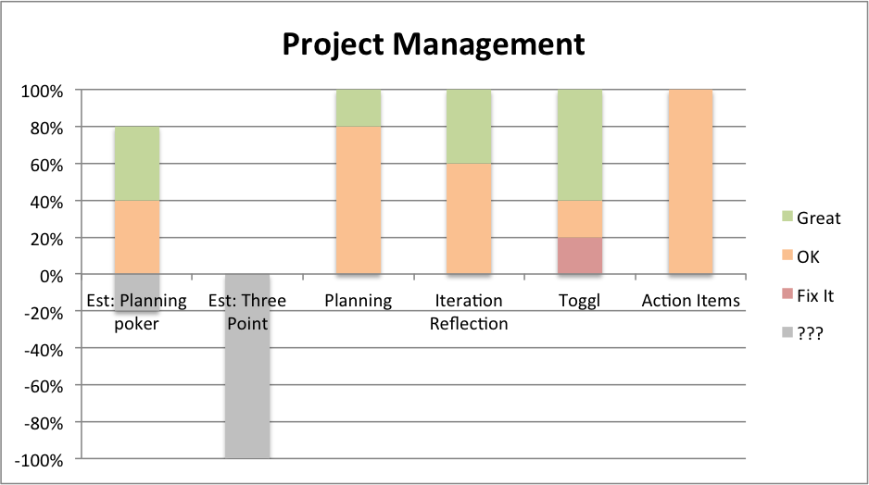
Process Quality Metric
Requirements / Design / Management / Quality / Risk
Bi-weekly process evaluation provided visibility into the health and status of internal processes
Made corrective actions based on team feedback
Project mgt.
Configuration mgt.
Requirements mgt.
Risk mgt.
Quality assurance
Design

Slide 41
Managing Technical Debt
Requirements / Design / Management / Quality / Risk
Managed two week iterations without losing the sight of quality of deliverables through technical debt
Provided insights into quality related issues of tasks, individuals and processes
Notes:
- Identifying types of technical debts
- Providing visibility into technical debt by putting them into the product backlog

Slide 42
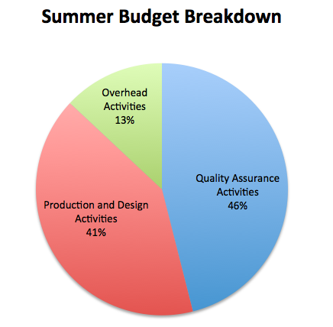
Eye to the future
Requirements / Design / Management / Quality / Risk
A detailed quality plan
created with activities
and estimates for summer
2012
Identified key quality
activities that would
improve the quality of
both the product and internal
processes

Slide 43
Reflections on Quality Assurance
Requirements / Design / Management / Quality / Risk
Having experienced engineers at the workshop is crucial to maximizing the value of the review
Correct lightweight methods can add more or equal value to the project as heavyweight methods
Managing time-boxed iteration with quality is a challenge as well as an opportunity
Notes:
- Qualitative methods works as long as individuals are committed and honest

Slide 44
Approach
Requirements / Design / Management / Quality / Risk
Requirements Management
Architecture Design
Project Management
Quality Assurance
Risk Management

Slide 45
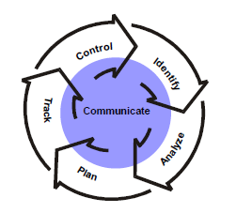
Risk Management Process
Requirements / Design / Management / Quality / Risk
Identification
Format: Condition + Consequence
Mini Team SRE (Software Risk Evaluation)
Analyze
Matrix of impact and probability
Prioritized through multi-voting
Plan
Mitigation strategy for top 3 risks
Track
Risk Manager reports risks bi-weekly
Risk repository
Control
Before iteration planning, reevaluate risks
Create mitigation tasks in backlog
SEI Continuous Risk Management

Slide 46
Top 3 Risks
Requirements / Design / Management / Quality / Risk
Condition | Consequence | Mitigation Strategy
Transport-level security decisions not yet finalized in the OpenADR specification | May not finalize architecture design without addressing security | Continuous communication with customer on specification Isolate transport security components to enable future modifiability
Team will use Amazon Web Services for architecture verification; design mistakes can cost money | Team may deplete test budget | Define the budget before doing verification on AWS and continuously monitor actual cost against budget Test approval process
No hands-on experience with large-scale systems and detailed knowledge of transport protocols | May not deliver multi-transport architecture | Protocol extensibility experiments (half done) Short and iterative design

Slide 47
Lessons Learned
Project strategy is not “one size fits all.” Our design requires a higher degree of confidence because it is the primary deliverable.
Risk-driven project architecture approach will work better for our project.
Notes:
Generic project strategy does not work for every project, need to define strategy based on project nature. Architecture heavy. Deliverable was evaluated architecture. We could have planned more time for verifying the architecture up front instead of kicking the period of uncertainty right before summer.
Underestimated complexity of architecture design. Why? We set a milestone which we can’t achieve. Based on what everyone else does.
Underestimated complexity of architecture design.
Risk driven project management should have been better.
Underestimated the design activities and thought we could reach go decision by end of spring, but we could not. Harder than expected.

Slide 48
Summer 2012 Roadmap
Week 1
Week 2
Week 3
Week 4
Week 5
Week 6
Iteration 12
Iteration 13
Iteration 14
Tools and Infrastructure
AWS Training
Security Design and Exp.
Protocol Gateway API
Protocol Gateways
(XMPP/HTTP/AMQP)
Protocol Extensibility Exp.
Design Refinement
Performance Exp.
Service API Stub
Core API Stub
Scalability Exp.
Availability Exp.
Database Design & Impl.
Test Infrastructure
Verification Plan
Verification Plan
Legend:
Overhead
High-Level Design
Design, Impl., and Test
Verification

Slide 49
Summer 2012 Roadmap
Week 7
Week 8
Week 9
Week 10
Week 11
Week 12
Iteration 15
Iteration 16
Iteration 17
Verification of
scalability, performance, and availability
Dispatch Service
OpenADR Services
Receive Service
Design Revision
OADR Application Services
Legend:
Overhead
High-Level Design
Design, Impl., and Test
Verification

Slide 50
Argonauts Team In Summer
Siddharth Subramanian
Team Lead
Matt Lenzo
Quality Assurance Lead
Rui Li
Chief Architect
Dandan Zheng
Development Lead
Tharanga Gamaethige
Planning Manger
Thank you!

Slide 51
Backup

Slide 52
Acceptance Criteria
An architecture that supports XMPP, HTTP, and AMQP transports
An analysis of scalability and performance thresholds
A reference implementation appropriate for demonstrating and verifying key architectural qualities
Well-documented design rationale

Slide 53
QA01 – Scalability Scenario
QA01 | Scalability
Source of Stimulus | An aggregator increases the size of its DR network
Stimulus | VTN utilization increases; the number of messages exchanged with VENs increases
Environmental Conditions | The VTN is at its peak capacity and serving 50,000 VENs Additional VENs will cause a degradation in response time
Architectural Elements | Routing Services Tier, Persistence Tier, Transport Services Tier
System Response | Additional VENs are added to the network New Dispatcher, Receiver, or Gateway instances are launched
Response Measures | No degradation in performance VTN should maintain 200 message per sec throughput Inbound and outbound messages processed in 500 ms

Slide 54
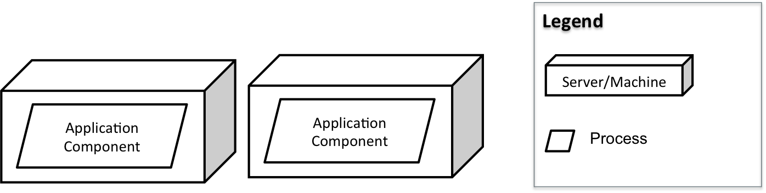
QA01 – Scalability Design Decisions
Redundant hosting of application components with medium size servers

Slide 55
QA01 – Scalability Design Decisions
Redundant hosting of application components with medium size servers

Slide 56
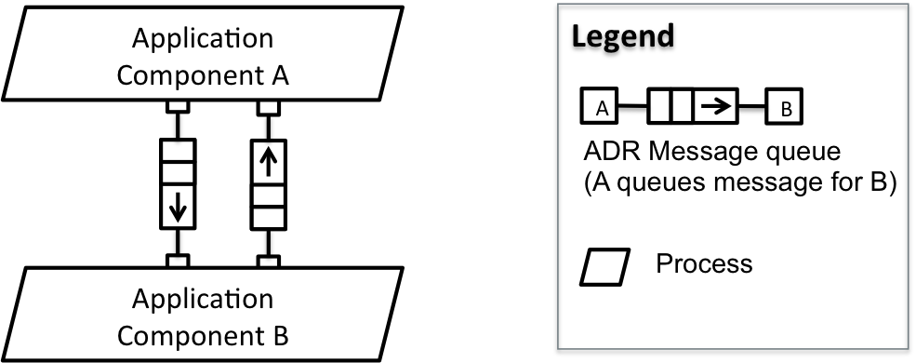
QA01 – Scalability Design Decisions
Event-driven asynchronous communication

Slide 57
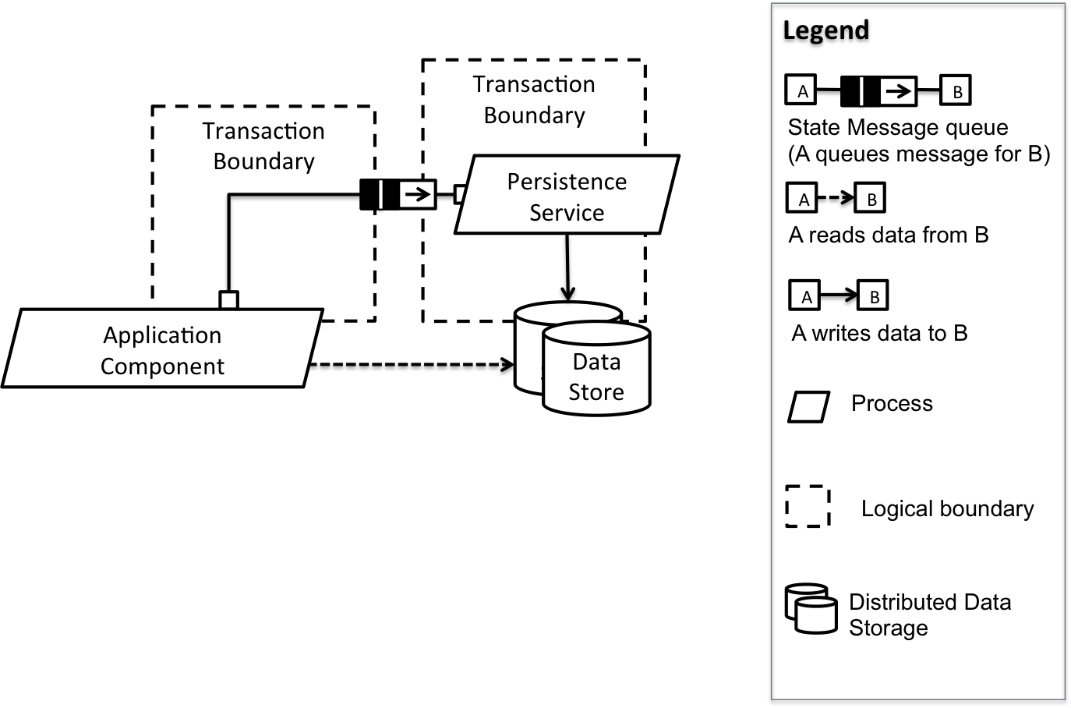
QA01 – Scalability Design Decisions
Command Query Responsibility Segregation (CQRS)
Avoid distributed transactions

Slide 58
Extensibility Scenarios
QA06 Protocol Extensibility: An application vendor wants to support an additional transport protocol. The development effort for complying with the provided interfaces and adding support for a new protocol should not exceed one person-day.
QA07 Service Extensibility: Services defined in the OpenADR 2.0 profile have changed (added, modified, or removed). The development effort for complying with the provided interfaces and adding support for a new service should not exceed one person-day.

Slide 59
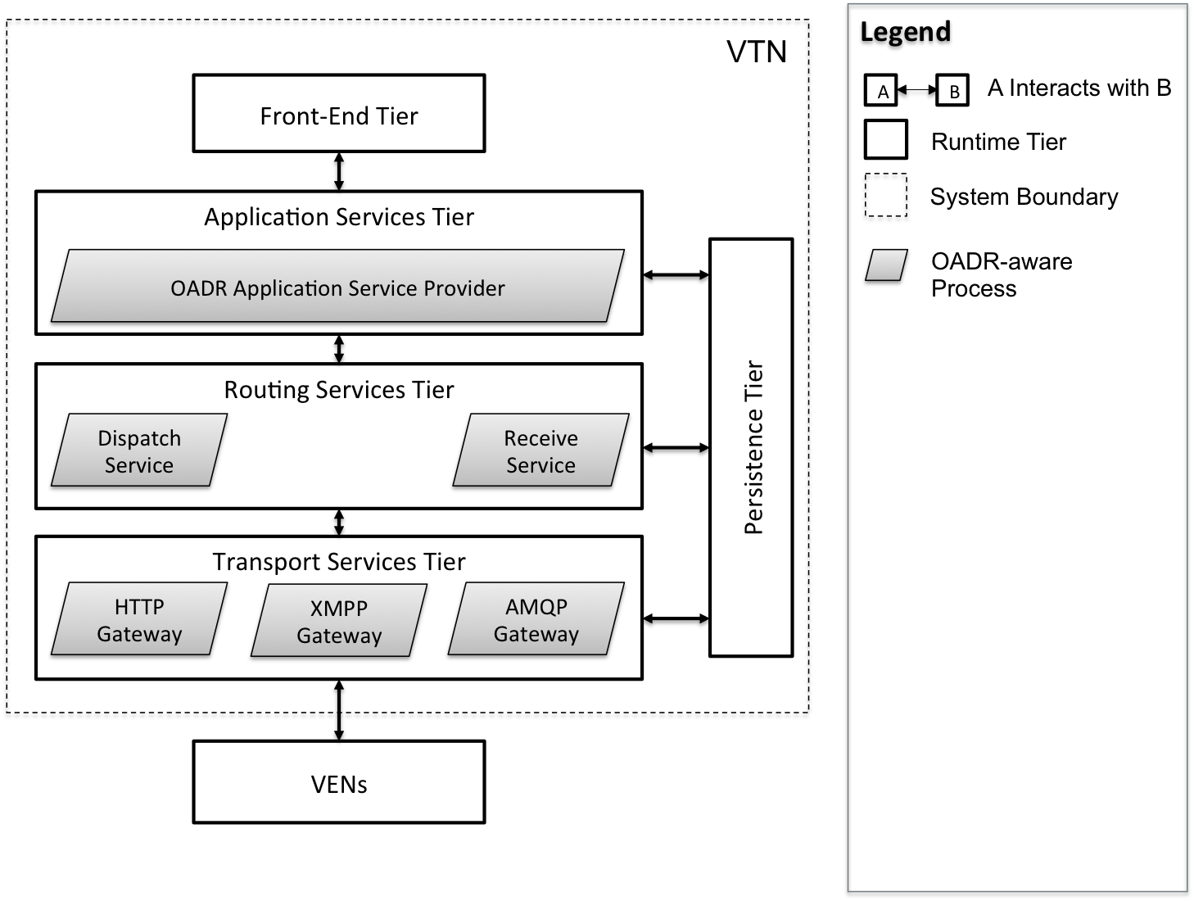
Dynamic Perspective, Process Allocation View

Slide 60
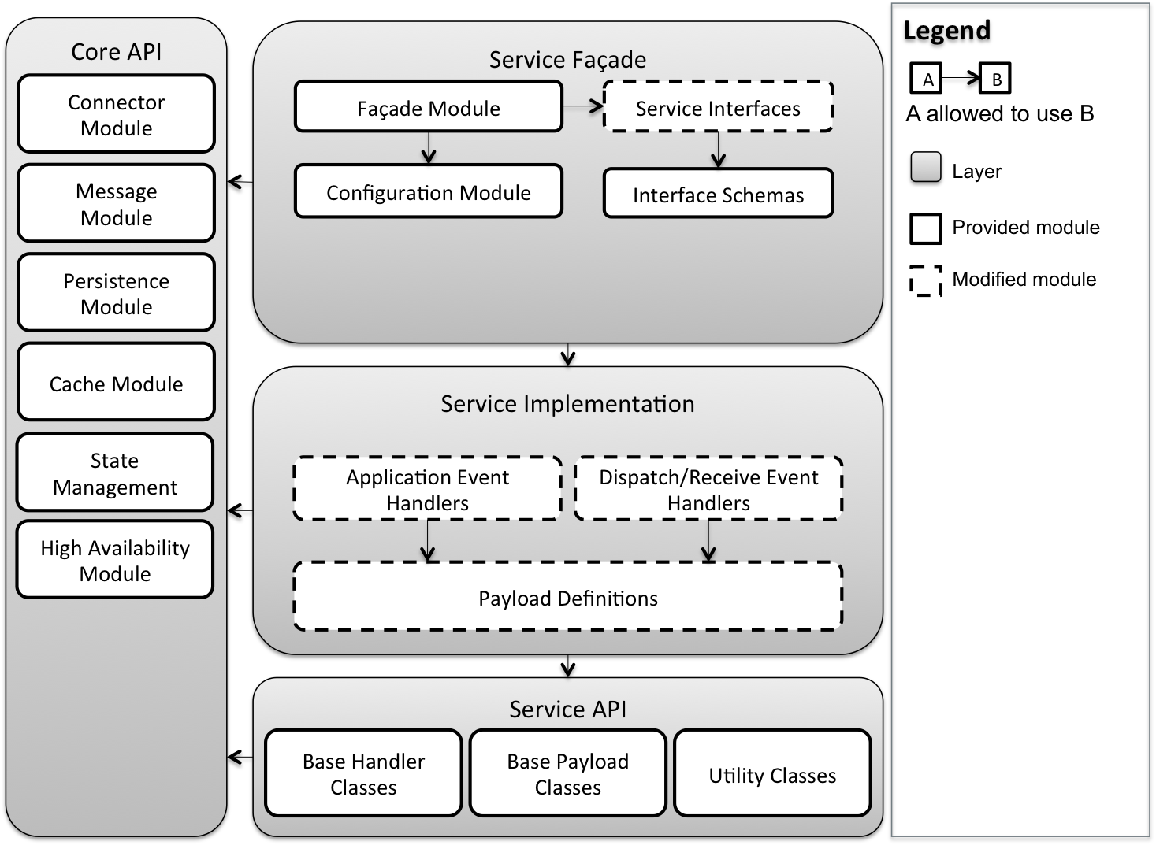
Static Perspective, OpenADR Service API

Slide 61
Performance Quality Attribute Scenarios
QA03 Outbound Latency: Outbound message latency is measured from the time an event is initiated from the Application Services tier to the time it exits the Transport Services tier. For any one message, the total outbound latency should not exceed 500ms.
QA04 Inbound Latency: Inbound message latency is measured from the time a message or request is received by the Transport Services tier to the time it is processed by the Persistence Tier. For any one message, the total inbound latency should not exceed 500ms.
QA05 Throughput: For both inbound and outbound communication paths, the VTN should be able to process 200 messages per second. That is, when distributing events to VENs, the VTN should be able to sustain a burst throughput of 200 messages per second. When receiving asynchronous requests or responses from VENs, the VTN should be able to sustain 200 transactions per second.

Slide 62
Deployability Quality Attribute Scenarios
QA10 Deployability: An administrator, familiar with a public or private cloud infrastructure, should be able to launch a VTN reference implementation and initiate a DR event in less than 20 minutes.

Slide 63
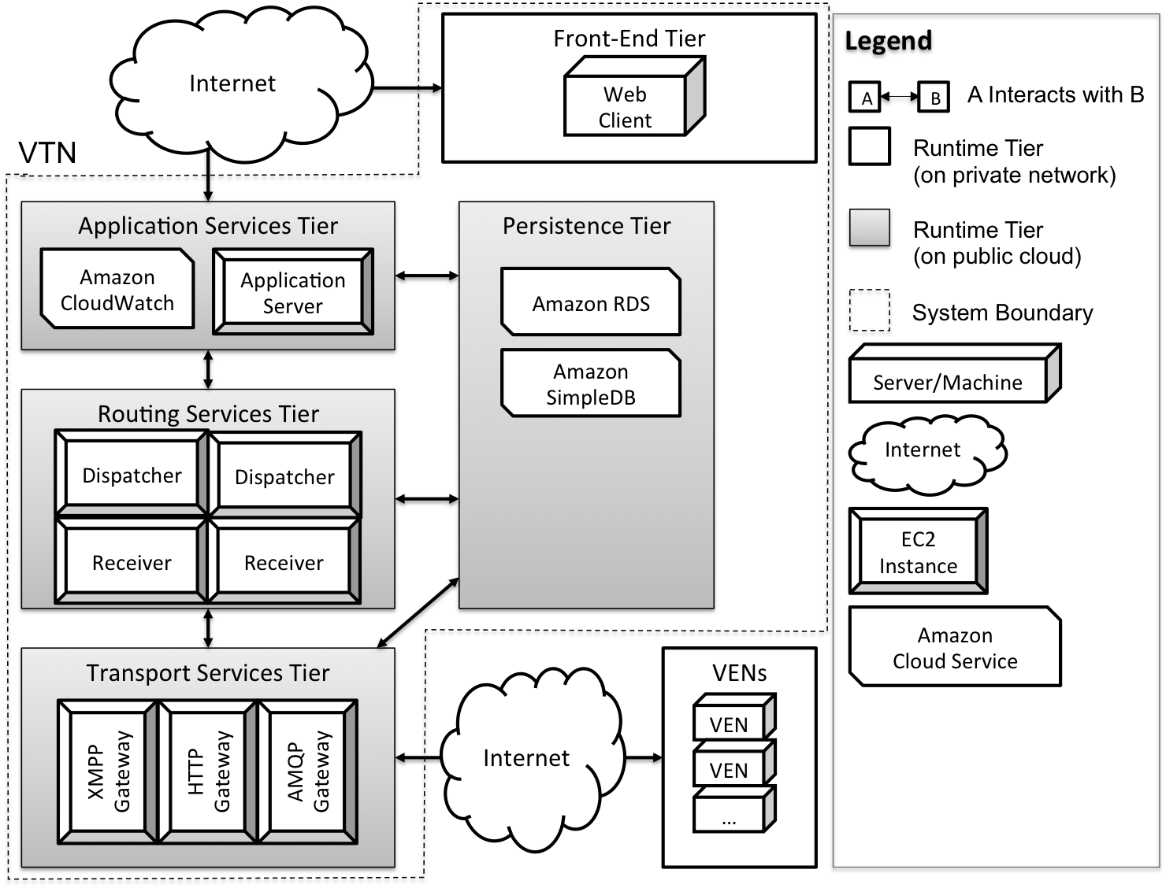
Physical Perspective, Allocation View

Slide 64
Availability Quality Attribute Scenarios
QA14 Fault Detection: A fault occurs; faults have been defined using an appropriate fault model. The VTN detects the fault and notifies systems administrators within one minute using either Email or SMS. Fault information contains sufficient detail such that system administrators can take corrective action.
QA13 Failure Recovery: A failure occurs; failures are traceable to a specific system fault. Manual recovery of any one module can be completed in less than 5 minutes. In the event of failure, no messages are lost in either the outbound or inbound message paths.

Slide 65
Security Quality Attribute Scenarios
QA12 Security: An attacker wishes to disrupt or manipulate a DR network in order to interrupt commercial or industrial operations or potentially damage equipment. The VTN does not respond to any illegitimate requests from unrecognized VENs or rogue applications.

Slide 66
Key Business Constraints
Constraint | Description
Cost Limitation | Fixed budget and schedule for studio project
Schedule Limitation | Incremental delivery
Legal Restriction | No third-party libraries or components Nondisclosure and waiver of intellectual rights
Market Restriction | Simple, understandable design and implementation Supports the OpenADR 2.0 specification Uses industry standard protocols
Logistical Demands | Public cloud testing infrastructure may be necessary for demonstrating the required scale and performance

Slide 67
Key Technical Constraints
Constraint | Description
Operating System | Target platform should be a Linux flavored operating system Amazon Machine Images (AMI) should support the selected OS
Computing Platform | The system should be verified on Amazon EC2 AMIs
Computer Languages | No usage of proprietary languages resulting in vendor lock-in Preferred computer languages are Java, Ruby or Python
Peripherals/Network Hardware | The system should be able to run behind firewalls, utilize load balancers, and communicate over the internet
Commercial Hardware/Software Products | No proprietary hardware or software components shall be used without justification.
Protocols/Standards | At a minimum, the system should support HTTP (SOAP/REST), XMPP, and an appropriate queuing protocol (e.g., AMQP or STOMP)
Tools/Methods | No proprietary software tools for developing, testing, and deploying the system
Computing Capacity | ADR system should support scaling out (scaling horizontally) by adding redundant computing and data storage nodes (servers).

Slide 68
Top 3 Risks
Risk | Mitigation | Trigger
Transport-level security decision not yet finalized in the OpenADR specification; Cannot finalize the architecture design | Continuous communication with customer Isolate transport security components to enable modifiability | No formal discussion about security in the first week in summer There is no stable requirement on system security before the second week in summer Design doesn’t meet security requirements by the second week of summer

Slide 69
Top 3 Risks
Risk | Mitigation | Trigger
Team will use Amazon Web Services for architecture verification; design mistakes can cost money | Define the budget before doing verification on AWS and continuously monitor actual cost against budget Test approval process | The team is still not familiar with AWS at the end of the second week in summer Test plans have no defined budget before execution

Slide 70
Top 3 Risks
Risk | Mitigation | Trigger
No hands-on experience with large-scale systems and detailed knowledge of transport protocols | Protocol extensibility experiments (half done) Short and iterative design | No team members experienced with protocols by end of spring semester No experiments designed by first week of summer to facilitate design

Slide 71
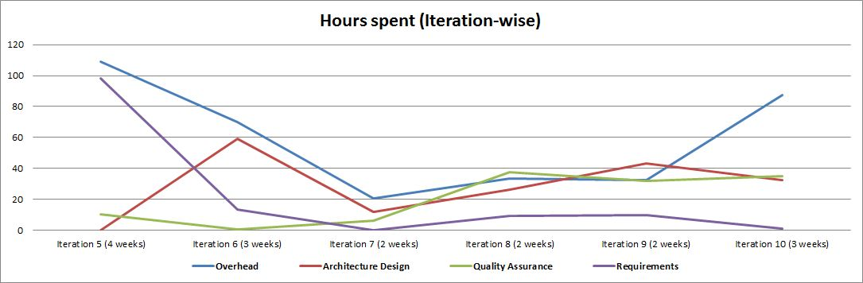
Time spent in activities

Slide 72
Achieving “Predictive” Design
Formal Verification | Experimentation and Architectural Spikes
Predictability without getting hands dirty and expending test resources | Closer to the real implementation
High upfront cost in learning tools or notation | High experimentation cost
Results are based on abstractions, but immediate | Results are concrete, but require time to produce
High risk, safety critical systems | Low risk commodity systems
Does not necessarily help establish proficiency with unfamiliar technologies | Establishes proficiency with unfamiliar technologies through hands-on development

Slide 73
Experimentation Work Packages in Backlog
Security Design and Experiments
SASL authentication mechanisms
Gateway transport performance concerns
Protocol Extensibility Experiments
Develop API stub with core transport service interfaces
Attempt to use API stub to create HTTP, XMPP, and AMQP gateways
Identify missing modules in Transport Services Layer
Identify other commonality/variability between protocols
Performance Experiments
Use queuing theory to develop budgets for complete inbound/outbound path
Investigate identified bottlenecks

Slide 74
Experimentation Work Packages in Backlog (Cont.)
Scalability Experiments
Distributed caching
State management
System-wide monitoring
Queuing mechanism
Availability and Deployability Experiments
Critically-loaded components
Time to launch multiple EC2 instances

Slide 75
Quality Assurance Plan - Requirements
Activities | Total Budget | Priority
Review | 35 hrs | HIGH

Slide 76
Quality Assurance Plan – Architecture Design
Activities | Total Budget | Priority
Peer Review | 18 hrs | HIGH
ADEW | 60 hrs | HIGH
Modeling | 72 hrs | MED
Experiment Design and Approval | 23 hrs | MED

Slide 77
Quality Assurance Plan – Detailed Design
Activities | Total Budget | Priority
Design Review | 80 hrs | HIGH

Slide 78
Quality Assurance Plan – Production Code
Activities | Total Budget | Priority
Smoke Test | 18 hrs | HIGH
Static Analysis | 58 hrs | MED
Dynamic Analysis | 32 hrs | MED
Peer Review | 102 hrs | HIGH
Fagan Inspection | 124 hrs | MED
Unit Testing | 380 hrs | HIGH
Integration Testing | 20 hrs | HIGH
System Testing | 50 hrs | HIGH
Design Structure Matrix | 12 hrs | HIGH

Slide 79
Quality Assurance Plan – Deployment Guide
Activities | Total Budget | Priority
Deployment Demonstration | 14 hrs | HIGH

Slide 80
Quality Assurance Plan – Test Cases and Test Plans
Activities | Total Budget | Priority
Test Coverage and Mutation Analysis | 18 hrs | HIGH
Activities | Total Budget | Priority
Test Approval (AWS Deployment) | 18 hrs | HIGH

Slide 81
Quality Assurance Plan – Processes
Activities | Total Budget | Priority
Scorecard Health Assessment | 12 hrs | HIGH
Meeting Review | 7 hrs | HIGH
Entry/Exit WP Review | 124 hrs | HIGH
Data and Metrics Analysis | 28 hrs | HIGH
SCM Audit | 8 hrs | MED
SCMP Review and Approval | 5 hrs | HIGH
SQA Audit | 8 hrs | MED
SQAP Review | 5 hrs | HIGH

