Slide 1
Spring 2012 MOSP Agenda
Team
Project
Progress
Approach
Lessons
Roadmap

Slide 2





Argonauts Team
PLANNING MANAGER
(Managing Engineer)
CHIEF ARCHITECT
(Requirements Engineer)
TEAM LEAD
(Risk Manager)
DEVELOPMENT LEAD
(Support Engineer & Chief Scientist)
QA LEAD
(Quality Process Engineer)

Slide 3
Studio Mentors

Slide 4

Client – EnerNOC, Inc.
A leading provider of energy management
applications for the smart grid
www.enernoc.com
Jake Thompson
Mgr. of Advanced Technology
EnerNOC, Inc.

Slide 5
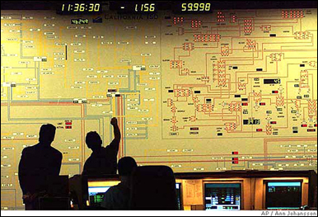





Project Context – Demand Response
Demand Response Event
Peak energy usage
Emergency curtailment
Utility/Grid Operator
Notification
Execute Energy Reduction Plans
Industrial
Institutional
Commercial
Feedback

Slide 6

Project Scope – Automated Demand Response
Feedback
Notification
Gateway
Lighting
HVAC
<OpenADR 2.0 />
Machinery
End Node (Customer)
Top Node
(EnerNOC)
1,000 Nodes
Large Industrial
Business Goals
Scalable demand response
Lower implementation costs
Real-time monitoring and control
100,000 Nodes
Small Commercial
1,000,000 Nodes
Residential

Slide 7
Architecture
Workflow
Design Criteria
Key Architecture Drivers
High Level C&C View
Decomposition – Service Extensibility
Experiments
Issues

Slide 8
Architecture - Workflow
Quick design iteration
Breadth first VS. Depth first
Low fidelity to high fidelity
Picture needed : Design -> Peer Review -> Client Review -> ADEW -> ADD -> Issue Analysis Meeting…

Slide 9
Architecture – Design Criteria
Peer review checklist
ADEW review checklist
Example criteria:
Relevant and multiple views
Design choices and decisions
Design rationales and tradeoffs
Entity-relationship catalog
Alternative designs, if applicable

Slide 10
Architecture –Architecture Drivers (Quality Attributes)
Quality Attributes | Priority
Scalability | High
Protocol Extensibility | High
Service Extensibility | High
Performance (Outbound Latency) | Medium
Performance (Inbound Latency) | Medium
Performance (Throughput) | Medium
Deployability (Cloud Launch) | Medium
Availability (Fault Detection) | Medium
Security (Confidentiality) | Low
Availability (Fault Recovery) | Low

Slide 11
Architecture –Architecture Drivers (Functional Requirements)
Four generic Message Exchange Patterns
VTN-initiated PUSH
VEN-initiated PULL
Bi-directional POINT-TO-POINT
PUBLISH-SUBSCRIBE
Eight core ADR services, one fully specified
EiEvent: Distributes Demand Response events
Specification continues to evolve (working draft)

Slide 12
Architecture –Architecture Drivers (Business Constraints)
Constraint | Description
Cost Limitation | Fixed budget and schedule for studio project
Schedule Limitation | Incremental delivery
Legal Restriction | No third – party libraries or components Non – disclosure and waiver of intellectual rights
Market Restriction | Simple, understandable design and implementation Supports the OpenADR 2.0 specification Uses industry – standard protocols
Logistical Demands | A public could infrastructure may be necessary for demonstrating the required scale and performance

Slide 13
Architecture –Architecture Drivers (Technical Constraints)
Constraint | Description
Operating System | Target platform should be a Linux flavored operating system Amazon Machine Images (AMI) should support the selected OS
Computing Platform | The system should be verified on Amazon EC2 AMIs
Computer Languages | No usage of proprietary languages resulting in vendor lock-in Preferred computer languages are Java, Ruby or Python
Protocols/Standards | At a minimum, the system should support HTTP (SOAP/REST), XMPP, and an appropriate queuing protocol (e.g., AMQP or STOMP)
Tools/Methods | No proprietary software tools for developing, and testing the system
Computing Capacity | ADR system should support scaling out (scaling horizontally) by adding redundant computing and data storage nodes (servers).

Slide 14
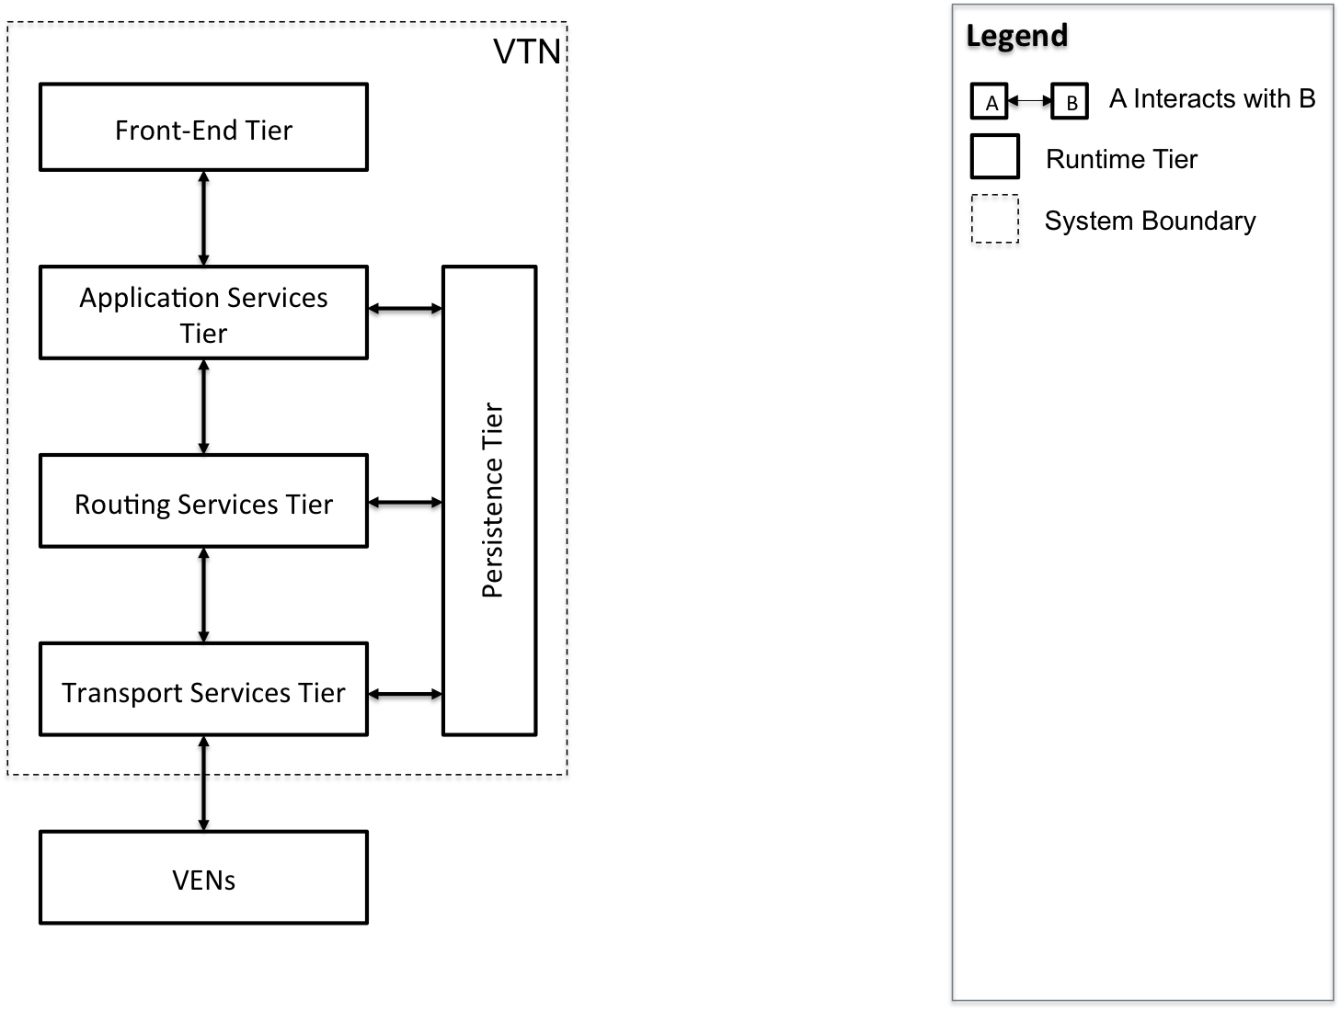
Architecture – High Level C&C View

Slide 15
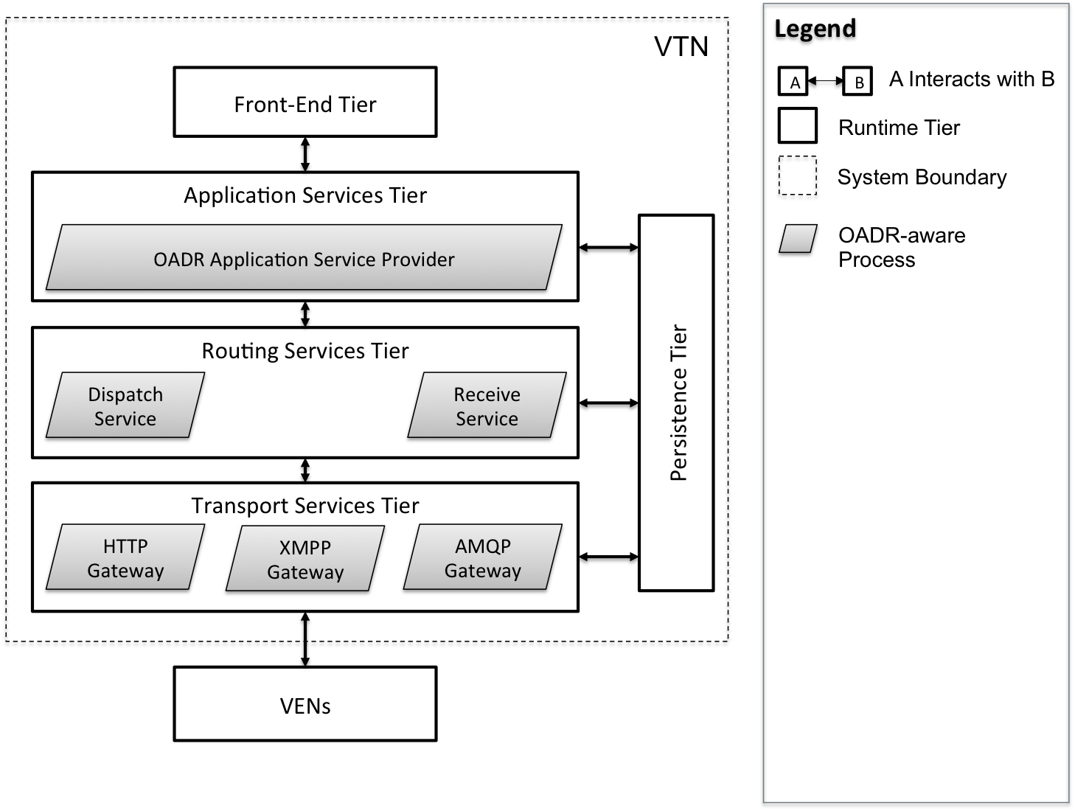
Architecture – Decomposition (Service Extensibility)

Slide 16
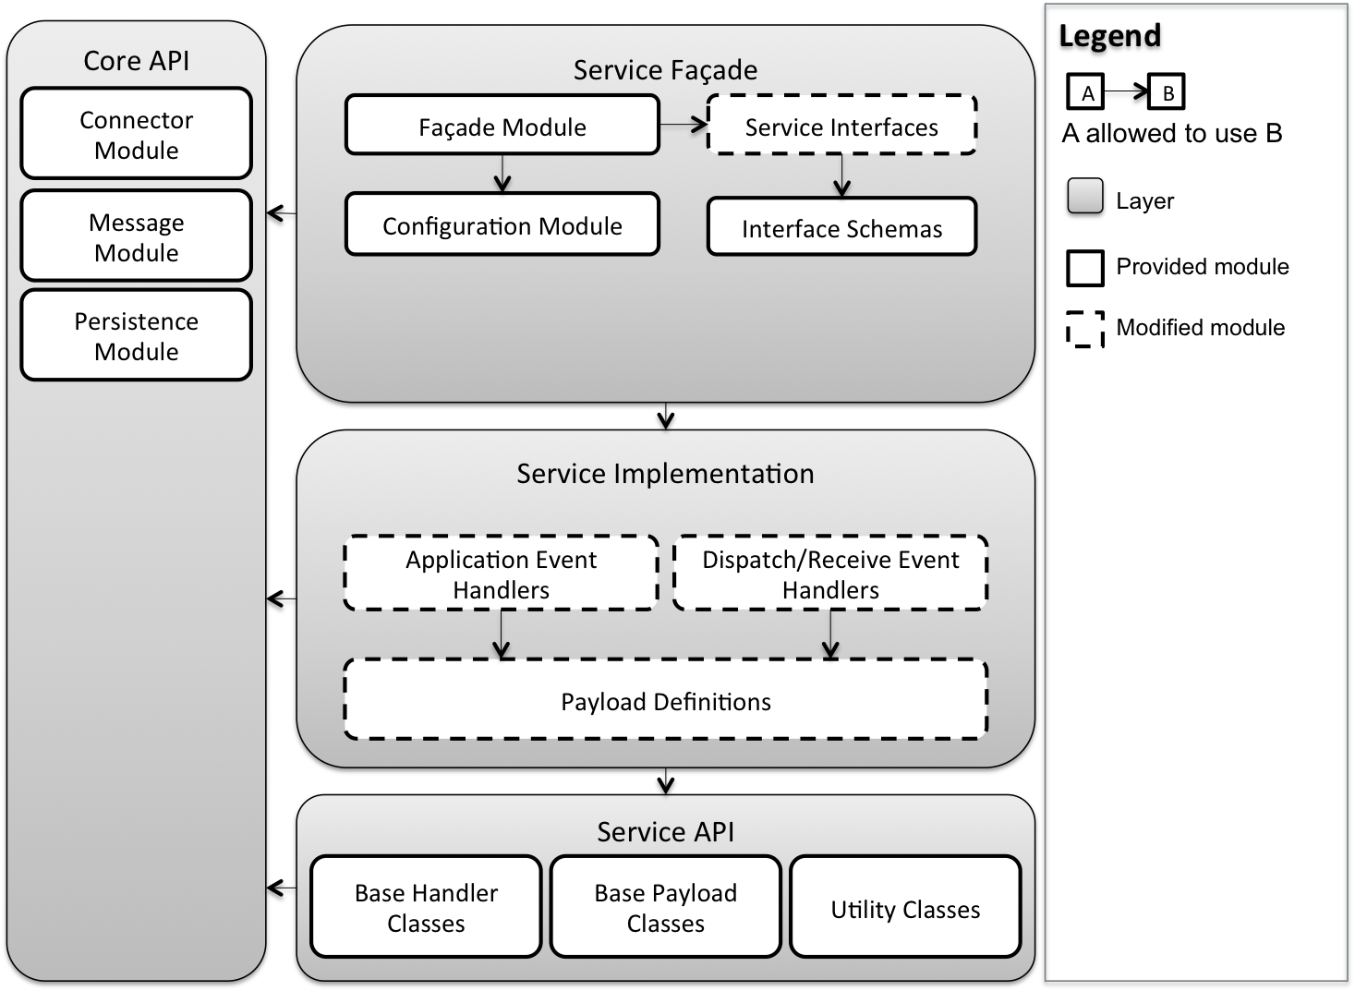
Architecture – Decomposition (Service Extensibility)

Slide 17
Architecture – Experiments
Reduce the uncertainty and bring up the confidence level
Address issues identified during issue analysis meeting
Example:
Understanding transport layer protocol
Address protocol extensibility quality attribute
Different characteristics of each protocol
Scope: HTTP, AMQP, XMPP
Characteristics: Resource identification, Sequencing, Security…
Proposed:
Data storage
Internal queue
Memcached

