Slide 1
Spring 2012 MOSP Agenda
Team
Project
Progress
Approach
Lessons
Roadmap

Slide 2




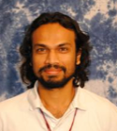
Argonauts Team
PLANNING MANAGER
(Managing Engineer)
CHIEF ARCHITECT
(Requirements Engineer)
TEAM LEAD
(Risk Manager)
DEVELOPMENT LEAD
(Support Engineer & Chief Scientist)
QA LEAD
(Quality Process Engineer)

Slide 3
Studio Mentors

Slide 4

Client – EnerNOC, Inc.
A leading provider of energy management
applications for the smart grid
www.enernoc.com
Jake Thompson
Mgr. of Advanced Technology
EnerNOC, Inc.

Slide 5
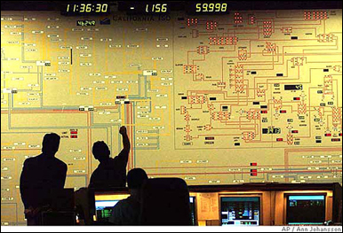
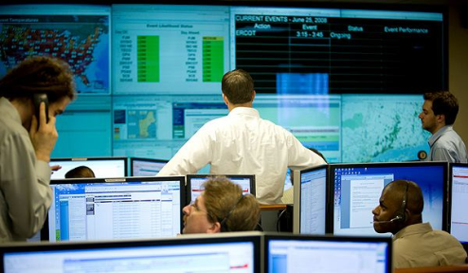




Project Context – Demand Response
Demand Response Event
Peak energy usage
Emergency curtailment
Utility/Grid Operator
Notification
Execute Energy Reduction Plans
Industrial
Institutional
Commercial
Feedback

Slide 6

Project Scope – Automated Demand Response
Feedback
Notification
Gateway
Lighting
HVAC
<OpenADR 2.0 />
Machinery
End Node (Customer)
Top Node
(EnerNOC)
1,000 Nodes
Large Industrial
Business Goals
Scalable demand response
Lower implementation costs
Real-time monitoring and control
100,000 Nodes
Small Commercial
1,000,000 Nodes
Residential

Slide 8
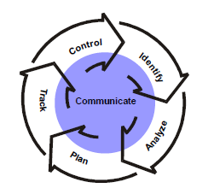
Risk Management Process
Continuous Risk Management
Identification
Format : Condition + Consequence
Mini Team SRE (Software Risk Evaluation)
Team members report every two weeks status meeting
Analyze
Matrix of impact and possibility
Prioritize by muti-voting
Plan
Mitigation strategy for Top 3
Track
Risk Manager report risks status in status meeting every two weeks
Risk Repository
Control
Before iteration plan, reevaluate the risks in risk repository.
Put the mitigation task into backlog

Slide 9
Top 3 Risks
Risk | Mitigation | Trigger
Team members make isolate design decisions and document them without communicating to everyone; we may have rework on design and miss the milestones in summer plan. | 1. Add into design process: show design to team infrequently. 2. quick design.
No experience with large-scale systems or technical knowledge on protocol transports; maybe not able to design the multi-transport architecture. | 1. experiments for protocol (half done) 2. short and iteratively design on protocol Extensibility and get feedback from mentors and customer (executing) | 1. No one start to learn protocols before the end of spring semester 2. No experiments designed for simulate the protocol work before

Slide 10
Top 3 Risks –Continued
Risk | Mitigation | Trigger
Not all the team members follow the set quality standard; the customer may do not want to accept our architecture design at the middle of summer semester. | Build quality assurance to design process. Peer review. | We got a low grade on the Arch final project When we show our design to client, client can not understand or think it’s poor quality.

Slide 11
Top 3 Risks –Continued
Risk | Mitigation | Trigger
Transport level security decision is not yet finalized in the OpenADR specification; Cannot finalize the architecture design | Continuous communication with customer Isolate security components and enable extensibility | 1. No formal discussion about security in the first week in summer 2. There is no stable requirement on system security before the second week in summer 3. Design doesn’t meet security requirement by the second week of summer

Slide 12
Top 3 Risks –Continued
Risk | Mitigation | Trigger
Team will use AWS for architecture verification and may exceed allocated budget; the team may overrun its budget given by the customer | Define the budget before doing verification on AWS and continuously monitor actual cost against budget Test approval process | The team still do not familiar with AWS at the end of second week in summer Test plans have no defined budget before execution

Slide 13
Top 3 Risks –Continued
Risk | Mitigation | Trigger
No hands-on experience with large-scale systems and technical knowledge on protocol transports; may be not able to design the multi-transport architecture | 1. experiments for protocol (half done) 2. short and iteratively design on protocol Extensibility and get feedback from mentors and customer (executing)" | "1. No one start to learn protocols before the end of spring semester . 2. No experiments design for simulate the protocol work

