Slide 1
Spring 2012 MOSP Agenda
Team
Project
Progress
Approach
Lessons
Roadmap

Slide 2





Argonauts Team
PLANNING MANAGER
(Managing Engineer)
CHIEF ARCHITECT
(Requirements Engineer)
TEAM LEAD
(Risk Manager)
DEVELOPMENT LEAD
(Support Engineer & Chief Scientist)
QA LEAD
(Quality Process Engineer)

Slide 3
Studio Mentors

Slide 4

Client – EnerNOC, Inc.
A leading provider of energy management
applications for the smart grid
www.enernoc.com
Jake Thompson
Mgr. of Advanced Technology
EnerNOC, Inc.

Slide 5
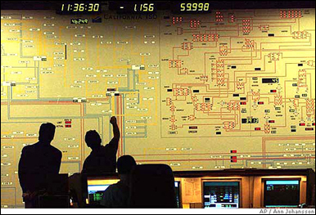





Project Context – Demand Response
Demand Response Event
Peak energy usage
Emergency curtailment
Utility/Grid Operator
Notification
Execute Energy Reduction Plans
Industrial
Institutional
Commercial
Feedback

Slide 6

Project Scope – Automated Demand Response
Feedback
Notification
Gateway
Lighting
HVAC
<OpenADR 2.0 />
Machinery
End Node (Customer)
Top Node
(EnerNOC)
1,000 Nodes
Large Industrial
Business Goals
Scalable demand response
Lower implementation costs
Real-time monitoring and control
100,000 Nodes
Small Commercial
1,000,000 Nodes
Residential

Slide 7
Project Strategy
1st Semester - 2011
2nd Semester - 2012
3rd Semester - 2012
4th Semester - 2012
Sep | Oct | Nov | Dec | Jan | Feb | Mar | Apr | May | Jun | Jul | Aug | Sep | Oct | Nov | Dec
Identify, define, and refine architectural drivers in iterative manner
Implement, integrate, and verify the architecture
Transition activities,
Postmortem
Create and refine architecture through evaluation and experimentation
Kickoff
Sep 23
Protocols Selection
Architecture Design
Core Implementation
Reference Implementation
SOW
ADD*, White Paper
*Architecture Design Document

Slide 8


Spring 2012 – Semester Goals
Stabilize requirements by mid-semester
Start architecture design by mid-semester
Reach “period of certainty” by end of semester

Slide 9
Spring 2012 Summary
January
February
March
April
May
1 | 2 | 3 | 4 | 5 | 6 | 7 | 8 | 9 | 10 | 11 | 12 | 13 | 14 | 15 | 16 | 17
ACDM Stages
Stage 1: Discovered architectural drivers
Stage 2: Established project scope
ACDM Stages (Iteratively)
Stage 3: Created/Refined architecture
Stage 4: Evaluated the architecture design
Stage 5: Took production decisions
Stage 6: Conducted few experiments
Protocols Selected
Production
Decision Taken
QAW
MOSP
EOSP
Production
Decision Taken
Architecture Designed
5
6
7
10
8
9
Iterations

Slide 10
Change in Planning Process
Goals
To add value to the client by maximizing the amount of time spent in design activities.
To minimize the amount of time spent in overhead and unplanned activities.
To provide more visibility into the plan and the planning process.

Slide 11

Change in Planning Process
Solutions:
Time-boxed planning and reflection meetings
Estimation at the work package level in velocity points using planning poker
Tracking through stand up meetings and constant communication among team members
Shorter iterations. Plan more, plan often
Online planning and tracking tool –

Slide 12
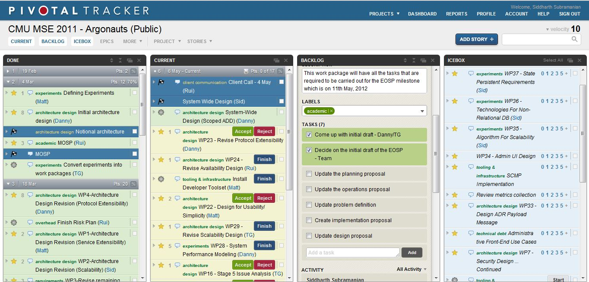
Pivotal Tracker Features

Slide 13
Planning Reflections
Measuring overhead and unplanned activities gave an indication to change process
Planning more, planning often is very useful when there are technical uncertainties.
Pivotal Tracker increases the visibility of project management.
Pivotal Tracker works well for tracking small work packages consisting of few tasks.
Pivotal Tracker may not work in Summer due to the expected increase in the number of work packages and tasks.

