Slide 1
Quality Assurance
“Quality is free” – Philip Crosby
“When there is no notion of quality, productivity is infinite” - Argonauts
Notes:
- Phil Crosby used the quote “Quality is free” to explain the definition of quality to executives in terms they can understand. We are using how productivity and quality are related to explain why we didn’t get the initial productivity we planned as we figure out the importance of quality.

Slide 2
Goals
Assure quality of the reference architecture and related deliverables as required by the customer – All attributes of the architecture are verified before the final delivery
Ensure the quality of internal processes, which are used to produce client deliverables – Continuously measuring and observing the health status of internal processes
Notes:
- Phil Crosby used the quote “Quality is free” to explain the definition of quality to executives in terms they can understand. We are using how productivity and quality are related to explain why we didn’t get the initial productivity we planned as we figure out the importance of quality.

Slide 3
Activities in Spring 2012
Product Quality
Requirements reviews
Peer reviews
Architecture Design Evaluation Workshop (ADEW)
Process Quality
Process quality metric
ETVX for planned tasks
Managing technical Debt
ETVX – Entry-Task-Validation-Exit

Slide 4
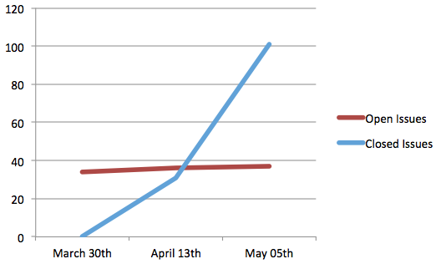
Architecture Design Evaluation Workshop (ADEW)
Conducted at the end of every iteration to review the architecture design, identify issues and make the production go/ no-go decision

Slide 5
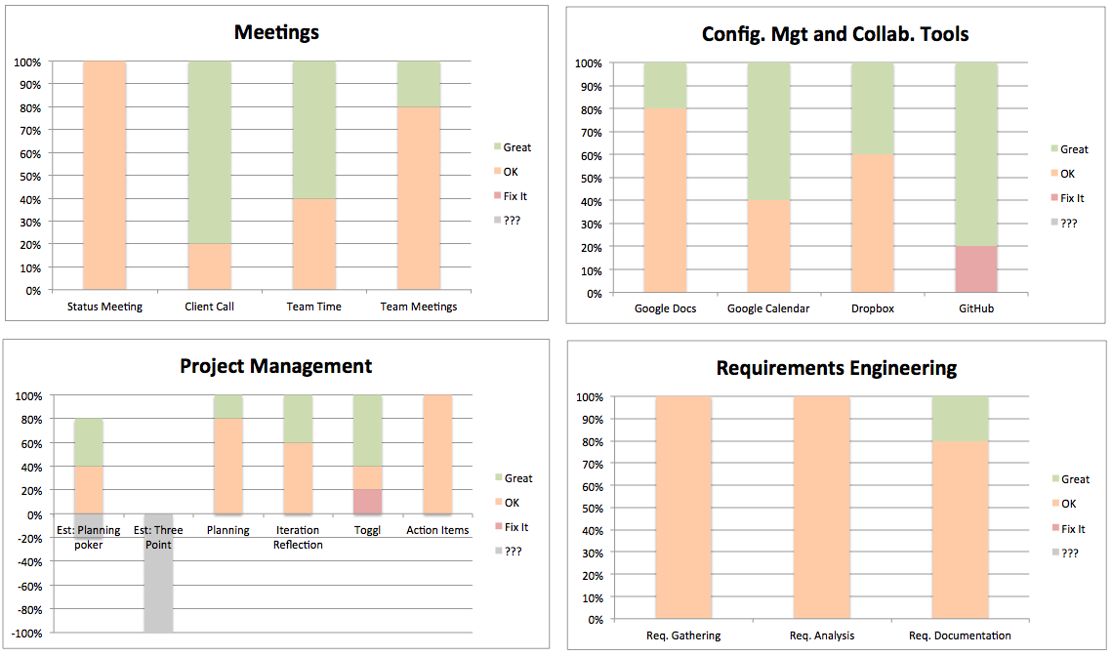
Process Quality Metric
Bi-Weekly process evaluation provided a snapshot of the health status of internal processes
Made corrective actions based on team feedback

Slide 6
Managing Technical Debt
Managed two week iterations without losing the sight of quality of deliverables through technical debt
Provided insights into quality related issues of tasks, individuals and processes
Notes:
- Identifying types of technical debts
- Providing visibility into technical debt by putting them into the product backlog

Slide 7
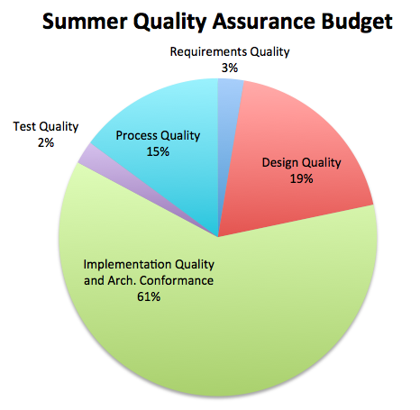
Eye to the future
A detailed quality plan was created with activities and estimates for the Summer 2012
27 activities were identified, which could improve the quality of both product and process

Slide 8
Reflections on Quality Assurance
Having experience people in the workshop is crucial to maximizing the value of the review
Correct light weight methods can add more or equal value to the project as heavy weight methods
Managing time boxed iteration with quality is a challenge as well as an opportunity
Notes:
- Qualitative methods works as long as individuals are committed and honest

Slide 9
Process and Operations - ACDM

