Slide 1
Architecture Drivers : Quality Attributes
Team
Project
Progress
Approach
Arch
Roadmap
Quality Attribute | Priority
Horizontal scalability | High
Scalability throughput | High
Protocol extensibility | High
Service extensibility | High
Usability – API configurability | High
Usability - Simplicity | Medium
Performance – Outbound latency | Medium
Performance – Inbound latency | Medium
Performance - Throughput | Medium
Modifiability – Development effort | Medium
Availability – Fault detection | Medium
Modifiability– Service modifiability | Low
Security – Unified authentication | Low
Availability – System recovery | Low
Notes:
Quickly evaluated project context with process frameworks
Everyone on the team agreed on using ACDM
Mapped ACDM into current roles and responsibilities, requirement engineering and client management activities
Templates to capture architecture drivers
Master design plan
Completed tailoring stage 1 and stage 2
Follow and continue to refine process through learning, it should not be a static body of knowledge
Experimented Scrum for projects as part of another course. Realized its not a good fit due to its inability to build an architecture upfront
© 2006 Carnegie Mellon University
Presentation Title

Slide 2
Arch drivers : Constraints
Team
Project
Progress
Approach
Lessons
Roadmap
Technical Constraints
Linux based OS
Amazon AMI compatibility
Cloud computing platform
Programming language – Java/Ruby/Python
No proprietary software components or tools (negotiable)
Business Constraints
Fixed budget and schedule
Incremental delivery
No components/tools with proprietary licensing
Non-disclosure intellectual rights
Simple design for multiple protocol support
Notes:
Quickly evaluated project context with process frameworks
Everyone on the team agreed on using ACDM
Mapped ACDM into current roles and responsibilities, requirement engineering and client management activities
Templates to capture architecture drivers
Master design plan
Completed tailoring stage 1 and stage 2
Follow and continue to refine process through learning, it should not be a static body of knowledge
Experimented Scrum for projects as part of another course. Realized its not a good fit due to its inability to build an architecture upfront
© 2006 Carnegie Mellon University
Presentation Title

Slide 3
Backup Slides

Slide 4
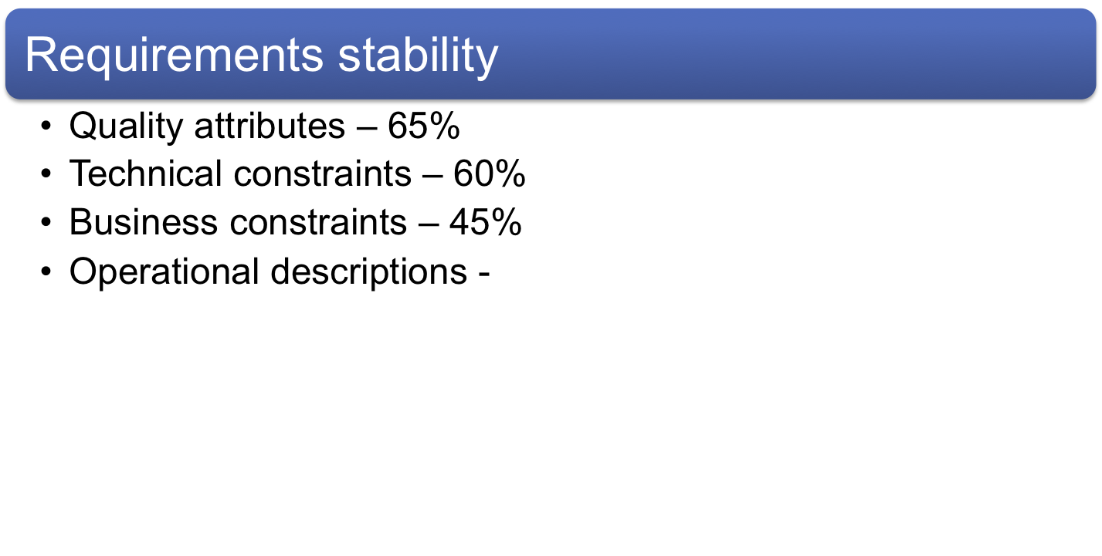
Requirements Engineering
Team
Project
Progress
Approach
Lessons
Roadmap
Notes:
There are several tactics we used during requirements elicitation
© 2006 Carnegie Mellon University
Presentation Title

Slide 5
Requirements Volatility
Requirements volatility = (added + deleted + changed (modified))/ (# of requirements agreed)*100

Slide 6
Protocol Extensibility
Source of stimulus | ADR vendors agree to use a new protocol
Stimulus | A software developer is adding support for a new protocol to the system
Environment | The developer is familiar with the relevant documentation and APIs, and the first three protocols are already provided by the reference implementation. The new protocol is based on TCP/IP. Reference architecture is released to the community.
Artifact | VTN
Response | The new protocol is successfully implemented and integrated into the system.
Response measure | Implementation and integration should require no changes to the existing system. Extensibility should be achieved through the existing interfaces.

Slide 7
Scalability
Source of stimulus | The number of messages/unit time increases.
Stimulus | New VTNs are added to the system due to growth of the business
Environment | Assuming each server stack can manage 50,000 VENs for the defined throughput (specified in a SLA), the VTN is now overloaded . However, limitations of underlying technologies may be disregarded.
Artifact | VTN
Response | The server resource is added and configured to handle the load.
Response measure | No software code-level changes are permitted and the required throughput is maintained. However, code changes are acceptable when scaling in order of magnitude (e.g. 10,000 VENs to 1,000,000 VENs).

Slide 8
Service Extensibility
Source of stimulus | OASIS publishes a new version of the Energy Interoperation standard, which specifies new services or operations.
Stimulus | A developer adds a new OpenADR service or operation
Environment | Abstract service interfaces exist to support communication between VTN and VENs
Artifact | VTN
Response | The new service is added to the system.
Response measure | No interface modifications or deletions are required. However, adding new interfaces is permitted. .

