Slide 1
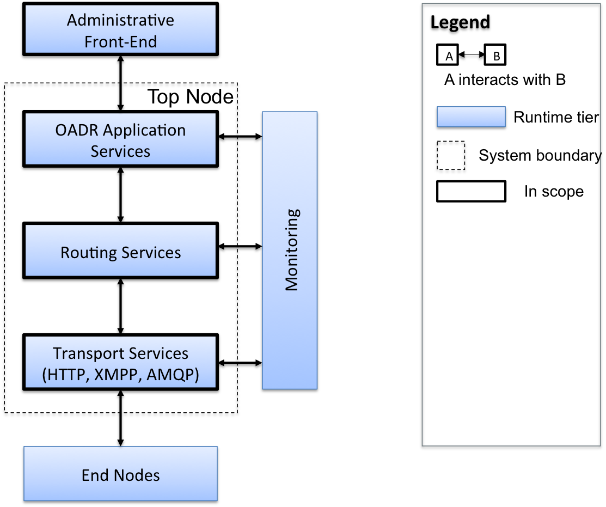
Architectural Context
Team
Project
Progress
Approach
Lessons
Roadmap
Notes:
Administrative Front End:
Provides command and control of the VTN
May be a user interface or remote application
OADR Application Services:
These services are defined in the OpenADR specification
Include services to manage the demand response network (VTNs)
Routing Services:
These services route application specific messages to various protocol gateways
The messages send by the routing service are protocol-independent
Different VENs require different gateways (HTTP, XMPP, AMQP)
Transport Services:
These services actually send and receive messages from the VTN
These messages are protocol-specific
Transport services implement the various message exchange patterns required by each protocol
© 2006 Carnegie Mellon University
Presentation Title

Slide 2
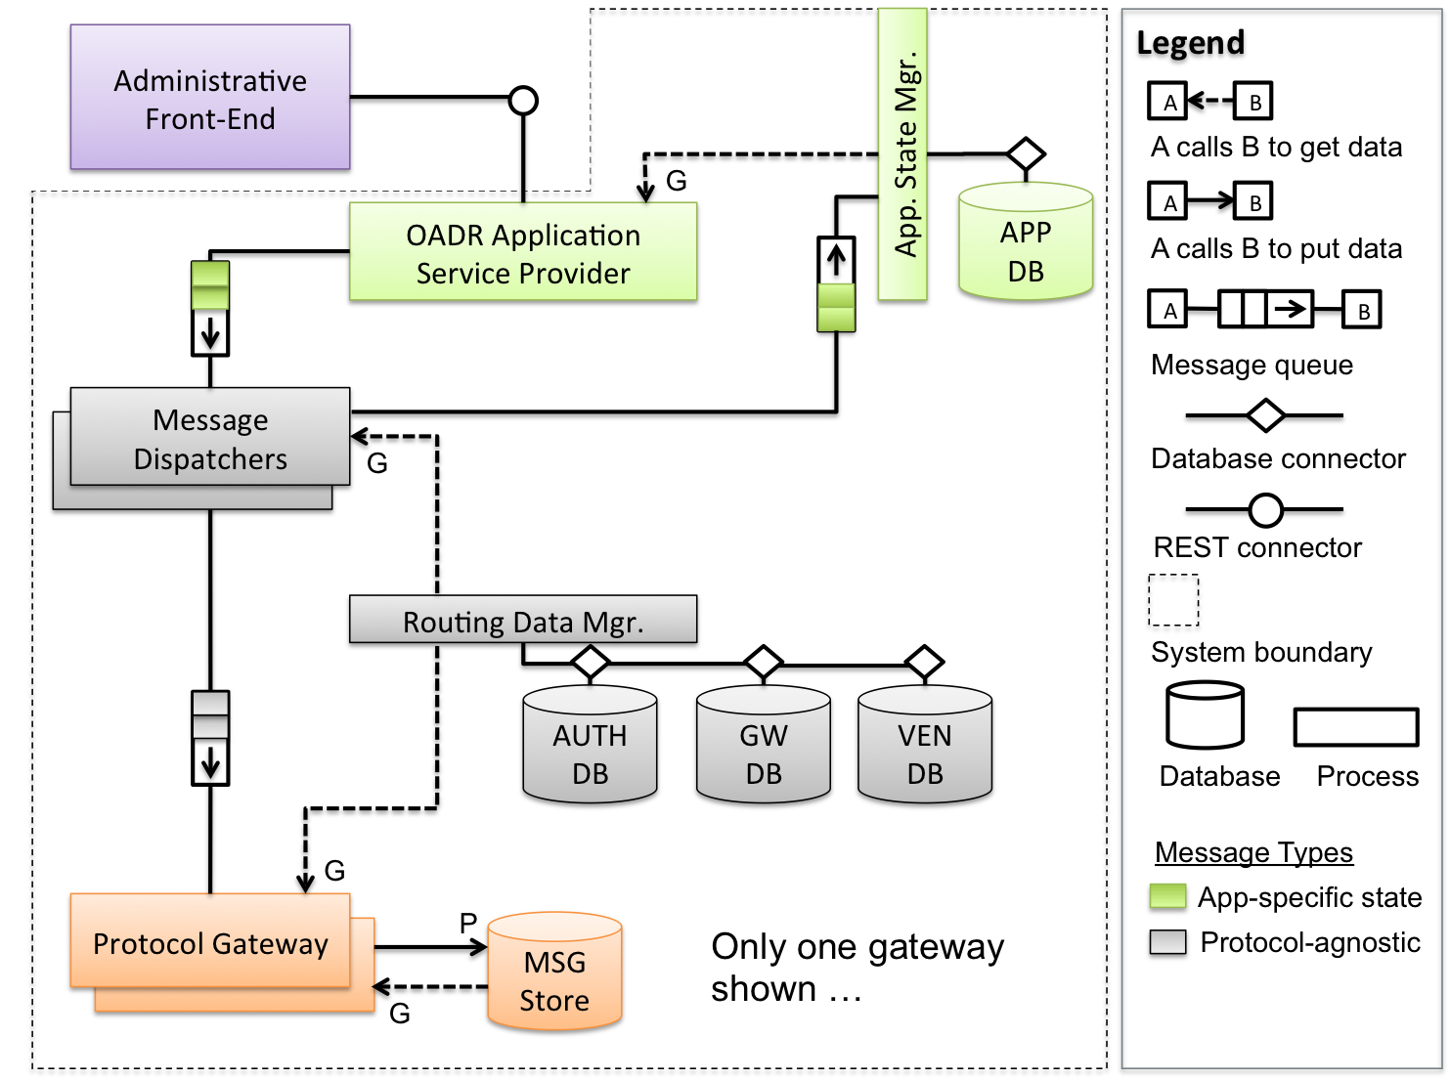
Routing Dispatch C&C View
Team
Project
Progress
Approach
Lessons
Roadmap
Notes:
This view shows how messages are sent from the Application Service Provider:
Application-specific messages are queued for dispatchers
Dispatchers take messages and look up gateway destination based on required protocol
Gateways look up authentication credentials and VEN destination
Gateways manage transaction according to required message-exchange pattern
© 2006 Carnegie Mellon University
Presentation Title

Slide 3
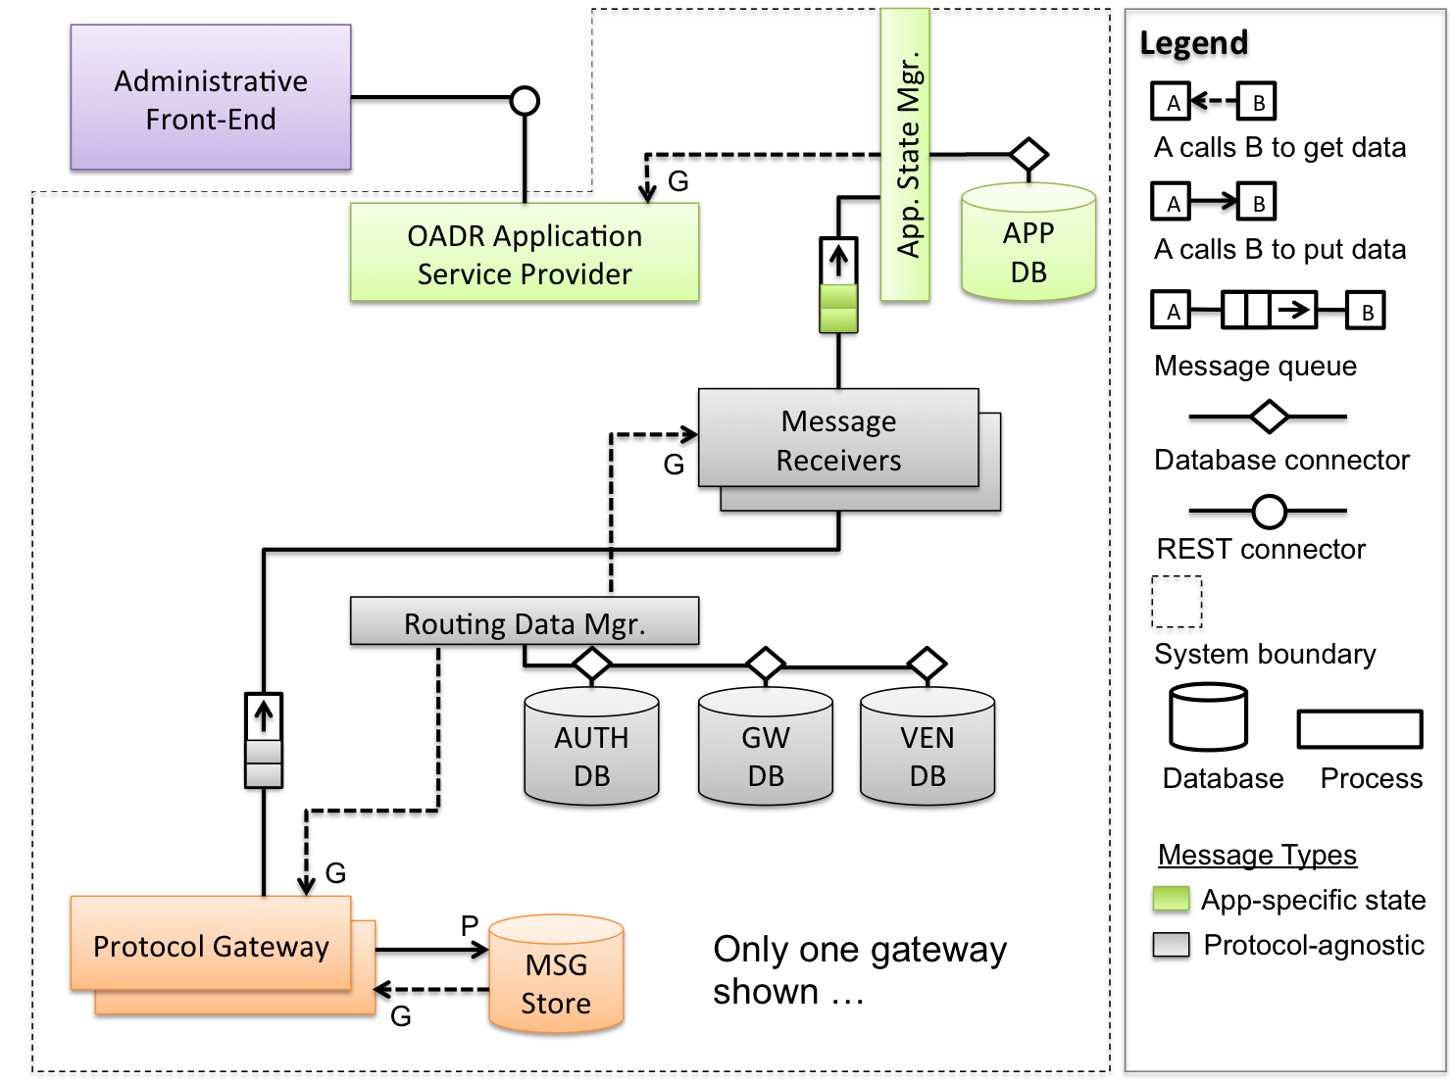
Routing Receive C&C View
Team
Project
Progress
Approach
Lessons
Roadmap
Notes:
This view shows how messages are received from VENs:
Protocol gateways receive responses from VENs
Message receivers take responses and look up sender context
Application state manager updates application state based on response
© 2006 Carnegie Mellon University
Presentation Title

Slide 4
Current Experiment
Team
Project
Progress
Approach
Lessons
Roadmap
  Issue: We don’t know how to approach protocol extensibility.
    Identify common protocol semantics like discovery, security, transaction, state management, scale, etc..
    Identify common mechanisms used by each protocol
    Focus on TCP/IP-based protocols
Notes:
© 2006 Carnegie Mellon University
Presentation Title

Slide 5
Proposed Experiments
Team
Project
Progress
Approach
Lessons
Roadmap
  Issue: Can we achieve the desired throughput with message queues? How do we monitor?
    Investigate different queuing mechanisms
  Issue: How can we make frequent data lookups inexpensive?
    Investigate memory caching mechanisms
  Issue: How can we provide a unified security mechanism for all protocols?
    Investigate security requirements for each protocol
Notes:
Internal queuing mechanism: We are using a lot of queues to guarantee scalability, throughput, and availability
Memory cache and data access latency: Memory access will affect throughput and scalability
Persistent data and message storage: Updating application state might be a bottleneck
© 2006 Carnegie Mellon University
Presentation Title

Slide 6
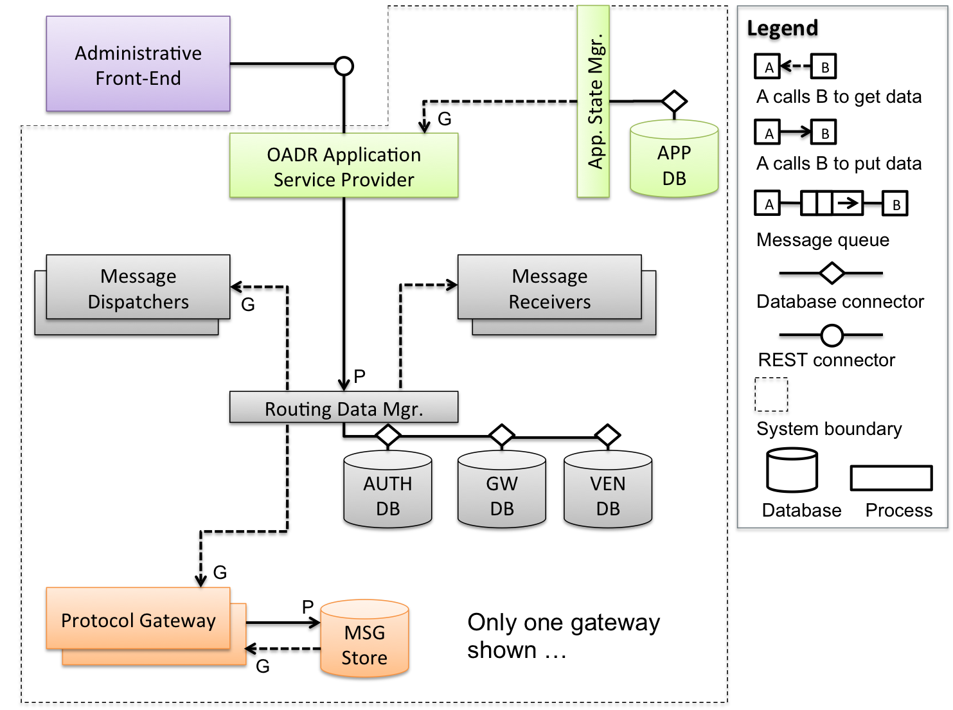
Routing Configuration C&C View (Backup)
Team
Project
Progress
Approach
Lessons
Roadmap
Notes:
This view shows how routing and gateway configurations are updated by the Application Service Provider
Message Dispatchers:
Responsible for routing messages to the appropriate gateway depending on the destination
These messages are protocol-independent
Message Receivers:
Responsible for routing messages from the gateways back to update application state
These messages are application-specific
Routing Data Manager:
Responsible for providing routing and transport information to the dispatchers, receivers, and gateways
Authentication credentials are stored in the AUTH DB
Gateway addresses are located in the GW DB
VEN addresses are located in the VEN DB
© 2006 Carnegie Mellon University
Presentation Title

Slide 7
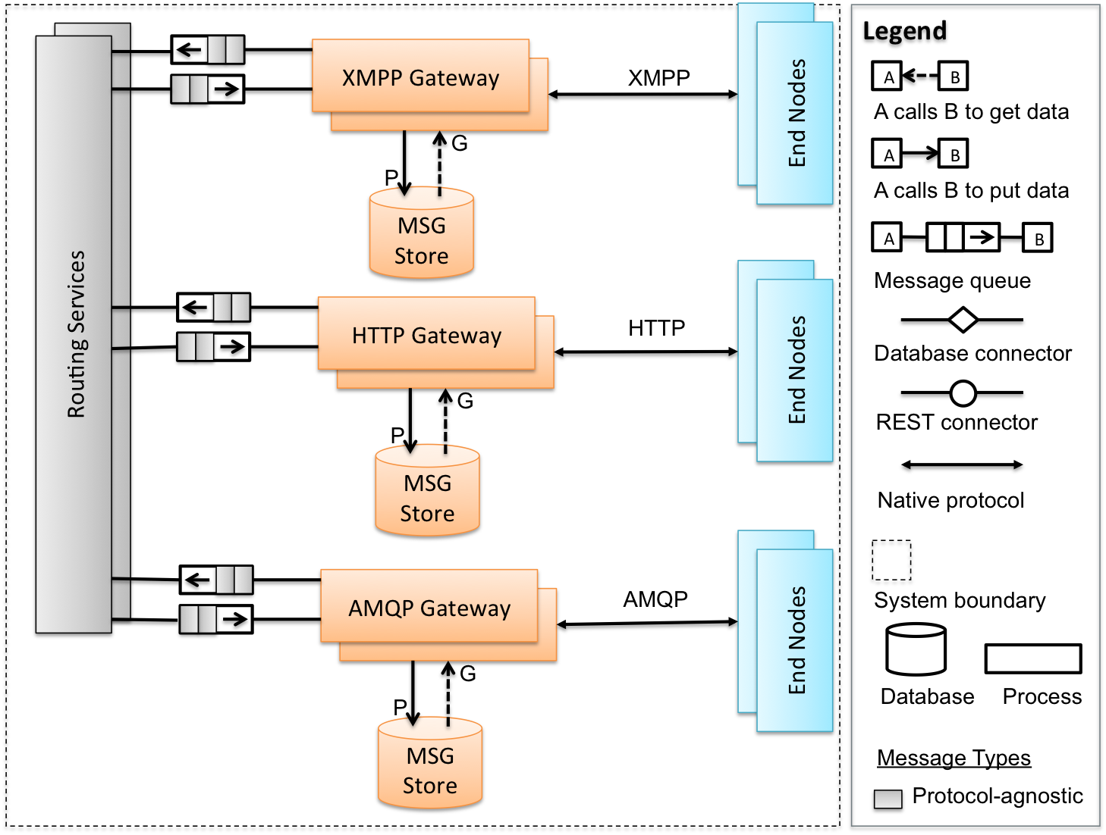
Transport Services C&C View (Backup)
Team
Project
Progress
Approach
Lessons
Roadmap
Notes:
This view expands the Transport Services Tier
Routing Services:
Each protocol gateway communicates to routing services through messaging queues
These messages are protocol-independent
Protocol Gateways:
Protocol independent messages are translated to protocol-specific messages
These messages are encoded according to the required protocol
Message state is maintained for certain types of Message-exchange patterns in a MSG store
VENs:
VENs communicate with a protocol gateway
© 2006 Carnegie Mellon University
Presentation Title

