Slide 1
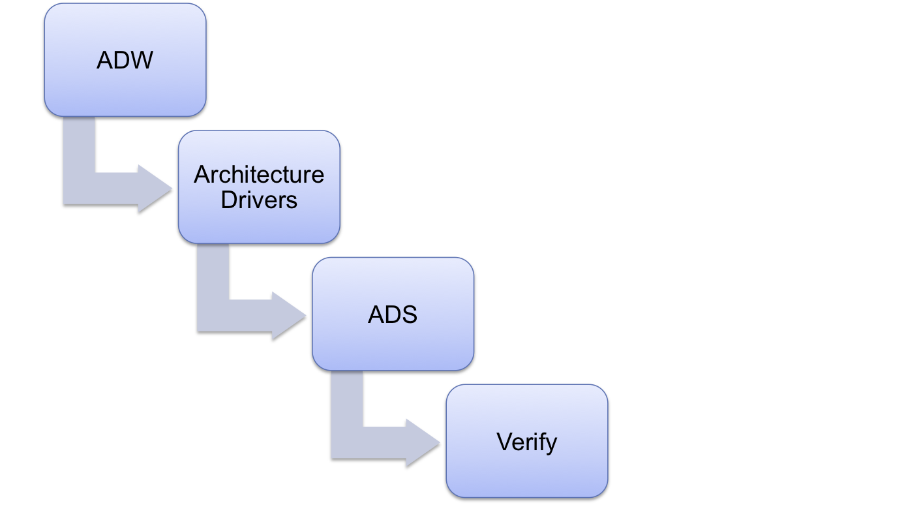
Requirements Engineering
Team
Project
Progress
Approach
Lessons
Roadmap
Architecture Drivers Workshop
Quality Attributes Workshop
Clarification
Prioritization
Testability
Architecture Drivers Specification
V 1.0
Verify with client
Notes:
Our current strategy for requirements is iterative – we’ll be constantly going through this cycle as we design our architecture
This semester were only able to focus on elicitation and analysis.
We elicit requirements from the customer, specifically information that drives the architecture
We then analyze the requirements, ensuring that they are both measureable and attainable
Document in the form of Architecture Drivers Specification
Verify through design, experimentation, and tests
© 2006 Carnegie Mellon University
Presentation Title

Slide 2
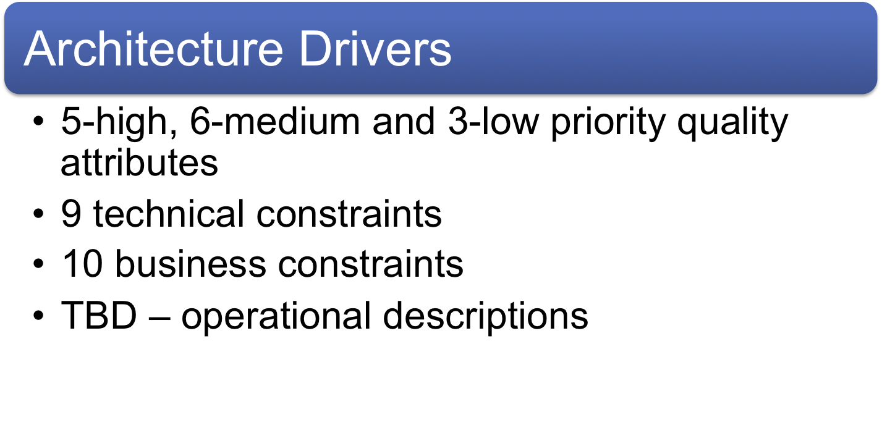
Requirements Engineering
Team
Project
Progress
Approach
Lessons
Roadmap
Notes:
There are several tactics we used during requirements elicitation
© 2006 Carnegie Mellon University
Presentation Title

Slide 3
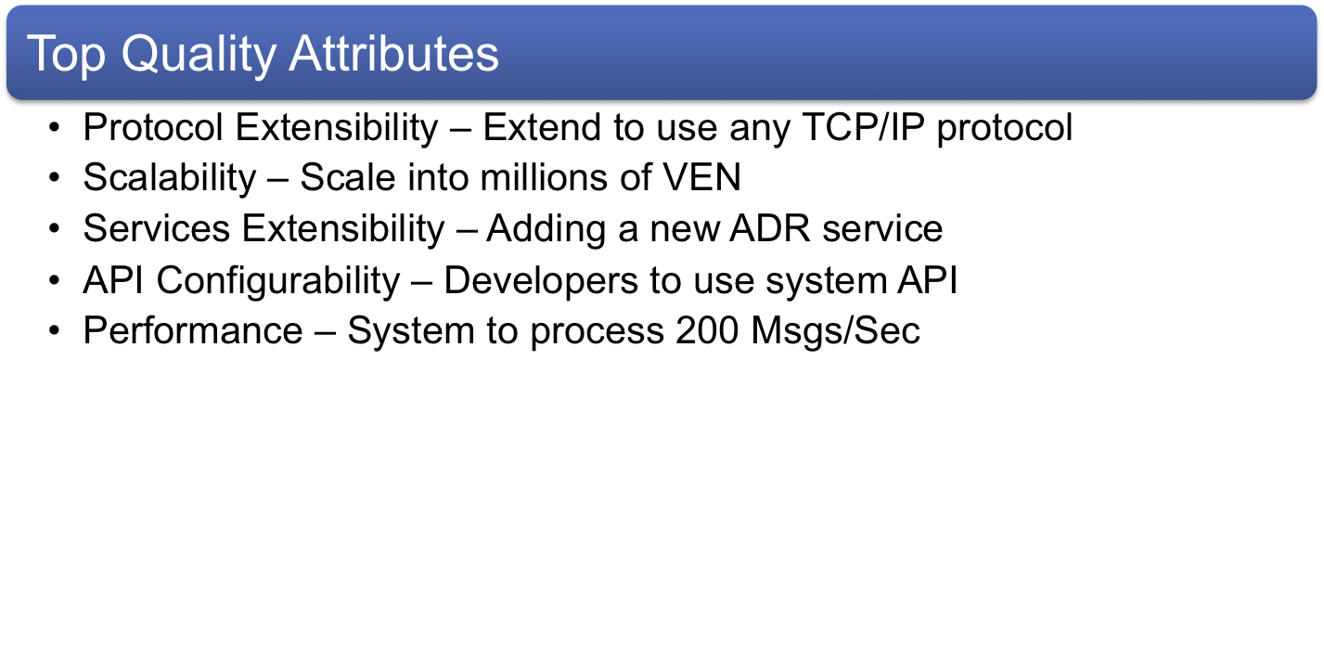
Requirements Engineering
Team
Project
Progress
Approach
Lessons
Roadmap
Notes:
There are several tactics we used during requirements elicitation
© 2006 Carnegie Mellon University
Presentation Title

Slide 4
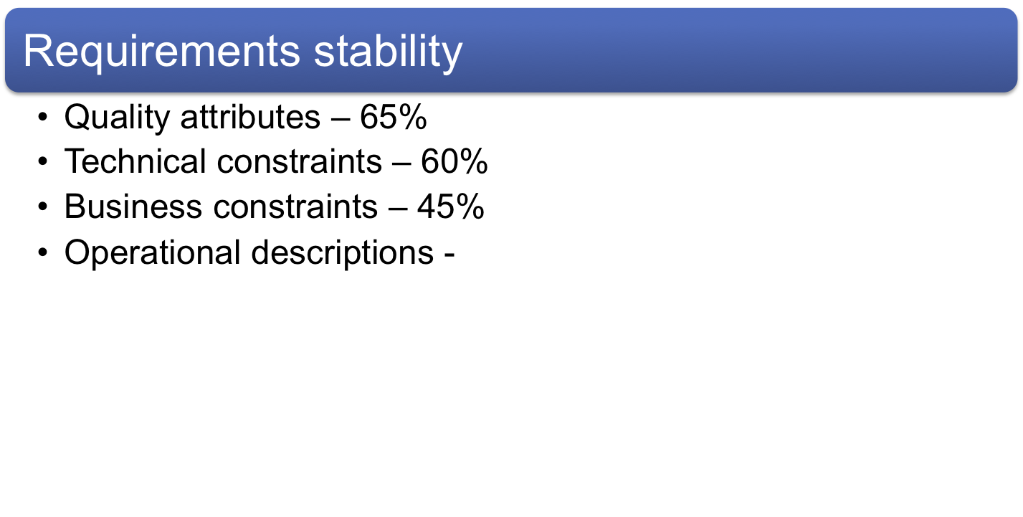
Requirements Engineering
Team
Project
Progress
Approach
Lessons
Roadmap
Notes:
There are several tactics we used during requirements elicitation
© 2006 Carnegie Mellon University
Presentation Title

Slide 5
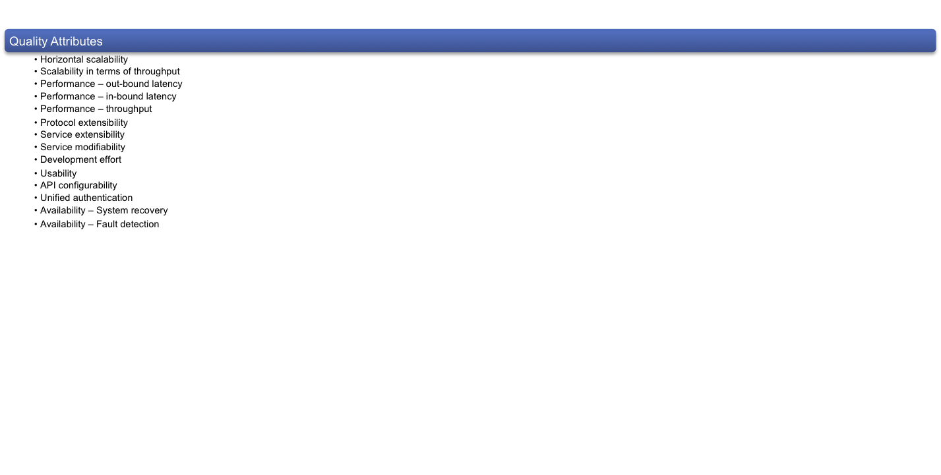
Requirements Engineering
Team
Project
Progress
Approach
Lessons
Roadmap
Notes:
There are several tactics we used during requirements elicitation
© 2006 Carnegie Mellon University
Presentation Title

Slide 6
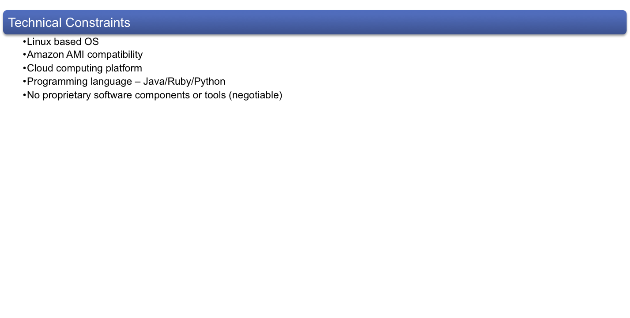
Requirements Engineering
Team
Project
Progress
Approach
Lessons
Roadmap
Notes:
There are several tactics we used during requirements elicitation
© 2006 Carnegie Mellon University
Presentation Title

Slide 7
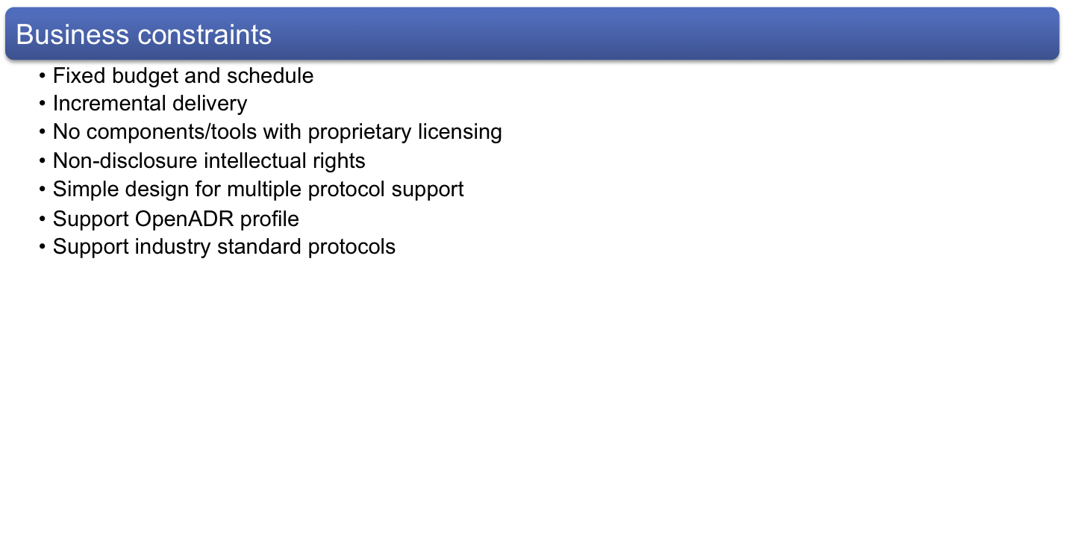
Requirements Engineering
Team
Project
Progress
Approach
Lessons
Roadmap
Notes:
There are several tactics we used during requirements elicitation
© 2006 Carnegie Mellon University
Presentation Title

Slide 8
Requirements Templates
Team
Project
Progress
Approach
Lessons
Roadmap
Problem / Operations / Planning / Risk
…
Client
Meeting
…
ADR
Specs
Requirements Templates
Operational Descriptions
Constraints
Quality Attribute Scenarios
Consistency and Traceability
What do we know? What are we missing? What are our sources?
Maintain traceability to OpenADR specifications
Notes:
What we did:
Show the requirements engineering process as outlined in the proposal document
Show raw capture feeding into analysis then to the ADS
Techniques
Kick-off, and bi-weekly meeting
Source documents
Reflection
We didn’t know what we had until we standardized how we captured it
We needed to think through what is good enough to get to a notional architecture
Use the ADS to validate the requirements with the customer w/ architecture
© 2006 Carnegie Mellon University
Presentation Title

Slide 9
Quality Attributes
Team
Project
Progress
Approach
Lessons
Roadmap
Problem / Operations / Planning / Risk
  Scalability
    10,000,000 VENs (Ultra High Scale)
    1,000,000 VENs (Very High Scale)
    100,000 VENs (High Scale)
    10,000 VENs (Medium Scale)
    1000 VENs (Low Scale)
  Availability (More information)
Notes:
Backup Slide: If there is a question as to what quality attributes we identified
© 2006 Carnegie Mellon University
Presentation Title

Slide 10
Quality Attributes
Team
Project
Progress
Approach
Lessons
Roadmap
Problem / Operations / Planning / Risk
  Performance
    Loop response time 3600s – 86400s (slow-DR)
    Loop response time 300s – 1800s (med-DR)
    Loop response time 1s – 60s (fast-DR)
  Modifiability
    Run-time support for multiple protocols
    XMPP, HTTP, AMQP are high priority
  Testability (More information)
Notes:
Backup Slide: If there is a question as to what quality attributes we identified
© 2006 Carnegie Mellon University
Presentation Title

Slide 11
Quality Attributes
Team
Project
Progress
Approach
Lessons
Roadmap
Problem / Operations / Planning / Risk
  Security
    Authentication using certificates and user/password
    Confidentiality through transport-layer security
    Data integrity through digital certificates
    Non-repudiation
Notes:
Backup Slide: If there is a question as to what quality attributes we identified
© 2006 Carnegie Mellon University
Presentation Title

Slide 12
Exit criteria between process stages
Team
Project
Progress
Approach
Lessons
Roadmap
Problem / Operations / Planning / Risk
From stage 2 to stage 3
  “Good enough” requirements (Volatility %)
From stage 5 to stage 7
  Agreement between client and team (quality attributes)
  Support of at least XMPP and HTTP
From stage 7 to transition
  Pass user acceptance tests (UAT)
  Percentage of defects remaining (TBD)
Notes:
Backup slide
© 2006 Carnegie Mellon University
Presentation Title

Slide 13
Exit criteria between process stages
Team
Project
Progress
Approach
Lessons
Roadmap
Problem / Operations / Planning / Risk
    Project complete
      White paper (optional)
      Decisions and rationale
Notes:
Backup slide
© 2006 Carnegie Mellon University
Presentation Title

Slide 14
Requirements Volatility
Requirements volatility = (added + deleted + changed (modified))/ (# of requirements agreed)*100

Slide 15
Technical Constraints
Operating System: Platform independent. Should run on a variety of platforms. It should not result in vendor lock-in.
  How many platforms are under consideration?
Computer Platform: Is there presence of any specific hardware platform? Should we take into consideration any particular hardware platform?
Computer Languages: No proprietary or platform binding languages (e.g. C#, .NET etc.). Consider languages like Java.
  What is the exact reason for not using a proprietary language?
  Is portability the reason? Or is Java widely used in EnerNOC

Slide 16
Technical Constraints
Peripheral or network hardware: Should any particular peripheral device or network hardware be used?
Tools and methods: Tools and technologies that require licensing are not suitable for the longevity of the project.
  Are there any specific tools in your mind?
Commercial hardware or software products: No commercial products to be used.
  What are the reasons for not using any commercial products?

Slide 17
Technical Constraints
﻿Protocols, interfaces, and standards: Architecture should be traceable to ADR 2.0 and should include all features on ADR 1.0. It should support at least 3 protocols.
  SOAP/REST
  XMPP
  AMQP
Legacy hardware and software: Is there any legacy system we need to keep in mind while designing the architecture?

Slide 18
Business Constraints
﻿Cost limitations: Fixed time and fixed budget.
Schedule limitations: Deliverables, as agreed in SOW, are due by December 2012
Mandatory regulatory restrictions and demands: Do we have any?
Legal restrictions and demands: All project artifacts are under NDA and not to be shared with anyone except CMU faculty.
Market restrictions and demands:
  Functionalities as defined in the OpenADR 2.0 profile of EI 1.0 spec.
  Must support the protocol specified in the OpenADR 2.0 (HTTP)
  Market variability of DR profiles

Slide 19
Business Constraints
﻿Organizational restrictions and demands: Perform as expected which allow EnerNOC to save energy as they agreed on.
Logistical issues:
  Testing devices
  End to end test environment

