Slide 1
Task Relative Error

Slide 2
Average Task Relative Error

Slide 3
Test Cases Distribution
Total Test Cases: 151

Slide 4
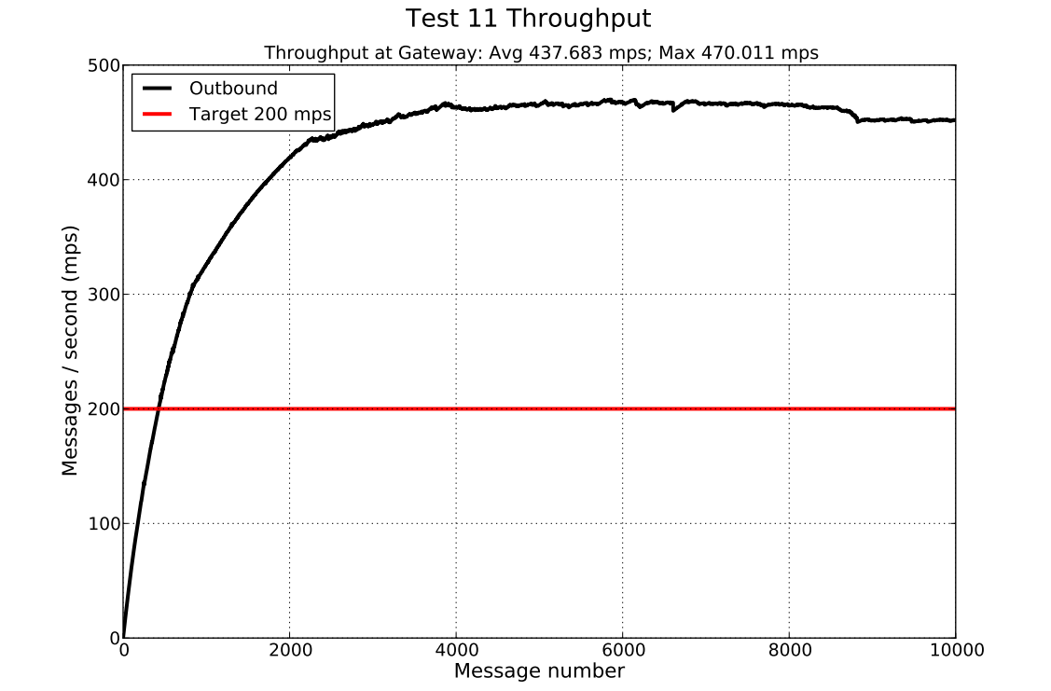
Test 11 Throughput (Scalability)

