Slide 1
Backup: The consistency between architecture and prototype
Downstream
- Detail design team review make sure the detail design mapping to architecture design.
- Code review make sure the detail deign can mapping to the detail design.
Upstream
Implementation verify the quality attributes
If the implementation do not match the requirement on the quality attributes, change the detail design and re-implemention.
If the implementation match the requirement, change ADD.

Slide 2
Backup: Scenarios for QA: Protocol Extensibility
Source of stimulus | ADR vendors agree to use a new protocol
Stimulus | A software developer is adding support for a new protocol to the system
Environment | The developer is familiar with the relevant documentation and APIs, and the first three protocols are already provided by the reference implementation. The new protocol is based on TCP/IP. Reference architecture is released to the community.
Artifact | VTN
Response | The new protocol is successfully implemented and integrated into the system.
Response measure | Implementation and integration should require no changes to the existing system. Extensibility should be achieved through the existing interfaces.

Slide 3
Backup: Scenarios for QA : Service Extensibility
Source of stimulus | OASIS publishes a new version of the Energy Interoperation standard, which specifies new services or operations.
Stimulus | A developer adds a new OpenADR service or operation
Environment | Abstract service interfaces exist to support communication between VTN and VENs
Artifact | VTN
Response | The new service is added to the system.
Response measure | No interface modifications or deletions are required. However, adding new interfaces is permitted.

Slide 4
Backup: Scenarios for QA : Scalability
Source of stimulus | The number of messages/unit time increases.
Stimulus | New VTNs are added to the system due to growth of the business
Environment | Assuming each server stack can manage 50,000 VENs for the defined throughput (specified in a SLA), the VTN is now overloaded . However, limitations of underlying technologies may be disregarded.
Artifact | VTN
Response | The server resource is added and configured to handle the load.
Response measure | No software code-level changes are permitted and the required throughput is maintained. However, code changes are acceptable when scaling in order of magnitude (e.g. 10,000 VENs to 1,000,000 VENs).

Slide 5
Backup: Scenarios for QA: Performance Outbound latency
Source of stimulus | aggregator wants to send the DR event to end node users
Stimulus | An automated or manual message transfer is initiated
Environment | VEN ready for receive the event
Artifact | VTN
Response | The particular DR event is delivered to each of the intended VENs.
Response measure | Refer to Slow DR profile, Medium DR profile, Real-time DR profile.

Slide 6
Backup: Scenarios for QA: Performance Inbound latency
Source of stimulus | 10,000 VENs need to find out if they are intended to receive an event from the VTN
Stimulus | The VENs send messages to the VTN, polling for events. Or responding to events
Environment | VEN can communicate with VTN
Artifact | VTN
Response | Persistence the event from VEN
Response measure | Refer to Slow DR profile, Medium DR profile, Real-time DR profile.

Slide 7
Backup: Scenarios for QA: Performance Throughput
Source of stimulus | Messages sent from the VTN to the VENs in the case of a DR event.
Stimulus | An automated or manual message transfer is initiated
Environment | VEN VTN can communicate with each other.
Artifact | VEN,VTN
Response | The particular DR event is delivered to each of the intended VENs. Persistence the event from VEN.
Response measure | At any given time, the VTN system should be able to process 200 messages, both outgoing and incoming. For each message (outgoing or incoming), the processing time should not be more than 200ms .

Slide 8
Backup: Change on Architecture
Modify the split algorithm to enhance the performance
Modify Gateway API to be more practical
Service handlers change according to the requirement
Remove receiver component

Slide 9
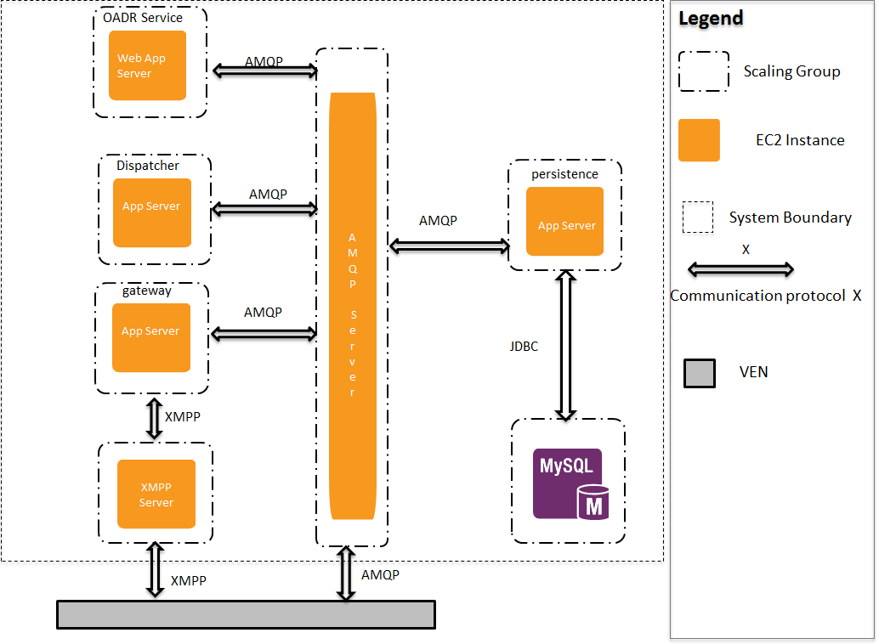
Backup: Allocation view and initial diagrams

Slide 10
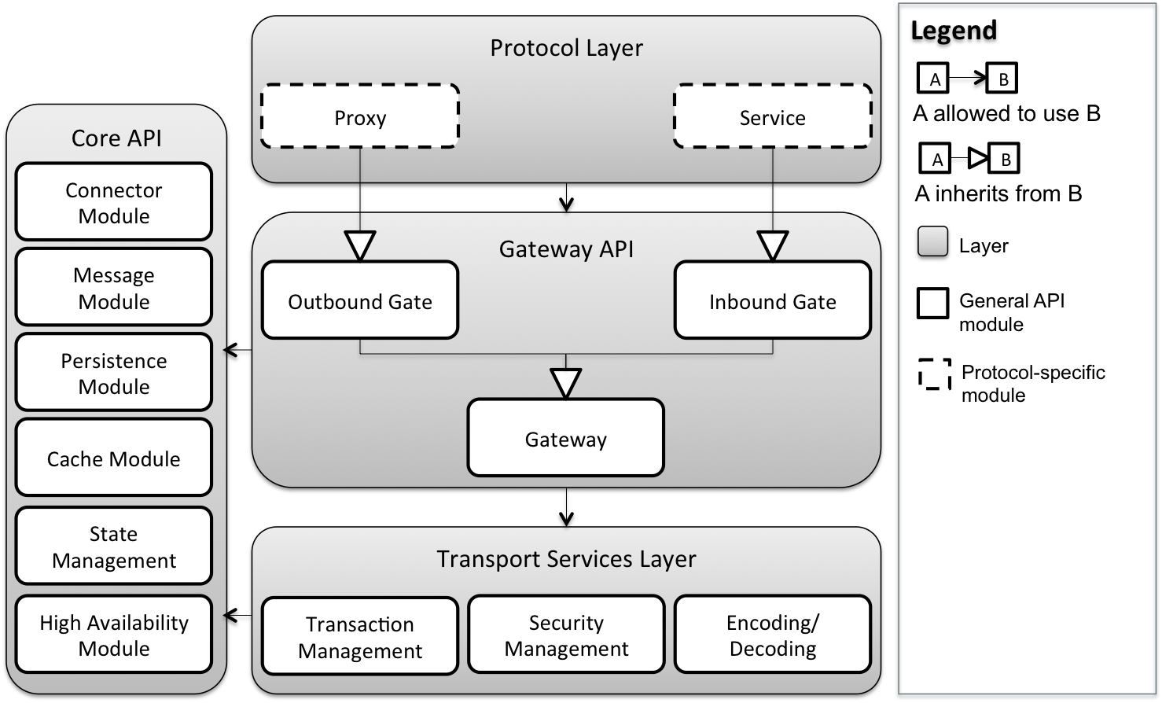
Backup: Allocation view and initial diagrams
10

Slide 11
Quality Activity: Smoke Testing

