Slide 1
Backup

Slide 2
Acceptance Criteria
An architecture that supports XMPP, HTTP, and AMQP transports
An analysis of scalability and performance thresholds
A reference implementation appropriate for demonstrating and verifying key architectural qualities
Well-documented design rationale

Slide 3
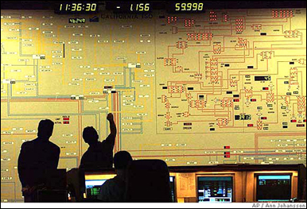





Project Context – Demand Response
1
Demand Response Event
Peak energy usage
Emergency curtailment
Utility/Grid Operator
2
Notification
Execute Energy Reduction Plans
3
Industrial
Institutional
Commercial
Feedback
4
Notes:
- Our system will reside with energy aggregators, such as EnerNOC to handle notification and feedback

Slide 4

Project Scope – Automated Demand Response
Feedback
Notification
VEN
Lighting
HVAC
<OpenADR 2.0 />
Machinery
Virtual Top Node
(EnerNOC)
Virtual End Node (Customer)
1,000 Nodes
Large Industrial
Business Goals
Untapped demand response markets
Lower implementation costs
Real-time monitoring and control
100,000 Nodes
Small Commercial
1,000,000 Nodes
Residential
Notes:
- Project scope is denoted by the grey dotted box

