Slide 1
Acceptance Criteria
An architecture that supports XMPP, HTTP, and AMQP transports
An analysis of scalability and performance thresholds
A reference implementation appropriate for demonstrating and verifying key architectural qualities
Well-documented design rationale

Slide 2
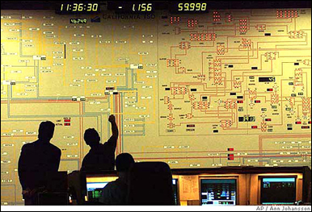





Project Context – Demand Response
1
Demand Response Event
Peak energy usage
Emergency curtailment
Utility/Grid Operator
2
Notification
Execute Energy Reduction Plans
3
Industrial
Institutional
Commercial
Feedback
4
Notes:
- Our system will reside with energy aggregators, such as EnerNOC to handle notification and feedback

Slide 3

Project Scope – Automated Demand Response
Feedback
Notification
VEN
Lighting
HVAC
<OpenADR 2.0 />
Machinery
Virtual Top Node
(EnerNOC)
Virtual End Node (Customer)
1,000 Nodes
Large Industrial
Business Goals
Untapped demand response markets
Lower implementation costs
Real-time monitoring and control
100,000 Nodes
Small Commercial
1,000,000 Nodes
Residential
Notes:
- Project scope is denoted by the grey dotted box

Slide 4
Week 1
Point value
Week

Slide 5
Week 2
Point value
Week

Slide 6
Week 3
Point value
Week

Slide 7
Week 4
Point value
Week

Slide 8
Week 5
Point value
Week

Slide 9
Week 6
Point value
Week

Slide 10
Week 7
Point value
Week

Slide 11
Week 8
Point value
Week

Slide 12
Week 9
Point value
Week

Slide 13
Week 10
Point value
Week

Slide 14
Week 11
Point value
Week

Slide 15
Week 12
Point value
Week

Slide 16
Iteration 12 Burndown
Hours

Slide 17
Iteration 13 Burndown
Hours

Slide 18
Task Relative Error

Slide 19
Average Task Relative Error

Slide 20
Top 3 Risks – Beginning of Summer 2012
Condition | Consequence | Mitigation Strategy
Transport-level security decisions not yet finalized in the OpenADR specification | May not finalize architecture design without addressing security | Continuous communication with customer on specification Isolate transport security components to enable future modifiability
Team will use Amazon Web Services for architecture verification; design mistakes can cost money | Team may deplete test budget | Define the budget before doing verification on AWS and continuously monitor actual cost against budget Test approval process
No hands-on experience with large-scale systems and detailed knowledge of transport protocols | May not deliver multi-transport architecture | Protocol extensibility experiments (half done) Short and iterative design
Notes:
- Status of the top 3 risks that were shown in Spring EOSP - What did we do to mitigate the top 3 risks.

Slide 21
Status of Risks over the Summer 2012
Number
Of
Risks
Week

Slide 22
Test Cases Distribution
Total Test Cases: 151

Slide 23
The consistency between architecture and prototype
Downstream
- Detail design team review make sure the detail design mapping to architecture design.
- Code review make sure the detail deign can mapping to the detail design.
Upstream
Implementation verify the quality attributes
If the implementation do not match the requirement on the quality attributes, change the detail design and re-implemention.
If the implementation match the requirement, change ADD.

Slide 24
Scenarios for QA: Protocol Extensibility
Source of stimulus | ADR vendors agree to use a new protocol
Stimulus | A software developer is adding support for a new protocol to the system
Environment | The developer is familiar with the relevant documentation and APIs, and the first three protocols are already provided by the reference implementation. The new protocol is based on TCP/IP. Reference architecture is released to the community.
Artifact | VTN
Response | The new protocol is successfully implemented and integrated into the system.
Response measure | Implementation and integration should require no changes to the existing system. Extensibility should be achieved through the existing interfaces.

Slide 25
Scenarios for QA : Service Extensibility
Source of stimulus | OASIS publishes a new version of the Energy Interoperation standard, which specifies new services or operations.
Stimulus | A developer adds a new OpenADR service or operation
Environment | Abstract service interfaces exist to support communication between VTN and VENs
Artifact | VTN
Response | The new service is added to the system.
Response measure | No interface modifications or deletions are required. However, adding new interfaces is permitted.

Slide 26
Scenarios for QA : Scalability
Source of stimulus | The number of messages/unit time increases.
Stimulus | New VTNs are added to the system due to growth of the business
Environment | Assuming each server stack can manage 50,000 VENs for the defined throughput (specified in a SLA), the VTN is now overloaded . However, limitations of underlying technologies may be disregarded.
Artifact | VTN
Response | The server resource is added and configured to handle the load.
Response measure | No software code-level changes are permitted and the required throughput is maintained. However, code changes are acceptable when scaling in order of magnitude (e.g. 10,000 VENs to 1,000,000 VENs).

Slide 27
Scenarios for QA: Performance Outbound latency
Source of stimulus | aggregator wants to send the DR event to end node users
Stimulus | An automated or manual message transfer is initiated
Environment | VEN ready for receive the event
Artifact | VTN
Response | The particular DR event is delivered to each of the intended VENs.
Response measure | Refer to Slow DR profile, Medium DR profile, Real-time DR profile.

Slide 28
Scenarios for QA: Performance Inbound latency
Source of stimulus | 10,000 VENs need to find out if they are intended to receive an event from the VTN
Stimulus | The VENs send messages to the VTN, polling for events. Or responding to events
Environment | VEN can communicate with VTN
Artifact | VTN
Response | Persistence the event from VEN
Response measure | Refer to Slow DR profile, Medium DR profile, Real-time DR profile.

Slide 29
Scenarios for QA: Performance Throughput
Source of stimulus | Messages sent from the VTN to the VENs in the case of a DR event.
Stimulus | An automated or manual message transfer is initiated
Environment | VEN VTN can communicate with each other.
Artifact | VEN,VTN
Response | The particular DR event is delivered to each of the intended VENs. Persistence the event from VEN.
Response measure | At any given time, the VTN system should be able to process 200 messages, both outgoing and incoming. For each message (outgoing or incoming), the processing time should not be more than 200ms .

Slide 30
Change on Architecture
Modify the split algorithm to enhance the performance
Modify Gateway API to be more practical
Service handlers change according to the requirement
Remove receiver component

Slide 31
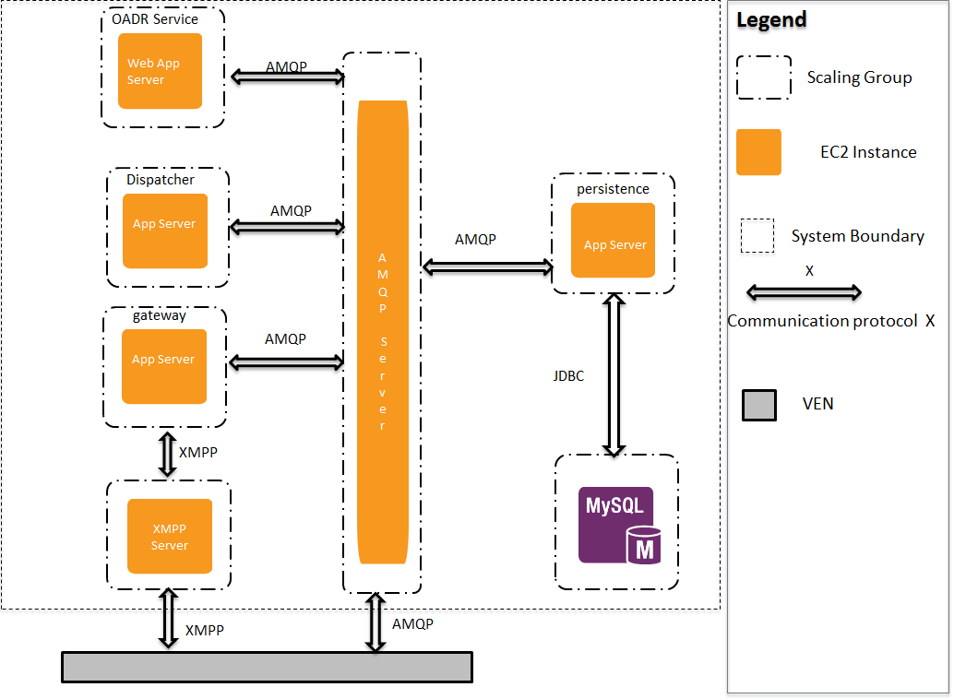
Allocation view and initial diagrams

Slide 32
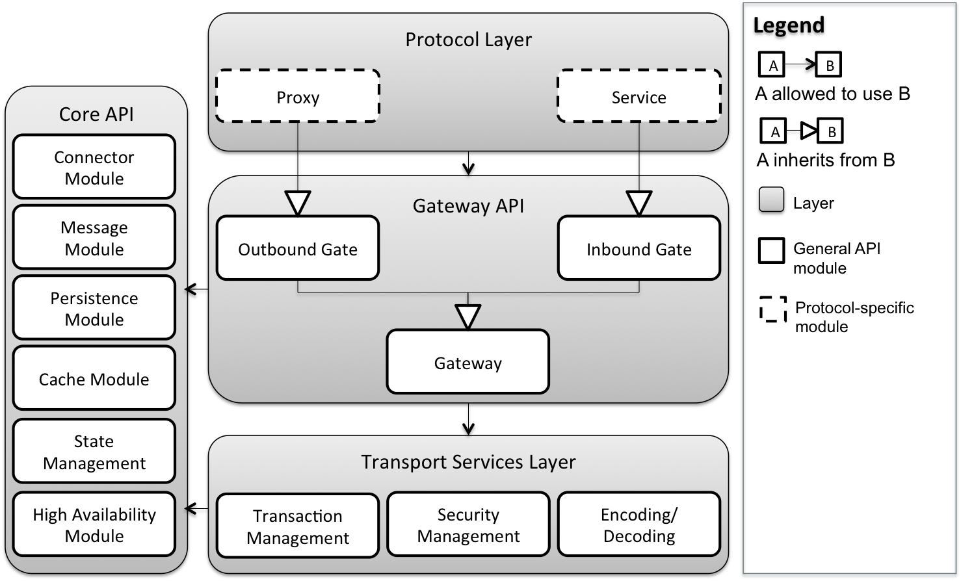
Allocation view and initial diagrams
32

