Slide 1

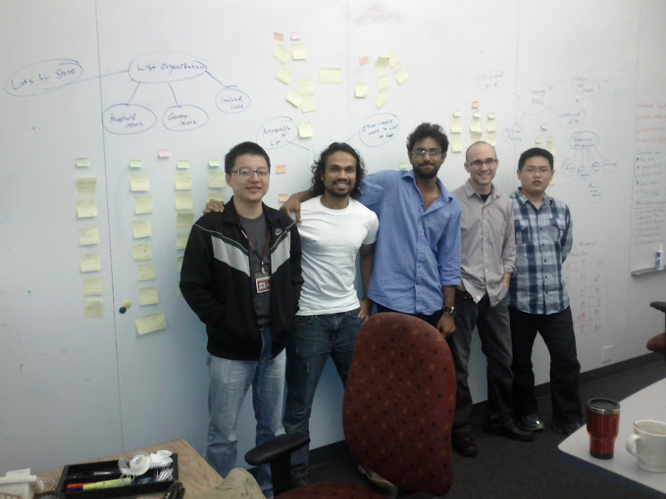



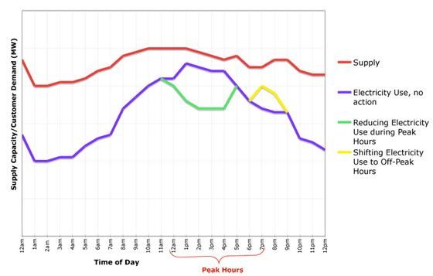
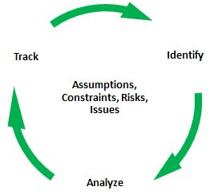
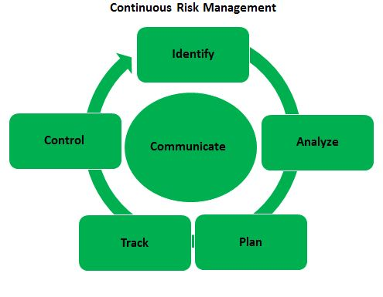
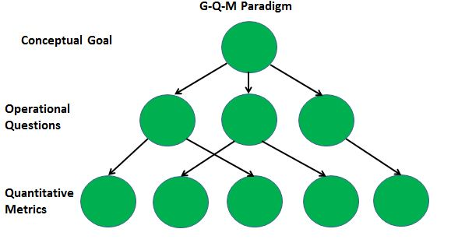
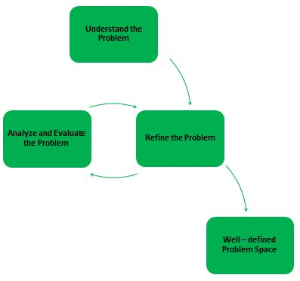
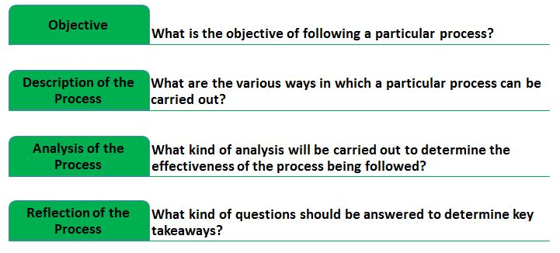
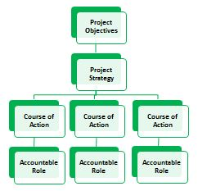
Voyage of the Argonauts (2011-2012)
Client - Jake
.. and the Argonauts
Mentors
Danny
Tharanga
Siddharth
Matt
A leading provider of energy management
applications for the smart grid
Rui
www.enernoc.com
Jake Thompson
Manager of Advanced Technology
EnerNOC, Inc.
Grace Lewis
Mel Rosso-Llopart
Bradley Schmerl
The Problem
The Solution
EnerNOC managing energy demand
Following are the project objectives and deliverables:
To design and deliver a reference architecture for a control system in accordance with the OpenADR 2.0 standard. This architecture should exhibit some key quality attributes, such as:
Scalability
Performance
Extensibility
To validate and demonstrate key architectural design decisions
Demand for electricity increases every year; however, electrical capacity (supply) is limited. Increased electrical demands result in higher costs, bigger carbon footprint, and environmental hazards.
Active steps need to be taken in order to bridge this increasing gap between energy demand and energy capacity.
EnerNOC acts as an “aggregator” between utility companies and large industrial/commercial institutions when energy demand is forecasted to exceed capacity.
Currently, managing energy demand is largely a manual process. There is a requirement to automate this entire process.
OpenADR 2.0 is an open standard for energy management that leverages automation to realize stability in the electrical distribution system. Hence, it serves to control and automate increasing demands from assets belonging to large industrial/commercial institutions.
September
2011
November 2011
December 2011
February
2012
May
2012
July
2012
November 2012
December
2012
Project kick-off
Process adopted, Roles defined
Success criteria and
acceptance criteria
established
Architectural drivers discovered,
Scope established
Version 1.0 of the architecture design delivered
Core elements of the architecture implemented
Go/No-go decision
made
Final
architecture design
delivered
Fall-2011
Spring-2012
Summer-2012
Fall-2012
Initial team formation, Project strategy formulation, Process establishment, Domain and problem understanding, Unstructured requirements gathering
Key takeaways:
Establish a concrete decision making process. Identify, analyze, and track assumptions and risks.
Establish a continuous feedback loop to re-evaluate the team’s understanding of the problem domain.
Assess the project’s objectives and strategy in order to understand where the project is and where you want it to be in 16 months. Set well-defined roles.
Team re-formation, Structured and iterative requirements gathering, Project scoping, Architecture designing
Key takeaways:
Formulate a risk-driven approach to get the project out of the period of uncertainty. Risk is the best means of measuring where the project is in the period of uncertainty.
Establish a risk-driven approach to architecture designing. Such an approach should answer key questions like “to what extent” for the non-trivial task of architecture designing.
s
Team re-formation, Architecture prototyping, Architecture evaluation
Key takeaways:
Institute the Goal-Question-Metric (GQM) model for data collection and analysis.
Data collection will serve its purpose only if it used for making project-related decisions.
Devise an agile, concrete, and a usable process proposal that force you to think first.
Implement a design such that it can be objectively evaluated and tested. Predictive design is a misnomer.
Team re-formation, Architecture evaluation, Architecture analysis
Key takeaways:
ACDM - Overview
ACDM - Stages
ACDM was the design process followed by the team to come up with the software architecture. It was one of the most significant aspects of the project.
Given the nature of our project, ACDM served as a strategic tool for coming up with a design and evaluating it.
A
Architecture Drivers Elicitation Workshop
C
Evaluate the Architecture Design
Do not spend too much time analyzing only the requirements. This leads to a waterfall-like approach to software development
Do make a conscious decision of getting out of the waterfall-like cycle, even though there are uncertainties
Do use evaluation as a means to synchronize design concepts among the team members
Do have the minimum design in place, along with sufficient prose for it to be effectively evaluated
Do have experienced engineers and architects evaluate the designs. Experienced architects can help novice designers communicate their design ideas effectively.
B
Create/Refine the Architecture
Do communicate design concepts among team members through requirements, and design documents. Otherwise, conceptual integrity of the design may be lost, leading to incomplete and incorrect solutions.
Do ensure that project planning activities are driven by the iterative designing model
Do not expect ACDM to teach you how to design. Do expect ACDM to force you to think about the problem space and business context that constrain the solution space and inform the design activity
D
Experimentation
Do conduct depth-first experiments to identify the unknown elements of a preliminary design. Otherwise, experiments may not answer the right questions
Understand the scope of an experiment and the unknowns it can and cannot address
Overall Takeaways
Formulate S.M.A.R.T objectives, and establish concrete entry and exit criteria for any kind of task/activity.
Ensure that there are measurements and metrics in place to identify the usefulness and effectiveness of processes.
Follow the Plan-Do-Check-Act cycle for project-related activities.

Slide 2
Track
Identify
Assumptions, Constraints, Risks, Issues
Analyze
Identify Initial Problem Space
Validate with Customer
Explore Problem Space
Problem Space Defined

Slide 3
Project Objectives
Project Strategy
Course of Action
Accountable Role

Slide 4
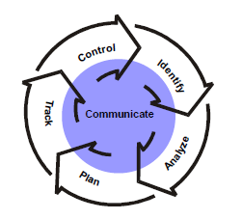
Continuous Risk Management
Identify
Communicate
Control
Analyze
Track
Plan

Slide 5
Plan
Do Work
Deliver Result
Take Corrective Actions
Measure Progress
Identify Issues, Risks, Opportunities
Project Control Cycle

Slide 6
Intelligible Design
Non-Intelligible Design
Component A
Legend:
Component A
Component
Component B
Queue
Component B
Component C
Component C
Element
Responsibility
1. Component A
2. Component B
3. Component C

Slide 7
Breadth-
First
Experiments
Non-specific and generalized outcome
Depth-
First
Experiments
Concrete and specific outcome
Fills theoretical knowledge gap
Fills knowledge gap by getting one step closer to implementation
Example: A survey of the commonalities among protocols.
Example: How does the Spring Framework work?

Slide 8
Discover Architectural Drivers & Establish Project Scope
A
Create/Refine Architecture
B
Architecture Review
C
Production Go/No-Go
Go
Production
Experimentation
D
ACDM Stages Followed

Slide 9
G-Q-M Paradigm
Conceptual Goal
Operational Questions
Quantitative Metrics
Objective
What is the objective of following a particular process?
Description of the Process
How should the process be carried out?
Analysis of the Process
How will we determine whether the process is working or not?
Reflection of the Process
What kind of questions should be answered to determine key takeaways?

