Slide 1

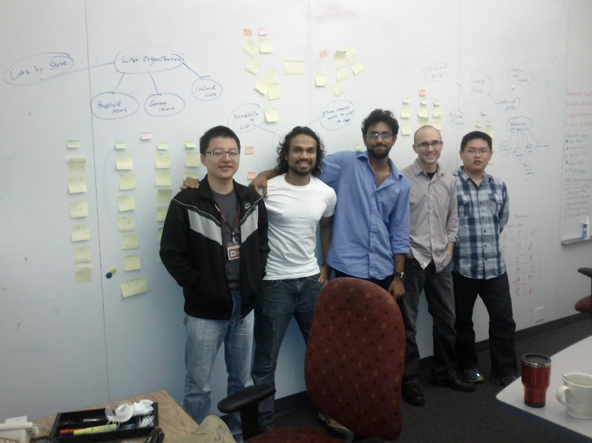



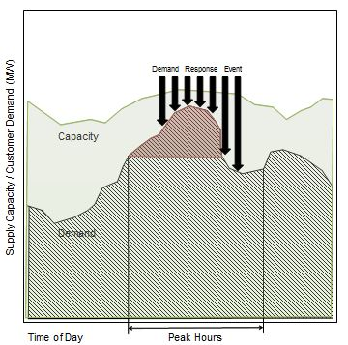
Voyage of the Argonauts (2011-2012)
Client - Jake
.. and the Argonauts
Mentors
Danny
Tharanga
Siddharth
Matt
A leading provider of energy management
applications for the smart grid
Rui
www.enernoc.com
Jake Thompson
Manager of Advanced Technology
EnerNOC, Inc.
Grace Lewis
Mel Rosso-Llopart
Bradley Schmerl
The Problem
The Solution
Managing energy demand
Design and deliver a reference architecture for a control system in accordance with the OpenADR 2.0 standard. This architecture should exhibit some key quality attributes, such as:
Scalability
Performance
Extensibility
Validate and demonstrate key architectural design decisions
Demand for electricity increases every year; however, electrical capacity (supply) is limited. Increased electrical demand results in higher costs, and environmental hazards.
Active steps need to be taken in order to bridge this increasing gap between energy demand and energy capacity during peak usage.
EnerNOC acts as an “aggregator” between utility companies and large industrial/commercial institutions when energy demand is forecasted to exceed capacity.
Currently, managing energy demand is largely a manual process. There is a requirement to automate this entire process.
OpenADR 2.0 is an open standard for energy management that leverages automation to realize stability in the electrical distribution system.
September
2011
November 2011
December 2011
February
2012
May
2012
July
2012
August
2012
November 2012
December
2012
Project
kick-off
Process adopted, Roles defined
Success criteria and
acceptance criteria
established
Architectural drivers discovered,
Scope established
Initial architecture design delivered
Critical
architectural elements prototyped
No-go decision made
Go/No-go decision
made
Final
architecture and prototype delivered
Fall-2011
Spring-2012
Summer-2012
Fall-2012
Initial team formation, Project strategy formulation, Process establishment, Domain and problem understanding, Unstructured requirements gathering
Key recommendations:
Establish concrete decision making process
Iteratively explore the problem space
Operationalize project strategy using courses of action and accountable roles
Team re-formation, Structured and iterative requirements gathering, Project scoping, Architecture designing
Key recommendations:
Use a risk-driven approach to measure where the project is in the period of uncertainty.
Risk should answer key questions like “to what extent” for the non-trivial task of architecture designing.
s
Team re-formation, Architecture prototyping, Architecture evaluation
Key recommendations:
Base data collection on concrete goals. It will serve its purpose only if data is used for decision-making.
Follow the studio process proposal framework to think before you act.
Team re-formation, Architecture evaluation, Architecture analysis
Key recommendations:
Continue planning, and re-planning by taking corrective actions until the end of the project. Planning cannot be completed until the project is completed.
Track
Assumptions, Constraints, Risks, Issues
Identify
Conceptual Goal
Analyze
Operational Questions
Plan
Identify Initial Problem Space
Identify
Quantitative Metrics
Do Work
Deliver Result
Validate with Customer
Explore Problem Space
Problem Space Defined
Control
Communicate
Analyze
Objective
What is the objective of following a particular process?
Take Corrective Actions
Measure Progress
Project Objectives
Description of the Process
How should the process be carried out?
Project Strategy
Track
Plan
Analysis of the Process
How will we determine whether the process is working or not?
Identify Issues, Risks, Opportunities
Course of Action
Reflection of the Process
Accountable Role
What kind of questions should be answered to determine key takeaways?
ACDM - Overview
ACDM - Stages
Architecture Centric Design Method (ACDM) was the design process followed by the team to come up with the software architecture.
ACDM served as a strategic tool for coming up with a design and evaluating it.
A
Architecture Drivers Elicitation Workshop
C
Evaluate the Architecture Design
Do not spend too much time analyzing only the requirements. This leads to a waterfall-like approach to software development.
Do make a conscious decision of getting out of the waterfall-like cycle, even though there are uncertainties.
Do have the minimum design in place, along with sufficient prose for it to be effectively evaluated.
Do have experienced engineers and architects evaluate the designs. Experienced architects can help novice designers communicate their design ideas effectively.
Discover Architectural Drivers & Establish Project Scope
A
D
Experimentation
Create/Refine Architecture
B
Create/Refine the Architecture
Breadth-
First
Breadth-
First
Conduct experiments that are appropriate to the question: breadth-first or depth-first
Clearly define the objective, scope, and deliverables of an experiment.
B
Do communicate design concepts with team members through design reviews. Otherwise, conceptual integrity of the design may be lost, leading to incomplete and incorrect solutions.
Do ensure that project planning activities are driven by the iterative design model.
Do not expect ACDM to teach you how to design; do expect ACDM to force you to think about the problem space and business context that constrain the solution.
Non-specific and generalized outcome
Concrete and
specific outcome
Architecture Review
Fills theoretical knowledge gap
Fills knowledge gap by getting one step closer to implementation
C
Go
Production Go/No-Go
Production
Example: A survey of the commonalities among protocols.
Example: How does the Spring Framework work?
Experimentation
D
Overall Takeaways
Formulate Specific, Measurable, Achievable, Realistic, Time-bound objectives, and establish concrete entry and exit criteria for any kind of task/activity.
Ensure that there are measurements and metrics in place to identify the usefulness and effectiveness of processes.
Recognize strengths of your customer, and leverage those in relevant project activities.

