Slide 1

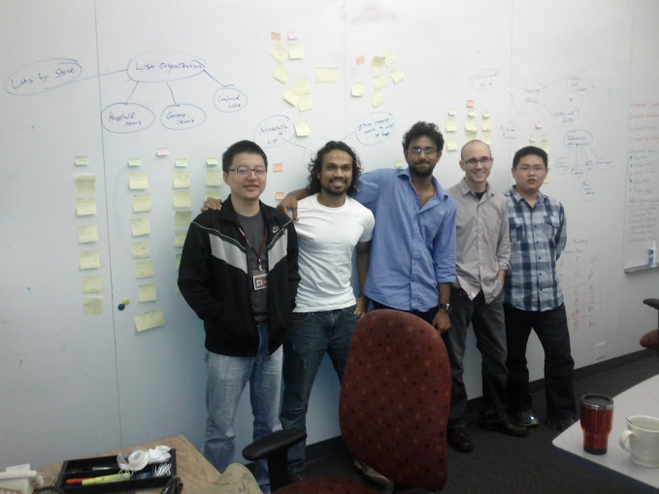



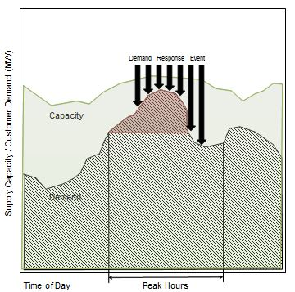
Voyage of the Argonauts (2011-2012)
The Client …
… and the Argonauts
Our Guides
Danny
Tharanga
Siddharth
Matt
A leading provider of energy management
applications for the smart grid
Rui
www.enernoc.com
Jake Thompson
Manager of Advanced Technology
EnerNOC, Inc.
Grace Lewis
Mel Rosso-Llopart
Bradley Schmerl
Our Mission
Our Destination
Managing Energy Demand
Reference Architecture
Demand for energy increases each year; however, energy capacity (supply) is limited. Increased energy demand results in higher costs and an unstable electrical grid.
EnerNOC acts as an “aggregator” between utility companies and large industrial/commercial institutions and takes action when energy demand is predicted to exceed capacity.
Currently, reducing energy demand during peak hours is done manually. OpenADR 2.0 is an open standard for energy management that automates such Demand Response.
OpenADR 2.0 is simply an information model; it does not account for practical Demand Response requirements such as scalability, latency, throughput, or support for multiple protocols.
EnerNOC wants assurance that a Demand Response system designed in accordance with OpenADR 2.0 will meet their business needs.
EnerNOC wants to be the thought-leader in the evolution of OpenADR 2.0.
Design and prototype a reference architecture in accordance with the OpenADR 2.0 standard. This architecture should exhibit key quality attributes, such as:
Scalability
Performance
Extensibility
Validate and demonstrate key architectural design decisions
September
2011
November 2011
December 2011
February
2012
May
2012
July
2012
August
2012
November 2012
December
2012
Project
kick-off
Process
adopted,
Roles defined
Success
criteria
established
Architectural drivers discovered,
Scope established
Initial architecture design delivered
Critical
elements
prototyped
No-go decision made
Go/No-go decision
made
Final
architecture and prototype delivered
Fall 2011
Spring 2012
Summer 2012
Fall 2012
Team formation, Project strategy and process establishment, Domain understanding, Ad-hoc requirements
Key recommendations:
Establish a concrete decision-making process
Iteratively explore
the problem space
Operationalize project strategy using courses of action and accountable roles
Team re-formation, Structured and iterative requirements gathering, Project scoping, Architecture design
Key recommendations:
Use a risk-driven approach to track the project in the period of uncertainty.
Risk should help to answer key questions like “to what extent do we document?” or “how long should we spend in design?”
s
Team re-formation, Architecture prototyping, Architecture evaluation
Key recommendations:
Base data collection on concrete goals. It will serve its purpose only if data is used for decision-making.
Follow the studio process proposal framework to think before you act.
Team re-formation, Architecture evaluation, Architecture analysis
Key recommendations:
Continue planning and re-planning by taking corrective actions until the end of the project. Planning is not finished until the project is complete.
Track
Assumptions, Constraints, Risks, Issues
Identify
Conceptual Goal
Analyze
Operational Questions
Plan
Identify Initial Problem Space
Identify
Quantitative Metrics
Do Work
Deliver Results
Validate with Customer
Explore Problem Space
Problem Space Defined
Control
Communicate
Analyze
Objective
What is the objective of following a particular process?
Take Corrective Actions
Measure Progress
Project Objectives
Process Description
How should the process be carried out?
Project Strategy
Track
Plan
Process Analysis
How will we determine whether the process is working or not?
Identify Issues, Risks, Opportunities
Course of Action
Process Reflection
What are the key takeaways from following the process?
Accountable Role
Our Compass
Followed the Architecture Centric Design Method (ACDM) to develop and evaluate the Reference Architecture.
A
Architecture Drivers Elicitation Workshop
C
Evaluate the Architecture Design
Do not spend too much time analyzing only the requirements. This leads to a waterfall-like approach to software development.
Do make a conscious decision to get out of the waterfall-like mindset, even though there are uncertainties.
Do have the minimum design in place, along with sufficient prose for it to be effectively evaluated.
Do have experienced engineers and architects evaluate the designs. Experienced architects can help novice designers communicate their design ideas effectively.
Discover Architectural Drivers & Establish Project Scope
A
B
Create/Refine the Architecture
D
Experimentation
Create/Refine Architecture
Conduct experiments that are appropriate to fill knowledge gaps: breadth-first or depth-first
Clearly define the objective, scope, and deliverables of an experiment.
B
Do communicate design concepts with team members through design reviews. Otherwise, conceptual integrity of the design may be lost, leading to incomplete and incorrect solutions.
Do ensure that project planning activities are driven by the iterative design model.
Do not expect ACDM to teach you how to design; do expect ACDM to force you to think about the problem space and business context to constrain the solution.
Breadth-
First
Non-specific and generalized outcome
Depth-
First
Concrete and
specific outcome
Architecture Review
C
Fills theoretical knowledge gap
Fills knowledge gap by getting one step closer to implementation
Production Go/No-Go
Go
Production
Example: A survey of commonalities among protocols.
Example: How does the Spring Framework work?
Experimentation
D
Our Sails
Formulate Specific, Measurable, Achievable, Realistic, Time-bound objectives, and establish concrete entry and exit criteria for every kind of task/activity.
Ensure that there are measurements and metrics in place to identify the usefulness and effectiveness of processes.
Recognize strengths of your customer, and leverage those in relevant project activities.

