Slide 1
Status Meeting [30 minutes]
ARGONAUTS
2012.01.24
Team semester goals [2 min]
Close action items [3 min]
Project Status [12 min]
Process Reflection [8min]
Mentor Minutes [5 min]

Slide 2
Team Goals[2 min] - Rui
ARGONAUTS

Slide 3
Close Action Items [3 min] - Rui
ARGONAUTS
Close open items

Slide 4
Project Status [12 min] - Sid
ARGONAUTS
Where are we? Where are we going?

Slide 5

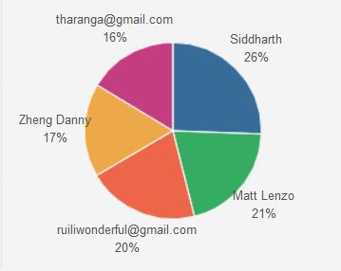
Time Distribution Among Team Members (Week of 1/15/2012)

Slide 6
Significant Achievements (Week of 1/15/2012)
Goals & objectives have been clearly formulated.
Roles & responsibilities have been clearly understood and revised.
Iteration – 5 tasks have been populated.
Agenda has been sent to the client for the workshops.

Slide 7
The Present Week (Week of 1/22/2012)
Various metrics the team wants to collect.
Incorporation of a tracking mechanism.
Start with stage-2 of ACDM ( i.e. analysis of the architectural drivers collected so far).
Updating of the Master Design Plan.

Slide 8
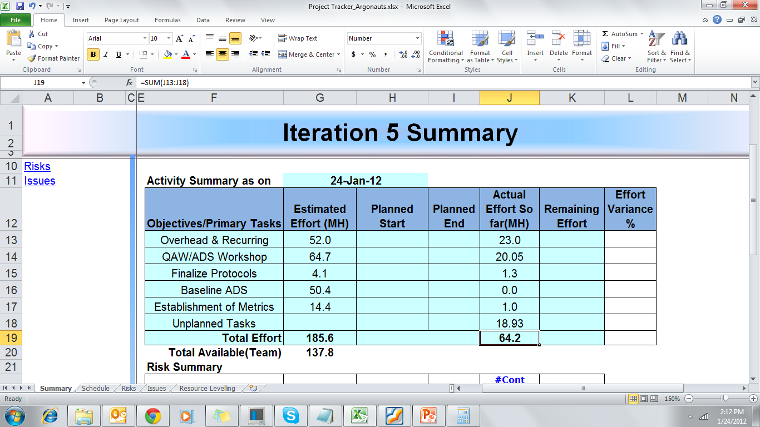
Iteration – 5 Summary
Total Available:
137.8
Total Estimated(without overhead): 133.6

Slide 9
Process Reflection [8 min] - Tharanga
ARGONAUTS
What are we doing?

Slide 10
Mentor Minutes [5 min]
ARGONAUTS
Feedback.

