Slide 1
Status Meeting [50 minutes]
ARGONAUTS
2012.05.29
Changed Plan Of Action and Milestone Chart for Summer [5mins]-TG
Round Table [3mins]-Team
Action Items [2mins]-Sid
Project Progress [10mins]-TG
Architecture Design Updates [5mins]-Rui
Architecture Experiments Updates [5mins]-Dan
Metrics and Measurements [5mins]-Matt
Open Risks and Mitigation Strategies [5mins]-TG
Mentor Comments [10mins]-Team

Slide 2
Changed POA and Milestone Chart[5 min] - TG
ARGONAUTS

Slide 3
Summer 2012 Milestones
May
June
July
August
September
1 | 2 | 3 | 4 | 5 | 6 | 7 | 8 | 9 | 10 | 11 | 12 | 13 | 14 | 15 | 16 | 17
Infrastructure, Tools
and AWS Training
Experiments and Design revisions
Verification Plan
Architecture stub
Architecture
Verified
EOSP
12
13
14
15
16
17
18
19
20
21
Iterations

Slide 4
Changing POA for Summer
Problem
Infeasible semester goal
“Waterfallish”, verification at the end
Solution (To be finalized)
Experiment –> Detail Design -> Stub implementation
Verifying step by step

Slide 5
Round Table[3 min] - Team
ARGONAUTS

Slide 6
Action Items[2 min] - Sid
ARGONAUTS

Slide 7
Project Progress[10 min] - TG
ARGONAUTS

Slide 8
Change in the planning process
Start with couple of weekly iterations
Basecamp for both work packages and tasks
Task board for visibility and tracking
Resource leveling with less overhead

Slide 9
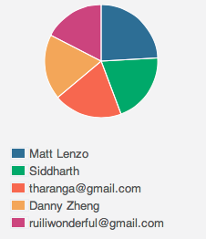
Week 1 Total Time – 206 Hours

Slide 10
Iteration 12 Burn down
Hours
Days

Slide 11
Overall Progress – Summer 2012
Value
Week

Slide 12
Architecture Design Updates [5 min] - Rui
ARGONAUTS

Slide 13
Architecture Experiments Updates [5 min] - Dan
ARGONAUTS

Slide 14
Metrics and Measurements [5 min] - Matt
ARGONAUTS

Slide 15
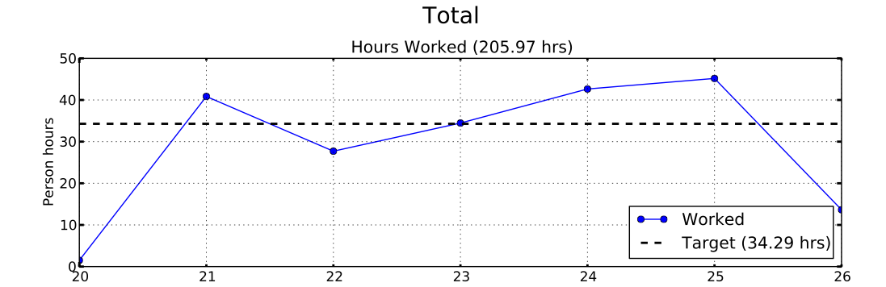
Sustainable Pace Goal

Slide 16
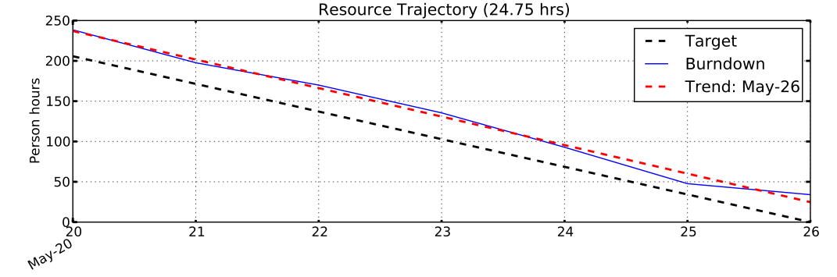
Sustainable Pace Goal
Recommendations:
Don’t count on much collaborative work on weekends
Plan daily targets at least one week in advance
Front-load meetings and overhead on Mondays

Slide 17
30% Overhead Goal
Resource | Week-1 Overhead
Team Lead | 41%
Chief Architect | 21%
Development Lead | 31%
Planning Manager | 60%
Quality Assurance | 32%
Team | 37%

Slide 18
30% Overhead Goal
Week-1 Overhead Activity | Hours
WP00.1.1: Iteration 12 Planning | 23hrs
WP00.1.9: Planning and Tracking | 15hrs
WP00.1.20: Backlog/Issue Mtg. | 10hrs
WP00.1.8: Kickoff Mtg. | 8hrs
Recommendations:
Time-box and monitor planning meeting cost
Automate creation of task cards from Basecamp
Streamline and identify duplication of planning/tracking effort

Slide 19
Period of Certainty Goal
Issue Type | Open | Dominant Method
Design Defects | 27 Issues
Documentation Defects | 8 Issues | ADEW
Protocol Extensibility | 11 Issues | Experimentation
Availability | 10 Issues | ADEW
Performance | 8 Issues | ADEW
Scalability | 5 Issues | ADEW
Service Extensibility | 1 Issue | ADEW

Slide 20
Open Risks and Mitigation Strategies [5 min] - TG
ARGONAUTS

Slide 21
Top 3 Risks
System security requirement is not yet finalized
Cost of using AWS
No experience with large scale systems

Slide 22
Mentor Comments[10 min] - Team
ARGONAUTS

