Slide 1
Status Meeting [50 minutes]
ARGONAUTS
2012.06.05
Round Table [3 min]-Team
Action Items [2 min]-Sid
Project Progress [15 min]-TG
Architecture Design Updates [5 min]-Rui
Architecture Experiments Updates [5 min]-Dan
Metrics and Measurements [5 min]-Matt
Open Risks and Mitigation Strategies [5 min]-TG
Mentor Comments [10 min]-Team

Slide 3
Round Table[3 min] - Team
ARGONAUTS

Slide 4
Action Items[2 min] - Sid
ARGONAUTS

Slide 5
Project Progress[15 min] - TG
ARGONAUTS

Slide 6
Summer 2012 Milestones
May
June
July
August
September
1 | 2 | 3 | 4 | 5 | 6 | 7 | 8 | 9 | 10 | 11 | 12 | 13 | 14 | 15 | 16 | 17
Infrastructure, Tools
AWS Training
Protocol Gateway
Implemented
Database and Core Components
EOSP
Architecture Stub
Design
Revisions
Architecture
Verified
Scalability and
Performance Verified
12
15
14
20
13
16
17
18
19
21
19
22
Iterations

Slide 7
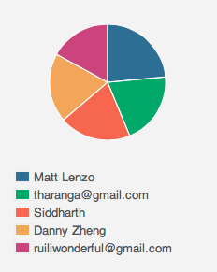
Week 2 Total Time – 202.5 Hours

Slide 8
Iteration 13 Burn down
Hours
Days

Slide 9
Iteration 13
Two outstanding tasks
Documenting conceptual data model
Physical data model – [Iteration 14 backlog]
Why iteration was not complete?
Few serial tasks in one big work package
Confusion on tasks

Slide 10
Iteration 14
Creating Solution According to the static architecture
Experiment - Design- Implementation
Core Connector module
Core Message module
Experiment on caching
QA Tools

Slide 11
Changes on planning
Set 42 hours as the realistic target – 210 hours
Evaluate estimation accuracy with Planned vs. Estimated
Independent tasks in iteration backlog

Slide 12
Overall Progress – Summer 2012
Value
Week

Slide 13
Architecture Design Updates [5 min] - Rui
ARGONAUTS

Slide 14
Status
Protocol extensibility (core API)
Data model design (physical model, only relational database)
Core technologies experiments
will last 2 iterations

Slide 15
Issues we have

Slide 16
Architecture Experiments Updates [5 min] - Dan
ARGONAUTS

Slide 17
Metrics and Measurements [5 min] - Matt
ARGONAUTS

Slide 18
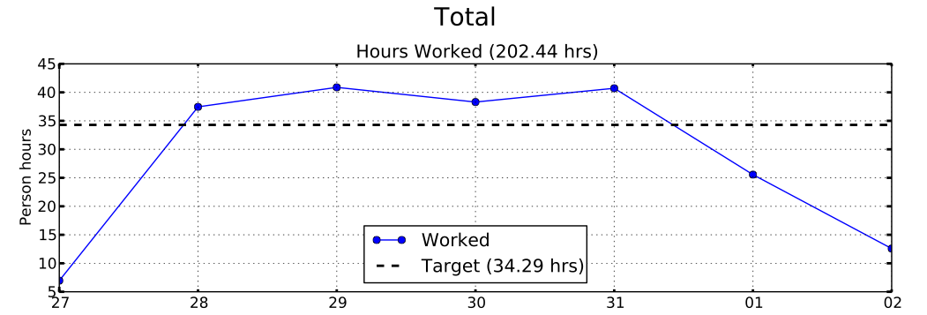
Sustainable Pace Goal – 48hrs

Slide 19
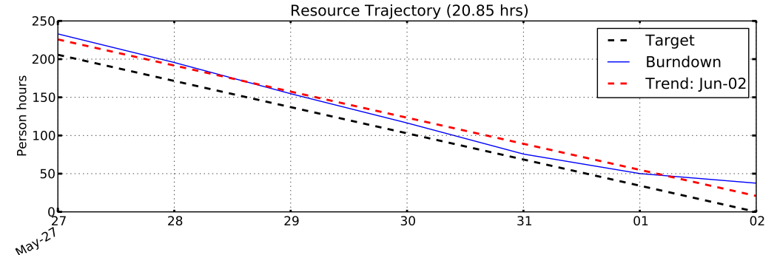
Sustainable Pace Goal – 48hrs
Recommendation:
48 task hours per person-week is not sustainable
Plan using 42 task hours per person-week

Slide 20
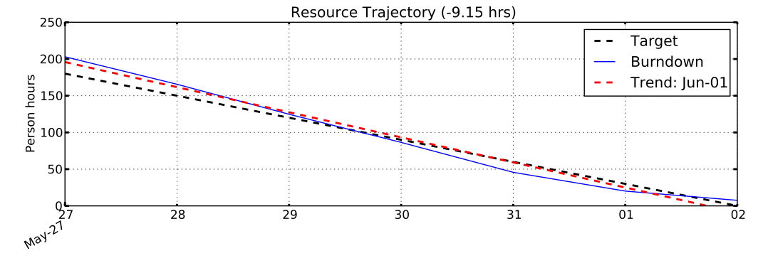
Sustainable Pace Goal – 42hrs

Slide 21
30% Overhead Goal
Resource | Week-1 | Week-2 | % Change
Team Lead | 41% | 24% | -42%
Chief Architect | 21% | 35% | +69%
Development Lead | 31% | 22% | -29%
Planning Manager | 60% | 47% | -22%
Quality Assurance | 32% | 33% | +2%
Team | 37% | 32% | -14%

Slide 22
30% Overhead Goal
Week-2 Overhead Activity | Hours
WP00.1.24: Iteration 13 Planning | 21hrs
WP00.1.5: Standup Meetings | 8.5hrs (30min / meeting)
WP00.1.9: Planning and Tracking | 7.8hrs (-48%)
Potential Issues:
Standup meetings are exceeding 15min/meeting

Slide 23
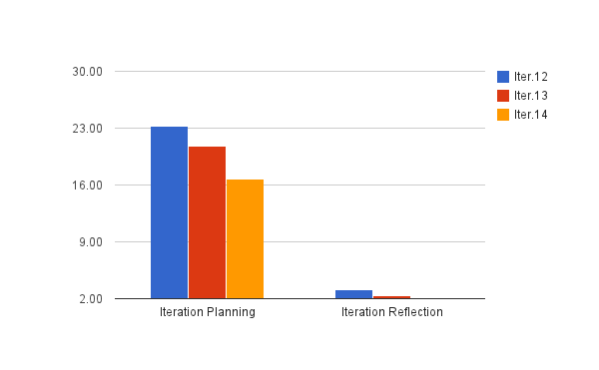
30% Overhead Goal
-11%
-20%

Slide 24
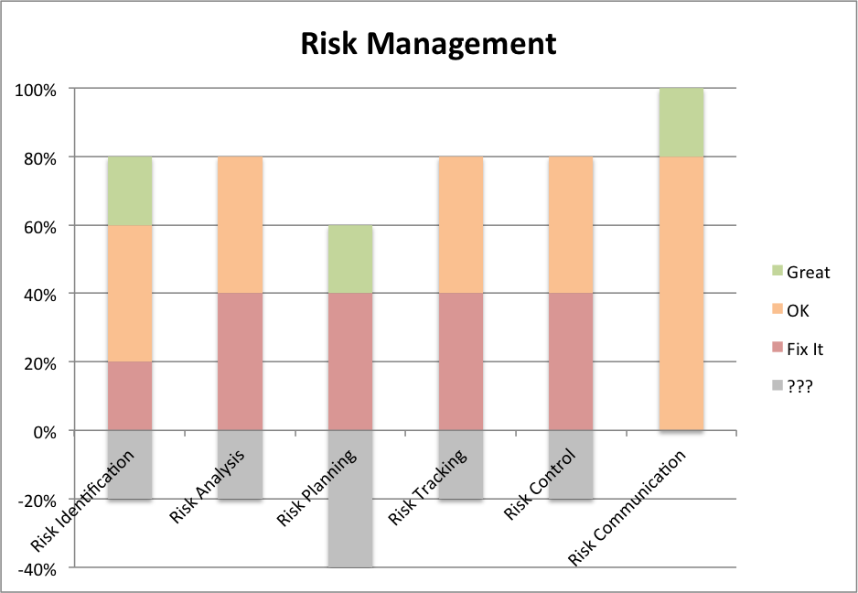
General Indicators

Slide 25
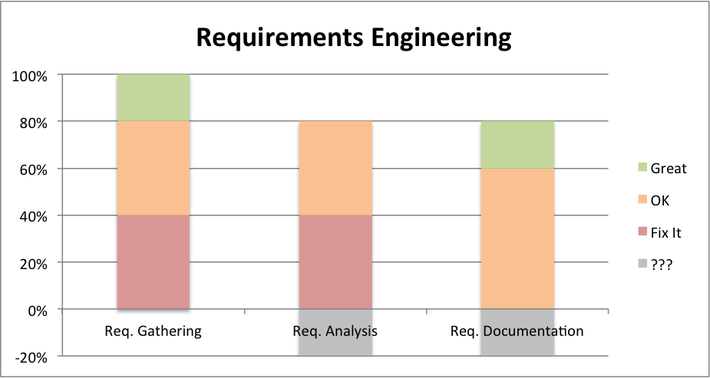
General Indicators
QA Improvements:
ETVX criteria for tasks
Iteration Reflection

Slide 26
Open Risks and Mitigation Strategies [5 min] - TG
ARGONAUTS

Slide 27
Top 3 Risks
Condition | Consequence
The system security requirement is still not clear | We may need to change our arch. corresponding to the design for security, however it may have a impact on whole arch
Team will use AWS for implementation and evaluation and AWS costs money | The team may overrun its budget given by the customer
No experience with large-scale systems or technical knowledge on protocol transports | May be not able to design the multi-transport architecture

Slide 28
Mentor Comments[10 min] - Team
ARGONAUTS

