Slide 1
Status Meeting [50 minutes]
ARGONAUTS
2012.06.05
Round Table [3 min]-Team
Action Items [2 min]-Sid
Project Progress [15 min]-TG
Architecture Design Updates [5 min]-Rui
Architecture Experiments Updates [5 min]-Dan
Metrics and Measurements [5 min]-Matt
Open Risks and Mitigation Strategies [5 min]-TG
Mentor Comments [10 min]-Team

Slide 2
Round Table[3 min] - Team
ARGONAUTS

Slide 3
Action Items[2 min] - Sid
ARGONAUTS

Slide 4
Project Progress[15 min] - TG
ARGONAUTS

Slide 5
Architecture Design Updates [5 min] - Rui
ARGONAUTS

Slide 6
Architecture Experiments Updates [5 min] - Dan
ARGONAUTS

Slide 7
Metrics and Measurements [5 min] - Matt
ARGONAUTS

Slide 8
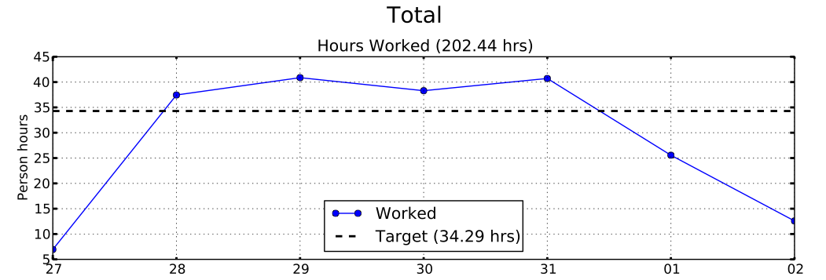
Sustainable Pace Goal – 48hrs

Slide 9
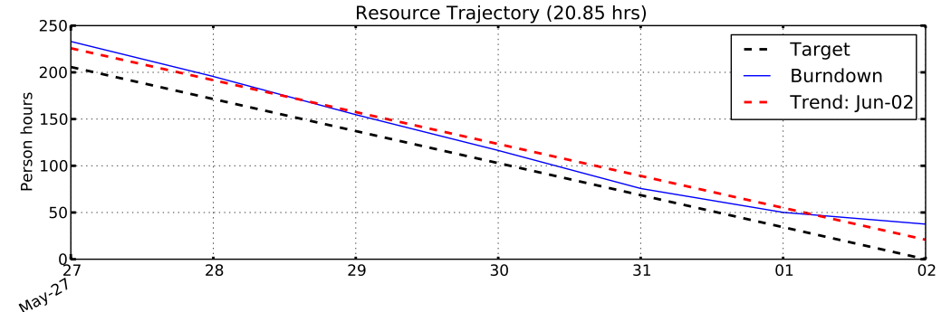
Sustainable Pace Goal – 48hrs
Recommendation:
48 task hours per person-week is not sustainable
Plan using 42 task hours per person-week

Slide 10
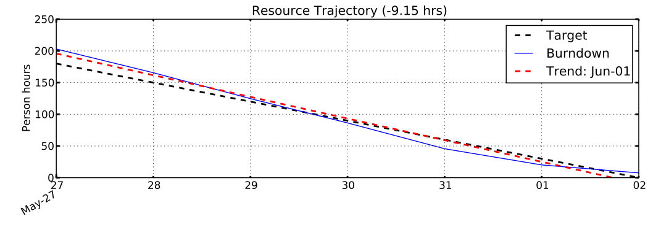
Sustainable Pace Goal – 42hrs

Slide 11
30% Overhead Goal
Resource | Week-1 | Week-2 | % Change
Team Lead | 41% | 24% | -42%
Chief Architect | 21% | 35% | +69%
Development Lead | 31% | 22% | -29%
Planning Manager | 60% | 47% | -22%
Quality Assurance | 32% | 33% | +2%
Team | 37% | 32% | -14%

Slide 12
30% Overhead Goal
Week-2 Overhead Activity | Hours
WP00.1.24: Iteration 13 Planning | 21hrs
WP00.1.5: Standup Meetings | 8.5hrs (30min / meeting)
WP00.1.9: Planning and Tracking | 7.8hrs (-48%)
Potential Issues:
Standup meetings are exceeding 15min/meeting

Slide 13
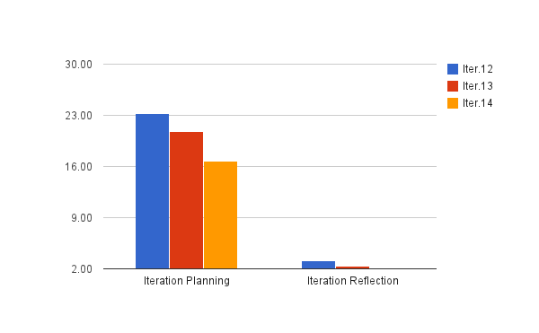
30% Overhead Goal
-11%
-20%

Slide 14
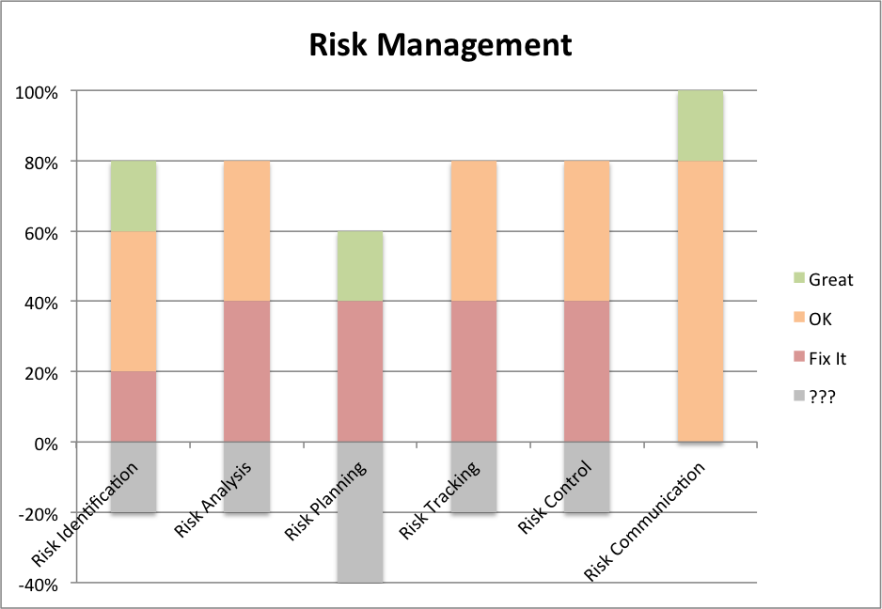
General Indicators

Slide 15
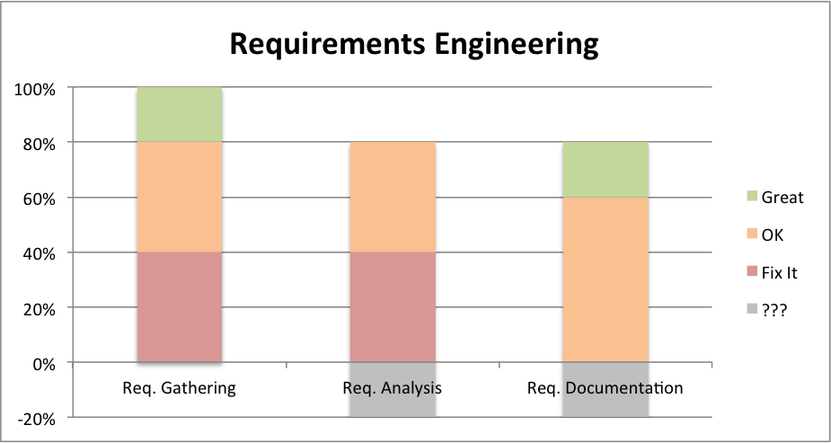
General Indicators
QA Improvements:
ETVX criteria for tasks
Iteration Reflection

Slide 16
Open Risks and Mitigation Strategies [5 min] - TG
ARGONAUTS

Slide 17
Mentor Comments[10 min] - Team
ARGONAUTS

