Slide 1
Status Meeting [55 minutes]
ARGONAUTS
2012.06.12
Round Table [3 min]-Team
Action Items [2 min]-Sid
Project Progress [15 min]-TG
Architecture Design Updates [5 min]-Rui
Architecture Experiments Updates [5 min]-Dan
Metrics and Measurements [5 min]-Matt
Open Risks and Mitigation Strategies [5 min]-TG
Mentor Comments [15 min]-Team

Slide 2
Round Table[3 min] - Team
ARGONAUTS

Slide 3
Action Items[2 min] - Sid
ARGONAUTS

Slide 4
Project Progress[15 min] - TG
ARGONAUTS

Slide 5
Iteration 14 Burn down
Hours
Days

Slide 6
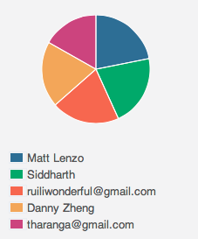
Week 3 Total Time – 195.5 Hours

Slide 7
Overall Progress – Summer 2012
Value
Week

Slide 8
Legend
In-Progress
Done
Not Started
A
B
A allowed to use B
OADR
Services
Layer
Framework
Dispatcher
Receiver
Persistence
XMPP
Gateway
Module
Handlers
Gateway API
Payloads
XMPP Stub
Facade
Core
Connector
Cache
Message
Error
Log
Config
Persistence
StateMgt
Data

Slide 9
Architecture Design Updates [5 min] - Rui
ARGONAUTS

Slide 10
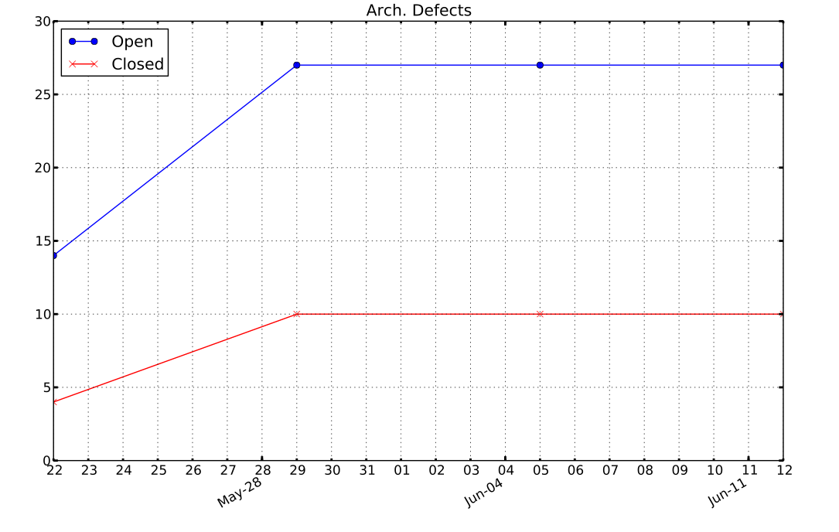

Slide 11
Architecture Experiments Updates [5 min] - Dan
ARGONAUTS

Slide 12
Metrics and Measurements [5 min] - Matt
ARGONAUTS

Slide 13
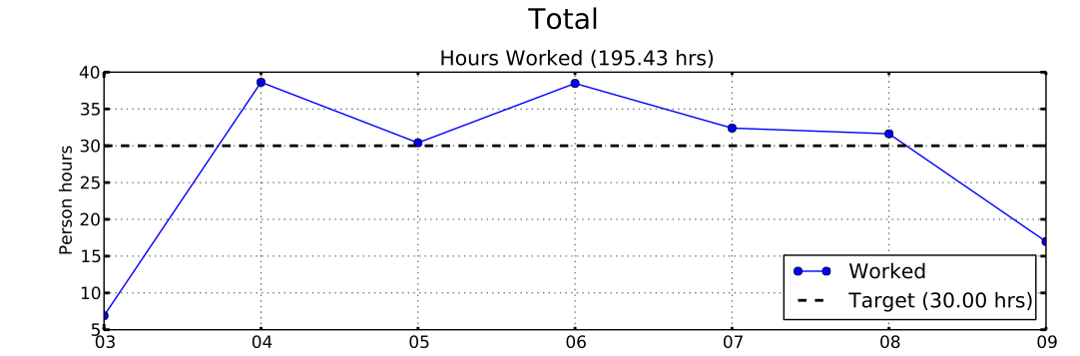
Sustainable Pace Goal – 42hrs
“Answer to the ultimate question of life, the universe, and everything: 42.”
Majority of work hours remaining after Friday are not used.

Slide 14
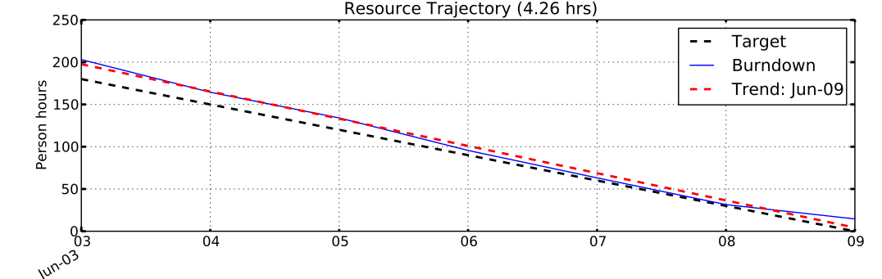
Sustainable Pace Goal – 42hrs
“Answer to the ultimate question of life, the universe, and everything: 42.”

Slide 15
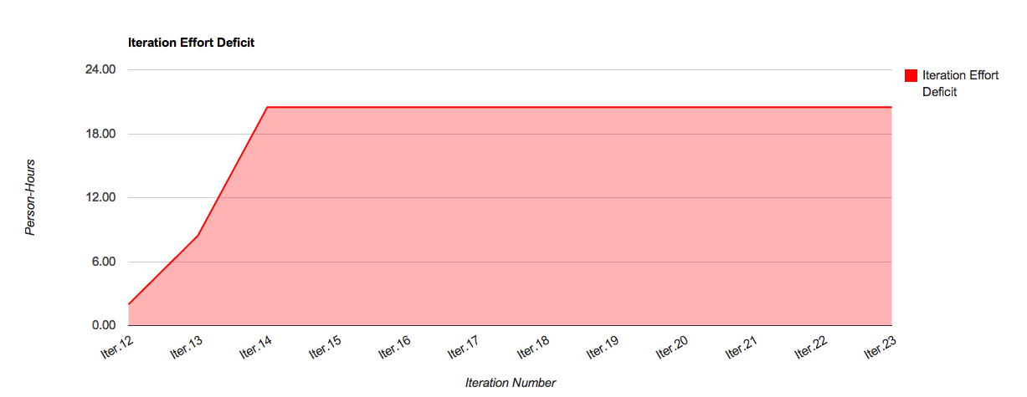
Iteration Deficit: 20.48 hrs

Slide 16
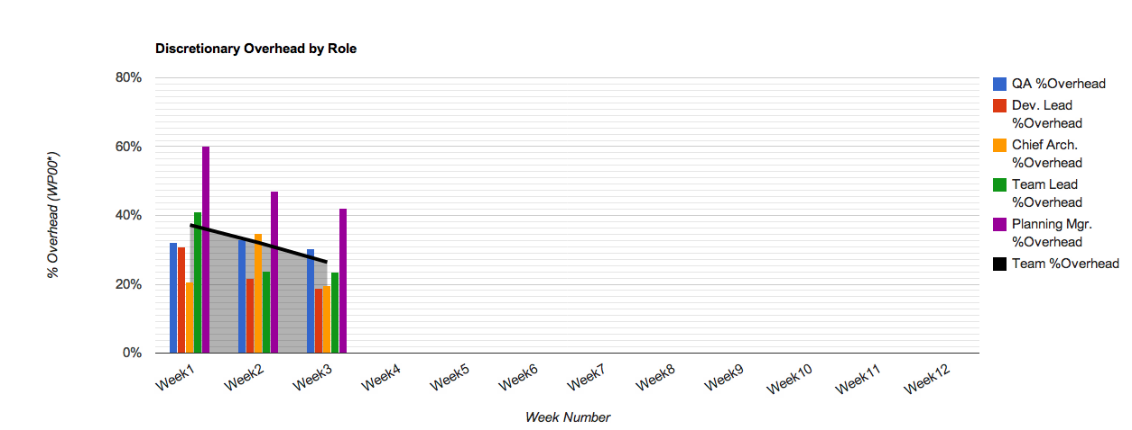
30% Overhead Goal
Resource | % Overhead | Resource | % Overhead
Team Lead | 23% | Planning Manager | 42%
Chief Architect | 20% | Quality Assurance | 30%
Development Lead | 19% | Team | 26%

Slide 17
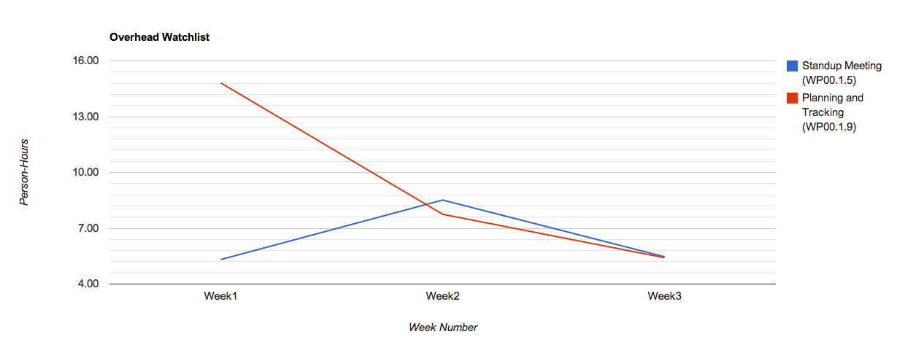
Overhead Watchlist
Top 3 Overhead Activities
WP00.1.27: Iteration 14 Planning
WP00.1.5: Standup Meetings
WP00.1.9: Planning and Tracking

Slide 18
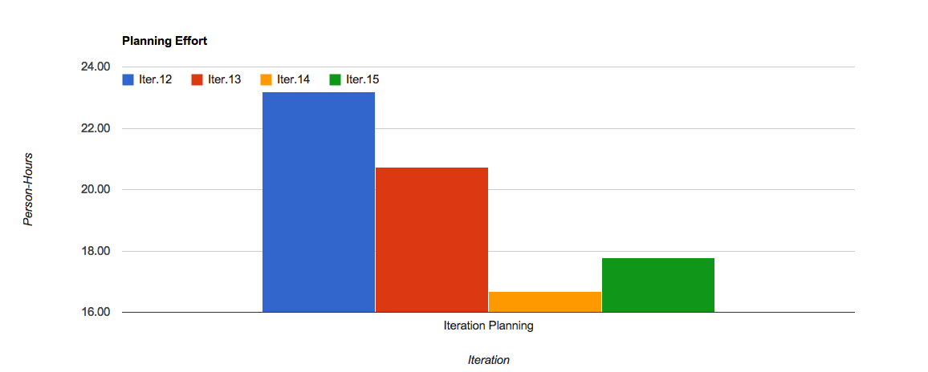
Overhead Watchlist - Planning

Slide 19
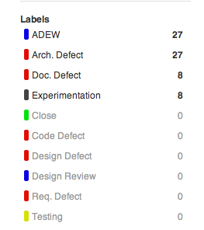
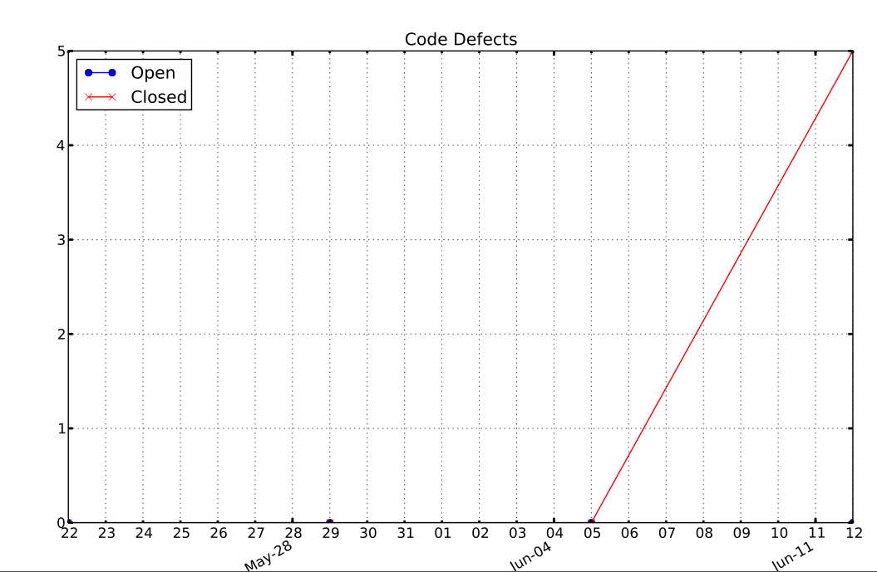
Issue Tracking

Slide 20
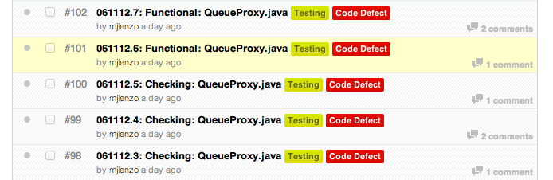
Issue Tracking

Slide 21
Open Risks and Mitigation Strategies [5 min] - TG
ARGONAUTS

Slide 22
Mentor Comments[15 min] - Team
ARGONAUTS

