Slide 1
Status Meeting [55 minutes]
ARGONAUTS
2012.06.19
Round Table [3 min]-Team
Action Items [2 min]-Sid
Project Progress [15 min]-TG
Architecture Design Updates [5 min]-Rui
Architecture Experiments Updates [5 min]-Dan
Metrics and Measurements [5 min]-Matt
Open Risks and Mitigation Strategies [5 min]-TG
Mentor Comments [10 min]-Team

Slide 2
Round Table[3 min] - Team
ARGONAUTS

Slide 3
Action Items[2 min] - Sid
ARGONAUTS

Slide 4
Project Progress[15 min] - TG
ARGONAUTS

Slide 5
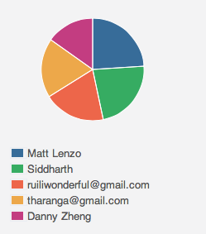
Week 4 Total Time – 220.5 Hours
33H 28min
52H 52min
41H 14min
50H
42H 52min

Slide 6
Iteration 15 Burn down
Hours
Days

Slide 7
Incomplete work packages
Four outstanding tasks
Caching module (14 hours)
Persistence module (6 hours)
Logging (9 hours)
Final review (6 hours)
Why iteration was not complete?

Slide 8
Overall Progress – Summer 2012
Value
Week

Slide 9
Legend
In-Progress
Done
Not Started
A
B
A allowed to use B
OADR
Services
Layer
Framework
Module
Gateway
Handlers
Dispatcher
Receiver
Persistence
XMPP Stub
HTTP Stub
AMQP Stub
Payloads
Facade
Gateway API
Core
Connector
Cache
Message
Error
Log
Config
Persistence
StateMgt
Data

Slide 10
Architecture Design Updates [5 min] - Rui
ARGONAUTS

Slide 11
Architecture Experiments Updates [5 min] - Dan
ARGONAUTS

Slide 12
Metrics and Measurements [5 min] - Matt
ARGONAUTS

Slide 13
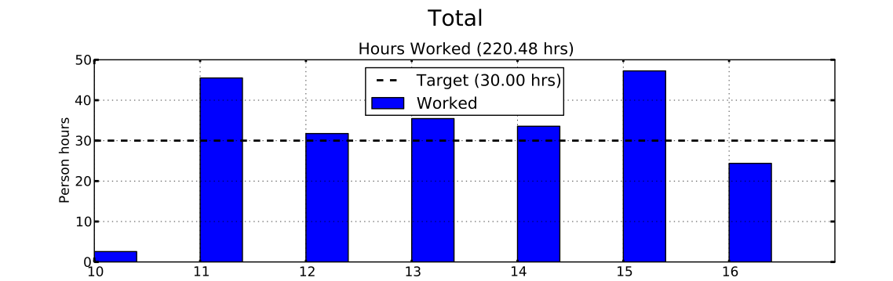
Sustainable Pace Goal – 42hrs
“Answer to the ultimate question of life, the universe, and everything: 42.”

Slide 14
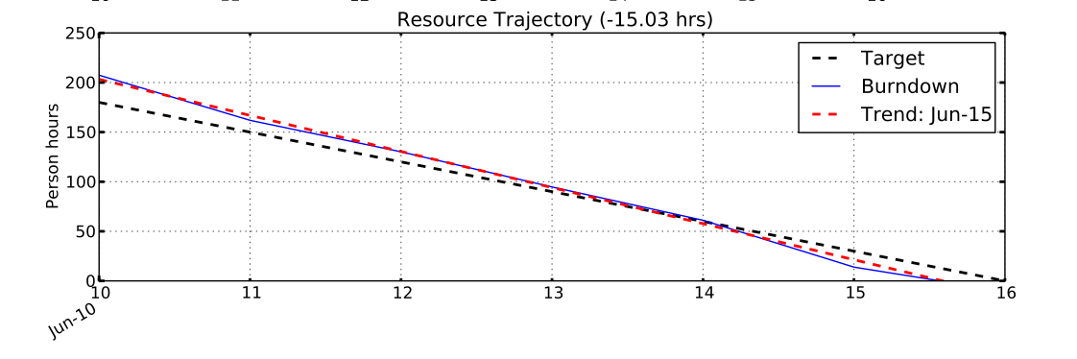
Sustainable Pace Goal – 42hrs
“Answer to the ultimate question of life, the universe, and everything: 42.”

Slide 15
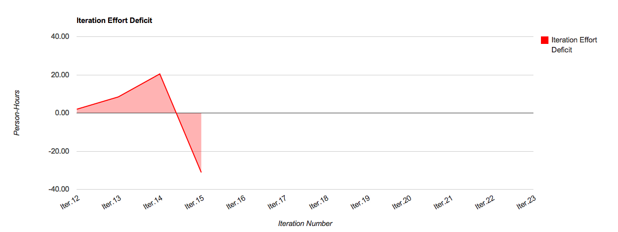
Iteration Surplus: 31.15 hrs

Slide 16
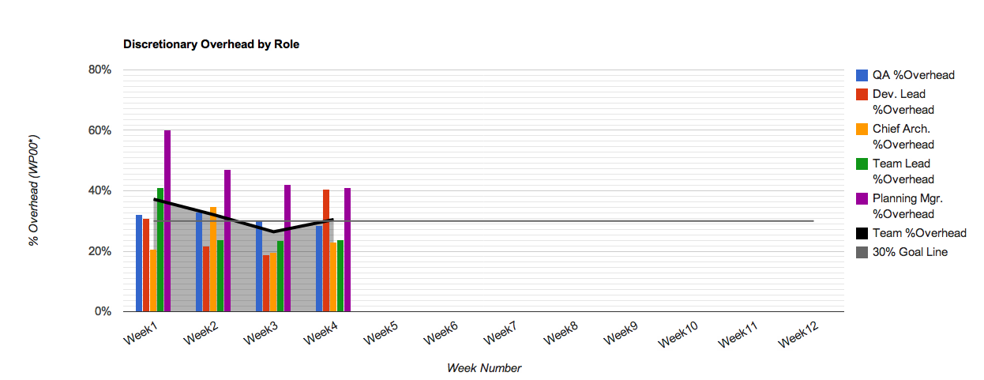
30% Overhead Goal
Resource | % Overhead | Resource | % Overhead
Team Lead | 24% | Planning Manager | 41%
Chief Architect | 23% | Quality Assurance | 28%
Development Lead | 40% | Team | 30%

Slide 17
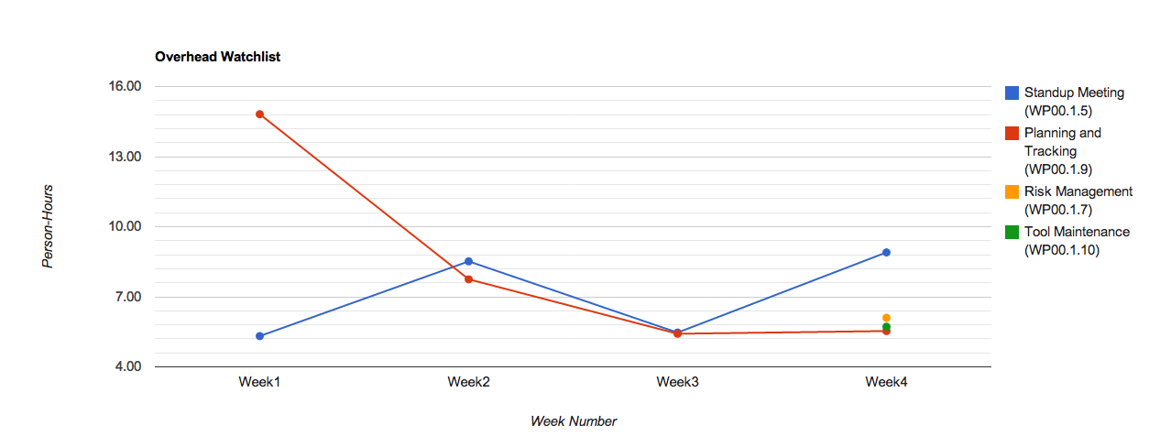
Overhead Watchlist
Top 3 Overhead Activities (Non-Planning)
WP00.1.5: Standup Meetings
WP00.1.7: Risk Management
WP00.1.10: Tool Maintenance

Slide 18
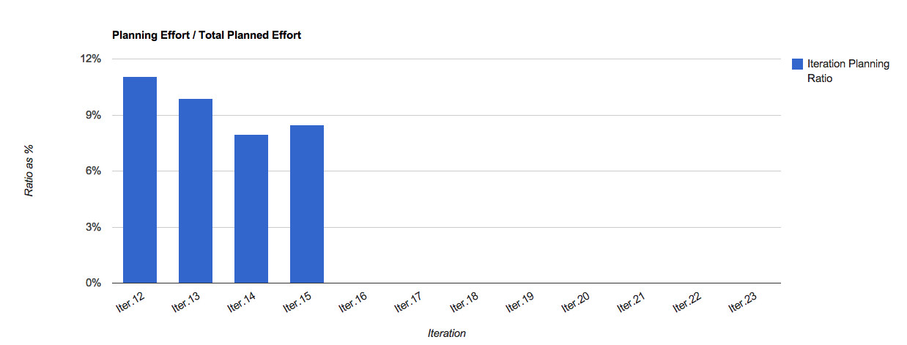
Overhead Watchlist - Planning

Slide 19
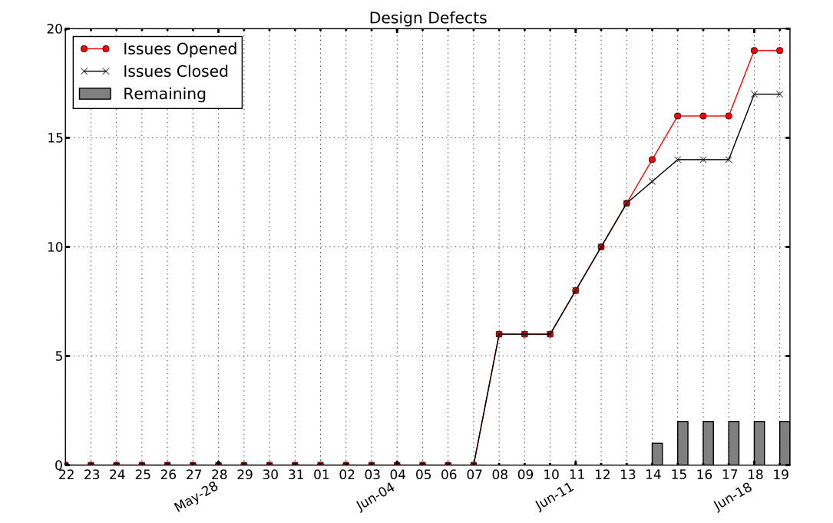
Design Defects

Slide 20
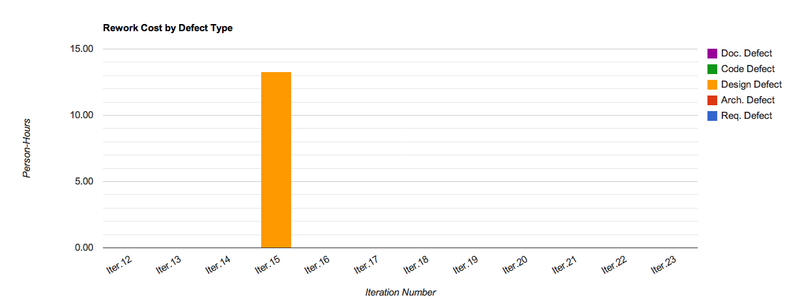
Rework Cost by Defect Type
Insufficient exploration of connector
API alongside tech-specific impl.
Lack of explicit detailed design step/review
Insufficient exploration of best-practices
Issue Number | Cost (Person-Hours)
#116: Connector API & RabbitMQ | 8 hrs
#113: Logical Data Model | 1 hr 50 min
#105: Connector API | 1 hr 40 min

Slide 21
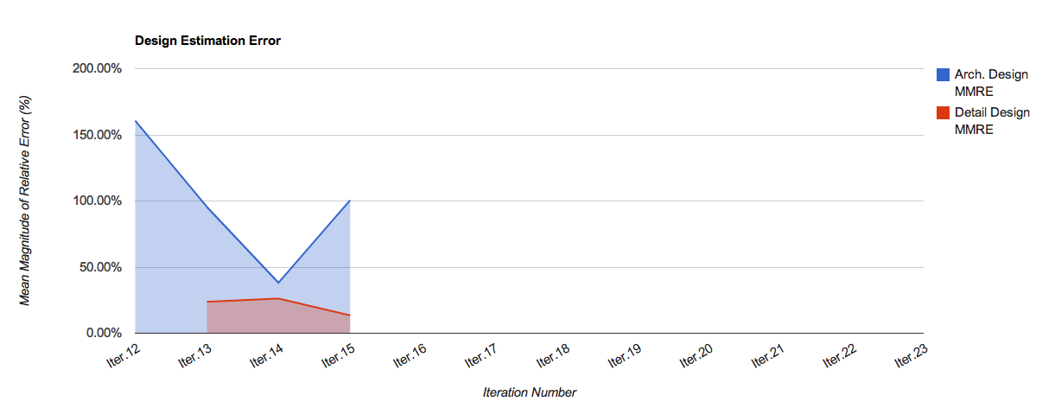
Detail Design Process Broken

Slide 22
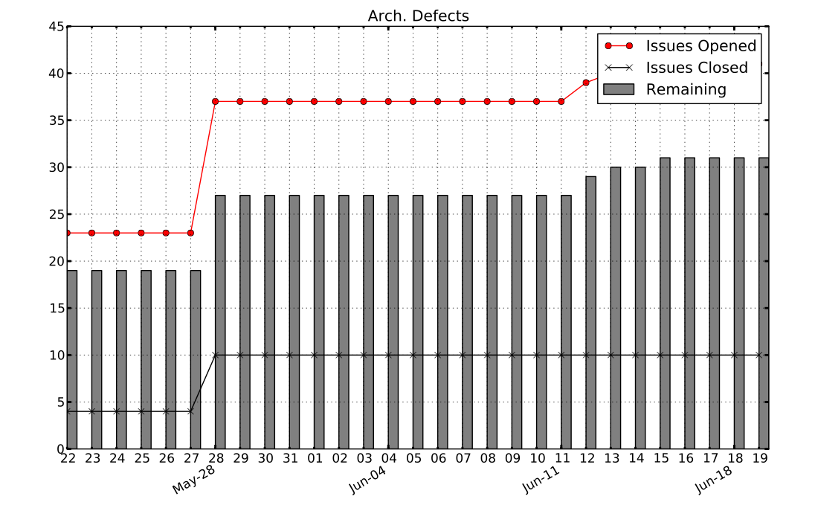
Arch. Issues

Slide 23
Open Risks and Mitigation Strategies [5 min] - TG
ARGONAUTS

Slide 24
Mentor Comments[15 min] - Team
ARGONAUTS

