Slide 1
Status Meeting [50 minutes]
ARGONAUTS
2012.06.26
Round Table [3 min]-Team
Action Items [2 min]-Sid
Project Progress [15 min]-TG
Architecture Design Updates [5 min]-Rui
Architecture Experiments Updates [5 min]-Dan
Metrics and Measurements [5 min]-Matt
Open Risks and Mitigation Strategies [5 min]-TG
Mentor Comments [10 min]-Team

Slide 2
Round Table[3 min] - Team
ARGONAUTS

Slide 3
Action Items[2 min] - Sid
ARGONAUTS

Slide 4
Project Progress[15 min] - TG
ARGONAUTS

Slide 5
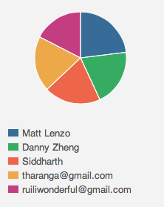
Week 5 Total Time – 213 Hours
37H 13min
49H 04min
41H 29min
42H 34min
42H 30min

Slide 6
Change of plan
Scope down end of summer goal – Verify only high priority quality attributes
Scalability
Performance
Service Extensibility
Protocol Extensibility
Let customer decide on Fall activities – Continue on high priority QAs vs. verify other QAs
Parallel work streams – bottom up and top down
Paired development

Slide 7
Overall Progress – Summer 2012
Value
Week

Slide 8
Legend
In-Progress
Done
Not Started
A
B
A allowed to use B
OADR
Services
Layer
Framework
Module
Gateway
Handlers
Dispatcher
Receiver
Persistence
XMPP Stub
HTTP Stub
AMQP Stub
Payloads
Facade
Gateway API
Core
Connector
Cache
Message
Error
Log
Config
Persistence
StateMgt
Data

Slide 9
Legend
In-Progress
Done
Not Started
A
B
A allowed to use B
OADR
Services
Layer
Framework
Module
Gateway
Handlers
Dispatcher
Receiver
Persistence
XMPP Stub
HTTP Stub
AMQP Stub
Payloads
Facade
Gateway API
Core
Connector
Cache
Message
Error
Log
Config
Persistence
Data

Slide 10
Architecture Design Updates [5 min] - Rui
ARGONAUTS

Slide 11
Architecture Experiments Updates [5 min] - Dan
ARGONAUTS

Slide 12
Metrics and Measurements [5 min] - Matt
ARGONAUTS

Slide 13
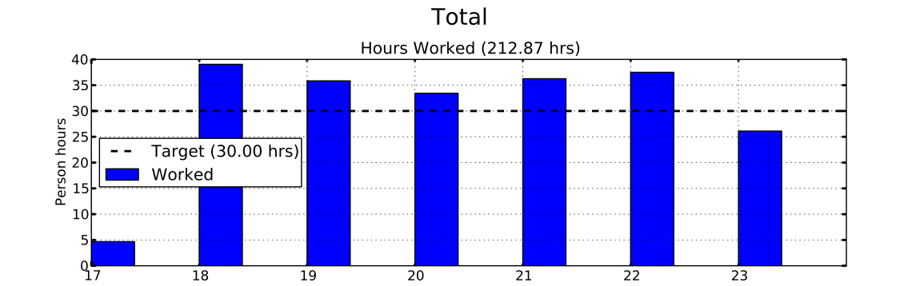
Sustainable Pace Goal – 42hrs

Slide 14
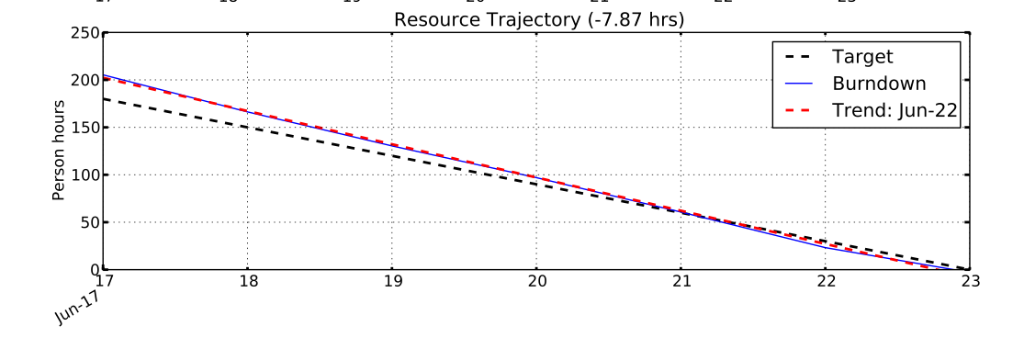
Sustainable Pace Goal – 42hrs

Slide 15
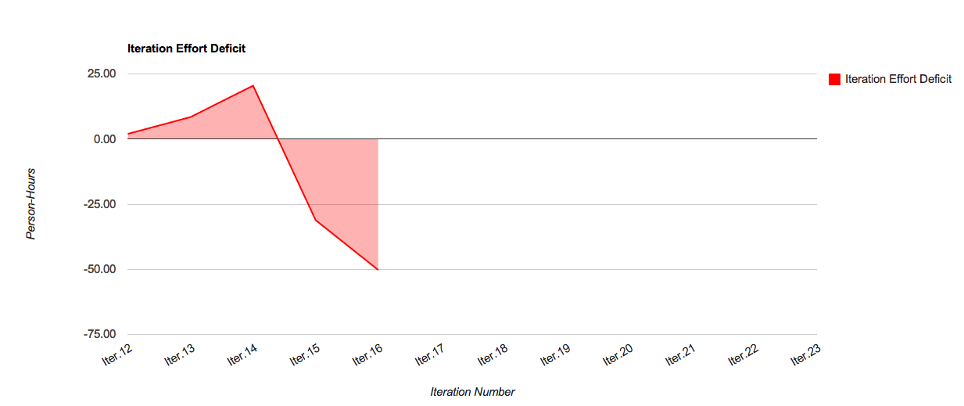
Iteration Surplus: 50.3 hrs

Slide 16
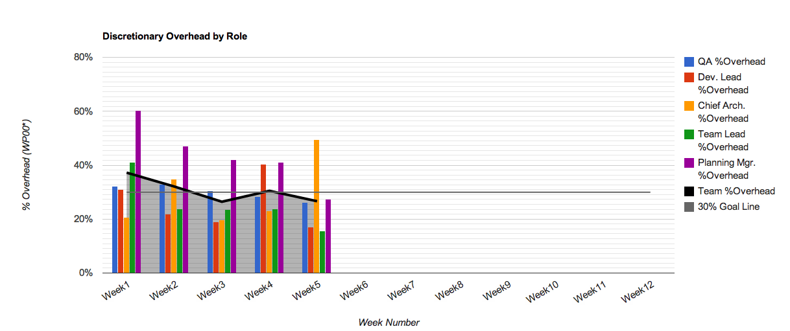
30% Overhead Goal
Resource | % Overhead | Resource | % Overhead
Team Lead | 16% | Planning Manager | 27%
Chief Architect | 50% | Quality Assurance | 26%
Development Lead | 17% | Team | 27%

Slide 17
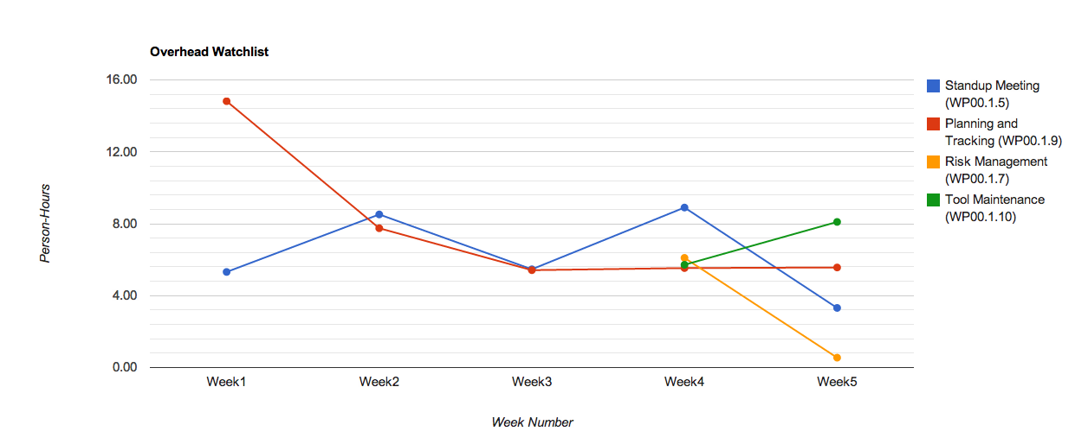
Overhead Watchlist
Top 3 Overhead Activities (Non-Planning)
WP00.1.10: Tool Maintenance
WP00.1.9: Planning & Tracking
WP00.1.5 Standup Meetings

Slide 18
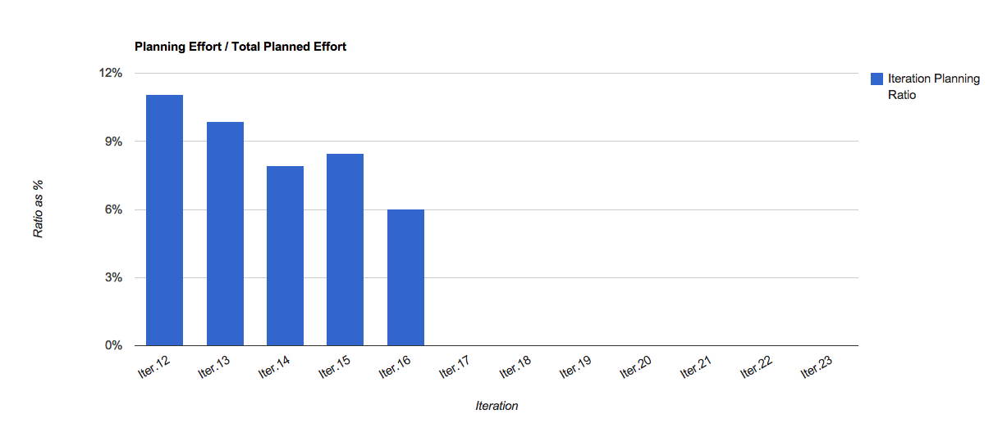
Overhead Watchlist - Planning

Slide 19
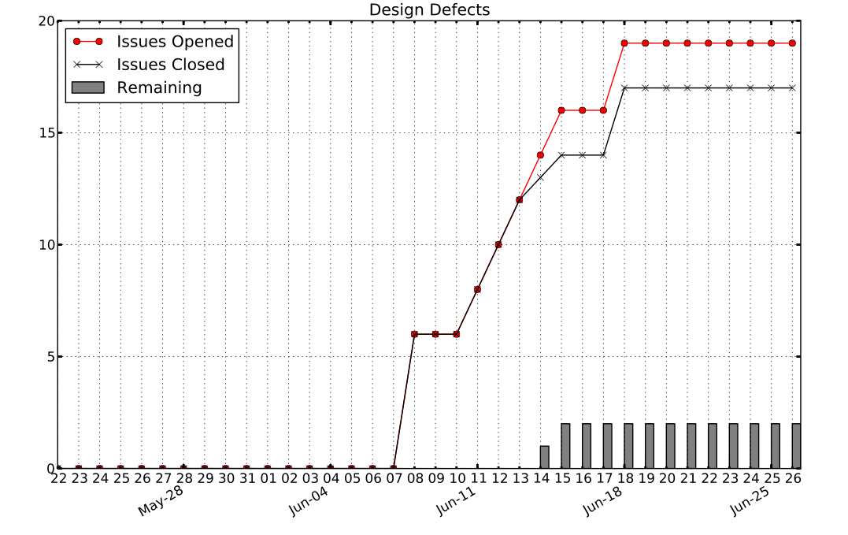
Design Defects

Slide 20
Open Risks and Mitigation Strategies [5 min] - TG
ARGONAUTS

Slide 21
Mentor Comments[10 min] - Team
ARGONAUTS

