Slide 1
Status Meeting [50 minutes]
ARGONAUTS
2012.07.02
Round Table [3 min]-Team
Action Items [2 min]-Sid
Project Progress [15 min]-TG
Architecture Design Updates [5 min]-Rui
Architecture Experiments Updates [5 min]-Dan
Metrics and Measurements [5 min]-Matt
Open Risks and Mitigation Strategies [5 min]-TG
Mentor Comments [10 min]-Team

Slide 2
Round Table[3 min] - Team
ARGONAUTS

Slide 3
Action Items[2 min] - Sid
ARGONAUTS

Slide 4
Project Progress[15 min] - TG
ARGONAUTS

Slide 5
Architecture Design Updates [5 min] - Rui
ARGONAUTS

Slide 6
Architecture Experiments Updates [5 min] - Dan
ARGONAUTS

Slide 7
Metrics and Measurements [5 min] - Matt
ARGONAUTS

Slide 8
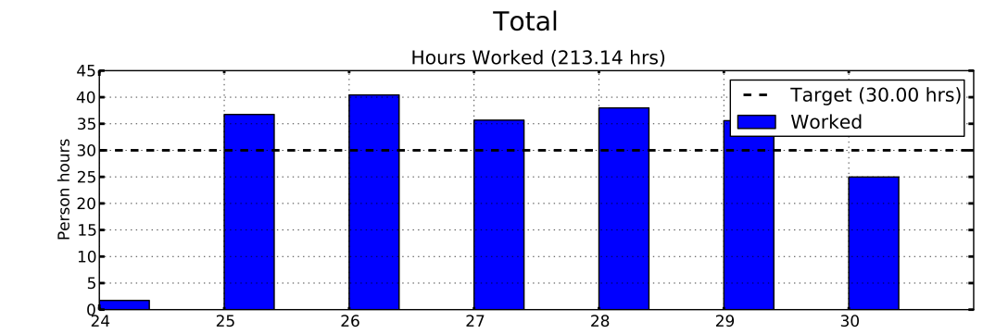
Sustainable Pace Goal – 42hrs

Slide 9
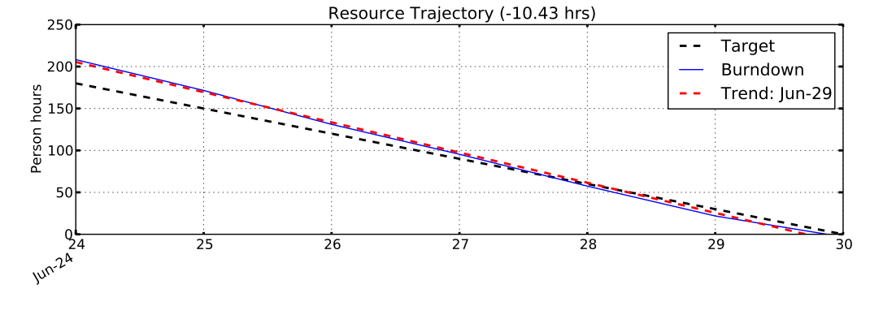
Sustainable Pace Goal – 42hrs

Slide 10
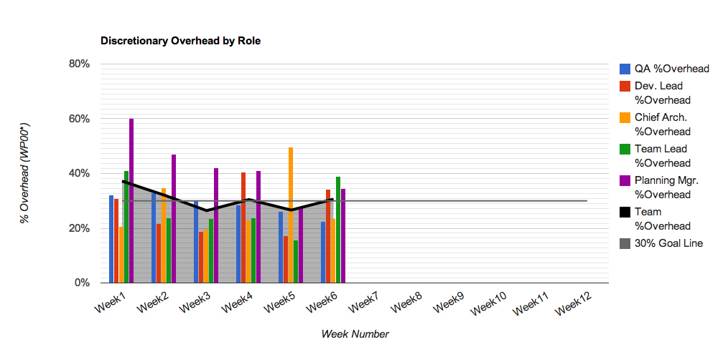
30% Overhead Goal
Resource | % Overhead | Resource | % Overhead
Team Lead | 39% | Planning Manager | 35%
Chief Architect | 24% | Quality Assurance | 22%
Development Lead | 34% | Team | 31%

Slide 11
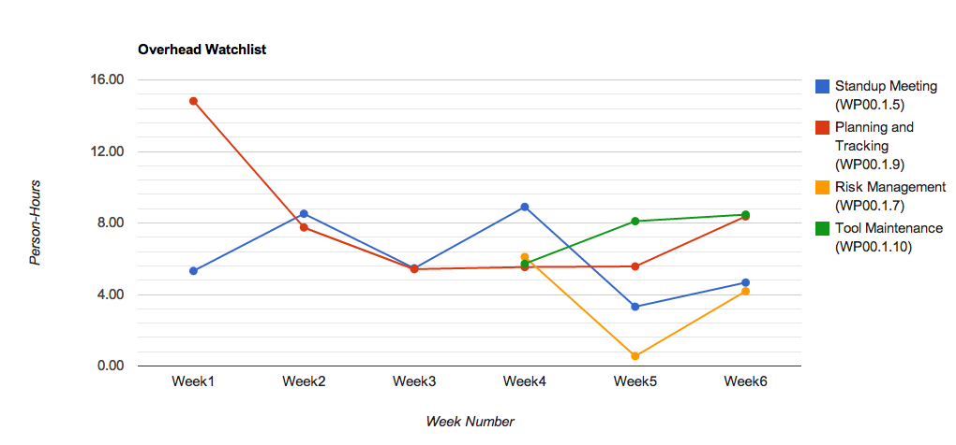
Overhead Watchlist
Top 3 Overhead Activities (Non-Planning)
WP00.1.10: Tool Maintenance
WP00.1.9: Planning & Tracking
WP00.1.5 Standup Meetings

Slide 12
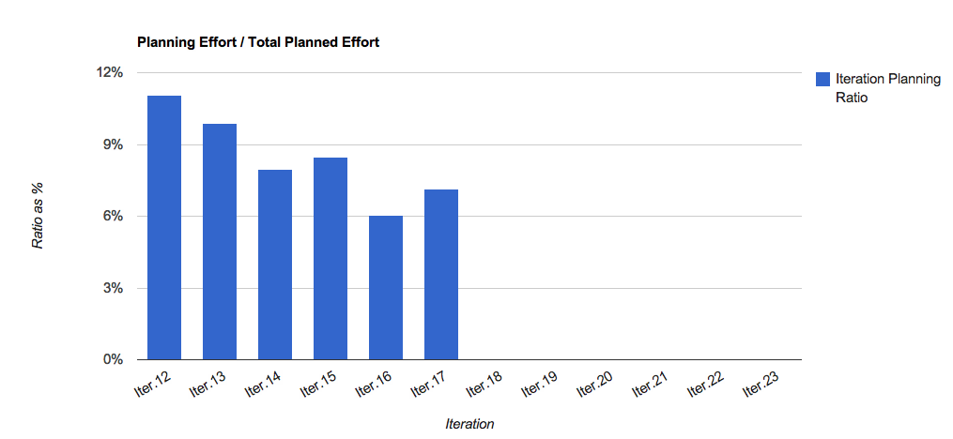
Overhead Watchlist - Planning

Slide 13
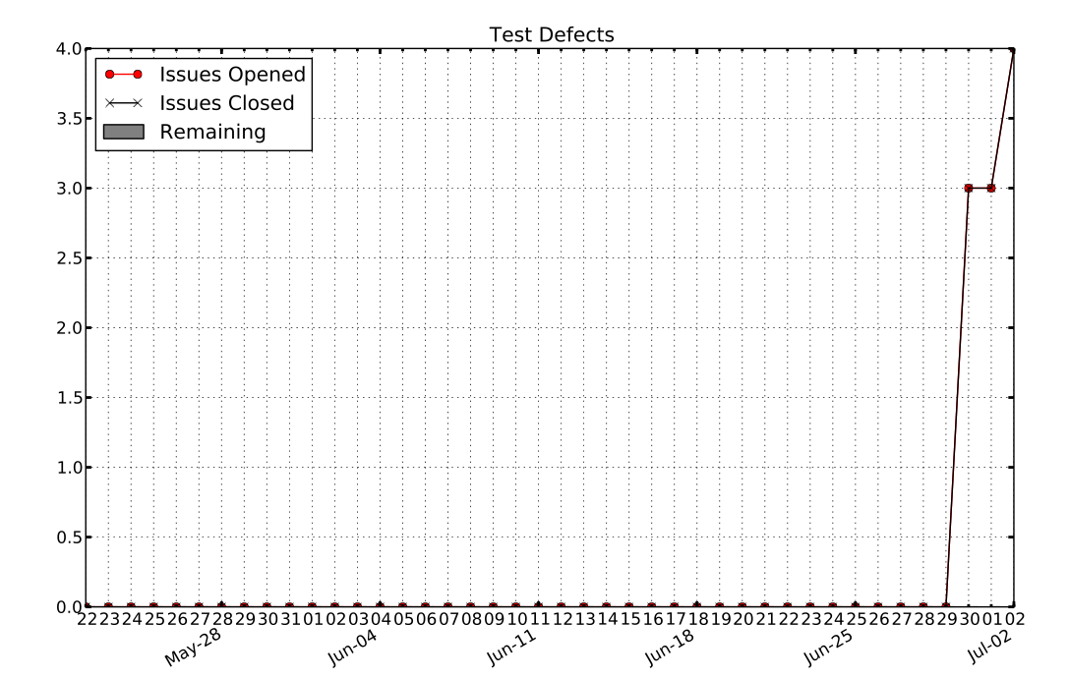

Slide 14
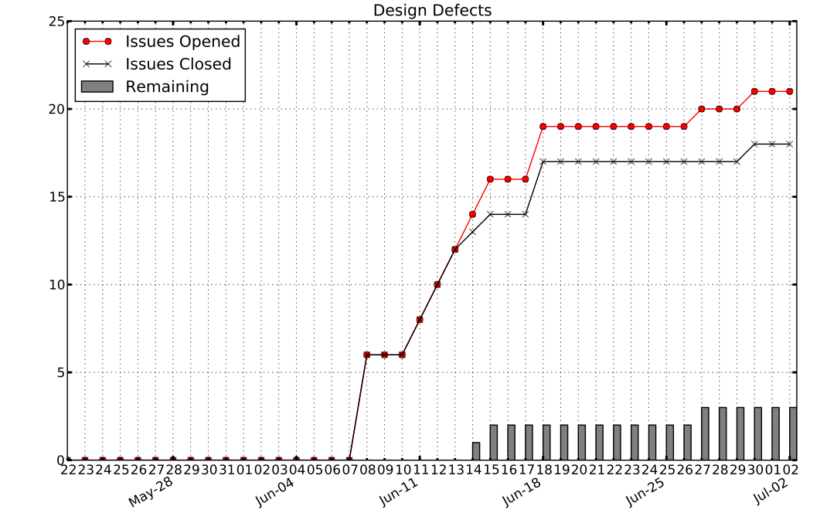
Design Defects

Slide 15
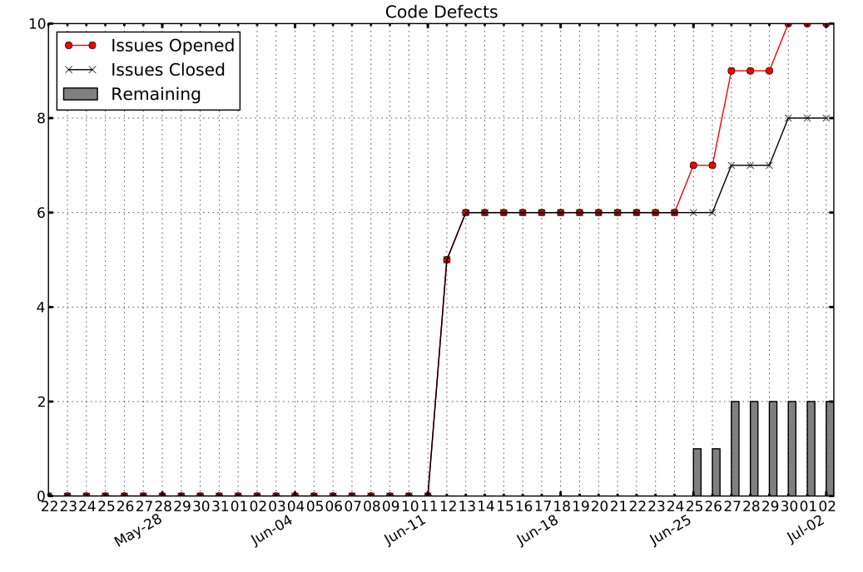

Slide 16
Open Risks and Mitigation Strategies [5 min] - TG
ARGONAUTS

Slide 17
Mentor Comments[10 min] - Team
ARGONAUTS

