Slide 1
Status Meeting [50 minutes]
ARGONAUTS
2012.07.10
Round Table [5 min]-Team
Action Items [2 min]-Sid
Project Progress [13 min]-TG
Architecture Design Updates [5 min]-Rui
Architecture Experiments Updates [5 min]-Dan
Metrics and Measurements [5 min]-Matt
Open Risks and Mitigation Strategies [5 min]-TG
Mentor Comments [10 min]-Team

Slide 2
Round Table[5 min] - Team
ARGONAUTS

Slide 3
Action Items[2 min] - Sid
ARGONAUTS

Slide 4
Project Progress[13 min] - TG
ARGONAUTS

Slide 5
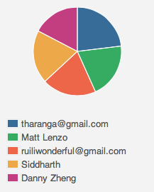
Week 7 Total Time – 208 Hours
36H 12min
48H 03min
40H 34min
42H 01min
41H 27min

Slide 6
Iteration 17 Burn down
Hours
Days

Slide 7
Overall Progress – Summer 2012
Value
Week

Slide 8
Legend
In-Progress
Done
Not Started
A
B
A allowed to use B
OADR
Services
Layer
Framework
Module
Gateway
Handlers
Dispatcher
Receiver
Persistence
XMPP Stub
HTTP Stub
AMQP Stub
Payloads
Facade
Gateway API
Core
Connector
Cache
Message
Error
Log
Config
Persistence
Data

Slide 9
Legend
In-Progress
Done
Not Started
A
B
A allowed to use B
OADR
Services
Layer
Framework
Module
Gateway
Handlers
XMPP Stub
AMQP Stub
Dispatcher
Persistence
Receiver
HTTP Stub
Payloads
Facade
Gateway API
Core
Connector
Cache
Message
Error
Log
Config
Persistence
Data

Slide 10
Architecture Design Updates [5 min] - Rui
ARGONAUTS

Slide 11
Architecture Experiments Updates [5 min] - Dan
ARGONAUTS

Slide 12
Metrics and Measurements [5 min] - Matt
ARGONAUTS

Slide 13
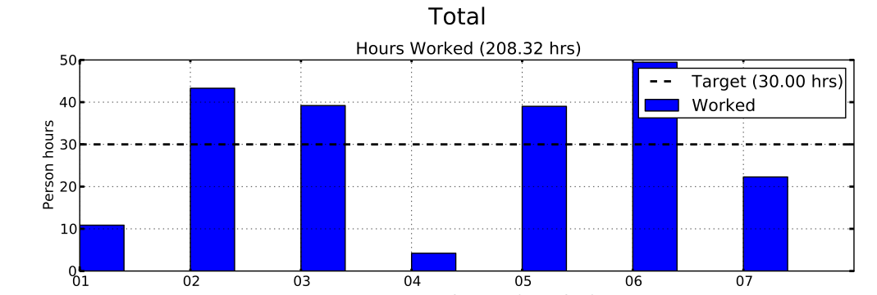
Sustainable Pace Goal – 42hrs

Slide 14
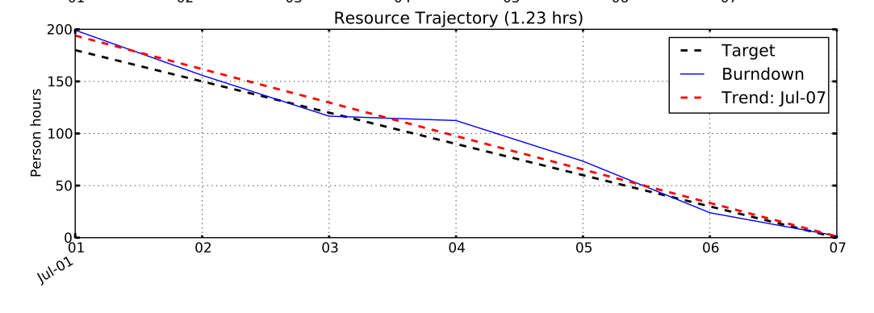
Sustainable Pace Goal – 42hrs

Slide 15
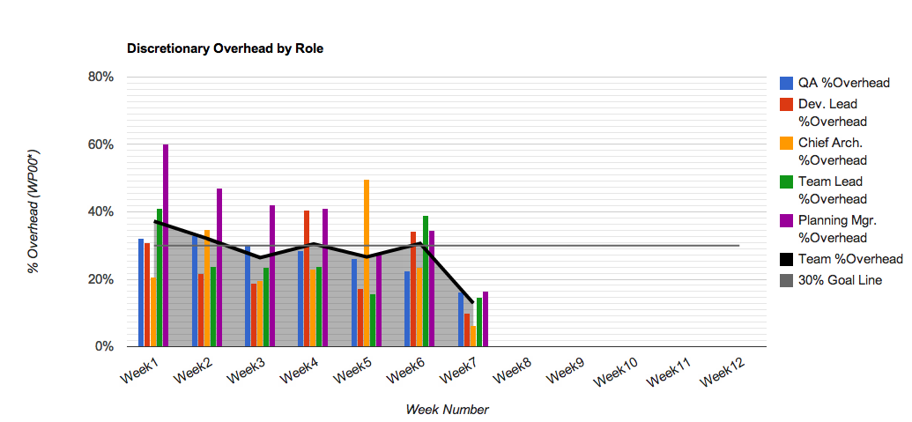
30% Overhead Goal
Resource | % Overhead | Resource | % Overhead
Team Lead | 15% | Planning Manager | 16%
Chief Architect | 6% | Quality Assurance | 16%
Development Lead | 10% | Team | 13%

Slide 16
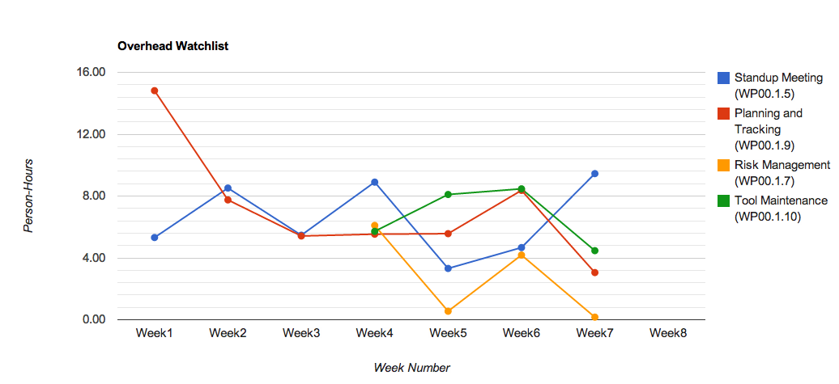
Overhead Watchlist
Top 3 Overhead Activities (Non-Planning)
WP00.1.5 Standup Meeting
WP00.1.10: Tool Maintenance
WP00.1.9: Planning & Tracking

Slide 17
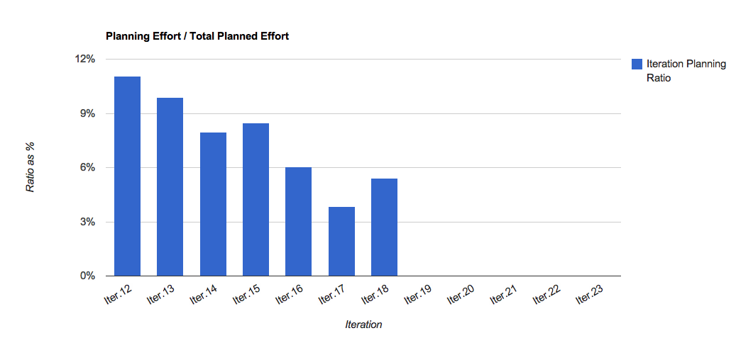
Overhead Watchlist - Planning

Slide 18
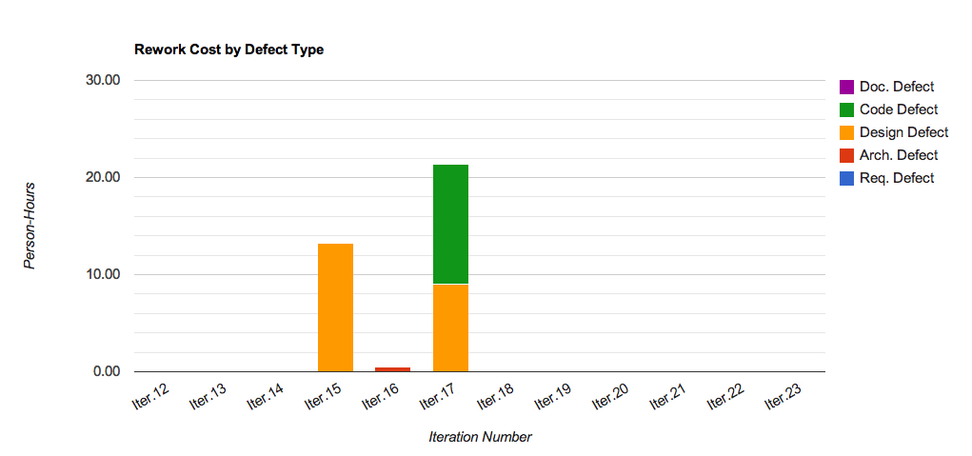
Rework Costs

Slide 19
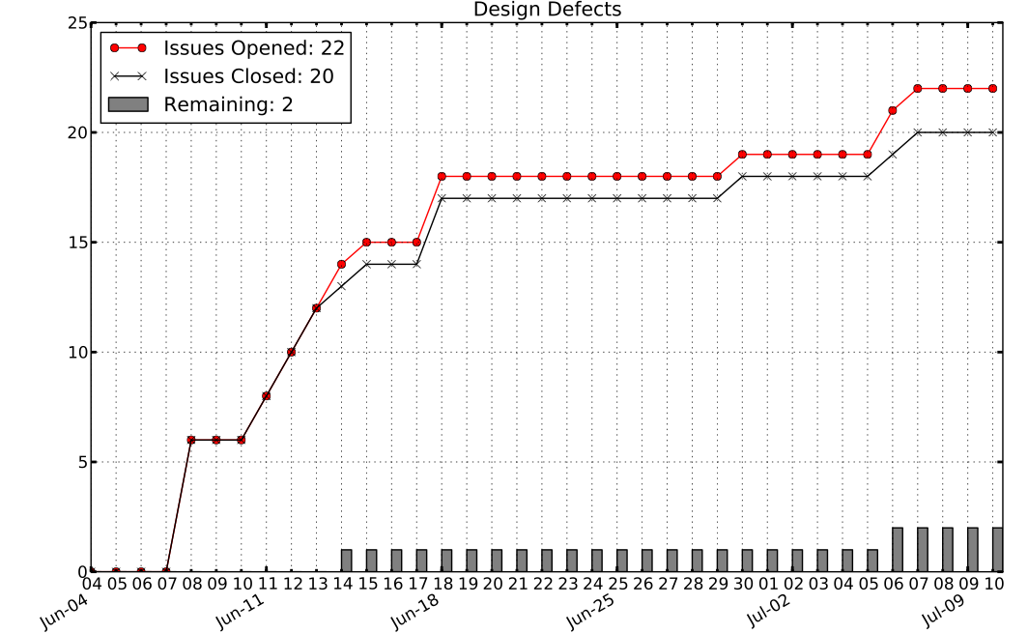

Slide 20
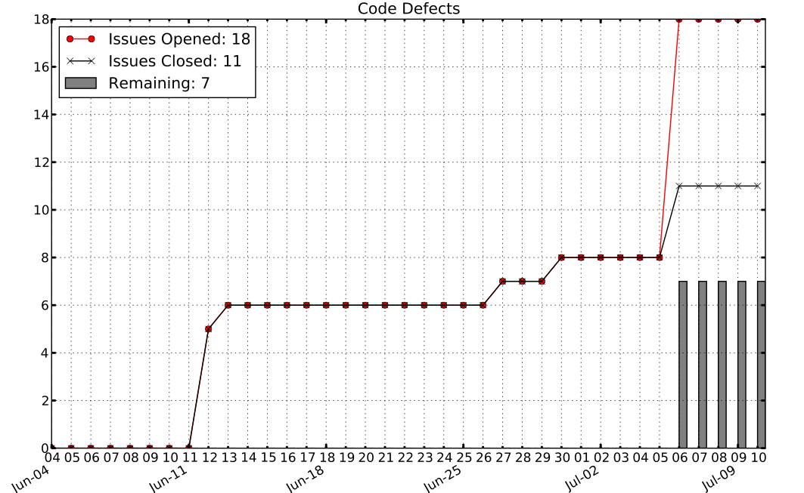

Slide 21
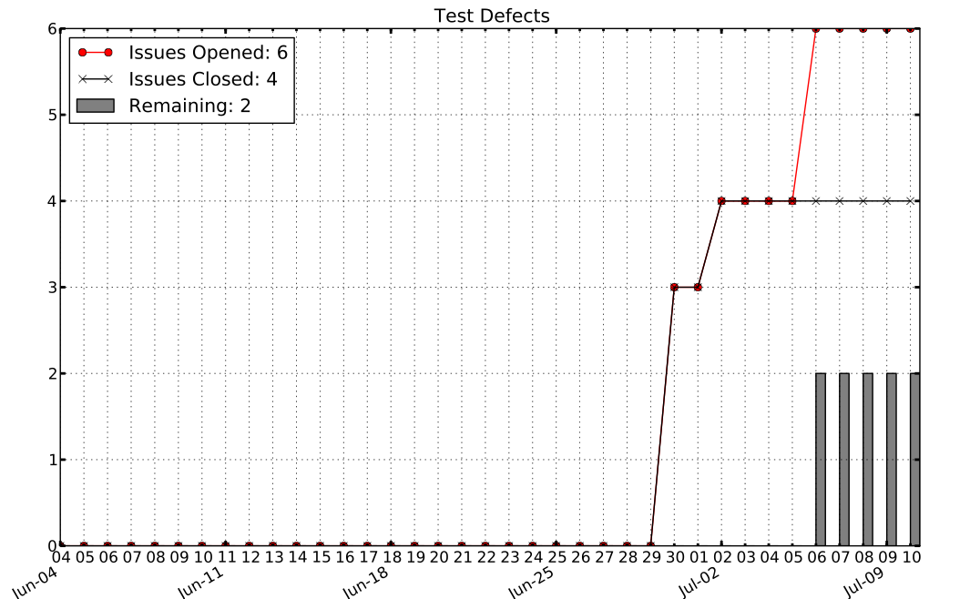

Slide 22
Open Risks and Mitigation Strategies [5 min] - TG
ARGONAUTS

Slide 23
Mentor Comments[10 min] - Team
ARGONAUTS

