Slide 1
Project Progress[15 min] - TG
ARGONAUTS

Slide 2
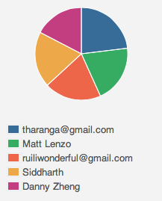
Week 7 Total Time – 208 Hours
36H 12min
48H 03min
40H 34min
42H 01min
41H 27min

Slide 3
Iteration 17 Burn down
Hours
Days

Slide 4
Overall Progress – Summer 2012
Value
Week

Slide 5
Legend
In-Progress
Done
Not Started
A
B
A allowed to use B
OADR
Services
Layer
Framework
Module
Gateway
Handlers
Dispatcher
Receiver
Persistence
XMPP Stub
HTTP Stub
AMQP Stub
Payloads
Facade
Gateway API
Core
Connector
Cache
Message
Error
Log
Config
Persistence
Data

Slide 6
Legend
In-Progress
Done
Not Started
A
B
A allowed to use B
OADR
Services
Layer
Framework
Module
Gateway
Handlers
XMPP Stub
AMQP Stub
Dispatcher
Persistence
Receiver
HTTP Stub
Payloads
Facade
Gateway API
Core
Connector
Cache
Message
Error
Log
Config
Persistence
Data

