Slide 1
Status Meeting [35 minutes]
ARGONAUTS
2012.07.17
Round Table [5 min]-Team
Project Progress [13 min]-TG
Architecture Experiments Updates [5 min]-Dan
Mentor Comments [12 min]-Team

Slide 2
Round Table[5 min] - Team
ARGONAUTS

Slide 3
Project Progress[13 min] - TG
ARGONAUTS

Slide 4
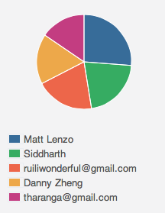
Week 8 Total Time – 214 Hours
33H
56H
36H 33M
45H 25M
42H 43M

Slide 5
Iteration 18 Burn down
Hours
Days

Slide 6
Overall Progress – Summer 2012
Value
Week

Slide 7
Legend
In-Progress
Done
Not Started
A
B
A allowed to use B
OADR
Services
Layer
Framework
Module
Gateway
Handlers
XMPP Stub
AMQP Stub
Dispatcher
Persistence
Receiver
HTTP Stub
Payloads
Facade
Gateway API
Core
Connector
Cache
Message
Error
Log
Config
Persistence
Data

Slide 8
Legend
In-Progress
Done
Not Started
Deferred
A
B
A allowed to use B
OADR
Services
Layer
Framework
Module
Gateway
Handlers
XMPP Stub
AMQP Stub
Dispatcher
Persistence
Receiver
HTTP Stub
Payloads
Facade
Gateway API
Core
Connector
Cache
Message
Error
Log
Config
Persistence
Data

Slide 9
Architecture Experiments Updates [5 min] - Dan
ARGONAUTS

Slide 10
Mentor Comments[12 min] - Team
ARGONAUTS

