Slide 1
Status Meeting [50 minutes]
ARGONAUTS
2012.07.31
Round Table [5 min]-Team
Action Items [2 min]-Sid
Project Progress [13 min]-TG
Architecture Design Updates [5 min]-Rui
Architecture Experiments Updates [5 min]-Dan
Metrics and Measurements [5 min]-Matt
Open Risks and Mitigation Strategies [5 min]-TG
Mentor Comments [10 min]-Team

Slide 2
Round Table[5 min] - Team
ARGONAUTS

Slide 3
Action Items [2 min] - Sid
ARGONAUTS

Slide 4
Project Progress[13 min] - TG
ARGONAUTS

Slide 5
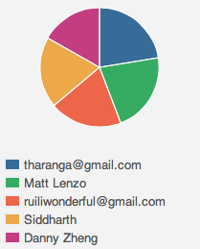
Week 10 Total Time – 208 Hours
35H
46H 49M
40H 07M
45H 20M
4H 13M

Slide 6
Iteration 20 Burn down
Hours
Days

Slide 7
Overall Progress (point based) – Summer 2012
Value
Week

Slide 8
Overall Progress (weight based) – Summer 2012
Value
Week

Slide 9
Legend
In-Progress
Done
Not Started
Deferred
A
B
A allowed to use B
OADR
Services
Layer
Framework
Module
Gateway
Handlers
XMPP Stub
AMQP Stub
Dispatcher
Persistence
Receiver
HTTP Stub
Payloads
Facade
Gateway API
Core
Connector
Cache
Message
Error
Log
Config
Persistence
Data

Slide 10
Legend
In-Progress
Done
Not Started
Deferred
A
B
A allowed to use B
OADR
Services
Layer
Framework
Module
Gateway
Handlers
XMPP Stub
AMQP Stub
Dispatcher
Persistence
Receiver
HTTP Stub
Payloads
Facade
Gateway API
Core
Connector
Cache
Message
Error
Log
Config
Persistence
Data

Slide 11
Summer 2012 Milestones
May
June
July
August
September
1 | 2 | 3 | 4 | 5 | 6 | 7 | 8 | 9 | 10 | 11 | 12 | 13 | 14 | 15 | 16 | 17
Infrastructure, Tools
AWS Training
Protocol Gateway
Implemented
Database and Core Components
EOSP
Architecture Stub
Design
Revisions
Architecture
Verified
Scalability and
Performance Verified
12
15
14
20
13
16
17
18
19
21
19
22
Iterations

Slide 12
Where are we ?
May
June
July
August
September
1 | 2 | 3 | 4 | 5 | 6 | 7 | 8 | 9 | 10 | 11 | 12 | 13 | 14 | 15 | 16 | 17
Infrastructure, Tools
AWS Training
Protocol Gateway
Implemented
Database and Core Components
EOSP
Architecture Stub
Architecture
Verified
Scalability and
Performance Verified
12
15
14
20
13
16
17
18
19
21
19
22
Iterations

Slide 13
Architecture Design Updates [5 min] - Rui
ARGONAUTS

Slide 14
Architecture Experiments Updates [5 min] - Dan
ARGONAUTS

Slide 15
Metrics and Measurements [5 min] - Matt
ARGONAUTS

Slide 16
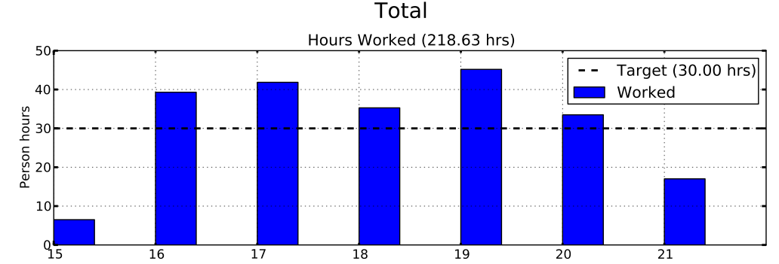
Sustainable Pace Goal – 42hrs

Slide 17
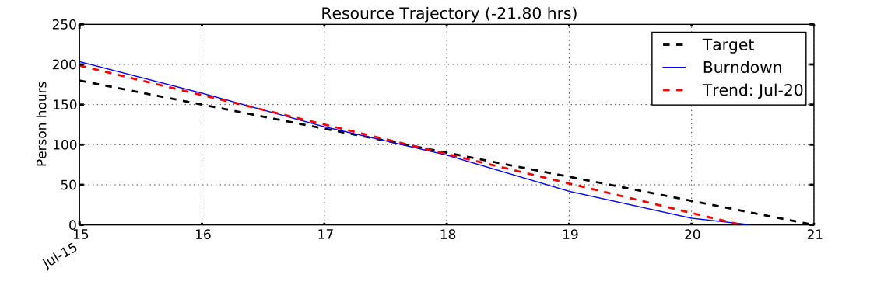
Sustainable Pace Goal – 42hrs

Slide 18
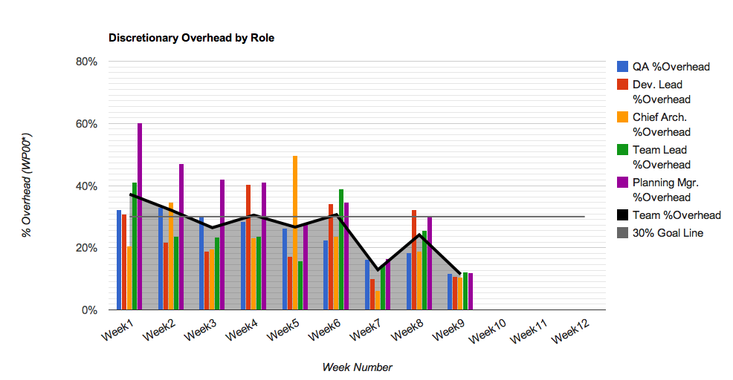
30% Overhead Goal
Resource | % Overhead | Resource | % Overhead
Team Lead | 12% | Planning Manager | 12%
Chief Architect | 11% | Quality Assurance | 12%
Development Lead | 11% | Team | 11%

Slide 19
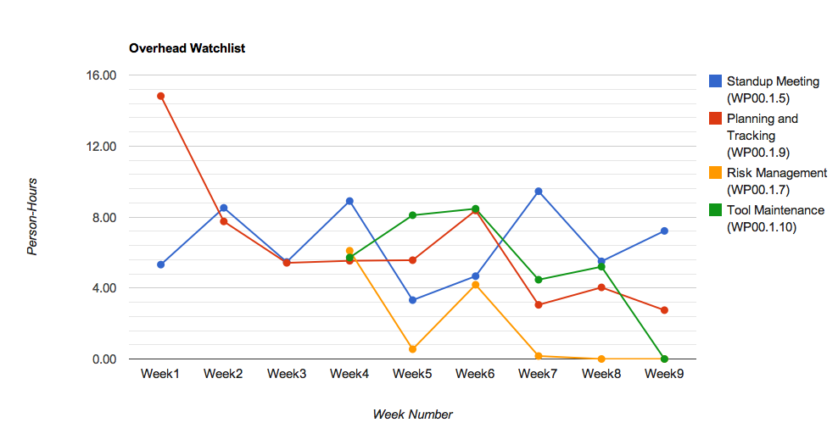
Overhead Watchlist
Top 3 Overhead Activities (Non-Planning)
WP00.1.5 Standup Meeting
WP00.1.9: Planning & Tracking

Slide 20
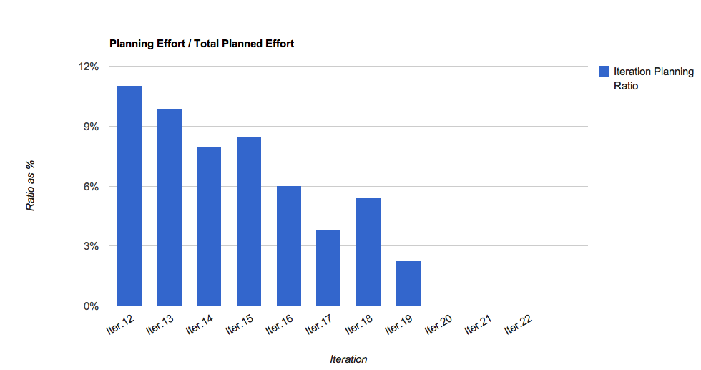
Overhead Watchlist - Planning

Slide 21
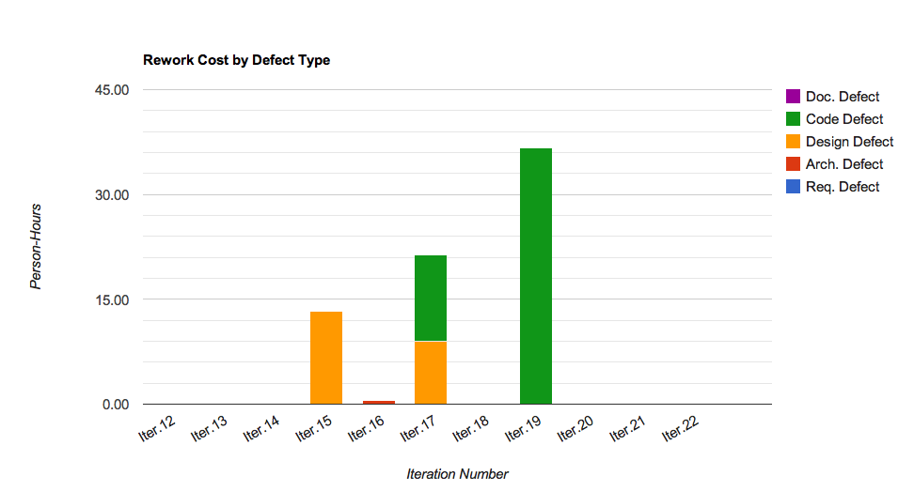
Rework Costs

Slide 22
Open Risks and Mitigation Strategies [5 min] - Team
ARGONAUTS

Slide 23
Mentor Comments[12 min] - Team
ARGONAUTS

