Slide 1
Cerebras at ALCF
Full-Stack Tutorial
November 16th, 2026
Sylvia Howland
Support & Success Engineer

Slide 2
Agenda
Intro to Wafer-Scale Computing
Device Programmability SDK
Machine Learning Training Stack
Ultrafast Cloud Inference

Slide 3
Intro to Wafer-Scale Computing

Slide 4

Cerebras Wafer Scale Engine 3 (WSE-3)
4 trillion transistors
46,225 mm2 silicon
900,000 cores optimized for sparse linear algebra
5nm TSMC process
125 Petaflops of AI compute
44 Gigabytes of on-chip memory
21 PByte/s memory bandwidth
214 Pbit/s fabric bandwidth
4
Notes:
The traditional way to ampflity Moore’s law is to make larger chips.
So we did that. But we took it to the extreme.
This is the Wafer-Scale Engine-2, the WSE-2,
It’s currently generally available and being used by our customers every day
It’s the largest chip ever built, at 56 times larger than the largest GPU today
At over 46 thousand square millimeters in size
With 2.6 trillion transistors on a single chip,
We can fit 850,000 cores
With all of these cores integrated on a single piece silicon, we get some truly mind-boggling numbers for memory and fabric performance
Because everything is on-chip

Slide 5

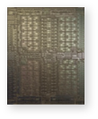

Cerebras WSE-3 vs. Nvidia B200 “Blackwell”
Cerebras WSE-3
NVIDIA B200 GPU
4 Trillion Transistors
46,225 mm² Silicon
208 Billion Transistors
~1,600 mm² Silicon
5

Slide 6
The Wafer-Scale Engine (WSE)
A semiconductor designed to solve fundamental AI problems
AI presents unusual compute challenges
An enormous number of simple calculations
Very complex communication patterns
Massive necessary memory bandwidth
The Wafer-Scale Engine (WSE) is the solution
20x more transistors
350x more on-chip memory
2,625x more memory bandwidth
Cerebras WSE-3
NVIDIA B200 GPU
4 Trillion Transistors
46,225 mm² Silicon
208 Billion Transistors
~1,600 mm² Silicon
6

Slide 7
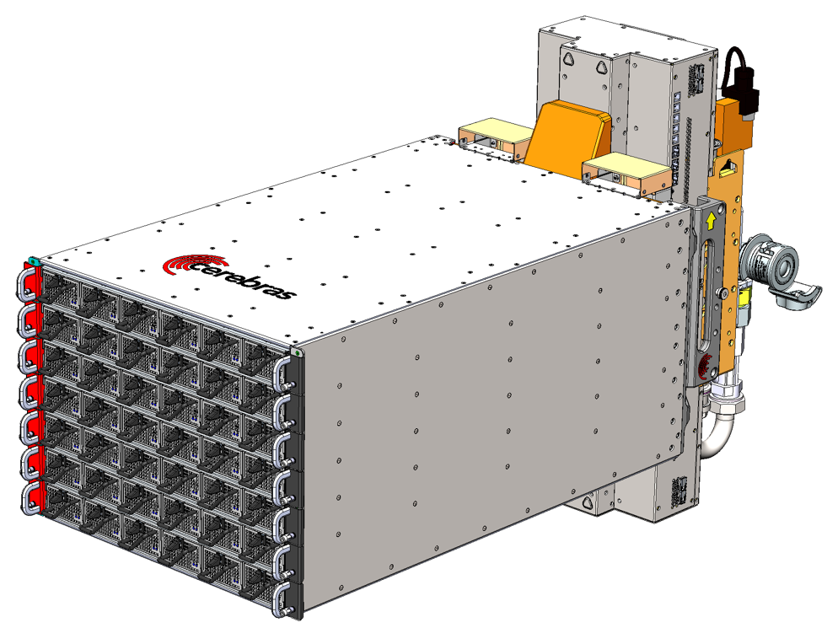
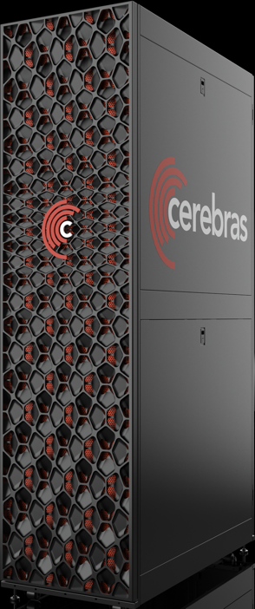




The Wafer-Scale Engine (WSE) Powers Our Servers
CS-3 and CS-4 servers power our AI supercomputers
Wafer Scale Engine
CS-4 Server
Cerebras AI Supercomputer
Core Technology, Not Salable
Rack-scale System
Systems Deployed in Data Centers
Cross-reticle stitching – developed technology to connect die together at the wafer level
Yield – pioneering architecture designed to withstand defects rather than avoid them
Cerebras Compiler Software– designed to seamlessly run models written for GPUs on Cerebras hardware
Thermal expansion-tolerant packaging – developed unique materials and techniques to manage the physical stresses caused by thermal expansion
Power delivery and cooling – developed novel delivery system to provide uniform power and cooling to the wafer surface while using a fraction of the power per unit compute
Wafer-Scale Cluster – designed to scale up to 2,048 CS-4 systems capable of training models with up to 24 trillion parameters as one logical device
Reduces code complexity by 97% by using unified memory and data parallel only training
Three CS-4s per rack design
7

Slide 8
A Uniform, Vertically-Integrated Mesh
Fabric
High bandwidth enables high numerical efficiency
Supports programmability for novel algorithms
Numerical algorithms drive ML and HPC
Memory provides storage for parameters, activations
Control
Math
Memory
8
Notes:
Story arc 3: How the models compile and run

Slide 9






Every Single Tile Has All Key Components
Fabric
  Vector streaming engine
  Activation selection filter
  Sparse stream support
Control
  Dataflow scheduling
  Nine execution heads
Math
  Floating point and integer support
  Entropy engine
  Tensor access patterns
Memory
  Single-cycle access latency
  Eight reads, four writes
Router
✕
Filter
Processor
Memory
Tensor
Traversal
$$i$$
$$[i]$$
$$x$$
Arithmetic
✕
＋
$$w$$
$$y$$
Scheduler
$$x_{i}$$
$$y$$
Fabric
Control
Math
Memory
9

Slide 10
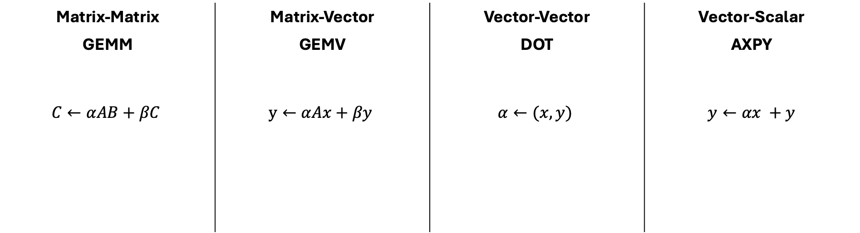


Full Memory Performance at All BLAS Levels
Massive bandwidth jump!
Matrix-Matrix | Matrix-Vector | Vector-Vector | Vector-Scalar
GEMM | GEMV | DOT | AXPY
$$C←αAB+βC$$ | $$y←αAx+βy$$ | $$α←(x, y)$$ | $$y←αx +y$$
CSX
0.005 Byte/FLOP
1 Byte/FLOP
2 Byte/FLOP
3 Byte/FLOP
GPU
C
+=
A
B
y
+=
A
x
+=
y
x
y
+=
x
$$α$$
$$α$$
10
Notes:
Now with that level of memory bandwidth, we can do some really remarkable things
We can run matrix operations out of memory, at full performance, across all BLAS levels
Traditional GPU architectures with limited off-chip memory bandwidth, are restricted to running only GEMMs at full performance, that’s matrix-matrix multiplies only.
In fact, you can see that any BLAS level below full Matrix-Matrix multiply requires a massive jump in memory bandwidth not possible in traditional architectures
But with enough bandwidth, you enable full performance all the way down to AXPY, which is a vector-scalar multiply.
[click]
Within neural network computation, that’s really important because it enables fully unstructured sparsity acceleration
That’s because, a sparse GEMM is just a collection of AXPY operations, one operation for every non-zero element
This level of memory bandwidth is a prerequisite for unstructured sparsity acceleration,
but additionally, we need a compute core that can accelerate that sparsity

Slide 11
Device Programmability SDK

Slide 12
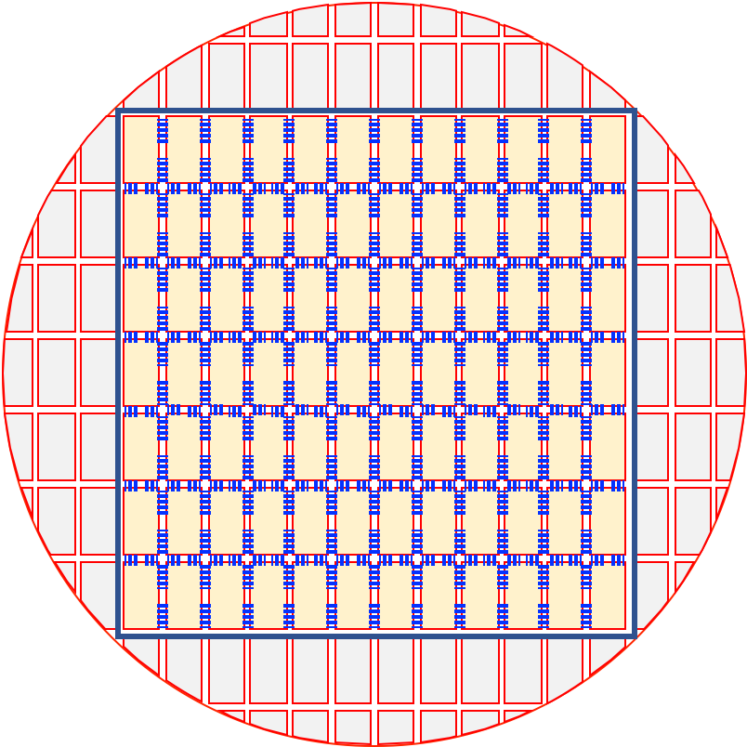
Does Your Application Scale Poorly Across Nodes?
Examples:
FFT-based solvers
Particle simulators
Nonlinear problems with iterative solvers
The Cerebras solution:
The WSE-3 has a fabric that is high bandwidth and low-latency, allowing for excellent parallel efficiency for non-linear and highly communicative codes
The CS-3 system with WSE-3 has 900k cores and can fit problems on an individual chip that traditionally take 10s to hundreds of small compute nodes.
  Each core is individually programmable
12
Notes:
As we have talked about, we built the Cerebras systems to overcome some of the common constraints for AI and HPC problems. I want to illustrate how a wafer can improve your time-to-solution for problems that are currently bottlenecked. First, are you suffering from poor scaling? Many applications have algorithmic scaling issues that arise because of the amount of communication that needs to happen, or the regularity of the communication. The Cerebras system is built for communication. The fabric allows for core-to-core communication that is high bandwidth and low latency. Not just that, but this fabric connects 850 thousand cores together, all of which can pass data to a neighbor in a single cycle. Our system can be programmed in blocks, or programmed where each core has a unique instruction set. The number of processing elements combined with the ability to pass data quickly allows us to tackle problems where all-to-all communication is required or where the cores have to pass data every cycle incredibly well.

Slide 13
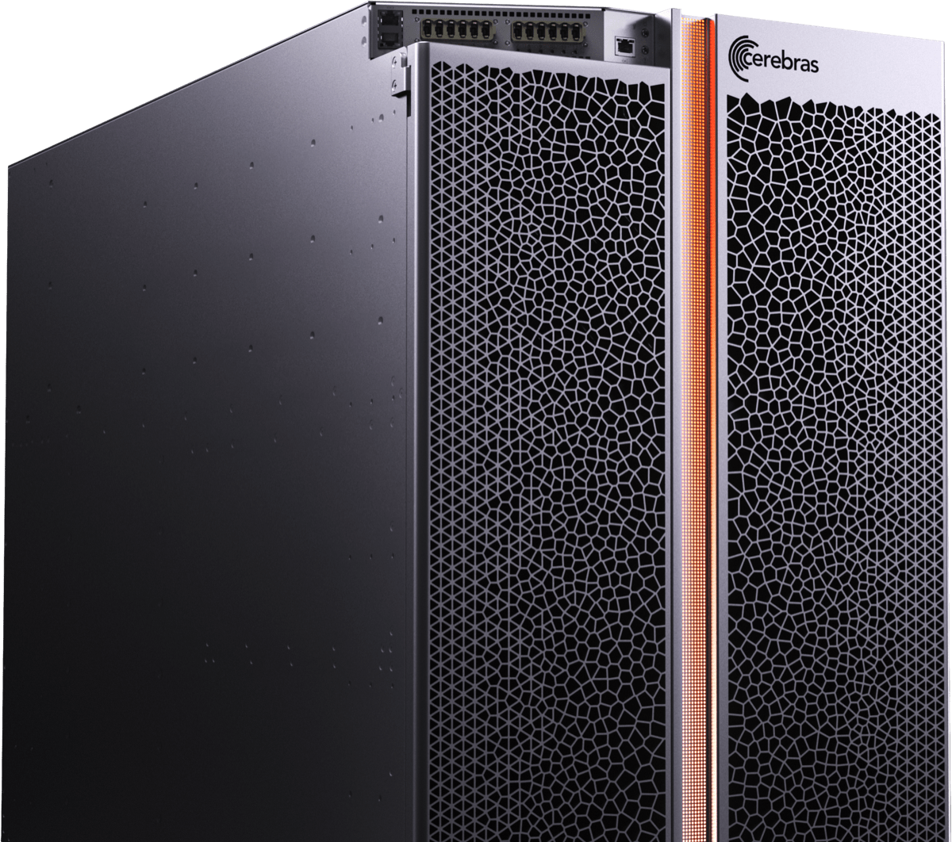
Is Your Application Constrained by Data Access?
Examples:
Stencil based PDE solvers
Linear algebra solvers
Signal processing
Sparse tensor math
Big data analysis
The Cerebras solution:
The CS-3 system has 44 GB of SRAM uniformly distributed across the WSE-3, one cycle away from each local processing element
The CS-3 supports 1.2 Tb/s bandwidth onto the chip
13
Notes:
Another group of applications that have been able to be accelerated are those that are constrained by data access. This constraint acts locally – how fast memory can be read into the registers on each core, as well as globally, how fast we can feed the system with data. The CS-2 c system an do both of these things incredibly well. On the wafer itself, we have 40 GB of sram that is uniformly distributed across all of our cores. Each core has access to it’s own private memory pool and memory can be put in the register in a single cycle. This allows for dramatic speed-up of any problem where your cache size or cache speed become a limiting factor. Additionally, our CS-2 system can be connected to external systems and is able to pass data onto the chip incredibly quickly. If you are streaming data and doing analysis on the fly, or if your problem is large enough that you would feed in portions of the data at a time, the wafer scale engine can handle that, and do it well. Many applications will see their times-to-completion go down by more than an order of magnitude, and we can enable system sizes that were untenable on standard hardware.

Slide 14
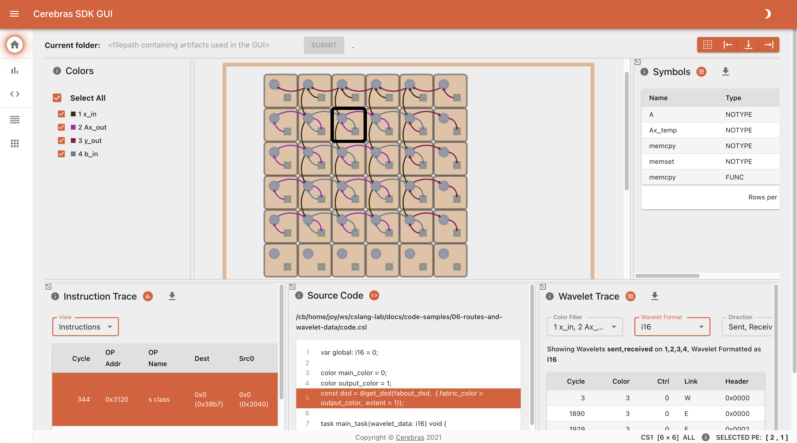
Cerebras SDK
A general-purpose parallel-computing platform and API allowing software developers to write custom programs (“kernels”) for Cerebras systems.
Language
CSL: Cerebras Software Language
Host APIs with Python
Libraries
Optimized primitives
Tools
Simulator
Debugger
Visualization
14
Notes:
Libraries are constantly evolving—working with customers to develop our libraries is extremely important
(RNG, memcpy)

Slide 15
SDK Components
Layout
PE Programming
Runtime
CSL layout blocks
CSL
SDK Runtime
Top level CSL layout file with set_tile_code, set_color_config calls
Define code that runs on PE, e.g. tasks
CSL is also used by internal engineers for some kernels in our ML stack
Use memcpy to copy data to/ from device, launch kernels
Built on top of production HostIO APIs
or
Paint-based layout
More expressive layout engine shared with ML stack
15

Slide 16



From a Programmer’s Perspective
Host CPU(s): Python
Loads program onto simulator or CS-3
Streams IO data from one or more workers
Reads/writes device memory
Device: CSL
Target software simulator or CS-3
CSL programs run on groups of WSE cores, specified by programmer
Executes dataflow programs
Device Read/Write
Memory I/O + Data Streams
16
Notes:
From the user’s perspective, Programming the CS-2 looks like most accelerators
You have a host, which loads programs onto the device, streams in and out data from worker CPUs, and reads or writes to device memory
The device can either be simulated in software, or you can run on real CS-2 hardware
On the device, you write one or more C-level programs using the CSL programming language which target groups of cores on the chip
And the main execution style for the cores on the device is dataflow programs

Slide 17
CSL: Language Basics
Types
Functions
Control structures
Structs/Unions/Enums
Comptime
Builtins
Module system
Params
Tasks
Data Structure Descriptors
Layout specification
Straight from C
(via Zig)
Used for writing device kernel code
Familiar to C/C++/HPC programmers
CSL specific
17
Notes:
When programming the CS-2 device, you’ll leverage our new CSL programming language
CSL contains common constructs familiar to most programmers and CSL-specific constructs
We’ll cover what some of these look like,
But most users who have written C or C++ should be very comfortable using CSL

Slide 18
SDK Access and Use
The SDK is publicly available for download, with public documentation, examples, and forums
  Access and Announcements: cerebras.net/developers/sdk-request
  Documentation: sdk.cerebras.net
  Forums at discourse.cerebras.net
In addition to offline simulator, SDK jobs can be run on hardware on any appliance cluster, with the same job handling pipelines as ML training jobs
18

Slide 19
SDK Example Programs Available
Repository: github.com/Cerebras/csl-examples
Introductory Tutorials
GEMV
GEMM
Cholesky Decomposition
1D and 2D FFT
7-Point Stencil SpMV
Power Method
Conjugate Gradient
Preconditioned Conjugate Gradient
Finite Difference Stencil Computations
Mandelbrot Set Generator
Shift-Add Multiplication
Hypersparse SpMV
Histogram Computation
19

Slide 20
Machine Learning
Training Stack

Slide 21
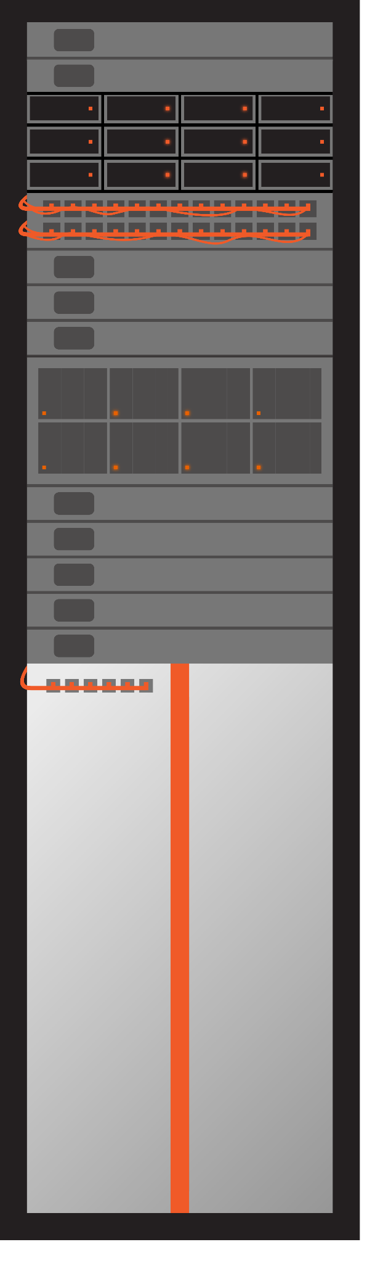
Wafer Scale Cluster: Scalable AI Supercomputer
MemoryX
1 terabyte
1 petabyte
1 billion parameters
24 trillion parameters
SwarmX
1 CS-3
2048 CS-3s
CS-3
125 petaflops
256 exaflops
21

Slide 22
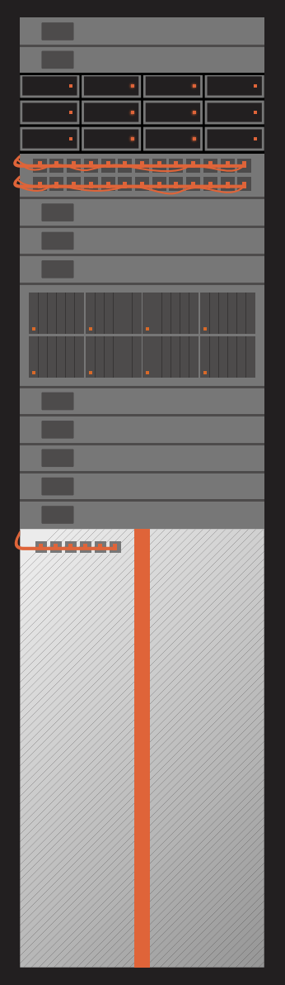
Wafer Scale Cluster: Scalable AI Supercomputer
MemoryX Memory Units
SwarmX Interconnect
Wafer Scale Engines
22

Slide 23


You Program It Like a Single Device
No Matter The Cluster Size
I see one big device
I see one big device
I see one big device
...
Wafer Scale Cluster
Interconnect
Interconnect
Interconnect
Memory
Memory
Memory
1x CS-3
4x CS-3
2048x CS-3
23
Notes:
What does all of this give you, the user?
It gives you the ability to program the it like a single device
No matter the cluster size
Whether it’s a single CS-3, 4 CS-3s, or even 2 thousand CS-3s
Same experience

Slide 24
And Your Model Always Fits
1B or 1T Parameters
I see one big device
I see one big device
I see one big device
...
...
...
Wafer Scale Cluster
Interconnect
Interconnect
Interconnect
Memory
Memory
Memory
Llama 7B
Llama 70B
Llama 700B
1.5TB
36TB
1,200 TB
24
Notes:
And your model always fits
Whether it’s 1B, 10B, 100B, or Trillions of parameters
All because the CS-3 wafer scale chip is big enough to run the largest models, even on a single device
And the CS-3 cluster is designed to scale using data parallelism only

Slide 25


Weight Streaming Technology
Disaggregates Memory and Compute for Trillion Parameter Model Training
Single WSE can run
extreme model size
Weights
Samples
Streamed 1 layer at a time
Labels
Gradients
External model memory, parameter server
External training data storage
CS-3 Compute
Scale model size and training speed independently
25
Notes:
To address the traditional challenges of scaling, we’ve created a new execution model we call Weight Streaming.
We take what’s traditionally been this complex, intertwined problem of distributing memory, compute, and communication, and synchronizing all of them at the same time - and we separate them.
We separate the memory from the compute
Fundamentally disaggregating them
And making the communication elegant and straightforward.
The reason we can do this is because neural networks use memory differently for different components of the model computation.
So, we can design a purpose-built solution for each type of memory and each type of compute that the network needs, and as a result, untangle them and completely simplify the scaling problem
[pause]
And, by disaggregation, the Weight Streaming execution model also provides unique flexibility by allowing independent scaling of the model size and the training speed, so the user can right-size the solution to the problem.

Slide 26
MemoryX External Memory
Virtually Unlimited Model Weight Capacity
Weights streamed onto wafer to compute layer
Weights trigger compute using HW dataflow
Weights are never stored on wafer
Decoupling weights and optimizer compute
Gradients streamed out of wafer
Weight update occurs in MemoryX
CS-3
MemoryX
Weight
Memory
Weights
Gradients
Optimizer Compute
Memory hierarchy enables massive models on a single CS system
26
Notes:
We start by storing all model weights in an external memory device called MemoryX
That give you virtually unlimited model capacity
We then stream the weights onto the wafer for compute
The weights trigger computation using specialized hardware dataflow triggers
That enables the weights to never be stored on the wafer, not even temporarily
Then we steam gradients back from the wafer
And perform the weight update in the MemoryX device
You can think of this as a specialized cluster level memory hierarchy capable of massive model sizes, on a single device

Slide 27
SwarmX Fabric
Purpose-Built Interconnect for Simple Scaling
CS-3s
Data-parallel only training across CS-3s
Weights are broadcast to all CS-3s
Gradients are reduced on way back
Multi-system scaling with the same execution model as a single system
Same system architecture
Same network execution flow
Same software user interface
SwarmX
Weights
Gradients
MemoryX
Weight
Memory
Weights
Gradients
Optimizer Compute
Scaling to cluster compute while operating like a single device
27
Notes:
Next, completely independently from that memory, we have a purpose built interconnect for simple scaling, called SwarmX
This enables data-parallel only scaling across CS-3s
By broadcasting all the weights to the CS-3s
And reducing the gradients on the way back
And the key is that this all built into the interconnect so the entire cluster can operate like a single device
You get multi-system performance scaling, preserving the execution as a single system
Same architecture, same network flow, same software interface

Slide 28
How to Get Good Model Quality at Scale (on GPUs)
2048 GPUs
Data & Tensor &
Pipeline & Expert &
Sequence parallelism
256 GPUs
Data & Tensor &
Pipeline parallel
100B
Time / Work
8 GPUs
Data Parallelism
13B
1 GPU
3B
.5B
Design the Experiments
Run Experiments
Pick Winners
Scale Up
28
Notes:
You have to refactor your code and do a harder level of distributed programming
to run your model on a bigger cluster.
So this distribution problem doesn’t just make your big run hard,
But it makes it hard to do all the runs in between that
Will get you to a high-quality result.

Slide 29
Cerebras Gets You to High-Quality Large Models Faster
Time / Work
On CS-3,
Data parallel only
at any model size
.5 B
3 B
13 B
100B
Design Sweeps
Run Experiments
Pick Winners
Scale Up
29
Notes:
But you can also easily move from your small to medium to large scale runs just as easily.
You can get to the best configuration faster, with no extra work.

Slide 30


Training Software Stack
Frontend API
PyTorch
• Model code is written in vanilla PyTorch
• cstorch API mirrors PyTorch API
– Helps with single-device abstraction
– Used for some drop-in replacements and unique Cerebras features
• Tensor Ops traced through LazyTensorCore (LTC)
– Graph-by-execution with lazy evaluation
– Also drives Google’s xla/tpu device
Cerebras
PyTorch
“device”
cstorch API
LazyTensorCore
Wafer-Scale Cluster
30
Notes:
- Let's begin by examining the essential components of the Cerebras Software stack that enable users to use the Wafer-Scale Cluster with PyTorch.
- We've introduced a user-friendly package called 'cstorch' or 'cerebras_pytorch,' which closely mirrors the familiar PyTorch API.
- The primary aim of this API is to simplify the targeting the Wafer-Scale Cluster as a single device, similar to a torch device.
- Beneath the surface, this API leverages lazy evaluation to construct a computational graph as operations are traced.
- Notably, lazy evaluation is inherently supported by PyTorch through the 'LazyTensorCore' project.
- Though we are a heavy user, 'LazyTensorCore' is not exclusive to Cerebras, as it is also utilized by TPU devices, offering an innovative approach to capturing computation graphs from a series of PyTorch operations.

Slide 31



Training Software Stack
Compilation
PyTorch
• MLIR translation from LTC provided by torch-mlir
– Hardware-focused compiler ecosystem for Torch
• Cerebras MLIR stack handles cluster optimizations
Cerebras
PyTorch
“device”
cstorch API
LazyTensorCore
LTC MLIR
Plugin
Torch Dialect
Cerebras
MLIR Dialect
Wafer-Scale Cluster
31
Notes:
- Once the model has been traced, the subsequent stage involves compilation, which is facilitated by the open-source Torch-MLIR project.
- Torch-MLIR serves as a hardware-centric compiler plugin for PyTorch, and it's worth noting that Cerebras actively participates in its development.
- Through the Torch-MLIR framework, we transform a user's model from the PyTorch aten dialect into a proprietary Cerebras MLIR dialect, and we further implement optimizations tailored specifically for the Wafer-Scale Cluster.
- These optimizations play a pivotal role in the efficient translation of PyTorch operations into a set of cerebras-specific kernels, which are then executed on the cluster for enhanced performance.

Slide 32
Training Software Stack
Runtime Executor
PyTorch
• Tensors get transferred to the cluster as needed
– Initial weights sent to MemoryX before first step
– Inputs are streamed each step from the custom data executor
Cerebras
PyTorch
“device”
cstorch API
LazyTensorCore
LTC MLIR
Plugin
Torch Dialect
Runtime Executor
Cerebras
MLIR Dialect
Wafer-Scale Cluster
32
Notes:
- Following the completion of the compilation phase, the weight tensors are transferred to the cluster at the outset of the execution process.
- Execution initiates asynchronously on the cluster, where, at each step, input data is streamed from a specialized data executor within the cluster.
- Meanwhile, the outputs are obtained by the primary training loop.
- By decoupling the execution from the main training loop, the cluster is empowered to process data as swiftly as possible without encountering any hindrance from the training loop itself.
- With this insight, let's now proceed to explore a code example that illustrates the simplicity of utilizing the cstorch API.

Slide 33
The Cerebras Modelzoo
Public repo at github.com/Cerebras/modelzoo
As a starting point | Reference model implementations: GPT-3, LLaMa, Mistral, BERT, LLaVa, and much more!
 | Data preparation scripts
 | Configurations for multiple model scales
For benchmarking | Tuned implementations for optimal performance
To develop new models | Cerebras PyTorch & Layer APIs
 | File organization as a template to start your own models
33
Notes:
The basis for your initial work (and potentially much of your work) on the CS-2 will be the Cerebras Model Zoo
The Cerebras Model Zoo is a public code repository
You can go there right now and check it out at that link in orange
You’ll clone it from GitHub, use it with pip-installed packages you use on the user node
Our typical process involves users starting from the modelzoo and modifying the models/dataloaders depending on their workloads
What it provides….
You may use it as a starting poing
Reference PyTorch implementations of various models and architectures → so you can start training from scratch
We provide configurations for multiple model sizes, from tens of millions of parameters all the way up to many billions, so you choose what you need
Data preparation scripts
Everyone wants to train models, nobody wants to work on data, right?
We help with the data preparation too,
we share some of our open source work on Slim Pajama, where we extensively deduplicated a trillion-token dataset. Those scripts are available
We offer different dataloaders to meet your needs
You can also use MZ for benchmarking
We offer tuned implementations for higher performance
And when you’ve quickly become a pro at using the CS-2, you have the flexibility to develop your own models
Using our PyTorch and Layer APIs, using the templates we provide
And I really want to foot-stomp, Model Zoo is a tool, not necessarily a lock-in mechanism
Use our reference models to start training from scratch immediately
You may convert a pretrained model checkpoint from the Hugging Face ecosystem
And you can convert models from the CS format to the Hugging Face format, so you’re not locked in
Use our PyTorch and layer APIs to build your model from scratch
And for all of this, we have public documentation at docs.cerebras.net that accompanies the model zoo, that walks through the short “how-to” guides, longer end-to-end tutorials, and how to use Model Zoo to its fullest effect
No matter how you want to use the CS-2, we want to help you experiment faster

Slide 34
Modelzoo: Batteries Included
Models
NLP
Data Processors
Tools
Common
Trainer
Vision
Multimodal
NLP
Vision
Multimodal
Checkpoint Converters
Class Registry
Checkpoint Utils
Run Utils
Eval Harnesses
Config Converters
Training logic
Callbacks
Loggers
Config Validation
Layers & Losses
Transformer Blocks
Position Embeddings
Attention Variants
Losses for LM, Bert, DPO, CLIP...
34

Slide 35
Modelzoo: Batteries Included
Models
NLP
Data Processors
Tools
Common
Trainer
Vision
Multimodal
NLP
Vision
Multimodal
Checkpoint Converters
Class Registry
Checkpoint Utils
Run Utils
Eval Harnesses
Config Converters
Training logic
Callbacks
Loggers
Config Validation
Layers & Losses
Transformer Blocks
Position Embeddings
Attention Variants
Losses for LM, Bert, DPO, CLIP...
35

Slide 36
Modelzoo: Batteries Included
Models
NLP
Data Processors
Tools
Common
Trainer
Vision
Multimodal
NLP
Vision
Multimodal
Checkpoint Converters
Class Registry
Checkpoint Utils
Run Utils
Eval Harnesses
Config Converters
Training logic
Callbacks
Loggers
Config Validation
Layers & Losses
Transformer Blocks
Position Embeddings
Attention Variants
Losses for LM, Bert, DPO, CLIP...
36

Slide 37
Anatomy of a Modelzoo Model Directory
…/modelzoo/models/nlp/my_model/
run.py | Main script to execute train, eval, prediction on CS-3, GPU, or CPU
model.py | PyTorch model definition and interface
configs/ | Folder with different parametrizations of the model in .yaml files
README.md | Model and config overview, links to other resources
Example: Modelzoo LLaMa
37

Slide 38
Modelzoo Experiment Configs
Backend
trainer:
init:
backend:
backend_type: CSX
cluster_config:
num_csx: 1
38

Slide 39
Modelzoo Experiment Configs
Model
trainer:
init:
model:
name: "gpt3"
hidden_size: 256
position_embedding_type: learned
share_embedding_weights: true
max_position_embeddings: 2048 # must be >= (ideally ==) the dataset's MSL
vocab_size: 50257
num_hidden_layers: 2
dropout_rate: 0.1
layer_norm_epsilon: 1.0e-05
num_heads: 2
attention_type: scaled_dot_product
attention_dropout_rate: 0.1
use_projection_bias_in_attention: true
use_ffn_bias_in_attention: true
filter_size: 1024
nonlinearity: gelu
use_ffn_bias: true
embedding_initializer: {mean: 0.0, name: truncated_normal, std: 0.02, a: -0.04, b: 0.04}
initializer: {mean: 0.0, name: truncated_normal, std: 0.02, a: -0.04, b: 0.04}
output_layer_initializer: {mean: 0.0, name: truncated_normal, std: 0.01, a: -0.02, b: 0.02}
use_bias_in_output: false
39

Slide 40
Modelzoo Experiment Configs
Optimizer, Schedulers, & Precision
trainer:
init:
optimizer:
AdamW:
betas: [0.9, 0.95]
eps: 1.0e-08
weight_decay: 0.1
correct_bias: true
schedulers:
- SequentialLR:
schedulers:
- LinearLR: {initial_learning_rate: 0.0, end_learning_rate: 0.0006, total_iters: 5}
precision:
enabled: true
fp16_type: bfloat16
precision_opt_level: 1
max_gradient_norm: 1.0
log_loss_scale: true
40

Slide 41
Modelzoo Experiment Configs
Loop, Checkpoint, Logging, & Callbacks
trainer:
init:
loop:
max_steps: 10 # raise if you want to see stabilized throughput
eval_frequency: 0
checkpoint:
steps: 10
save_initial_checkpoint: false
logging:
log_steps: 5
callbacks:
- ComputeNorm: {}
- ScopedTrainFlags:
# Equal to batch_size, so one micro-batch per step and NO
# gradient accumulation. Must be <= batch_size / num_csx.
csx.performance.micro_batch_size: 32
41

Slide 42
Modelzoo Experiment Configs
Fit
trainer:
fit:
train_dataloader:
data_processor: GptHDF5DataProcessor
data_dir:
- <DATA_DIR>
shuffle: true
shuffle_seed: 0
batch_size: 32
num_workers: 1
prefetch_factor: 10
persistent_workers: true
42

Slide 43
The Modelzoo Command-Line Interface
The modelzoo library comes with an accessible command-line interface (CLI)
Supported commands include:
  Model training and evaluation
  Conversion of model configs and checkpoints
  Summarizing supported models and breaking down a given model config
  Data preprocessing and breaking down a given modelzoo DataProcessor
The modelzoo also has an LLM assistant! It can:
  Answer questions about Cerebras’ hardware, software, and documentation
  Process natural language instructions to execute modelzoo CLI commands (with permission)
  All you need is an API key from inference.cerebras.ai
43

Slide 44
Modelzoo CLI: Training a Model
cszoo fit example_config.yaml
  --model_dir
  --validate_only
  --compile_only
  --num_csx
  --checkpoint_path
44

Slide 45
Modelzoo CLI: Checkpoint Conversion
cszoo checkpoint convert
  --model llama \ # Must be a registered modelzoo family
  --src-fmt cs-auto \
  --tgt-fmt hf \
  --config my_llama_config.yaml \
  --output-dir ./to_hf/ \
  model_dir/checkpoint_0.mdl \
45

Slide 46
Modelzoo CLI: Available Models
This is just a small sample of the model list
cszoo model list
Available models in ModelZoo
bert
bert/classifier
gpt3
llama
llava
mixtral
vision_transformer
46

Slide 47
Modelzoo CLI: Model Evaluation
cszoo validate example_config.yaml # uses a single trainer.validate dataloader
47

Slide 48
Modelzoo CLI: Model Evaluation
cszoo validate example_config.yaml # uses a single trainer.validate dataloader
cszoo validate_all example_config.yaml # uses a list of trainer.validate_all loaders
48

Slide 49
Modelzoo CLI: Model Evaluation
cszoo validate example_config.yaml # uses a single trainer.validate dataloader
cszoo validate_all example_config.yaml # uses a list of trainer.validate_all loaders
cszoo lm_eval example_config.yaml # eval on Eleuther eval harness task(s)
--tasks=winogrande
--checkpoint_path=./model_dir/my_ckpt.mdl
49

Slide 50
Modelzoo CLI: Model Evaluation
cszoo validate example_config.yaml # uses a single trainer.validate dataloader
cszoo validate_all example_config.yaml # uses a list of trainer.validate_all loaders
cszoo lm_eval example_config.yaml # eval on Eleuther eval harness task(s)
--tasks=winogrande
--checkpoint_path=./model_dir/my_ckpt.mdl
cszoo bigcode_eval example_config.yaml # eval on BigCode eval harness task(s)
--tasks=mbpp
--checkpoint_path=./model_dir/my_ckpt.mdl
50

Slide 51
Clusters and Jobs with csctl
The csctl command is built into any cluster’s user nodes, so once you’re logged in you don’t need any particular environment to use it
csctl handles various things, like…
51

Slide 52
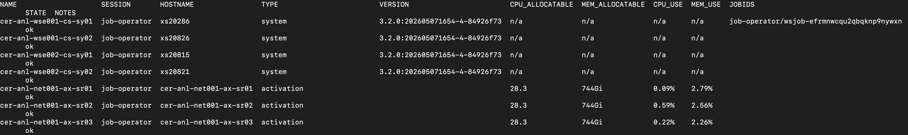
Clusters and Jobs with csctl
csctl get cluster
52

Slide 53
Clusters and Jobs with csctl
csctl get jobs
wsjob-<id> # for a specific job
-a # all jobs, including historical ones
-m # only my jobs
53

Slide 54
Clusters and Jobs with csctl
csctl log-export wsjob-<id> # exports *all* job logs from the cluster appliance
csctl cancel wsjob-<id>. # to terminate one of your queued or running jobs
54

Slide 55
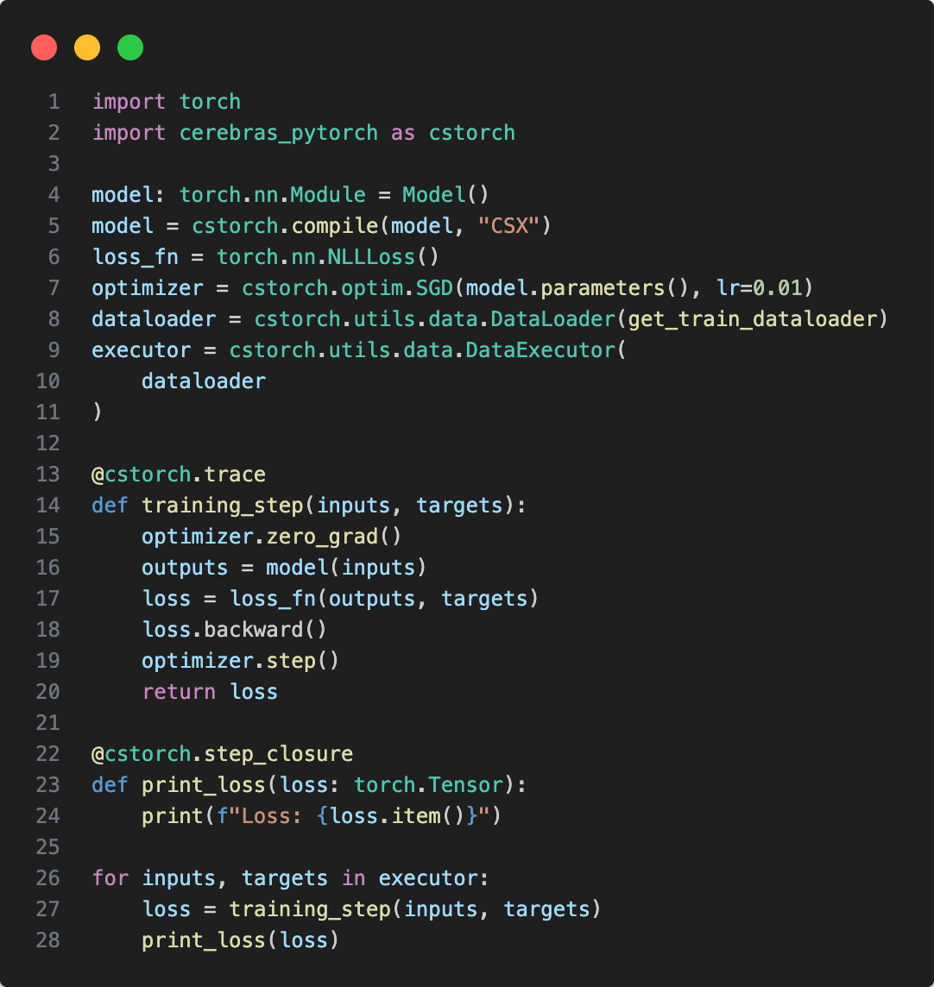
Custom Training Loops with the cstorch API
Import cstorch package
Import
55
Notes:
To begin, we start by importing the cstorch package.

Slide 56
Custom Training Loops with the cstorch API
Import cstorch package
Define the model
  Our model is defined as if running on a single device
  We use the familiar PyTorch API with some drop-in replacements from cstorch
  The dataloader gets wrapped in a cstorch data executor
Define
Model
56
Notes:
- Then, we proceed to define the model.
- It's important to note that there's no need to handle data parallelism, model parallelism, or tensor parallelism within the model itself.
- Your model code can be written as if it's targeting a single CPU device.
- Once the model is defined, we pass it to cstorch.compile(). This step prepares the model for compilation, effectively instantiating the cstorch device, which is akin to moving the model to a torch device.
- Following this, we create an optimizer and a dataloader, and then wrap the dataloader with a data executor.

Slide 57
Custom Training Loops with the cstorch API
Import cstorch package
Define the model
  Our model is defined as if running on a single device
  We use the familiar PyTorch API with some drop-in replacements from cstorch
  The dataloader gets wrapped in a cstorch data executor
Create the training loop method
  Nothing novel here, except the decorator
  cstorch.trace() makes sure to capture the computation graph used in each training step
Define Training
Loop
57
Notes:
- Then we proceed to define the training loop.
- As you can observe on the right, the training loop itself remains unchanged from a vanilla PyTorcj training loop..
- The only difference is that we decorate the training loop method with cstorch.trace to enable further optimizations.

Slide 58
Custom Training Loops with the cstorch API
Import cstorch package
Define the model
  Our model is defined as if running on a single device
  We use the familiar PyTorch API with some drop-in replacements from cstorch
  The dataloader gets wrapped in a cstorch data executor
Create the training loop method
  Nothing novel here, except the decorator
  cstorch.trace() makes sure to capture the computation graph used in each training step
Run the training loop
  Compiles the model during the first step and then starts asynchronous execution
  Outputs (losses) are retrieved from the wafer as they become available
Train
58
Notes:
- With all the necessary components in place, we run the data executor, call the training step, and retrieve the outputs.
- Behind the scenes, in the initial step, once the computation graph is completely traced, we compile the model and initiate asynchronous execution on the cluster.
- From that point onward, outputs are fetched on demand as required by the training loop.
- That's it! These are the steps you need to execute AI workloads on the Wafer-Scale Cluster.
- At this point, you might be curious about how to enhance the speed of your model.
- Well, that’s quite simple: [click]

Slide 59
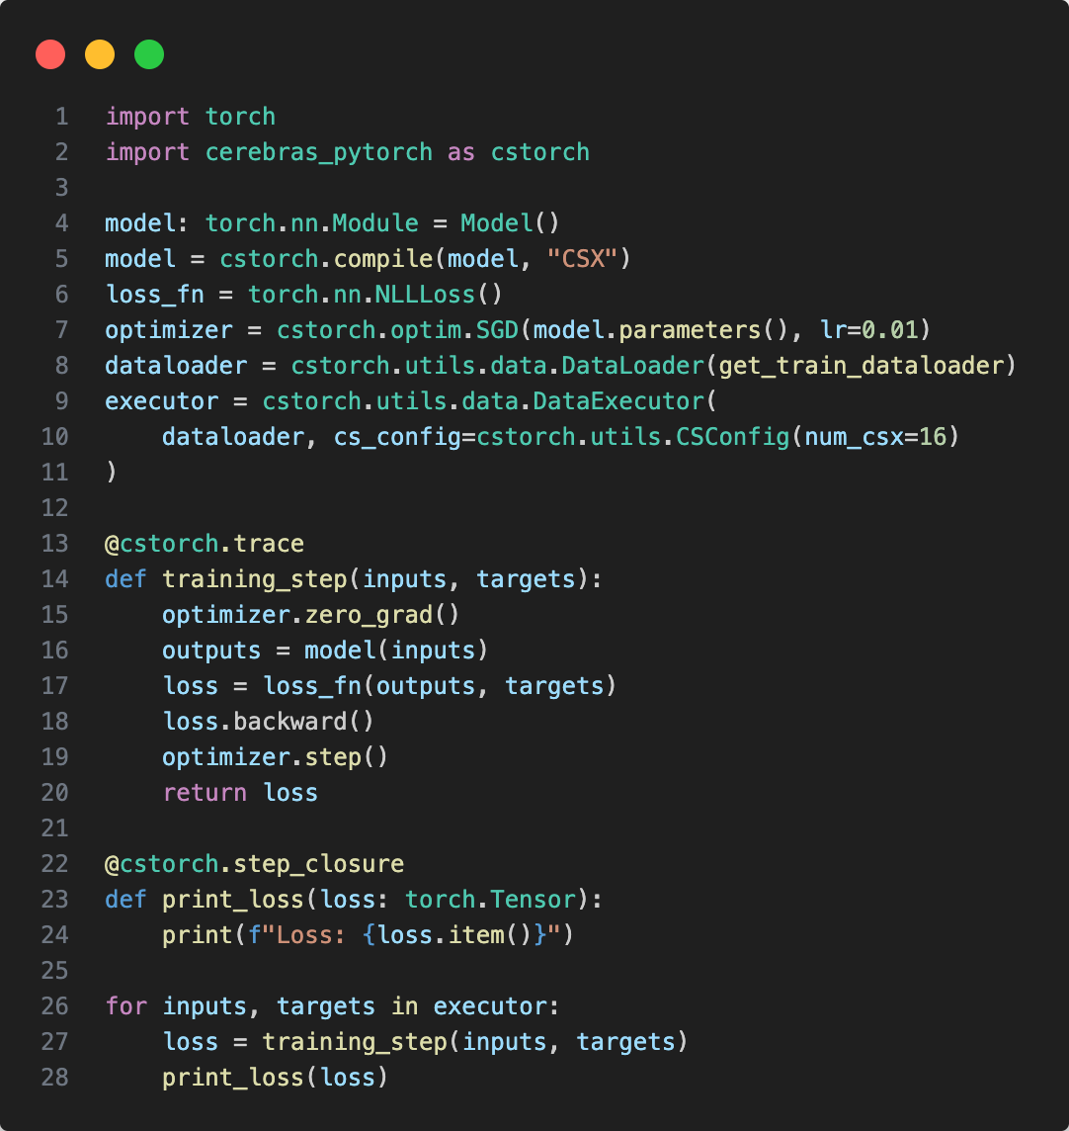
Custom Training Loops with the cstorch API
Scale out to multiple CS-3s with a one-argument configuration change
Near-linear scaling happens automatically
We don’t need to change…
  Model code
  Training loop
  Effective batch size
It’s easy to supply the value programmatically for edit-free scaling
Scale out
59
Notes:
- You just need to specify the number of CS-2s you want to target in the cluster using a single line of code
- The cstorch API and the cluster take care of the rest. No changes to your model, training loop, or batch size are required. EVERYTHING IS HANDLED FOR YOU!
- This approach allows you to concentrate on crafting your model while achieving nearly linear scaling as you scale out to multiple CS-2s.
- In addition to accelerating on multiple CS-2s, we can also leverage sparsity to further speed up training.

Slide 60
Ultrafast Cloud Inference

Slide 61

Pipeline Execution on a Single Chip
Massive memory bandwidth enables opposite execution model
• GPU: multiple chips to run a single layer
• Cerebras: fraction of a chip to run a single layer
Layer 1
Layer 2
Layer 3
Layer 4
61

Slide 62
Pipeline Execution on a Single Chip
Massive memory bandwidth enables opposite execution model
• GPU: multiple chips to run a single layer
• Cerebras: fraction of a chip to run a single layer
Pipeline mapping of model
Model layers are mapped to wafer regions
Size of wafer region determined based on memory and compute requirements
Model weights and KV cache stored locally in the region memory close to the compute
Layer 1
Layer 2
Layer 3
Layer 4
62

Slide 63
Pipeline Execution
A low latency pipeline
Each wafer region processes 1 token
  Enough memory bandwidth to run local batch size 1
  Memory to feed compute datapath at full speed
  Enabling optimized performance for matrix*vector
  Local fabric interconnect to maintain low latency
Layer 1
Layer 2
Layer 3
Layer 4
Token
63

Slide 64
Pipeline Execution
A low latency pipeline
Each wafer region processes 1 token
  Enough memory bandwidth to run local batch size 1
  Memory to feed compute datapath at full speed
  Enabling optimized performance for matrix*vector
  Local fabric interconnect to maintain low latency
Regions are placed to reduce latency
  The next region is physically adjacent
  Virtually no latency between pipe stages
  Possible because it’s all done on-chip
Layer 1
Layer 2
Layer 3
Layer 4
Token
64

Slide 65
Pipeline Execution
A low latency pipeline
Each wafer region processes 1 token
  Enough memory bandwidth to run local batch size 1
  Memory to feed compute datapath at full speed
  Enabling optimized performance for matrix*vector
  Local fabric interconnect to maintain low latency
Regions are placed to reduce latency
  The next region is physically adjacent
  Virtually no latency between pipe stages
  Possible because it’s all done on-chip
Layer 1
Layer 2
Layer 3
Layer 4
Token
65

Slide 66
Pipeline Execution
A low latency pipeline
Each wafer region processes 1 token
  Enough memory bandwidth to run local batch size 1
  Memory to feed compute datapath at full speed
  Enabling optimized performance for matrix*vector
  Local fabric interconnect to maintain low latency
Regions are placed to reduce latency
  The next region is physically adjacent
  Virtually no latency between pipe stages
  Possible because it’s all done on-chip
Layer 1
Layer 2
Layer 3
Layer 4
Token
66

Slide 67
Pipeline Execution
A low latency pipeline
New token
Each wafer region processes 1 token
  Enough memory bandwidth to run local batch size 1
  Memory to feed compute datapath at full speed
  Enabling optimized performance for matrix*vector
  Local fabric interconnect to maintain low latency
Regions are placed to reduce latency
  The next region is physically adjacent
  Virtually no latency between pipe stages
  Possible because it’s all done on-chip
Last region output cycled back to generate next token
Pipelined execution enables super-fast token generation
Layer 1
Layer 2
Layer 3
Layer 4
Token
67

Slide 68
Mapping to Multiple Wafers
Llama3.1-70B
70 billion parameters
140 GB of memory (FP16)
Layer 1
Layer 2
...
Layer 20
Layer 21
Layer 22
...
Layer 40
Layer 41
Layer 42
...
Layer 60
Layer 61
Layer 62
...
Layer 80
4x WSE-3
176GB of SRAM
68

Slide 69
Mapping to Multiple Wafers
Models that require more memory are mapped to multiple wafers
Keep almost all high communication on wafer, using internal high bandwidth fabric
Transfer only activations between wafers, requiring relatively lower bandwidth
Using CS-3 low latency RDMA over Ethernet interconnect between systems
Llama3.1-70B
70 billion parameters
140 GB of memory (FP16)
Layer 1
Layer 2
...
Layer 20
Layer 21
Layer 22
...
Layer 40
Layer 41
Layer 42
...
Layer 60
Layer 61
Layer 62
...
Layer 80
4x WSE-3
176GB of SRAM
69

Slide 70
Multiple Requests
“Excess” memory bandwidth enables high multi-user throughput
• Single user is using only a fraction of the total memory bandwidth
• We can use the extra bandwidth to support multiple users
Layer 1
Layer 2
Layer 3
Layer 4
1
70

Slide 71
Multiple Requests
More than enough memory bandwidth for single user enables high multi-user throughput
Single user is using only a fraction of the total memory bandwidth
We can use the extra bandwidth to support multiple users
Additional users all run in parallel
Each accessing the model simultaneously
Layer 1
Layer 2
Layer 3
Layer 4
2
1
71

Slide 72
Multiple Requests
More than enough memory bandwidth for single user enables high multi-user throughput
Single user is using only a fraction of the total memory bandwidth
We can use the extra bandwidth to support multiple users
Additional users all run in parallel
Each accessing the model simultaneously
Every user gets full performance
All pipe stages to run at the same time
Layer 1
Layer 2
Layer 3
Layer 4
3
2
1
72

Slide 73
Multiple Requests
More than enough memory bandwidth for single user enables high multi-user throughput
Single user is using only a fraction of the total memory bandwidth
We can use the extra bandwidth to support multiple users
Additional users all run in parallel
Each accessing the model simultaneously
Every user gets full performance
All pipe stages to run at the same time
Full pipeline model parallelism on single chip
Layer 1
Layer 2
Layer 3
Layer 4
4
3
2
1
73

Slide 74
Continuous Batching
Fine-grained token scheduling enables natural continuous batching
Token-by-token processing and pipeline execution gives native ability to do fine-grained mixing of streams, both prompt and outputs.
Can dynamically interleave all sequences at fine granularity to give good balance of prompt and output performance simultaneously.
As long as there is pipeline capacity, available sequences can be processed, no need to wait until sequence boundaries.
Scheduler attempts to fill pipeline slots with whatever is available to drive up performance: prompt, output, draft
Layer 1
Layer 2
Layer 3
Layer 4
3p
3p
2o
1o
74

Slide 75
Getting Started with
Cerebras Inference

Slide 76
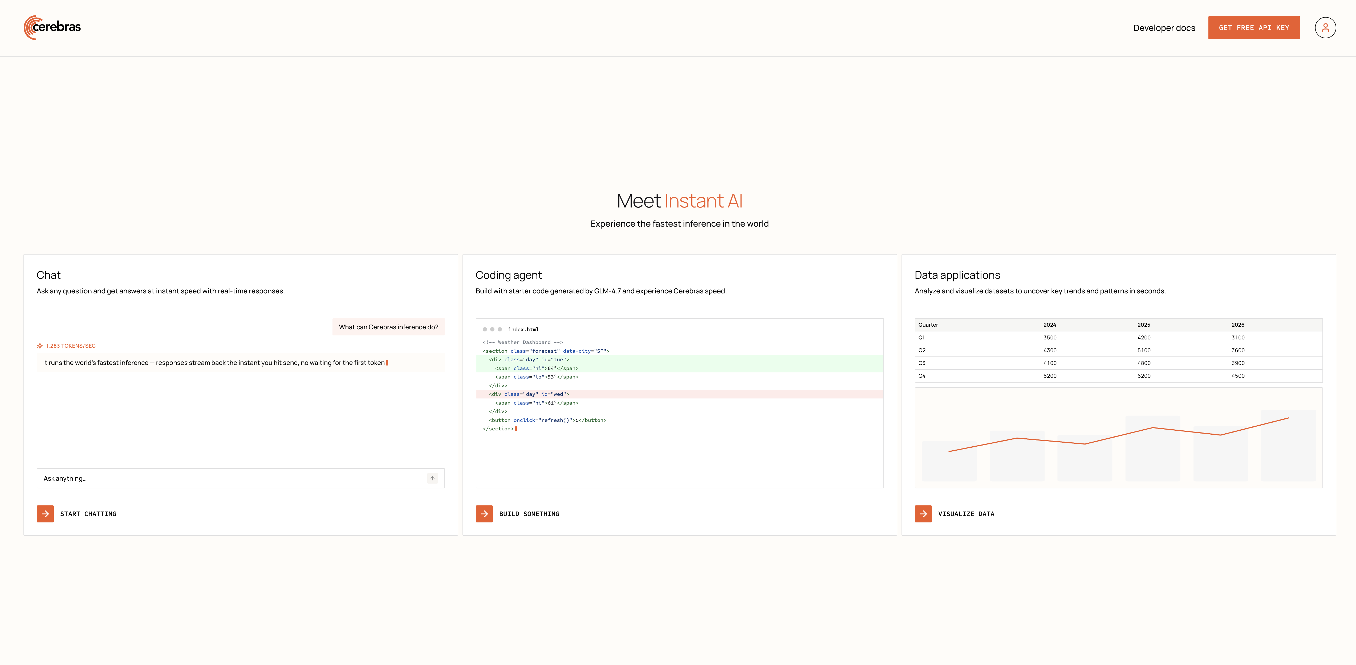
Inference: Getting Started
Head on over to chat.cerebras.ai
76

Slide 77
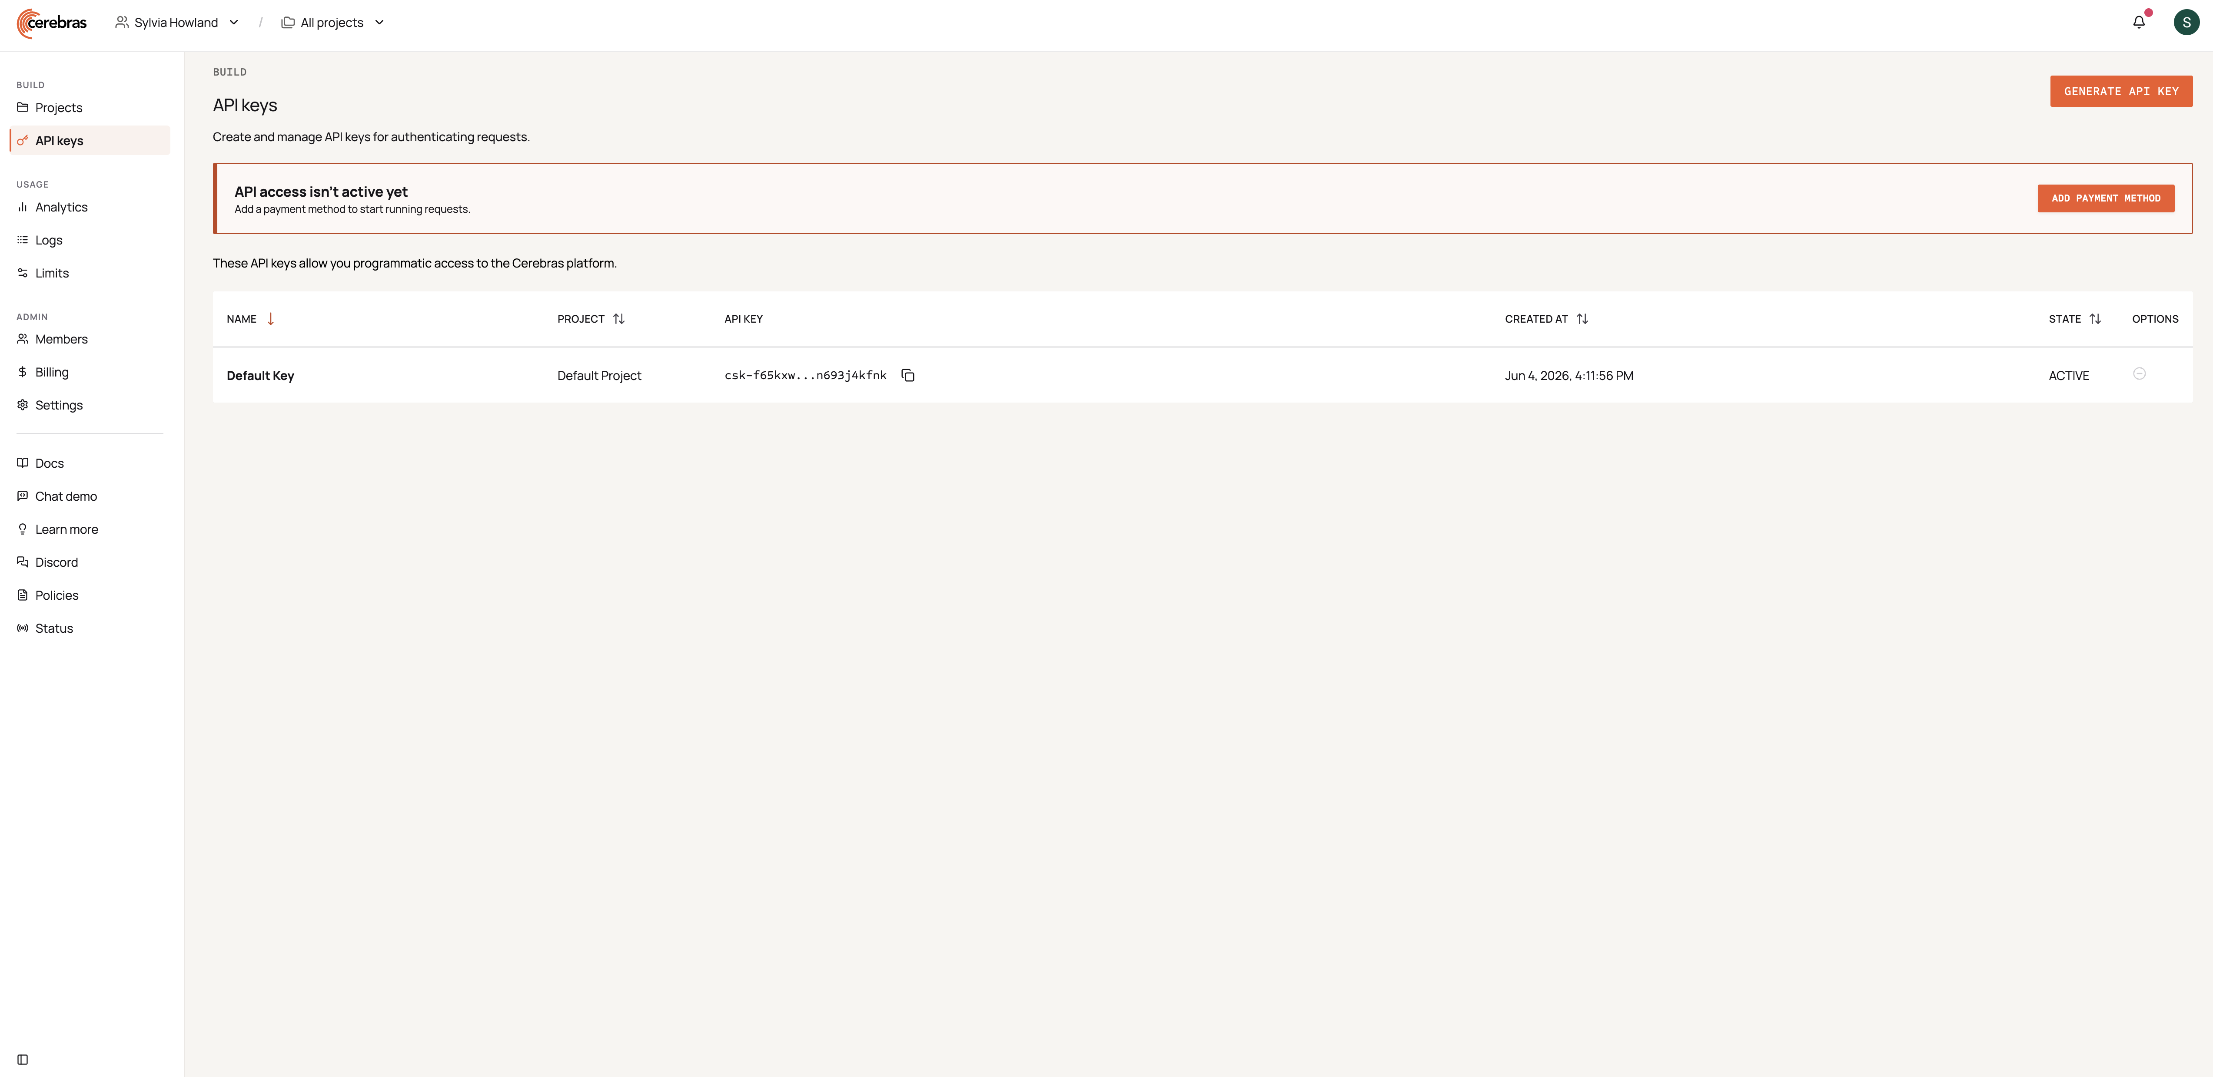
Inference: Getting Started
77

Slide 78
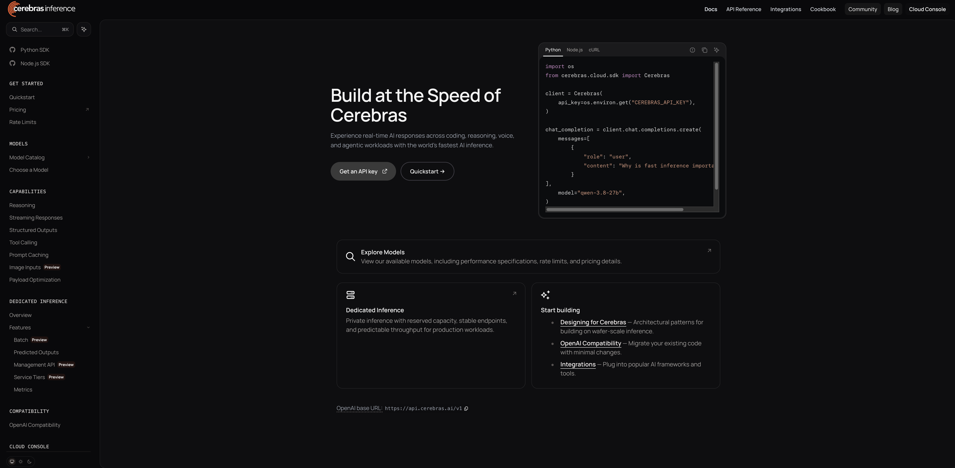
Inference Documentation
Learn more about the API and setup at inference-docs.cerebras.ai
78

Slide 79
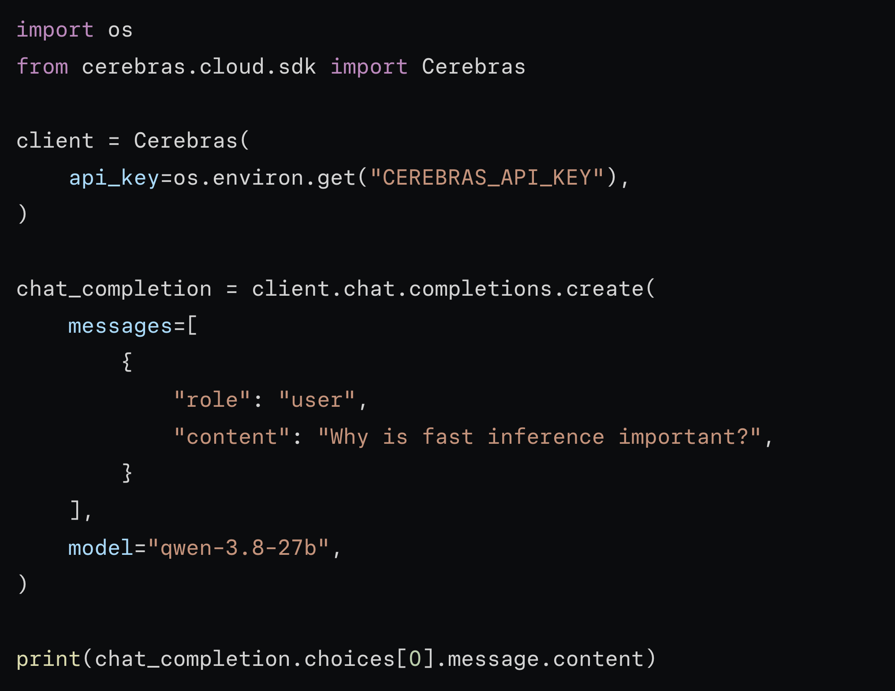
Inference Documentation
Our inference API is OpenAI compatible and familiar
79

Slide 80

Thank You

