Slide 1
LLMs

Slide 2
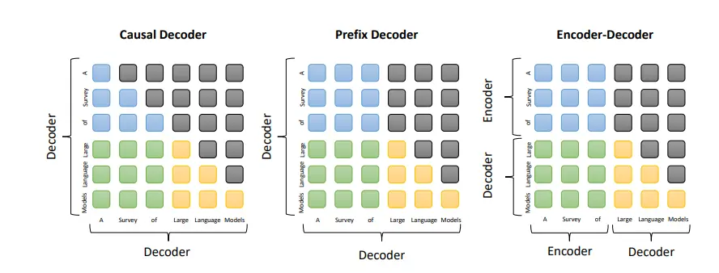
Common architectures

Slide 3
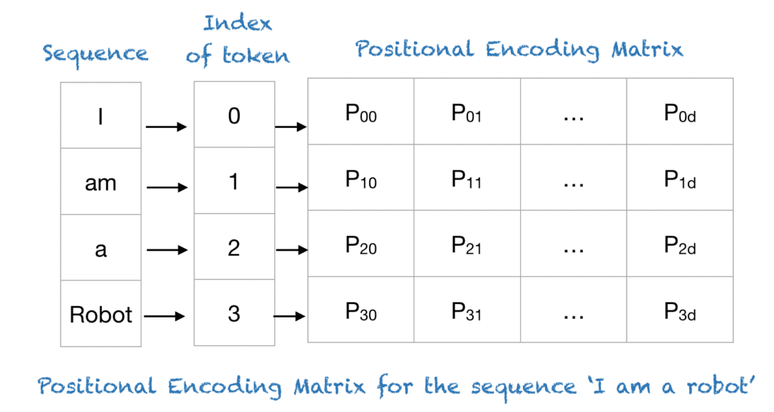
Positional embeddings

Slide 4
Attention mechanisms

