Slide 1
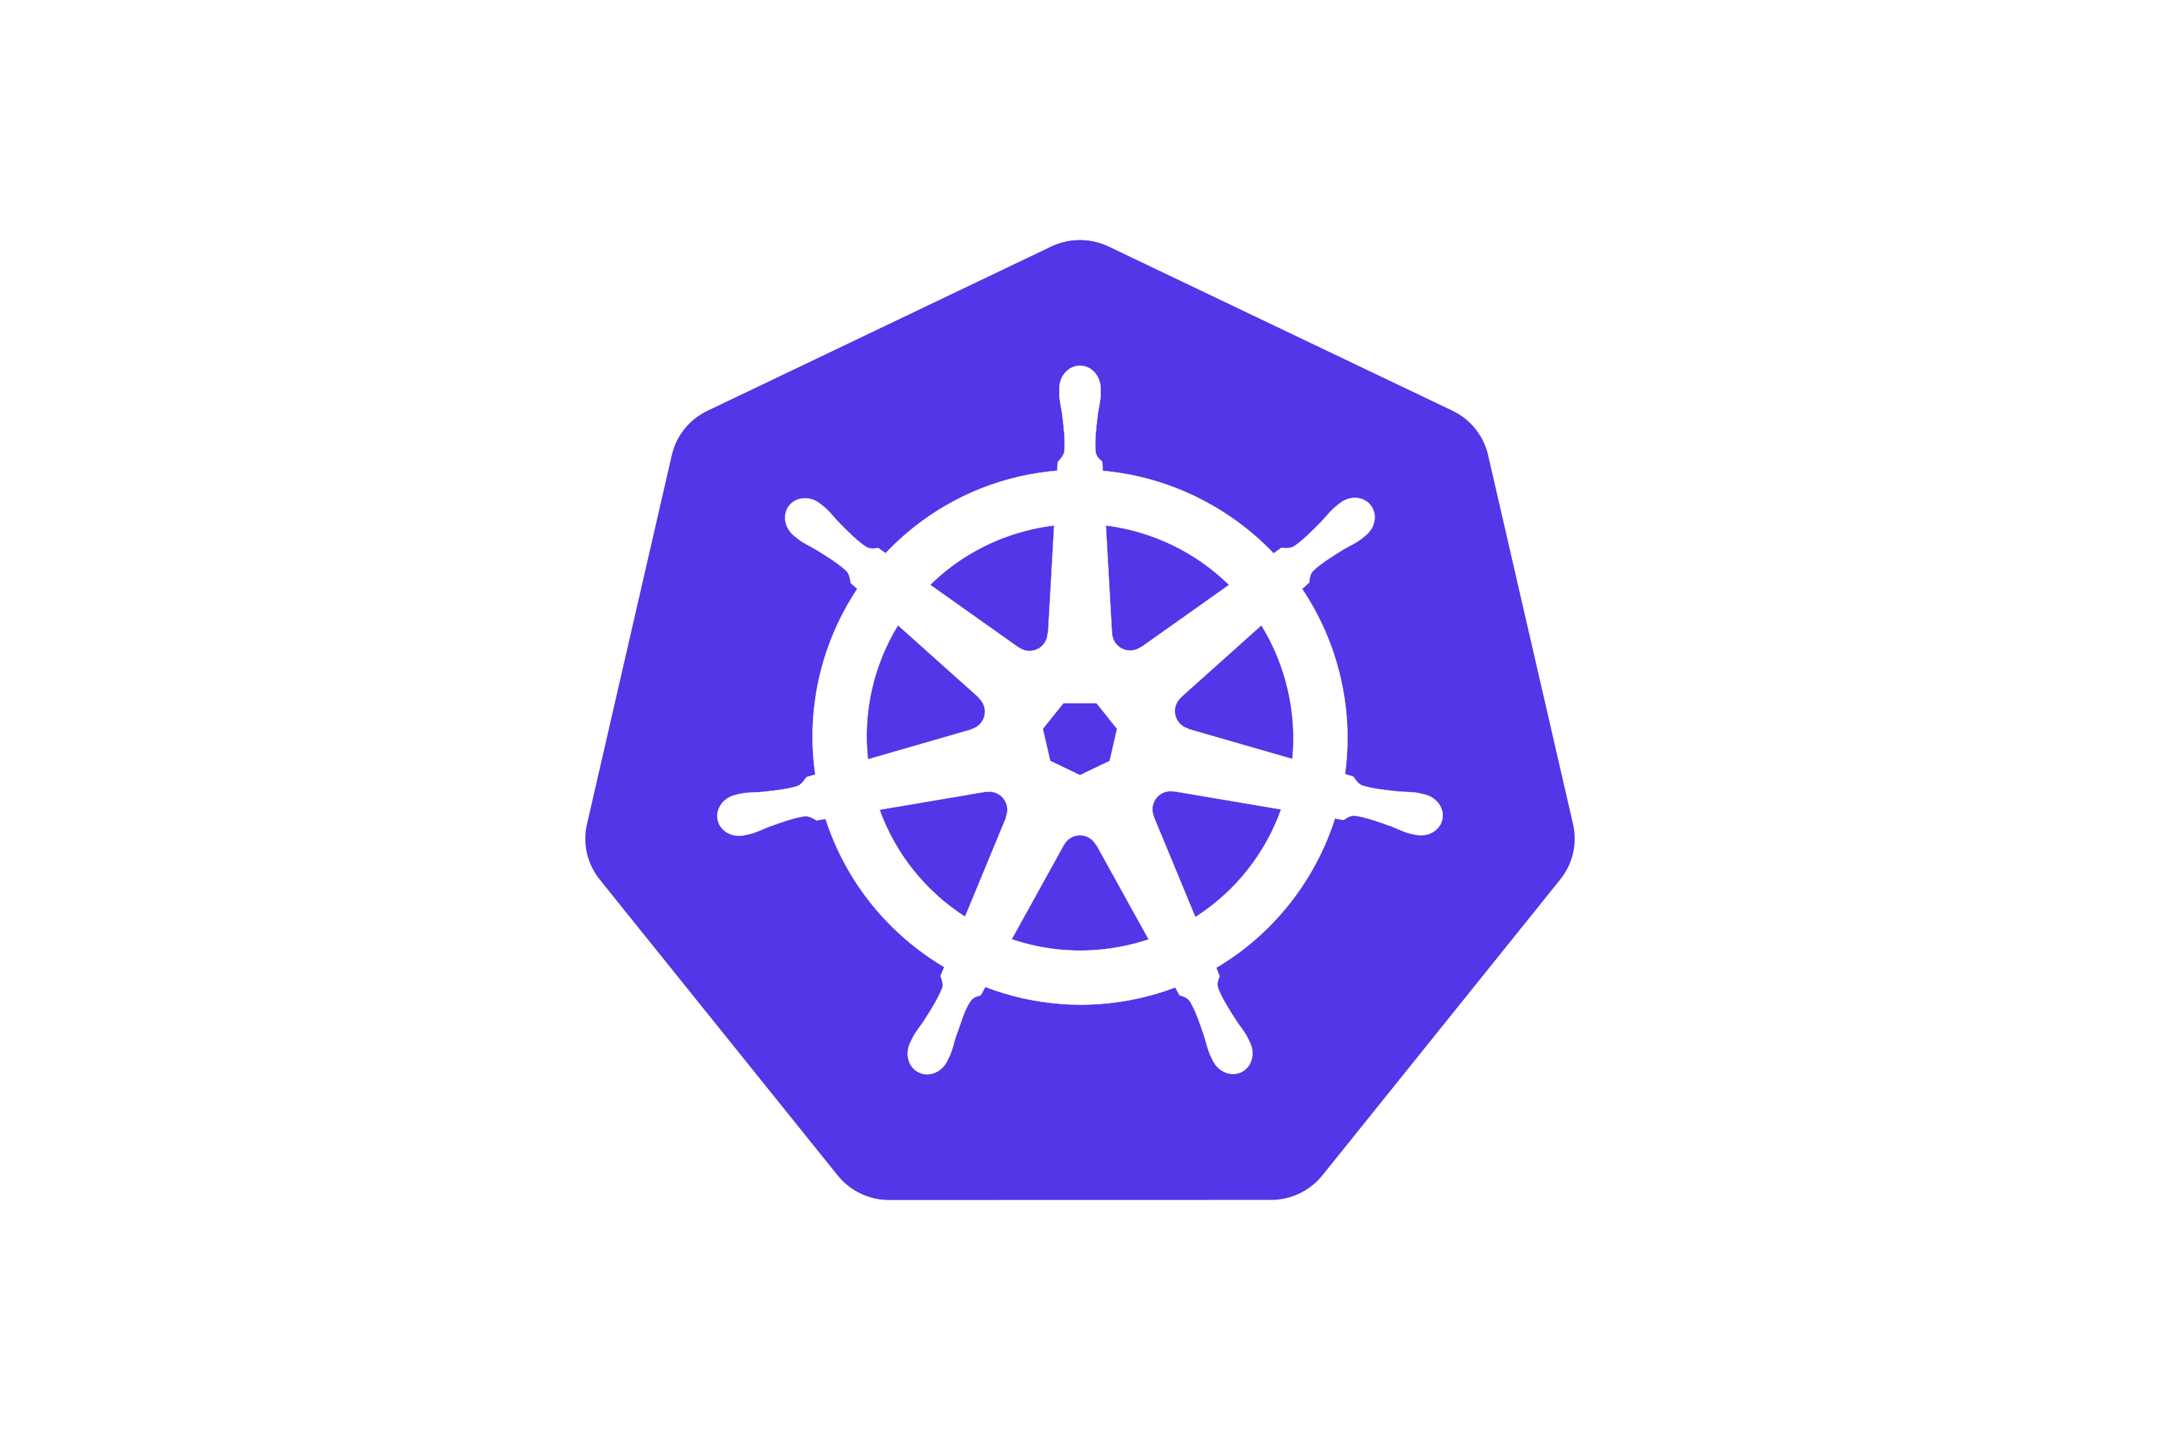


ApplicationSet Controller
ApplicationSet CRD
Cluster
events
Creates,
updates,
deletes
Application CRD
Application
Application
Argo CD handles the creation of Kubernetes resources within the target namespace
Deployments
Services
Kubernetes
cluster(s)
(...)

