Slide 1
BLUE TEAM BRNO hACKATHON 2019 VOICE ASSISTANT FOR AEROSPACE
Cernicko sergij
FRONT-END EXPERT
Liska Martin
FRONT-END EXPERT
Sacco carmine
VOICE UI EXPERT
Urbanek radomir
VOICE UI EXPERT
Vladyka vojtech
BACK-END EXPERT

Slide 2
Elevator pitch
Checklist execution Assistant
For
Target customer
Airlines and OEMs
WHO
Statement of need or opportunity
Want to transition to single pilot operations with improved safety and pilot’s experience and also improve maintenance speed and reliability
THE
Product name
Checklist Execution Assistant
IS A
Product category
Voice-enabled Checklist readout and verification assistant
THAT
Key benefit, compelling reason for customer to pay
Decreases mistakes in checklist execution by 35% and improves speed of checklist execution by 30%, enables single pilot operations and therefore reduces cost by replacing second pilot
UNLIKE
Primary competitive alternative
Standard paper or on-screen checklist readouts
OUR PRODUCT
Statement of primary differentiation
Automatically finds the correct procedure and help pilots and maintainers to execute them by natural voice control and automatically verifies their execution.
Need help in filling this? Get video training and guidance at z21.honeywell.com ● Get these graphic templates for print and editing at go.honeywell.com/StrategyBrno-Z21 ● Curious about innovation & in-house startup process? Visit go.honeywell.com/InnovationBrno

Slide 3
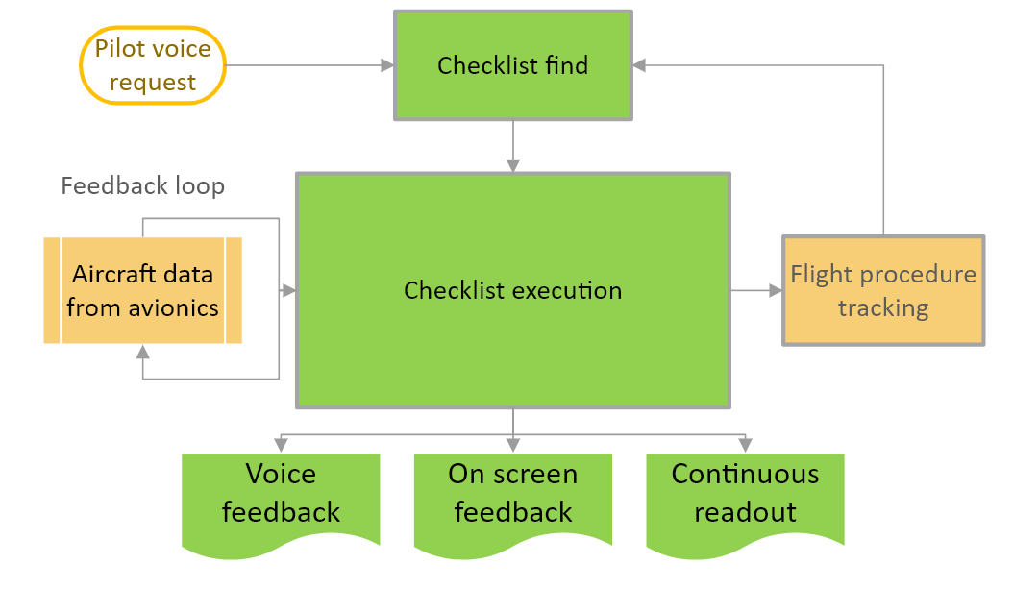
CHECKLIST EXECUTION ASSISTANT
Problem Statement
Pilot in a single pilot setup can be fully loaded while executing standard and emergency procedures and there is no cross-checking from a second pilot. Maintainers are overloaded by amount of maintenance manuals.
Solution Hypothesis
Solution diagram
Reduce pilot’s load by semi-automatic voice-assisted checklist execution and verification. Technology replaces second pilot need for checklist execution. Same system can provide guidance to maintenance crew.
Functions:
Opens checklist by name on demand
Reads out individual checklist items
Automatic checklist execution verification
Types of checklist items
Confirmed by operator only (Ground Crew Clearance)
Confirmed by operator and automatic verification (Flaps Position)
Continuous (Maintain Speed)
On-screen display of checklist execution
Suggests checklists based on flight or maintenance phase
Checklist Execution Assistant is part of Honeywell Go-Direct Voice Cockpit.
Consider adding an image,
schematic or a diagram

Slide 4
TECHNOLOGY DEMONSTRATION
Notable achievements
System is general enough to support multitude of procedure execution operations
Modular architecture connected with customer systems
Photos will be available at http://go.honeywell.com/INNOVATIONBRNO

