Slide 1
Quantum Hopfield Neural Networks
A brief panorama
Dimitri Vinci
Department of Information Engineering and Computer Science, University of Trento
February, 15, 2022

Slide 2
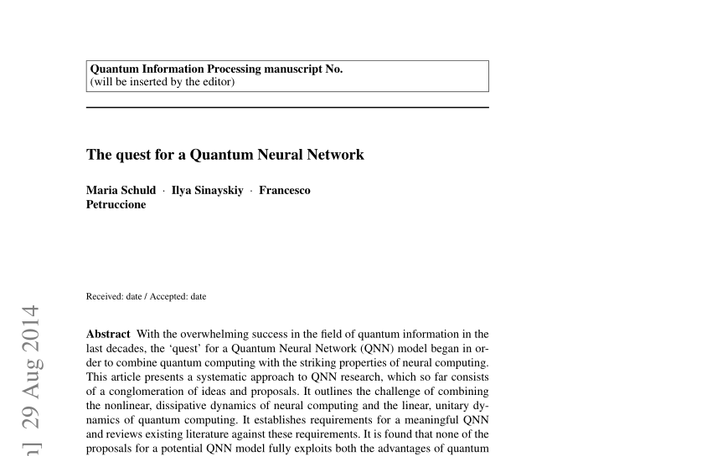
Presentation Purpose
we try to put forward an analysis that could be able to underline trends of implementation of a quantum neural network architecture:
Hopfield neural network

Slide 3
Presentation structure
What are Hopfield Neural Networks?
The quest for a quantum Hopfield network
A quantum circuit implementation
AQO and Hopfield

Slide 4
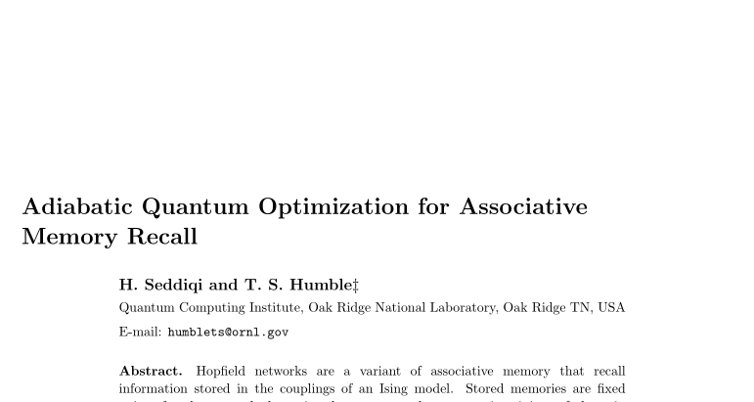
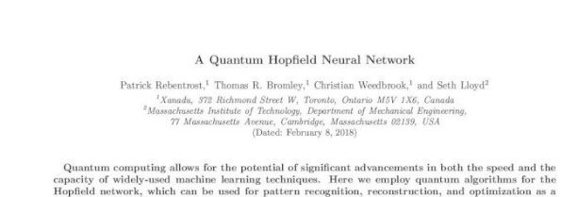
Our Main References
Circuit
AQO

Slide 5
Why these papers?
Conciseness
Didactical purpose
Rapresentativity
Influence

Slide 6
Why quantum hopfield neural network?
Building block
Intractable
Local minima
Complexity

Slide 7
Basic definitions
Neural Network
Quantum Neural Network

Slide 8
What are Hopfield Neural Networks

Slide 9
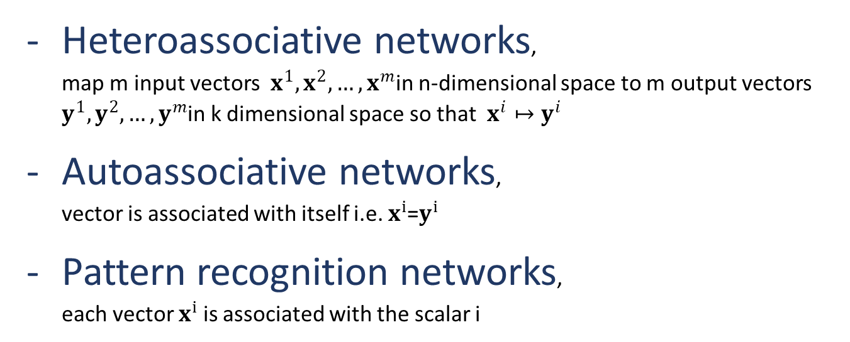
Associative Network
Heteroassociative networks, map m input vectors $x^{1},x^{2},…,x^{m}$in n-dimensional space to m output vectors $y^{1},y^{2},…,y^{m}$in k dimensional space so that $x^{i}↦y^{i}$
Autoassociative networks, vector is associated with itself i.e. $x^{i}$=$y^{i}$
Pattern recognition networks, each vector $x^{i}$is associated with the scalar i

Slide 10
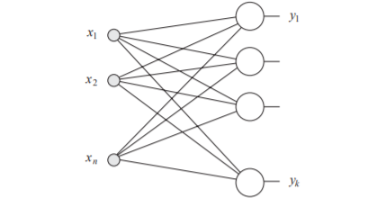
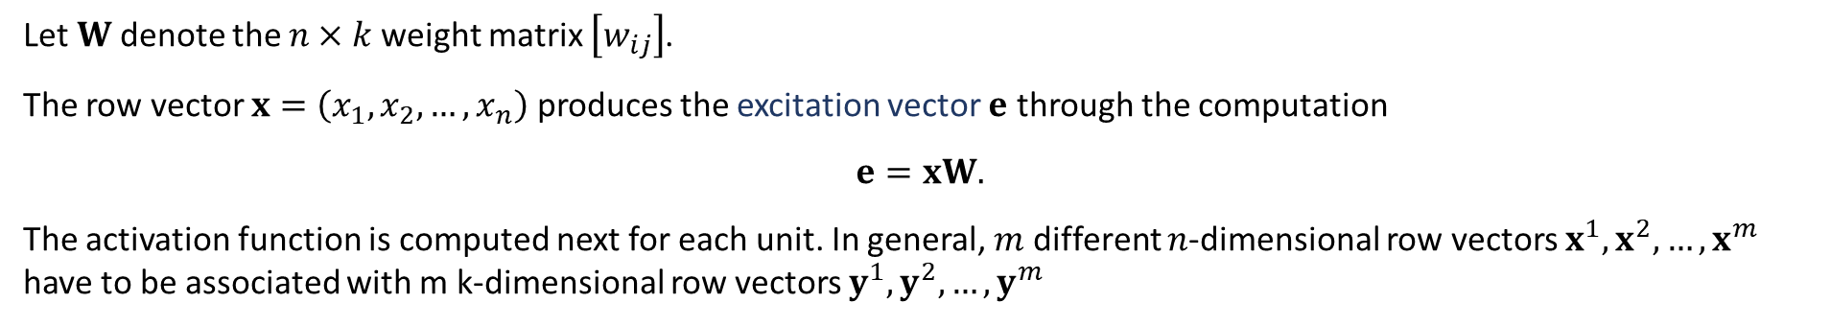
Let $W$ denote the $n×k$ weight matrix $\left[w_{ij}\right]$.
The row vector $x=\left(x_{1},x_{2},…,x_{n}\right)$ produces the excitation vector $e$ through the computation
$$e=xW.$$
The activation function is computed next for each unit. In general, $m$ different $n$-dimensional row vectors $x^{1},x^{2},…,x^{m}$ have to be associated with m k-dimensional row vectors $y^{1},y^{2},…,y^{m}$

Slide 11
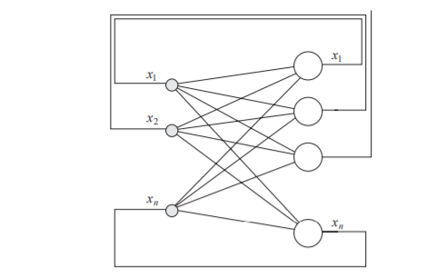
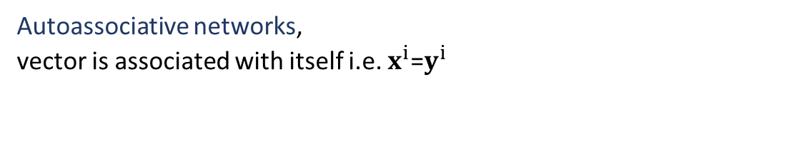
CAM
Autoassociative networks, vector is associated with itself i.e. $x^{i}$=$y^{i}$
Content addressable memory (CAM)
is a form of autoassociative memory that recalls information by value
In general input/output vector is bipolar

Slide 12
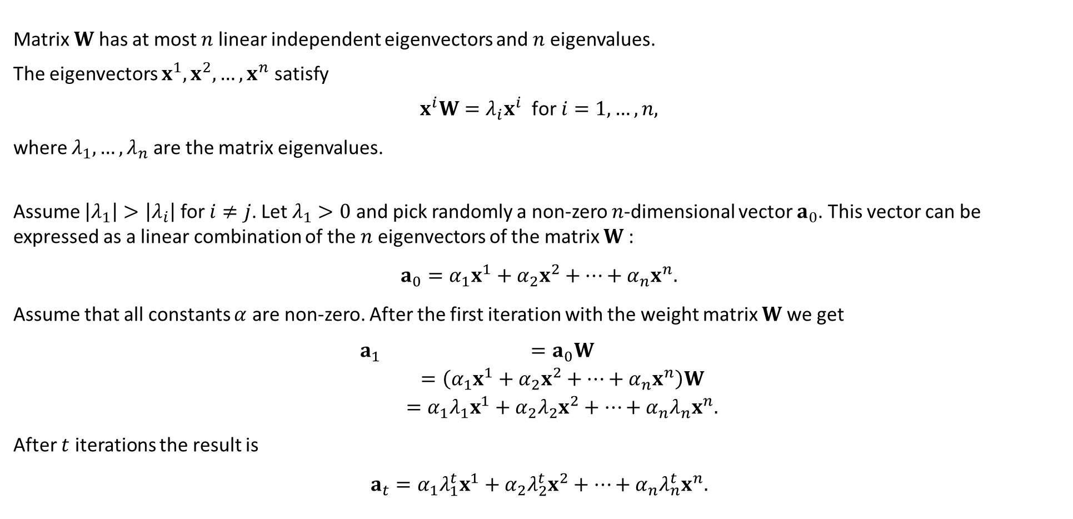
Attractor Dynamic
Matrix $W$ has at most $n$ linear independent eigenvectors and $n$ eigenvalues.
The eigenvectors $x^{1},x^{2},…,x^{n}$ satisfy
$$x^{i}W=λ_{i}x^{i} \text{for} i=1,…,n,$$
where $λ_{1},…,λ_{n}$ are the matrix eigenvalues.
Assume $\left|λ_{1}\right|>\left|λ_{i}\right|$ for $i≠j$. Let $λ_{1}>0$ and pick randomly a non-zero $n$-dimensional vector $a_{0}$. This vector can be expressed as a linear combination of the $n$ eigenvectors of the matrix $W$ :
$$a_{0}=α_{1}x^{1}+α_{2}x^{2}+⋯+α_{n}x^{n}.$$
Assume that all constants $α$ are non-zero. After the first iteration with the weight matrix $W$ we get
$$\begin{matrix}a_{1} & =a_{0}W \\ & =\left(α_{1}x^{1}+α_{2}x^{2}+⋯+α_{n}x^{n}\right)W \\ & =α_{1}λ_{1}x^{1}+α_{2}λ_{2}x^{2}+⋯+α_{n}λ_{n}x^{n}.\end{matrix}$$
After $t$ iterations the result is
$$a_{t}=α_{1}λ_{1}^{t}x^{1}+α_{2}λ_{2}^{t}x^{2}+⋯+α_{n}λ_{n}^{t}x^{n}.$$

Slide 13
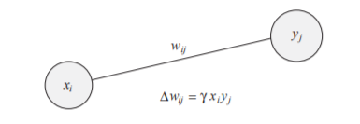
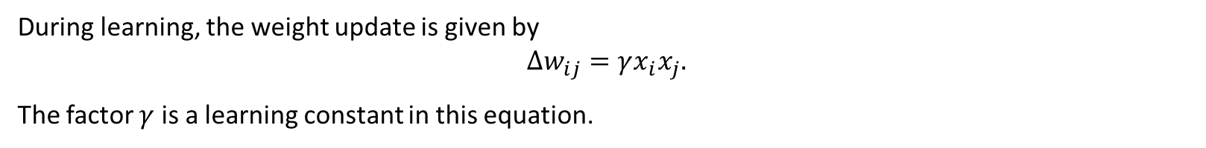
Hebbian Learning
During learning, the weight update is given by
$$Δw_{ij}=γx_{i}x_{j}.$$
The factor $γ$ is a learning constant in this equation.

Slide 14
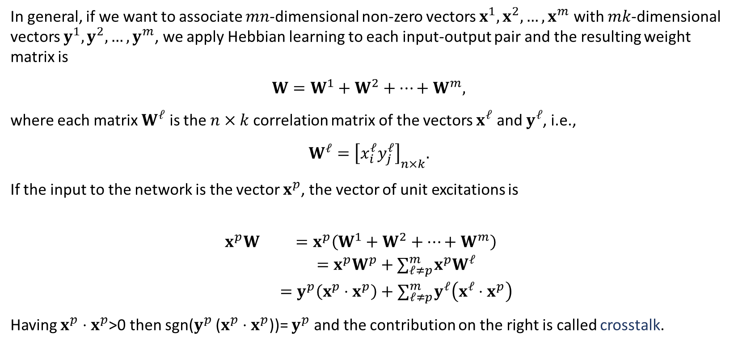
Crosstalk Problem
In general, if we want to associate $mn$-dimensional non-zero vectors $x^{1},x^{2},…,x^{m}$ with $mk$-dimensional vectors $y^{1},y^{2},…,y^{m}$, we apply Hebbian learning to each input-output pair and the resulting weight matrix is
$$W=W^{1}+W^{2}+⋯+W^{m},$$
where each matrix $W^{𝓁}$ is the $n×k$ correlation matrix of the vectors $x^{𝓁}$ and $y^{𝓁}$, i.e.,
$$W^{𝓁}={\left[x_{i}^{𝓁}y_{j}^{𝓁}\right]}_{n×k}.$$
If the input to the network is the vector $x^{p}$, the vector of unit excitations is
$$\begin{matrix}x^{p}W & =x^{p}\left(W^{1}+W^{2}+⋯+W^{m}\right) \\ & =x^{p}W^{p}+∑_{𝓁≠p}^{m} x^{p}W^{𝓁} \\ & =y^{p}\left(x^{p}⋅x^{p}\right)+∑_{𝓁≠p}^{m} y^{𝓁}\left(x^{𝓁}⋅x^{p}\right)\end{matrix}$$
Having $x^{p}⋅x^{p}$>0 then sgn($y^{p}$ ($x^{p}⋅x^{p}$))= $y^{p}$ and the contribution on the right is called crosstalk.

Slide 15
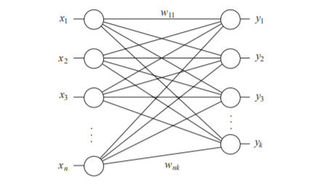
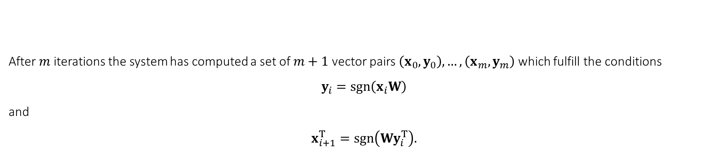
Resonance network
After $m$ iterations the system has computed a set of $m+1$ vector pairs $\left(x_{0},y_{0}\right),…,\left(x_{m},y_{m}\right)$ which fulfill the conditions
$$y_{i}=sgn⁡\left(x_{i}W\right)$$
and
$$x_{i+1}^{T}=sgn⁡\left(Wy_{i}^{T}\right).$$

Slide 16
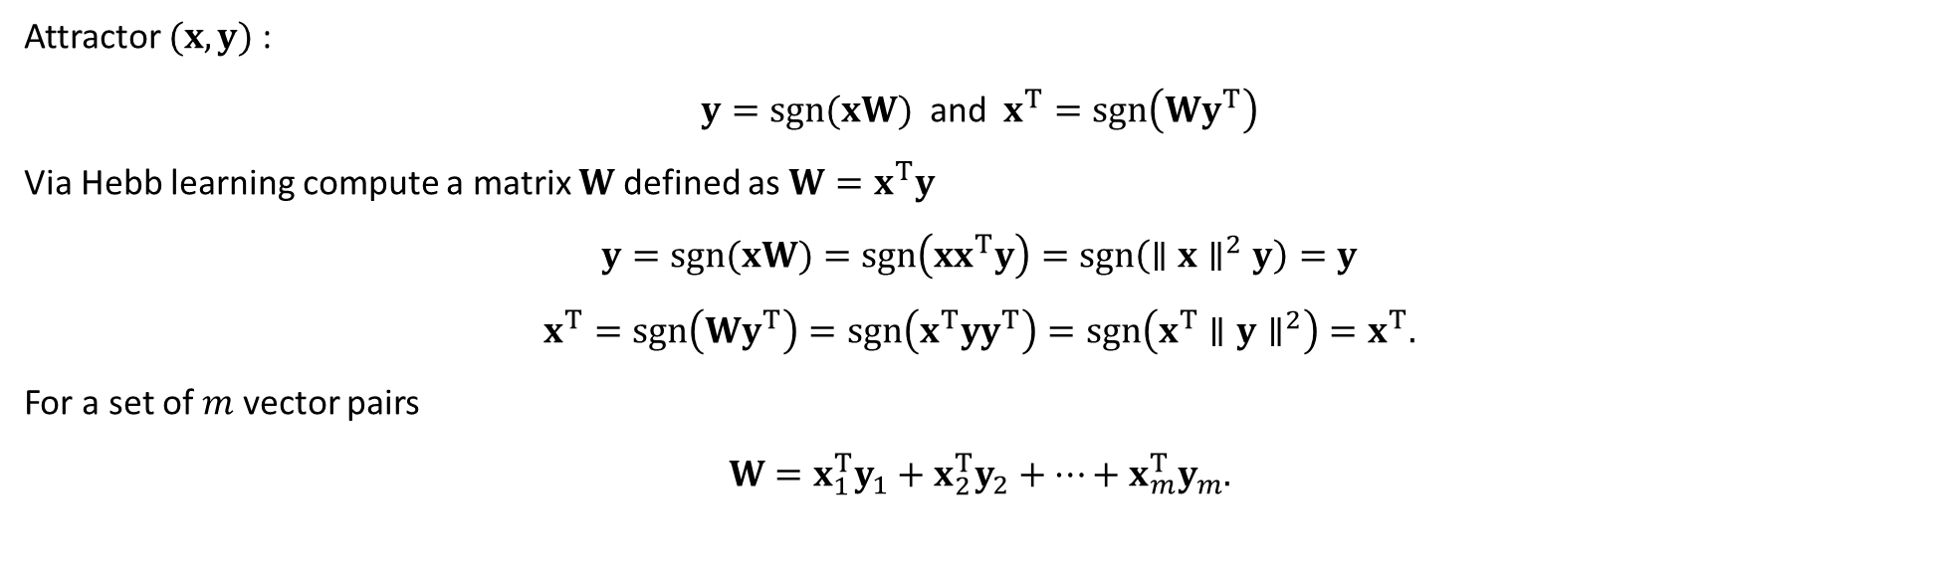
Attractor
Attractor $(x,y)$ :
$$y=sgn(xW) \text{and} x^{T}=sgn\left(Wy^{T}\right)$$
Via Hebb learning compute a matrix $W$defined as $W=x^{T}y$
$$y=sgn(xW)=sgn\left(xx^{T}y\right)=sgn\left(∥x∥^{2}y\right)=y$$
$$x^{T}=sgn\left(Wy^{T}\right)=sgn\left(x^{T}yy^{T}\right)=sgn\left(x^{T}∥y∥^{2}\right)=x^{T}.$$
For a set of $m$ vector pairs
$$W=x_{1}^{T}y_{1}+x_{2}^{T}y_{2}+⋯+x_{m}^{T}y_{m}.$$

Slide 17

Energy function
For a vector pair $\left(x_{0},y_{0}\right)$, the product
$$E=−x_{0}e^{T}=−x_{0}Wy_{0}^{T}$$
is smaller if the vector $Wy_{0}^{T}$ lies closer to $x_{0}$.
We call $E$ the energy function of the network.
$$E\left(x_{i},y_{i}\right)=−\frac{1}{2}x_{i}Wy_{i}^{T}$$
Adding thresholds
$$E\left(x_{i},y_{i}\right)=−\frac{1}{2}x_{i}Wy_{i}^{T}+\frac{1}{2}θ_{r}y_{i}^{T}+\frac{1}{2}x_{i}θ_{𝓁}^{T}.$$

Slide 18
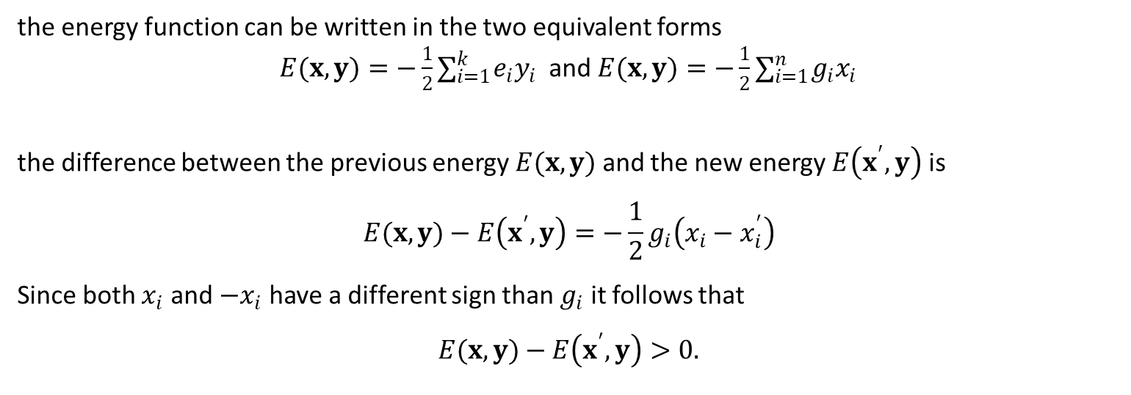
Energy function -2
the energy function can be written in the two equivalent forms
$E(x,y)=−\frac{1}{2}∑_{i=1}^{k} e_{i}y_{i}$ and $E(x,y)=−\frac{1}{2}∑_{i=1}^{n} g_{i}x_{i}$
the difference between the previous energy $E(x,y)$ and the new energy $E\left(x^{′},y\right)$ is
$$E(x,y)−E\left(x^{′},y\right)=−\frac{1}{2}g_{i}\left(x_{i}−x_{i}^{′}\right)$$
Since both $x_{i}$ and $−x_{i}$ have a different sign than $g_{i}$ it follows that
$$E(x,y)−E\left(x^{′},y\right)>0.$$

Slide 19
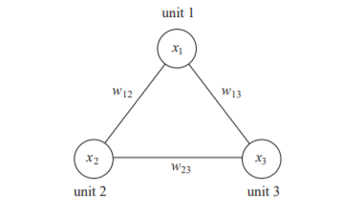
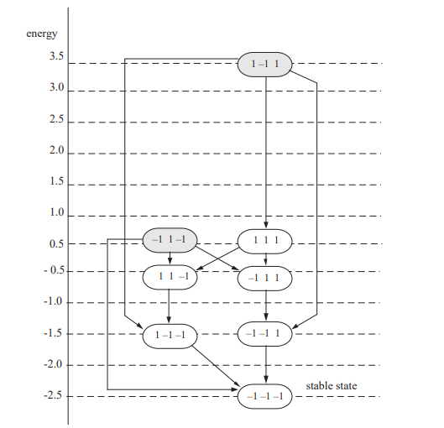
Hopfield model
Hopfield network (HNN) is a bidirectional associative memory of interconnected neurons each of which is a bipolar threshold unit

Slide 20
Core concepts
Radius of attraction
Capacity

Slide 21
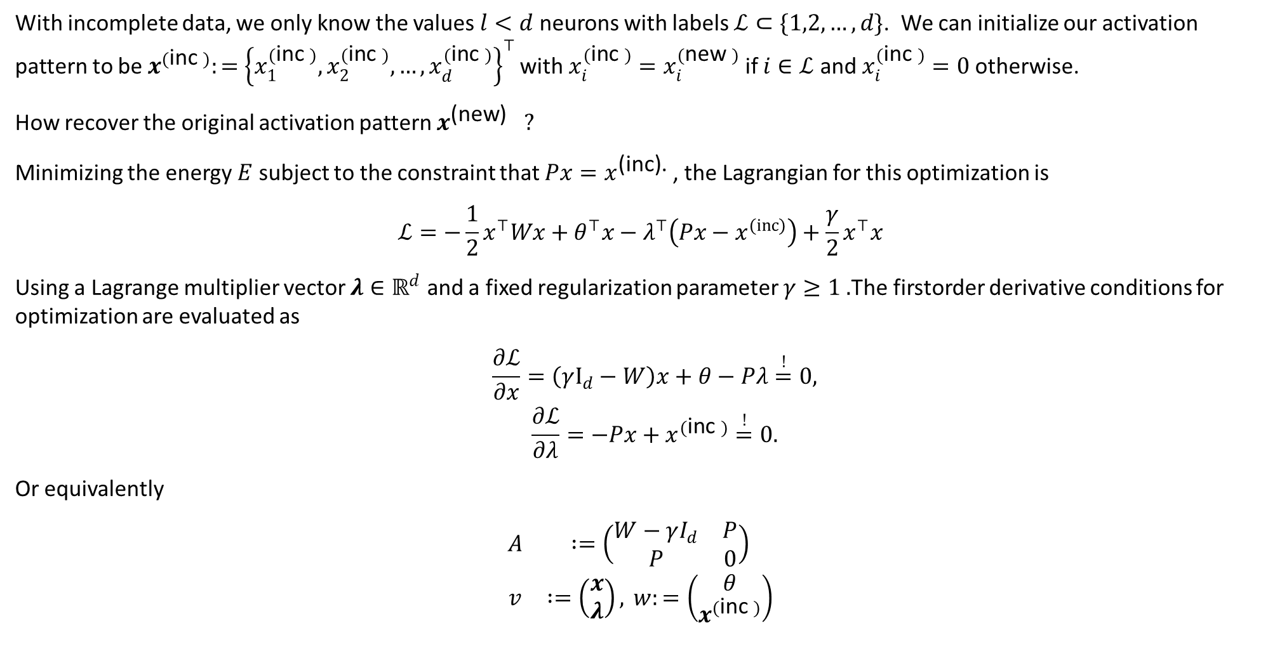
Another formulation
With incomplete data, we only know the values $l<d$ neurons with labels $ℒ⊂\{1,2,…,d\}$. We can initialize our activation pattern to be $x^{(\text{inc} )}:=$ ${\left\{x_{1}^{(\text{inc} )},x_{2}^{(\text{inc} )},…,x_{d}^{(\text{inc} )}\right\}}^{⊤}$ with $x_{i}^{(\text{inc} )}=x_{i}^{(\text{new} )}$ if $i∈ℒ$ and $x_{i}^{(\text{inc} )}=0$ otherwise.
How recover the original activation pattern $x^{\text{(}\text{new}\text{) }}?$
Minimizing the energy $E$ subject to the constraint that $Px=x^{\text{(}\text{inc}\text{).} }$, the Lagrangian for this optimization is
$$ℒ=−\frac{1}{2}x^{⊤}Wx+θ^{⊤}x−λ^{⊤}\left(Px−x^{(inc)}\right)+\frac{γ}{2}x^{⊤}x$$
Using a Lagrange multiplier vector $λ∈ℝ^{d}$ and a fixed regularization parameter $γ≥1 .$The firstorder derivative conditions for optimization are evaluated as
$$\begin{matrix} & \frac{∂ℒ}{∂x}=\left(γI_{d}−W\right)x+θ−Pλ\overset{!}{=}0, \\ & \frac{∂ℒ}{∂λ}=−Px+x^{(\text{inc} )}\overset{!}{=}0.\end{matrix}$$
Or equivalently
$$\begin{matrix}A & :=\left(\begin{matrix}W−γI_{d} & P \\ P & 0\end{matrix}\right) \\ v & :=\left(\begin{matrix}x \\ λ\end{matrix}\right), w:=\left(\begin{matrix}θ \\ x^{(\text{inc} )}\end{matrix}\right)\end{matrix}$$

Slide 22

Learning Rules
Hebb rule:
$$w_{ij}=\frac{1}{n}\sum_{μ=1}^{p}{ }ξ_{i}^{μ}ξ_{j}^{μ}$$
for a set of $p$ memories $\left\{ξ^{1},ξ^{2},…,ξ^{p}\right\}$, each of length $n$ with bipolar elements $ξ_{i}^{μ}∈\{±1\}$.
Storkey rule:
$$w_{ij}^{ν}=w_{ij}^{ν−1}+\frac{1}{n}ξ_{i}^{ν}ξ_{j}^{ν}−\frac{1}{n}ξ_{i}^{ν}h_{ji}^{ν}−\frac{1}{n}h_{ij}^{ν}ξ_{j}^{ν}$$
where $ξ^{ν}$ is the memory to be learned in the $ν$-th iteration for $ν=1$ to $p$ and
$$h_{ij}^{ν}=\sum_{k=1,k≠i,j}{ }w_{ik}^{ν−1}ξ_{k}^{ν}$$
Projection rule
$$w_{ij}=\frac{1}{n}\sum_{μ,μ^{′}=1}^{p}{ }ξ_{i}^{μ}C_{μμ^{′}}^{−1}ξ_{j}^{μ^{′}}$$
where $C_{μμ^{′}}=\frac{1}{n}∑_{k=1}^{n} ξ_{k}^{μ}ξ_{k}^{μ^{′}}$ is the covariance matrix and $C^{−1}$ is the inverse of $C$.

Slide 23
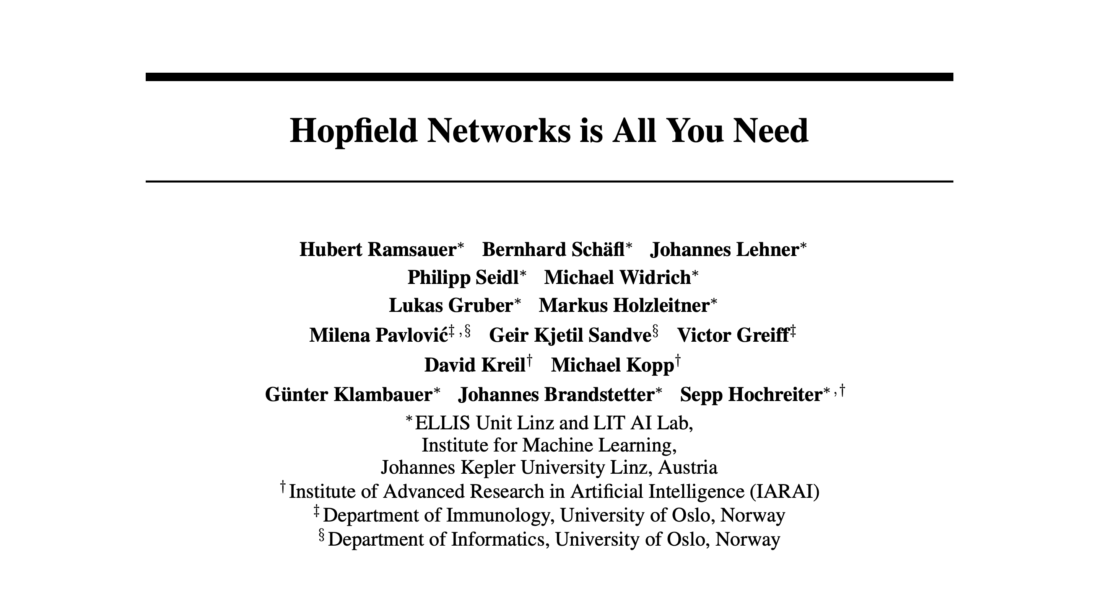
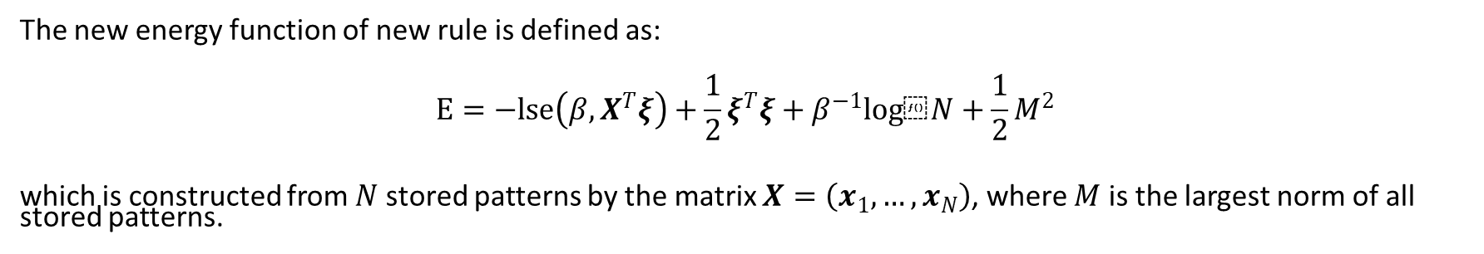
New Rule
The new energy function of new rule is defined as:
$$E=−lse\left(β,X^{T}ξ\right)+\frac{1}{2}ξ^{T}ξ+β^{−1}log⁡N+\frac{1}{2}M^{2}$$
which is constructed from $N$ stored patterns by the matrix $X=\left(x_{1},…,x_{N}\right)$, where $M$ is the largest norm of all stored patterns.

Slide 24
A quest for quantum neural network

Slide 25
Quantum computing and exploited principles
Exploited quantum phenomena
Entanglement
Quantum parallelism
Linear Operators
Coherence and Decoherence

Slide 26
The two paradygms
there are two main distinct quantum computing paradigms
quantum gate computing
adiabatic quantum computing

Slide 27
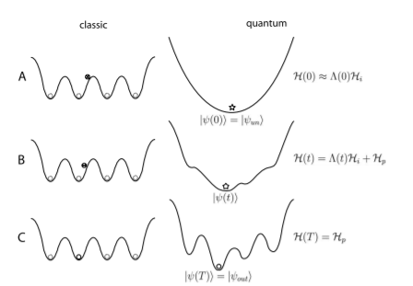
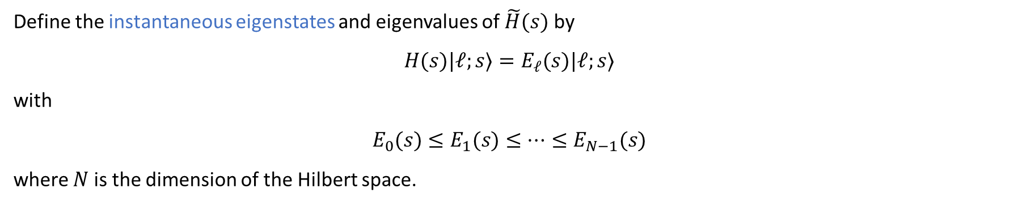
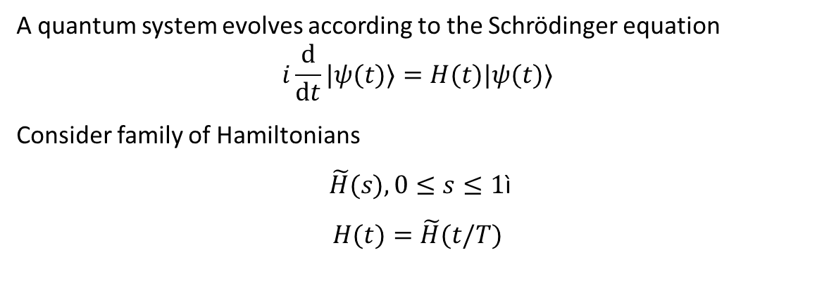
AQO a bit more in detail -1
A quantum system evolves according to the Schrödinger equation
$$i\frac{d}{dt}|ψ(t)⟩=H(t)|ψ(t)⟩$$
Consider family of Hamiltonians
$\tilde{H}(s),0≤s≤1$ì
$$H(t)=\tilde{H}(t/T)$$
Define the instantaneous eigenstates and eigenvalues of $\tilde{H}(s)$ by
$$H(s)|𝓁;s⟩=E_{𝓁}(s)|𝓁;s⟩$$
with
$$E_{0}(s)≤E_{1}(s)≤⋯≤E_{N−1}(s)$$
where $N$ is the dimension of the Hilbert space.

Slide 28
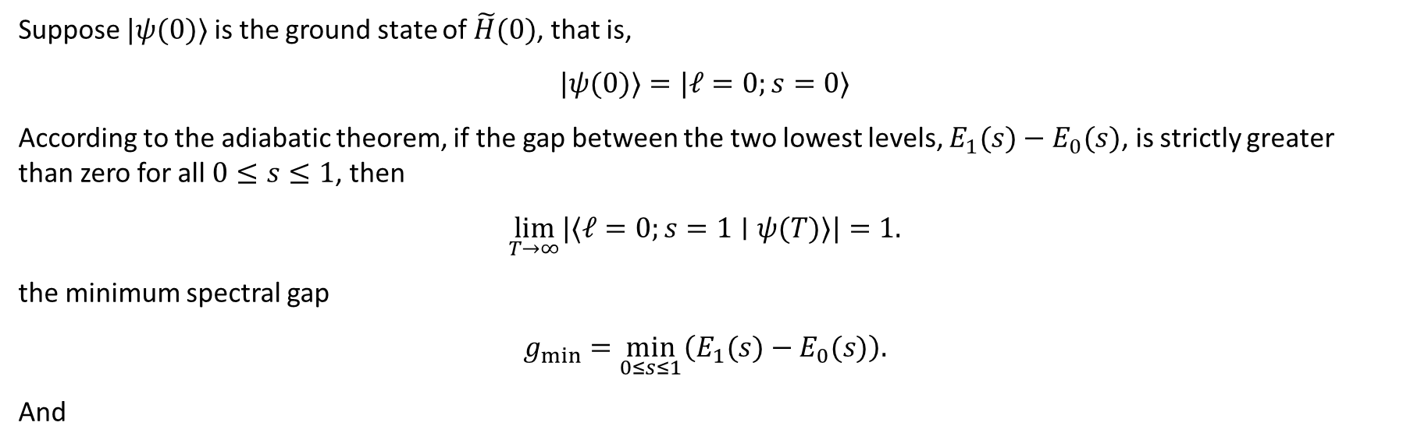

AQO a bit more in detail -2
Suppose $|ψ(0)⟩$ is the ground state of $\tilde{H}(0)$, that is,
$$|ψ(0)⟩=|𝓁=0;s=0⟩$$
According to the adiabatic theorem, if the gap between the two lowest levels, $E_{1}(s)−E_{0}(s)$, is strictly greater than zero for all $0≤s≤1$, then
$$\lim_{T→∞} |⟨𝓁=0;s=1∣ψ(T)⟩|=1.$$
the minimum spectral gap
$$g_{min}=\min_{0≤s≤1} \left(E_{1}(s)−E_{0}(s)\right).$$
And
$$T≫\frac{ℰ}{g_{min}^{2}}$$

Slide 29
The three criteria
The initial state of the quantum system encodes any binary string of length N.
The QNN reflects one or more basic neural computing mechanisms
3. The evolution is based on quantum effects

Slide 30
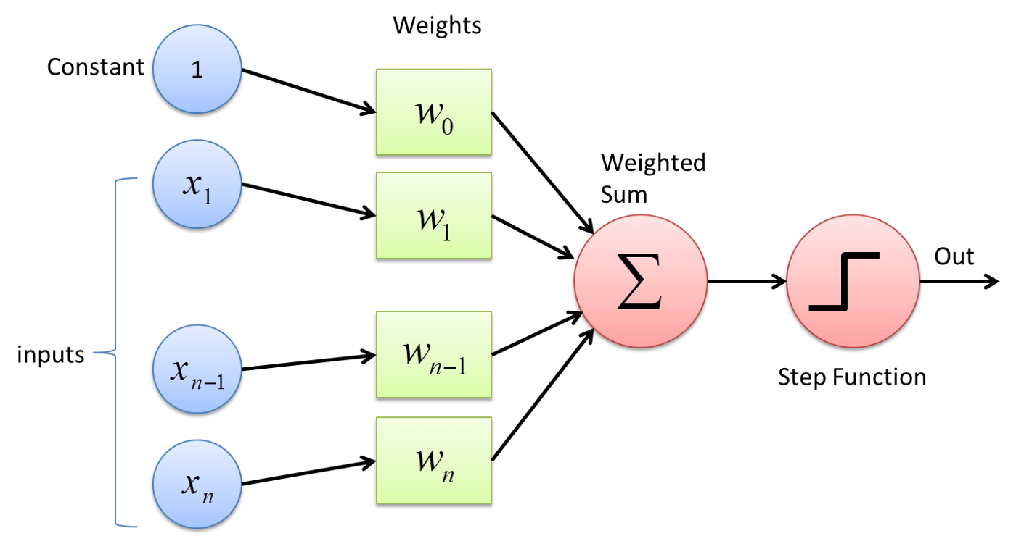
A foundamental challenge
dissipative dynamics of attractor based NNs vs linear operator

Slide 31

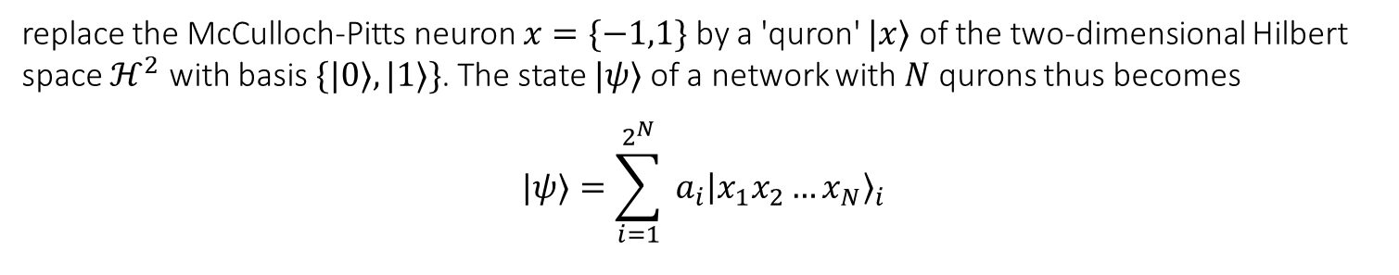
A fast history –quron approach -1
replace the McCulloch-Pitts neuron $x=\{−1,1\}$ by a 'quron' $|x⟩$ of the two-dimensional Hilbert space $ℋ^{2}$ with basis $\{|0⟩,|1⟩\}$. The state $|ψ⟩$ of a network with $N$ qurons thus becomes
$$|ψ⟩=\sum_{i=1}^{2^{N}}{ }a_{i}{\left|x_{1}x_{2}…x_{N}\right\rangle }_{i}$$

Slide 32
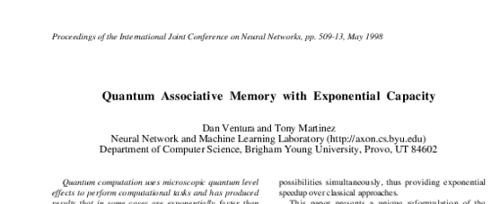
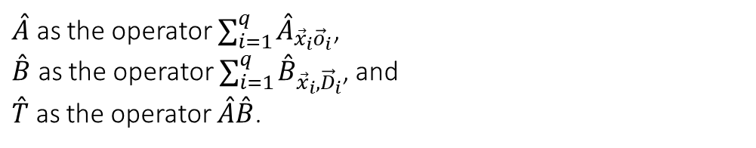

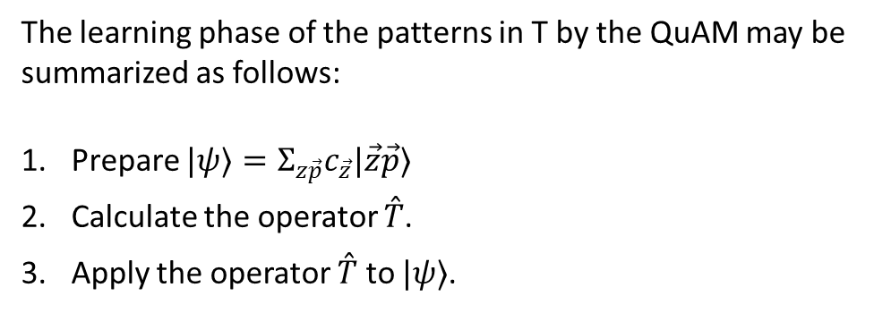
A fast history –quron approach -2
$$\left|ψ\right\rangle =\sum{c_{\vec{z}\vec{p}}\left|\vec{z}\vec{p}\right\rangle }$$
$\overset{ˆ}{A}$ as the operator $∑_{i=1}^{q} {\overset{ˆ}{A}}_{{\vec{x}}_{i}{\vec{o}}_{i}}$, $\overset{ˆ}{B}$ as the operator $∑_{i=1}^{q} {\overset{ˆ}{B}}_{{\vec{x}}_{i},{\vec{D}}_{i}}$, and $\overset{ˆ}{T}$ as the operator $\overset{ˆ}{A}\overset{ˆ}{B}$.
The learning phase of the patterns in T by the QuAM may be summarized as follows:
Prepare $|ψ⟩=Σ_{z\vec{p}}c_{\vec{z}}|\vec{z}\vec{p}⟩$
Calculate the operator $\overset{ˆ}{T}$.
Apply the operator $\overset{ˆ}{T}$ to $|ψ⟩$.

Slide 33
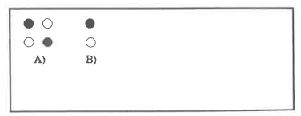
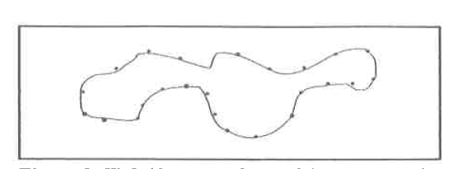
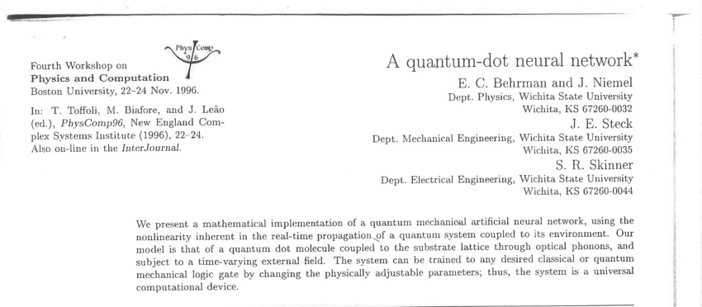
A fast history –quron approach -3
Group of four quantum dots
The state of one of the quantum dot in the discretized quantum path integral

Slide 34
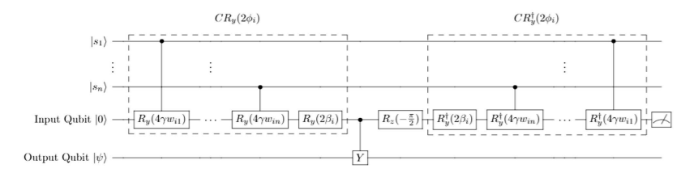
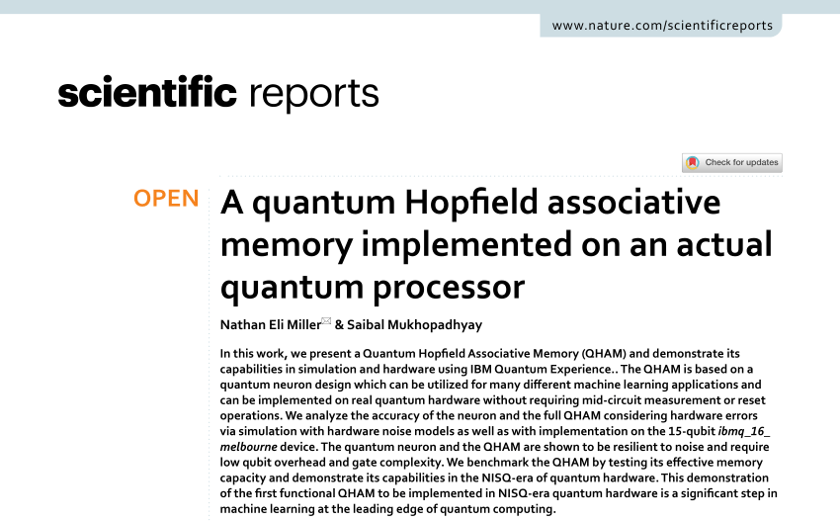
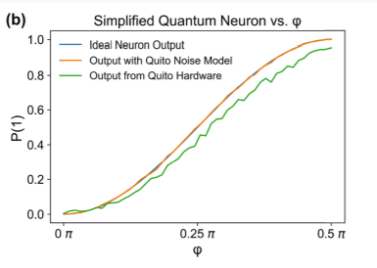
A fast history –quron approach -4

Slide 35
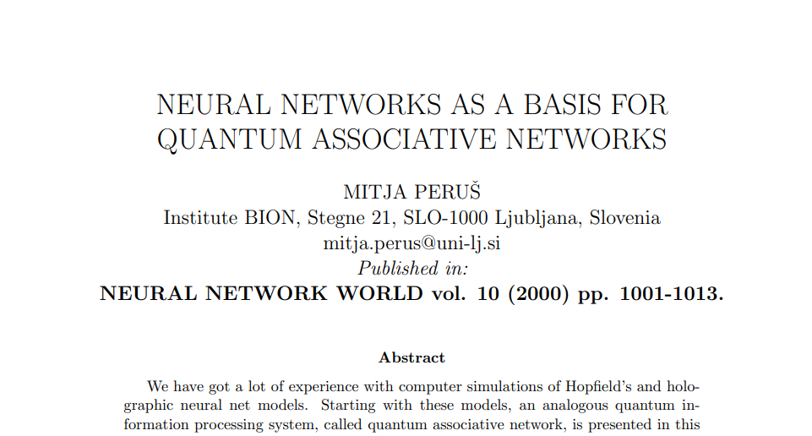
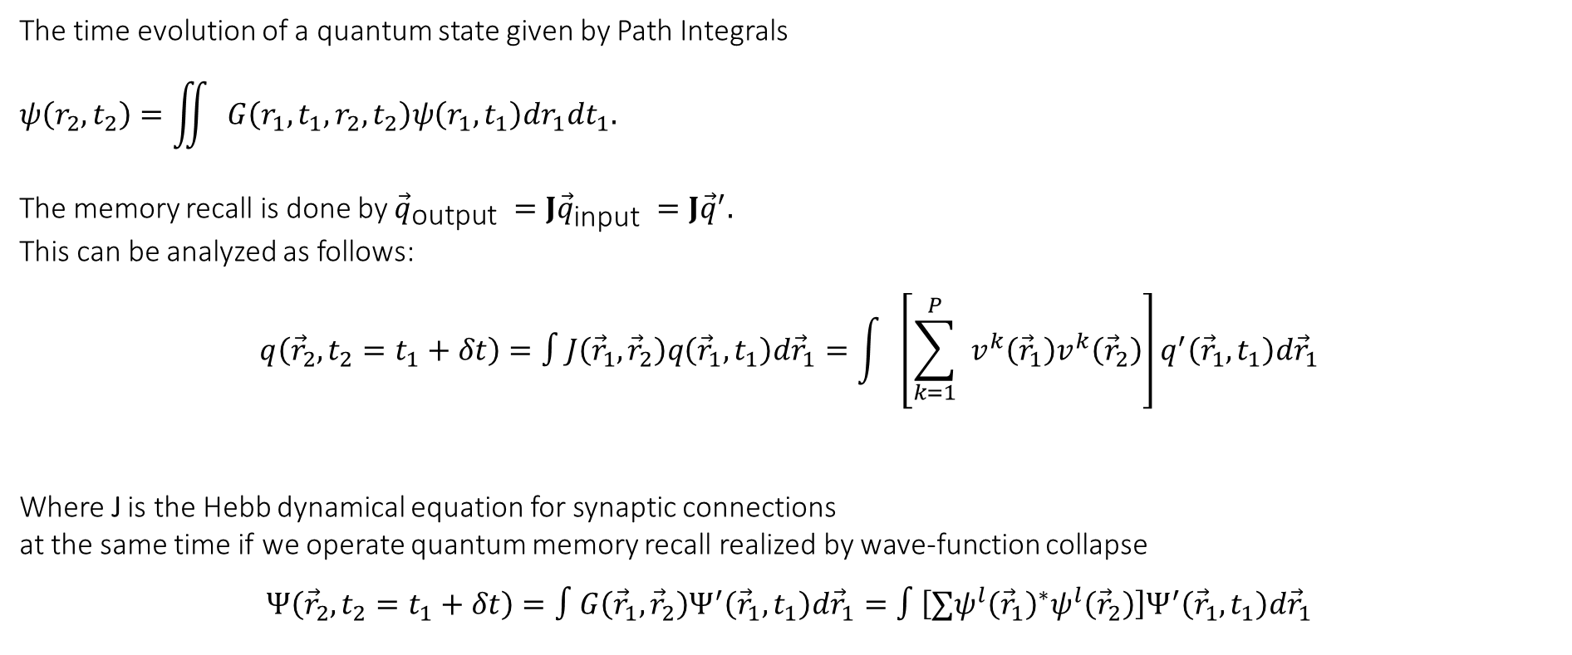
A fast history – measurement approach -1
The time evolution of a quantum state given by Path Integrals
$$ψ\left(r_{2},t_{2}\right)=\iint{ }G\left(r_{1},t_{1},r_{2},t_{2}\right)ψ\left(r_{1},t_{1}\right)dr_{1}dt_{1}.$$
The memory recall is done by ${\vec{q}}_{\text{output} }=J{\vec{q}}_{\text{input} }=J{\vec{q}}^{′}.$ This can be analyzed as follows:
$$q\left({\vec{r}}_{2},t_{2}=t_{1}+δt\right)=∫J\left({\vec{r}}_{1},{\vec{r}}_{2}\right)q\left({\vec{r}}_{1},t_{1}\right)d{\vec{r}}_{1}=\int{ }\left[\sum_{k=1}^{P}{ } v^{k}\left({\vec{r}}_{1}\right)v^{k}\left({\vec{r}}_{2}\right)\right]q^{′}\left({\vec{r}}_{1},t_{1}\right)d{\vec{r}}_{1}$$
Where J is the Hebb dynamical equation for synaptic connections at the same time if we operate quantum memory recall realized by wave-function collapse
$$Ψ\left({\vec{r}}_{2},t_{2}=t_{1}+δt\right)=∫G\left({\vec{r}}_{1},{\vec{r}}_{2}\right)Ψ^{′}\left({\vec{r}}_{1},t_{1}\right)d{\vec{r}}_{1}=∫\left[∑ψ^{l}{\left({\vec{r}}_{1}\right)}^{∗}ψ^{l}\left({\vec{r}}_{2}\right)\right]Ψ^{′}\left({\vec{r}}_{1},t_{1}\right)d{\vec{r}}_{1}$$

Slide 36
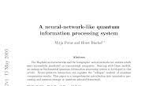
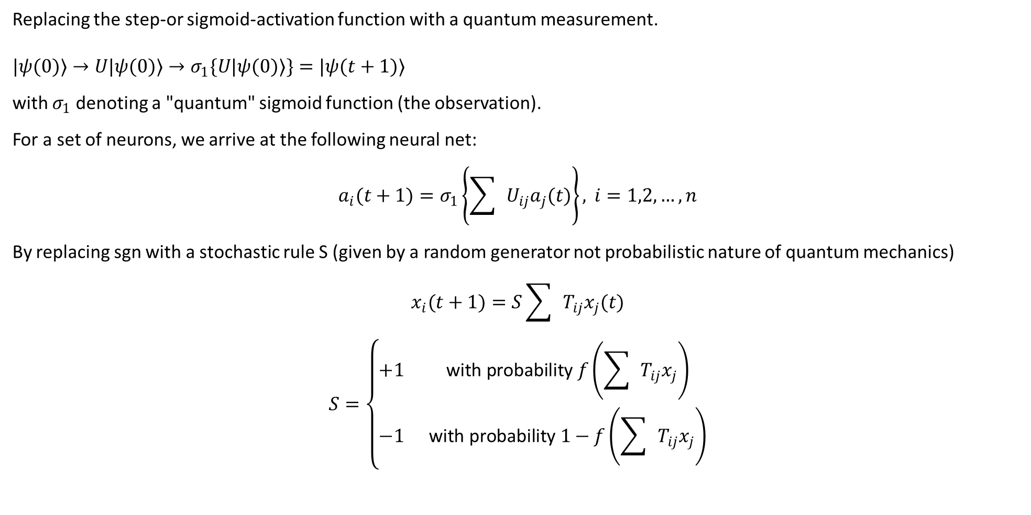
A fast history – measurement approach -2
Replacing the step-or sigmoid-activation function with a quantum measurement.
$$|ψ(0)⟩→U|ψ(0)⟩→σ_{1}\{U|ψ(0)⟩\}=|ψ(t+1)⟩$$
with $σ_{1}$ denoting a "quantum" sigmoid function (the observation).
For a set of neurons, we arrive at the following neural net:
$$a_{i}(t+1)=σ_{1}\left\{\sum{ }U_{ij}a_{j}(t)\right\}, i=1,2,…,n$$
By replacing sgn with a stochastic rule S (given by a random generator not probabilistic nature of quantum mechanics)
$$\begin{matrix}x_{i}(t+1)=S\sum{ }T_{ij}x_{j}(t) \\ S=\left\{\begin{matrix}+1 & \text{with} \text{probability} f\left(\sum{ }T_{ij}x_{j}\right) \\ −1 & \text{with} \text{probability} 1−f\left(\sum{ }T_{ij}x_{j}\right)\end{matrix}\right.\end{matrix}$$

Slide 37
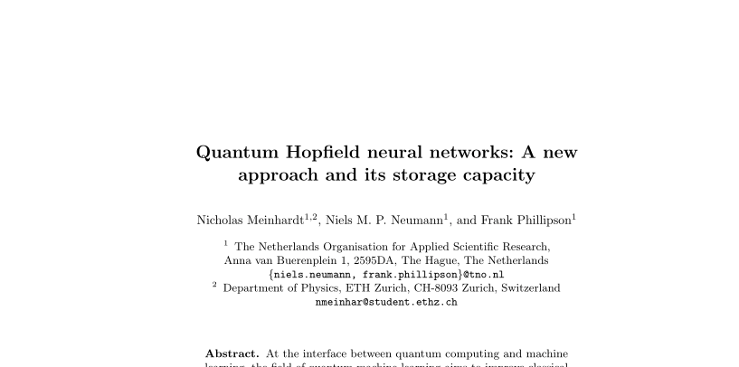
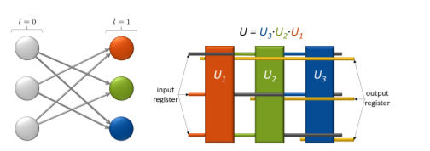
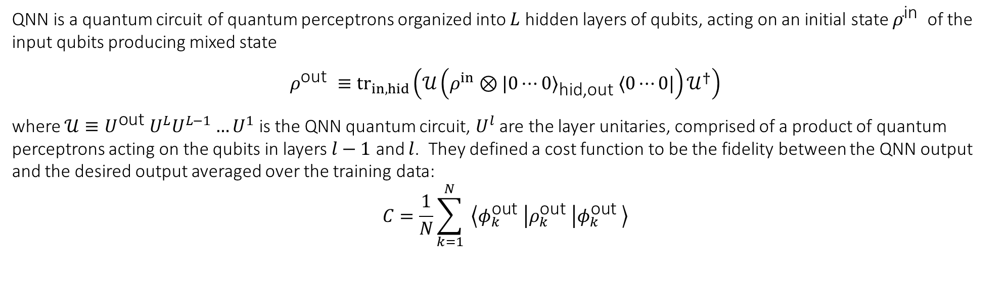
A fast history – operator network
QNN is a quantum circuit of quantum perceptrons organized into $L$ hidden layers of qubits, acting on an initial state $ρ^{\text{in} }$ of the input qubits producing mixed state
$$ρ^{\text{out} }≡{tr}_{in,hid}⁡\left(𝒰\left(ρ^{in}⊗|0⋯0⟩_{\text{hid}\text{,}\text{out} }⟨0⋯0|\right)𝒰^{†}\right)$$
where $𝒰≡U^{\text{out} }U^{L}U^{L−1}…U^{1}$ is the QNN quantum circuit, $U^{l}$ are the layer unitaries, comprised of a product of quantum perceptrons acting on the qubits in layers $l−1$ and $l$. They defined a cost function to be the fidelity between the QNN output and the desired output averaged over the training data:
$$C=\frac{1}{N}\sum_{k=1}^{N}{ }\left\langle φ_{k}^{\text{out} }\left|ρ_{k}^{\text{out} }\right|φ_{k}^{\text{out} }\right\rangle$$

Slide 38
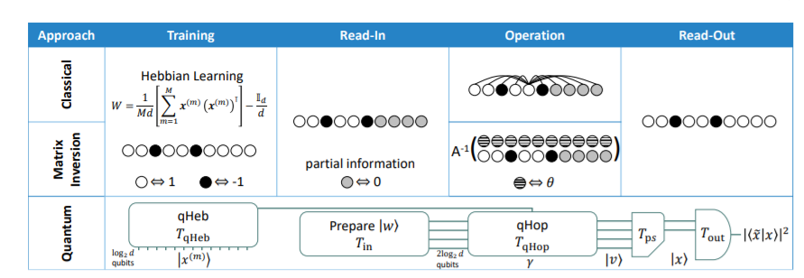
Quantum circuit

Slide 39
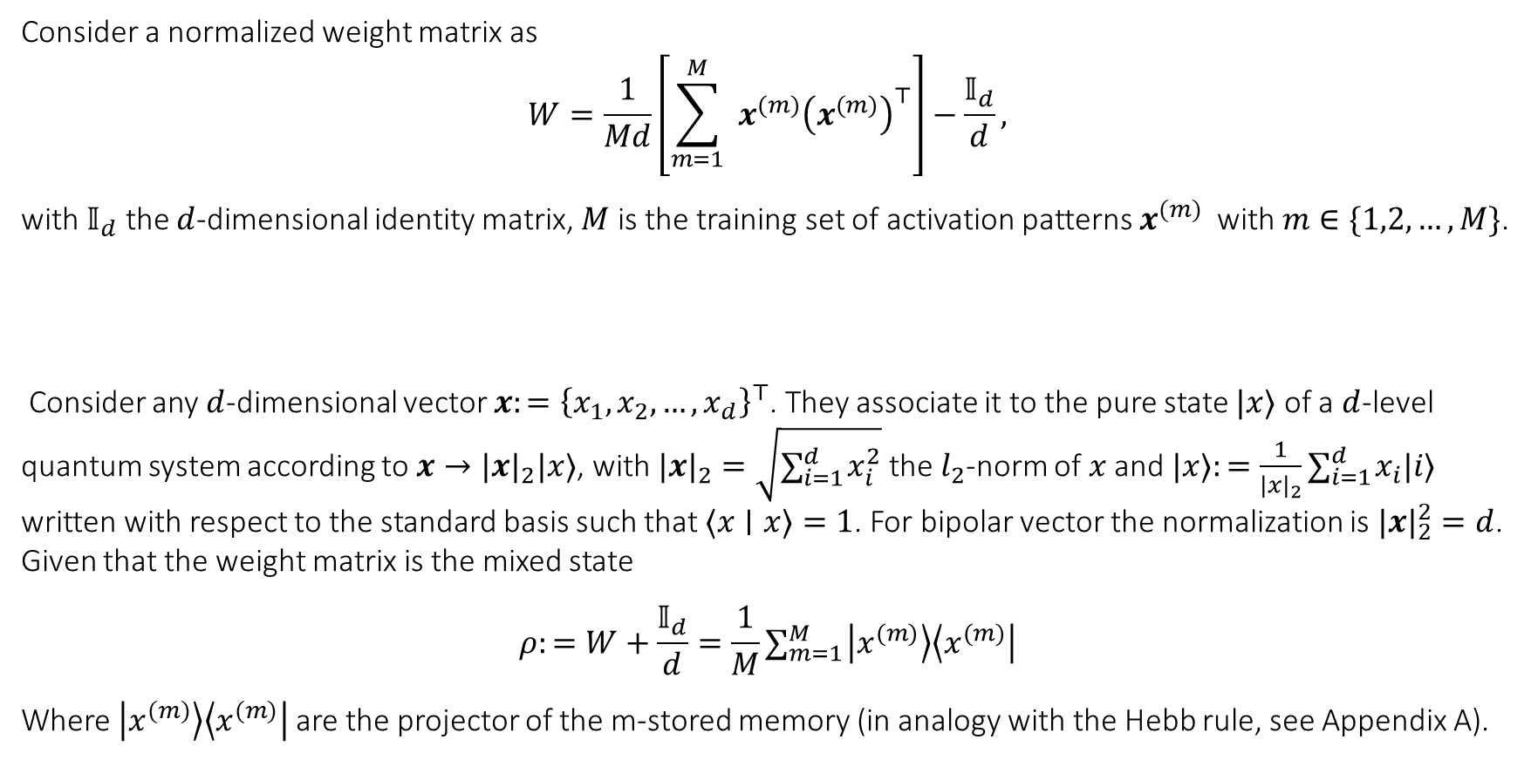
Core concepts
Consider a normalized weight matrix as
$$W=\frac{1}{Md}\left[\sum_{m=1}^{M}{ } x^{(m)}{\left(x^{(m)}\right)}^{⊤}\right]−\frac{𝕀_{d}}{d},$$
with $𝕀_{d}$ the $d$-dimensional identity matrix, $M$ is the training set of activation patterns $x^{(m)}$ with $m∈\{1,2,…,M\}$.
Consider any $d$-dimensional vector $x:={\left\{x_{1},x_{2},…,x_{d}\right\}}^{⊤}$. They associate it to the pure state $|x⟩$ of a $d$-level quantum system according to $x→|x|_{2}|x⟩$, with $|x|_{2}=\sqrt{∑_{i=1}^{d} x_{i}^{2}}$ the $l_{2}$-norm of $x$ and $|x⟩:=\frac{1}{|x|_{2}}∑_{i=1}^{d} x_{i}|i⟩$ written with respect to the standard basis such that $⟨x∣x⟩=1$. For bipolar vector the normalization is $|x|_{2}^{2}=d$. Given that the weight matrix is the mixed state
$$ρ:=W+\frac{𝕀_{d}}{d}=\frac{1}{M}∑_{m=1}^{M} \left|x^{(m)}\right\rangle \left\langle x^{(m)}\right|$$
Where $\left|x^{(m)}\right\rangle \left\langle x^{(m)}\right|$are the projector of the m-stored memory (in analogy with the Hebb rule, see Appendix A).

Slide 40
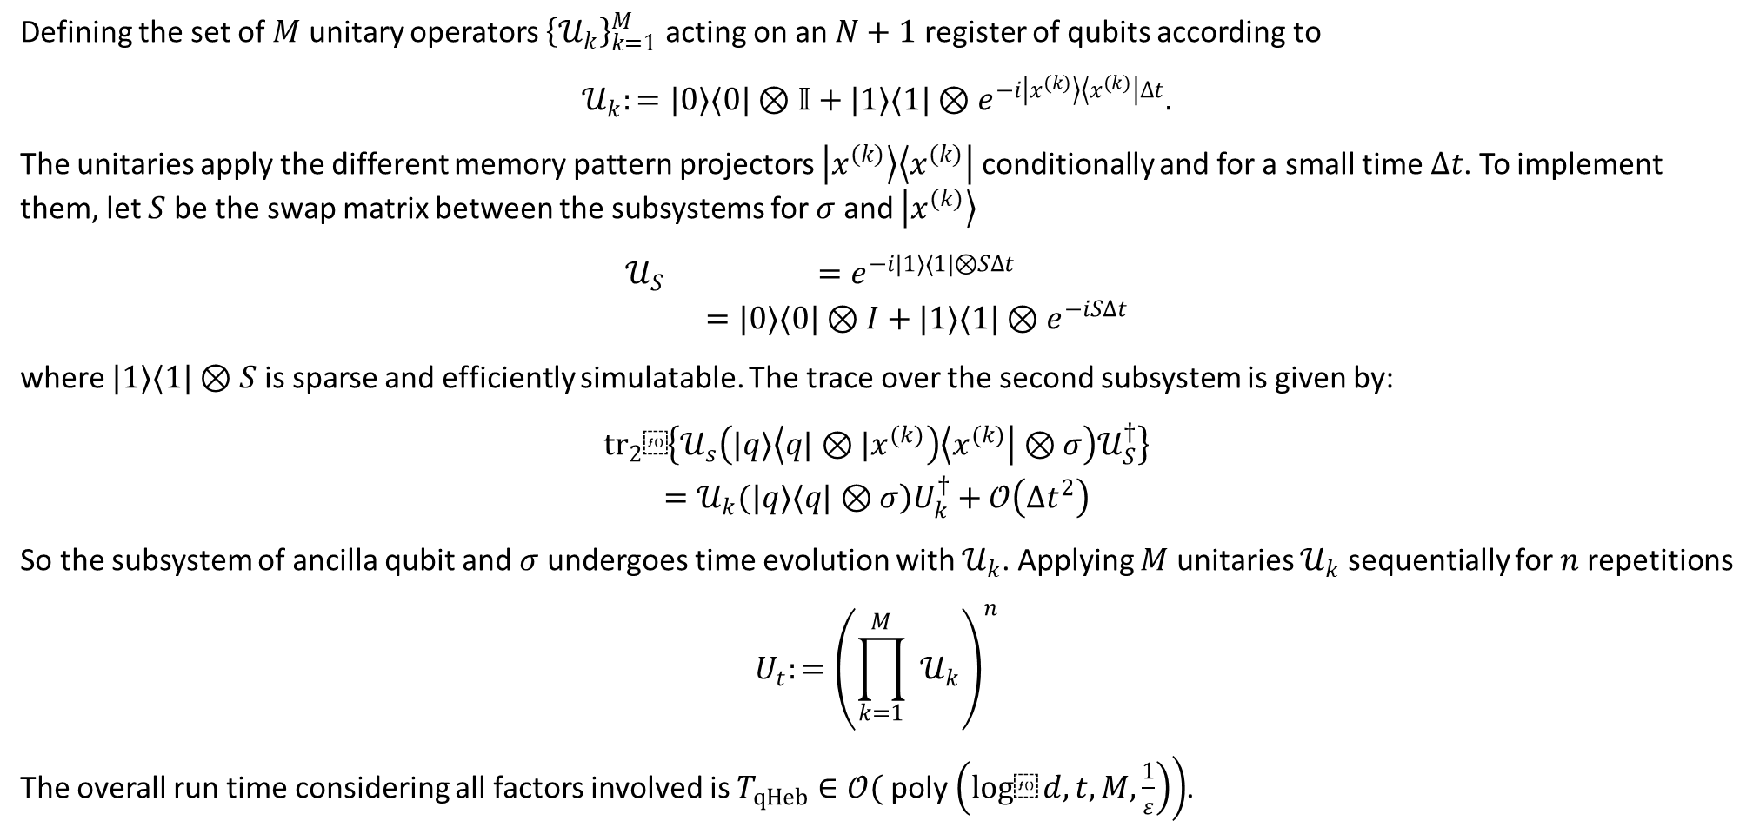
qHeb
To efficiently simulate $e^{\text{i}\text{ρ}\text{t}}$
Defining the set of $M$ unitary operators ${\left\{𝒰_{k}\right\}}_{k=1}^{M}$ acting on an $N+1$ register of qubits according to
$$𝒰_{k}:=|0⟩⟨0|⊗𝕀+|1⟩⟨1|⊗e^{−i\left|x^{(k)}\right\rangle \left\langle x^{(k)}\right|Δt}.$$
The unitaries apply the different memory pattern projectors $\left|x^{(k)}\right\rangle \left\langle x^{(k)}\right|$ conditionally and for a small time $Δt$. To implement them, let $S$ be the swap matrix between the subsystems for $σ$ and $\left|x^{(k)}\right\rangle$
$$\begin{matrix}𝒰_{S} & =e^{−i|1⟩⟨1|⊗SΔt} \\ & =|0⟩⟨0|⊗I+|1⟩⟨1|⊗e^{−iSΔt}\end{matrix}$$
where $|1⟩⟨1|⊗S$ is sparse and efficiently simulatable. The trace over the second subsystem is given by:
$$\begin{matrix}{tr}_{2}⁡\left\{𝒰_{s}\left(|q⟩\left\langle q|⊗|x^{(k)}\right)\left\langle x^{(k)}\right|⊗σ\right)𝒰_{S}^{†}\right\} \\ \left.=𝒰_{k}(|q⟩⟨q|⊗σ\right)U_{k}^{†}+𝒪\left(Δt^{2}\right)\end{matrix}$$
So the subsystem of ancilla qubit and $σ$ undergoes time evolution with $𝒰_{k}$. Applying $M$ unitaries $𝒰_{k}$ sequentially for $n$ repetitions
$$U_{t}:={\left(\prod_{k=1}^{M}{ } 𝒰_{k}\right)}^{n}$$
The overall run time considering all factors involved is $T_{qHeb}∈𝒪($ poly $\left.\left(log⁡d,t,M,\frac{1}{ε}\right)\right)$.

Slide 41
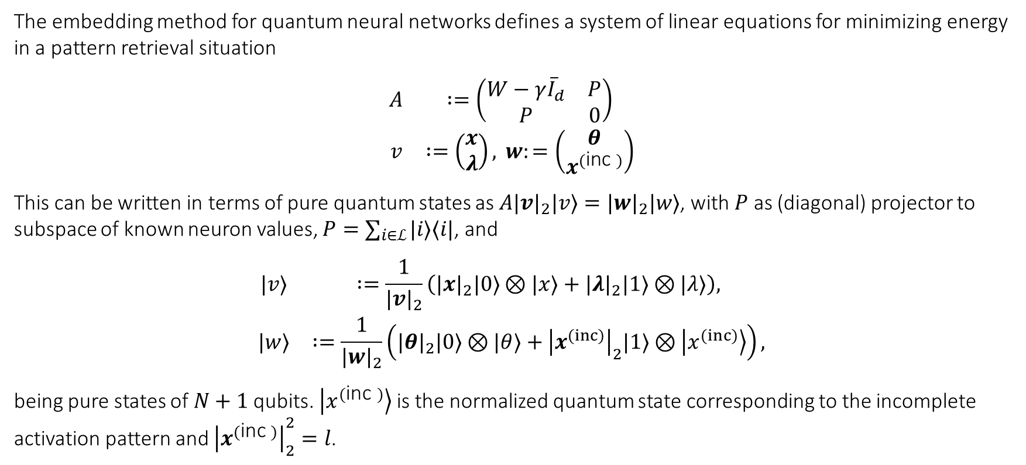
qHop -1
The embedding method for quantum neural networks defines a system of linear equations for minimizing energy in a pattern retrieval situation
$$\begin{matrix}A & :=\left(\begin{matrix}W−γ{\overset{‾}{I}}_{d} & P \\ P & 0\end{matrix}\right) \\ v & :=\left(\begin{matrix}x \\ λ\end{matrix}\right), w:=\left(\begin{matrix}θ \\ x^{(\text{inc} )}\end{matrix}\right)\end{matrix}$$
This can be written in terms of pure quantum states as $A|v|_{2}|v⟩=|w|_{2}|w⟩$, with $P$ as (diagonal) projector to subspace of known neuron values, $P=∑_{i∈ℒ} |i⟩⟨i|$, and
$$\begin{matrix}|v⟩ & :=\frac{1}{|v|_{2}}\left(|x|_{2}|0⟩⊗|x⟩+|λ|_{2}|1⟩⊗|λ⟩\right), \\ |w⟩ & :=\frac{1}{|w|_{2}}\left(|θ|_{2}|0⟩⊗|θ⟩+{\left|x^{(inc)}\right|}_{2}|1⟩⊗\left|x^{(inc)}\right\rangle \right),\end{matrix}$$
being pure states of $N+1$ qubits. $\left|x^{(\text{inc} )}\right\rangle$ is the normalized quantum state corresponding to the incomplete activation pattern and ${\left|x^{(\text{inc} )}\right|}_{2}^{2}=l$.

Slide 42
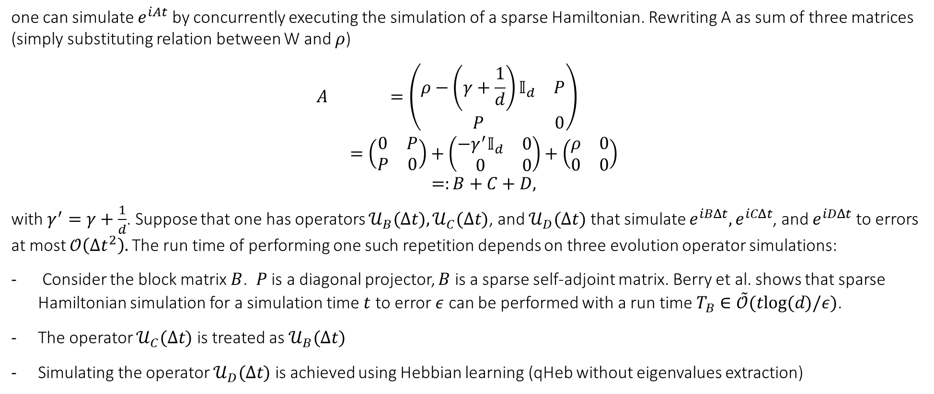
qHop -2
one can simulate $e^{iAt}$ by concurrently executing the simulation of a sparse Hamiltonian. Rewriting A as sum of three matrices (simply substituting relation between W and $ρ$)
$$\begin{matrix}A & =\left(\begin{matrix}ρ−\left(γ+\frac{1}{d}\right)𝕀_{d} & P \\ P & 0\end{matrix}\right) \\ & =\left(\begin{matrix}0 & P \\ P & 0\end{matrix}\right)+\left(\begin{matrix}−γ^{′}𝕀_{d} & 0 \\ 0 & 0\end{matrix}\right)+\left(\begin{matrix}ρ & 0 \\ 0 & 0\end{matrix}\right) \\ & =:B+C+D,\end{matrix}$$
with $γ^{′}=γ+\frac{1}{d}$. Suppose that one has operators $𝒰_{B}(Δt),𝒰_{C}(Δt)$, and $𝒰_{D}(Δt)$ that simulate $e^{iBΔt},e^{iCΔt}$, and $e^{iDΔt}$ to errors at most $𝒪\left(Δt^{2}\right).$The run time of performing one such repetition depends on three evolution operator simulations:
Consider the block matrix $B$. $P$ is a diagonal projector, $B$ is a sparse self-adjoint matrix. Berry et al. shows that sparse Hamiltonian simulation for a simulation time $t$ to error $ε$ can be performed with a run time $T_{B}∈\overset{˜}{𝒪}(tlog⁡(d)/ε)$.
The operator $𝒰_{C}(Δt)$ is treated as $𝒰_{B}(Δt)$
Simulating the operator $𝒰_{D}(Δt)$ is achieved using Hebbian learning (qHeb without eigenvalues extraction)

Slide 43

qHop -3
The spectral decomposition of $A$
$$\begin{matrix}A= & \sum_{j:\left|μ_{j}(A)\right|≥μ}{ } μ_{j}(A)\left|v_{j}(A)\right\rangle \left\langle v_{j}(A)\right| \\ & +\sum_{j:\left|μ_{j}(A)\right|<μ}{ } μ_{j}(A)\left|v_{j}(A)\right\rangle \left\langle v_{j}(A)\right|\end{matrix}$$
Where two separate sums dependent upon the size of the eigenvalues $μ_{j}(A)$ are obtained in comparison to a fixed user-defined number $μ>0$. the chosen value of $μ$ is a trade-off between the run time and the error in calculating the pseudoinverse. The matrix inversion algorithm returns
$$A^{−1}|w⟩=\sum_{j:\left|μ_{j}(A)\right|≥μ}{ }\frac{β_{j}}{μ_{j}(A)}\left|v_{j}(A)\right\rangle$$
where $β_{j}=\left\langle v_{j}(A)∣w\right\rangle$. Preparing the input state $|w⟩$ (via for example qRAM) and consider it in the eigenbasis of $A$, i.e. so that $\left|w\right\rangle =∑ β_{j}\left|v_{j}\left(A\right)\right\rangle$, qHeb algorithm is then used to perform quantum phase estimation, allowing to ob$tain⁡$an approximation of the eigenvalue $μ_{j}(A)$ to precision $ε$ in a subset limited to eigenvalues larger than $μ$ . The output of qHop algorithm is the pure state $|v⟩$)

Slide 44
Efficiency and comparison -1
The efficiency of the algorithm is dependent on three phases
Input
Computation
Output

Slide 45

Efficiency and comparison -2
Computation phase
1. Phase estimation requires to perform $𝒪\left(\frac{1}{ε^{3}}\right)$ calls to $e^{iAt}$
decompose $A$ into three block matrices $B,C$, and $D$ . applying for $n$ short times $Δt$ the unitaries $U_{B/C/D}$ generated by these block matrices requiring a number of steps $n=𝒪\left(t^{2}/ε\right)$. The decomposition require
both $B$ and $C$ are sparse matrices use efficient sparse Hamiltonian simulation techniques to evaluate $U_{B/C}(Δt)$ with run time $T_{B/C}∈$ $𝒪\left(\right.$ poly $\left.\left(Δt,log⁡d,log⁡\left(\frac{1}{ε}\right)\right)\right)$.
matrix $D$use the quantum Hebbian learning techniques discussed to simulate for a time $Δt$, requiring a run time $T_{D}∈𝒪\left(\right.$ poly $\left.\left(Δt,M,\frac{1}{ε},log⁡d\right)\right)$
$T_{D}$ is the dominant run time compared to $T_{B/C}$
2. The run time for filtering and amplification adds an additional overhead $T_{\text{filter} }∈𝒪\left(\frac{1}{μ}\right)$
overall algorithm run time of
$$T_{qHop}∈𝒪\left(poly⁡\left(M,log⁡d,\frac{1}{ε},\frac{1}{μ}\right)\right)$$

Slide 46


Application
They store the first 50 RNA-bases from each of the 8 segments of the influenza A H1N1 strain (i.e., so that $d=100,M=8$ ) in the weighting matrix $W$ using the Hebbian learning rule. They then generate incomplete data from the first segment of H1N1 randomly selecting $l/2$ known RNA-bases for $l/2∈\{1,2,…,50\}$. The Hamming distance measured between the result and the original pattern is used to measure differences in performance between classical and quantum Hopfield network. This is averaged over 1000 repetitions of random choices of $l/2$ RNA-bases as known bases.

Slide 47
AQO model

Slide 48




A view over local minima
the free energy for this circuit is given by
$$E=A−1/2∑_{i≠j} B_{ij}N_{i}N_{j}−∑_{i} C_{i}N_{i}$$
where $N_{i}$ is the state of each tunnel junction, and that the coefficients $A,B_{ij}$, and $C_{i}$ can be set at any desired value, based on the connection pattern and the capacitance values of the tunnel junctions, connection capacitors, and ground capacitors

Slide 49


Ising Parallelism
The total magnetic field $h_{i}$sensed by the atom i in an ensemble of particles is the sum of the fields induced by each atom and the external field $h^{∗}$ (if present), that is
$$h_{i}=∑_{j=1}^{n} w_{ij}x_{j}+h^{∗}$$
where $w_{ij}$represents the magnitude of the magnetic coupling between the atoms labeled i and j. The potential energy E of a certain state of an Ising material has the form
$$E=−\frac{1}{2}∑_{i,j}^{n} w_{ij}x_{i}x_{j}+∑_{i}^{n} −h^{∗}x_{i}$$

Slide 50


Problem solving via Hopfield
They consider the k-rooks problem as a canonical example of an energy minimization solvable problem. Modeling the configuration or state of the chessboard in terms of a bipolar k × k matrix S with entries
$$s_{ij}=\left\{\begin{matrix}+1 & \text{if} \text{a} \text{rook} \text{is} \text{placed} \text{on} \text{field} (i,j) \\ −1 & \text{otherwise} \end{matrix}\right.$$
The rook problem is a 2-d extension of the multiflop network: Assume that we are looking for a binary vector of dimension n whose components are all zero with the exception of a single 1.

Slide 51


Problem solving via Hopfield -1
Let $x_{1},…,x_{n}$ denote the binary states of the individual units. Our task is to find a minimum of
$$E\left(x_{1},…,x_{n}\right)={\left(∑_{i=1}^{n} x_{i}−1\right)}^{2}$$
This expression can also be written expanding square
$$E\left(x_{1},…,x_{n}\right)=∑_{i=1}^{n} x_{i}^{2}+∑_{i≠j}^{n} x_{i}x_{j}−2∑_{i=1}^{n} x_{i}+1$$
For binary states it holds that x_{i} = x_{i} ² and therefore
$$E\left(x_{1},…,x_{n}\right)=∑_{i≠j}^{n} x_{i}x_{j}−∑_{i=1}^{n} x_{i}+1$$
which can be rewritten as
$E\left(x_{1},…,x_{n}\right)=−\frac{1}{2}∑_{i≠i}^{n} (−2)x_{i}x_{j}+∑_{i=1}^{n} (−1)x_{i}+1$

Slide 52



Problem solving via Hopfield - 2
In the case of each column has only one 1 each we have that the function to be minimized is
$$E_{1}\left(x_{11},…,x_{nn}\right)=∑_{j=1}^{n} {\left(∑_{i=1}^{n} x_{ij}−1\right)}^{2}$$
An alternative (as done by the paper authors) is that we may consider the identity matrix $I$, the matrix of all zeros $0$, and the matrix $J={11}^{⊤}−I$ all of size $4×4$ in order to define a $16×16$ weight matrix
$$W_{r}=−2\left[\begin{matrix}J & 0 & 0 & 0 \\ 0 & J & 0 & 0 \\ 0 & 0 & J & 0 \\ 0 & 0 & 0 & J\end{matrix}\right]$$
Together with a 16-dimensional threshold vector
$$θ_{r}=−2(2−k)1$$
energy function $H_{r}=−\frac{1}{2}s^{⊤}W_{r}s+θ_{r}^{⊤}s$

Slide 53



Problem solving via Hopfield -3
Consider a time dependent system of n = 16 qubits
$$|ψ(t)⟩=∑_{i=0}^{2^{n}−1} a_{i}(t)\left|ψ_{i}\right\rangle$$
which is in a superposition of 65.536 basis states $\left|ψ_{i}\right\rangle$. Using schroedinger equation, we consider a period ranging from t = 0 to t = τ and assume the Hamiltonian of the Schrödinger equation to be a convex combination of two static Hamiltonian
$$H(t)=\left(1−\frac{t}{τ}\right)H_{B}+\frac{t}{τ}H_{P}$$
$$H_{P}=∑_{i=1}^{n} ∑_{j=1}^{n} Q_{ij}σ_{z}^{i}σ_{z}^{j}+∑_{i=1}^{n} q_{i}σ_{z}^{i}$$
Evolving the system from t =0 to τ and after evolution measuring it , probabilities ${|a}_{i}\left(t\right)|$² of obtain $\left|ψ_{i}\right\rangle$ will be finded.
Translating in AQO algorithm we may let
$$Q=−\frac{1}{2}\left(W_{r}+W_{c}\right) \\ q=θ_{r}+θ_{c}$$

Slide 54


Problem solving via Hopfield -4

Slide 55



Grover Parallelism -1
Hamiltonian is defined by
$$H(t)=H_{C_{1}}(t)+H_{C_{2}}(t)+⋯+H_{C_{M}}(t)$$
where each $H_{C_{a}}$ depends only on clause $C_{a}$ and acts only on the bits in $C_{a}.$
Clause $C$ is associated with the 3 bits labeled $i_{C},j_{C}$, and $k_{C}.$ For each clause $C$ they define an energy function
$$h_{C}\left(z_{i_{C}},z_{j_{C}},z_{k_{C}}\right)=\left\{\begin{matrix}0, & \text{if} \left(z_{i_{C}},z_{j_{C}},z_{k_{C}}\right) \text{satisfies} \text{clause} C \\ 1, & \text{if} \left(z_{i_{C}},z_{j_{C}},z_{k_{C}}\right) \text{violates} \text{clause} C.\end{matrix}\right.$$
They replace the bit $z_{i}$ by a spin- $\frac{1}{2}$ qubit labeled by $\left|z_{i}\right\rangle$ where $z_{i}=0,1$ and construct base Hamiltonian $H_{P}$ accordingly. they consider an $n$-bit Hamiltonian $H_{B}$ that is straightforward to construct but whose ground state is simple to find. Let $H_{B}^{(i)}$ be the 1-bit Hamiltonian acting on the $i$-th bit
$$H_{B}^{(i)}=\frac{1}{2}\left(1−σ_{x}^{(i)}\right) \text{with} σ_{x}^{(i)}=\left(\begin{matrix}0 & 1 \\ 1 & 0\end{matrix}\right)$$

Slide 56

Grover Parallelism -2
clause $C$ is associated with the bits $i_{C},j_{C}$, and $k_{C}$
$$H_{B,C}=H_{B}^{\left(i_{C}\right)}+H_{B}^{\left(j_{C}\right)}+H_{B}^{\left(k_{C}\right)}$$
$$H_{B}=\sum_{C}{ }H_{B,C}.$$
The ground state of $H_{B}$ is $\left|x_{1}=0\right\rangle \left|x_{2}=0\right\rangle ⋯\left|x_{n}=0\right\rangle$. This state, written in the $z$ basis, is a superposition of all $2^{n}$ basis vectors $\left|z_{1}\right\rangle \left|z_{2}\right\rangle ⋯\left|z_{n}\right\rangle$,
$$\left|x_{1}=0\right\rangle \left|x_{2}=0\right\rangle ⋯\left|x_{n}=0\right\rangle =\frac{1}{2^{n/2}}\sum_{z_{1}}{ }\sum_{z_{2}}{ }⋯\sum_{z_{n}}{ }\left|z_{1}\right\rangle \left|z_{2}\right\rangle ⋯\left|z_{n}\right\rangle$$
and
$$H_{B}=\sum_{i=1}^{n}{ }d_{i}H_{B}^{(i)}$$
where $d_{i}$ is the number of clauses in which bit $i$ appears in the instance of 3-SAT being considered.

Slide 57

Grover Parallelism -3
Corresponding to $h_{G}$ is a problem Hamiltonian
$$\begin{matrix}H_{P}|z⟩ & =\left\{\begin{matrix}|z⟩, & z≠w \\ 0, & z=w\end{matrix}\right. \\ & =1−|z=w⟩⟨z=w|\end{matrix}$$
where $|z⟩=\left|z_{1}\right\rangle \left|z_{2}\right\rangle …,\left|z_{n}\right\rangle$. So, they construct $H(t)=\tilde{H}(t/T)$ with $H_{B}$ given with $d_{i}=1$ for all $i$ from 1 to $n$. evolving using $H(t)$. The problem is "oracular" that is, it uses no knowledge about the structure of $H_{P}$ which could aid in finding $w$ . Writing $\tilde{H}(s)$ explicitly
$$\tilde{H}(s)=(1−s)\sum_{j=1}^{n}{ }\frac{1}{2}\left(1−σ_{x}^{(j)}\right)+s(1−|z=w⟩⟨z=w|).$$

Slide 58




Recall via different learning rules -1
Encode the complete problem in the Hamiltonian
$$ℋ_{p}=ℋ_{\text{mem} }+Γℋ_{\text{inp} }$$
H_{inp} can be obtained and imposed independently of memory pattern dynamic (computed only once).
$$ℋ_{\text{inp} }=\sum_{i}{ }ξ_{i}^{\text{inp} }σ_{i}^{z}$$

Slide 59


Recall via different learning rules -2
Series of recall averages for different annealing times. For small values of T, the average success is low, especially as p approaches n. As T increases, the average success also increases but only up to a limit that depends on each learning rule.

Slide 60
Conclusive Remarks

Slide 61
No single clear trend
Not performant fisical implementation
Not clear purposes in community
Not all factors considered

