Slide 1

18th November 2025
From EF to Argot:
Solidity’s New Home
Lea Schmitt, Argot Collective
@_schmitted

Slide 2

Solidity lead the biggest EF spin out: the Argot Collective

Slide 3
What is Argot?
The Argot Collective is an independent nonprofit emerging from the EF, maintaining Solidity and foundational Ethereum infrastructure.

Slide 4
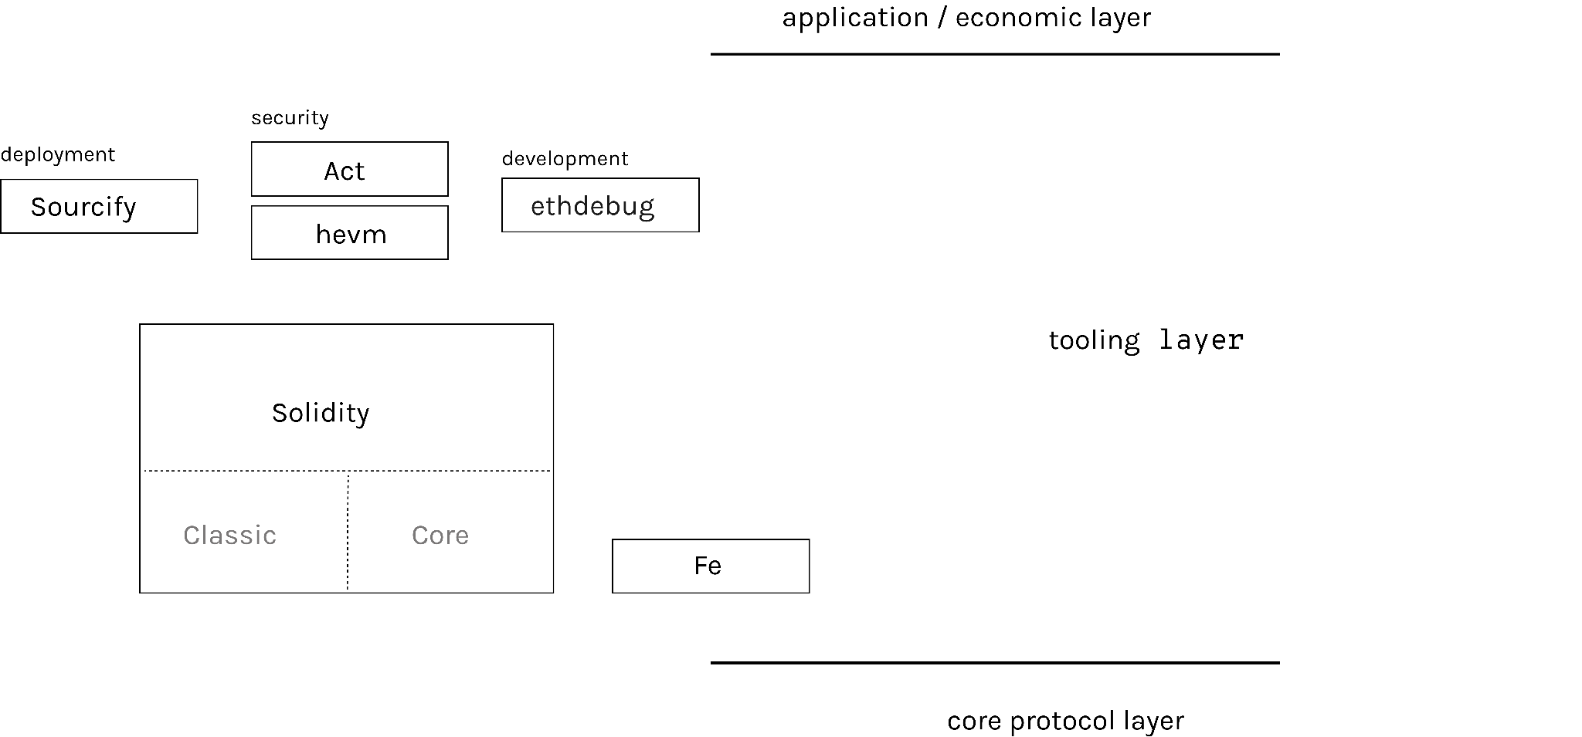
An overview:

Slide 5
An overview:
shared backend targeting yul

Slide 6
An overview:

Slide 7
An overview:
specification for Core Solidity

Slide 8
An overview:
used for fuzzing by Solidity
team members moving over to Core Solidity

Slide 9
An overview:
bug discovery
benchmarking
user behavior

Slide 10
An overview:

Slide 11
We strongly believe critical infrastructure should be
Independent
Open-source
Rigorously engineered
Sustainable

Slide 12
Why we spun out & where are we at
EF’s decentralization
Incorporated as non-profit this summer
Funding diversification: 3-4 years secured, working towards 10
Aiming to work very closely with the community to shape future direction

Slide 13
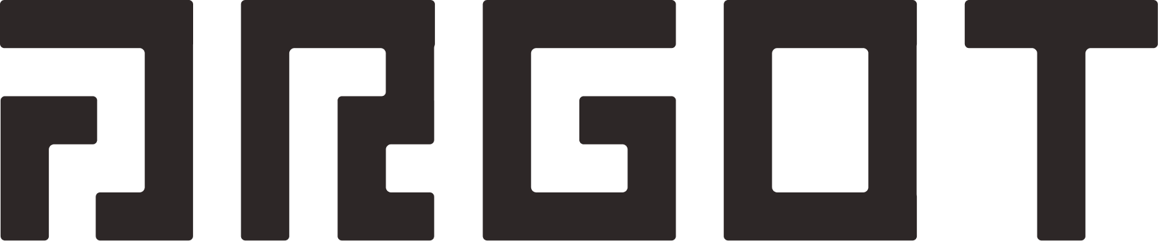
Thank you!
@argotorg
@_schmitted

