Slide 1


18 NOV 2025
Hardhat 3 is here
What’s new and why you should use it
Notes:
Hello and welcome,
My name is John Kane and I work on the Hardhat team at the Nomic Foundation.
I am going to be talking about Hardhat 3, our major new release, currently in Beta but ready for production.
I will walk you through the big improvements you can leverage, some tips on migrating, and exciting new features you should expect in the next few months.

Slide 2

Notes:
Before I jump in, let me just say a word on the Nomic Foundation.
The entire Hardhat team works at Nomic. Hardhat is our largest project, but it is one among several:
* slang - our compiler targeted at developer tools
* Also EDR (Ethereum Development Runtime) - a Rust library that lets you simulate an Ethereum node - you use it every time you boot up `hardhat node`.
Nomic is a non-profit that is dedicated to improving the development platform for Ethereum, and only Ethereum, our job is to make life easier for Ethereum devs.

Slide 3
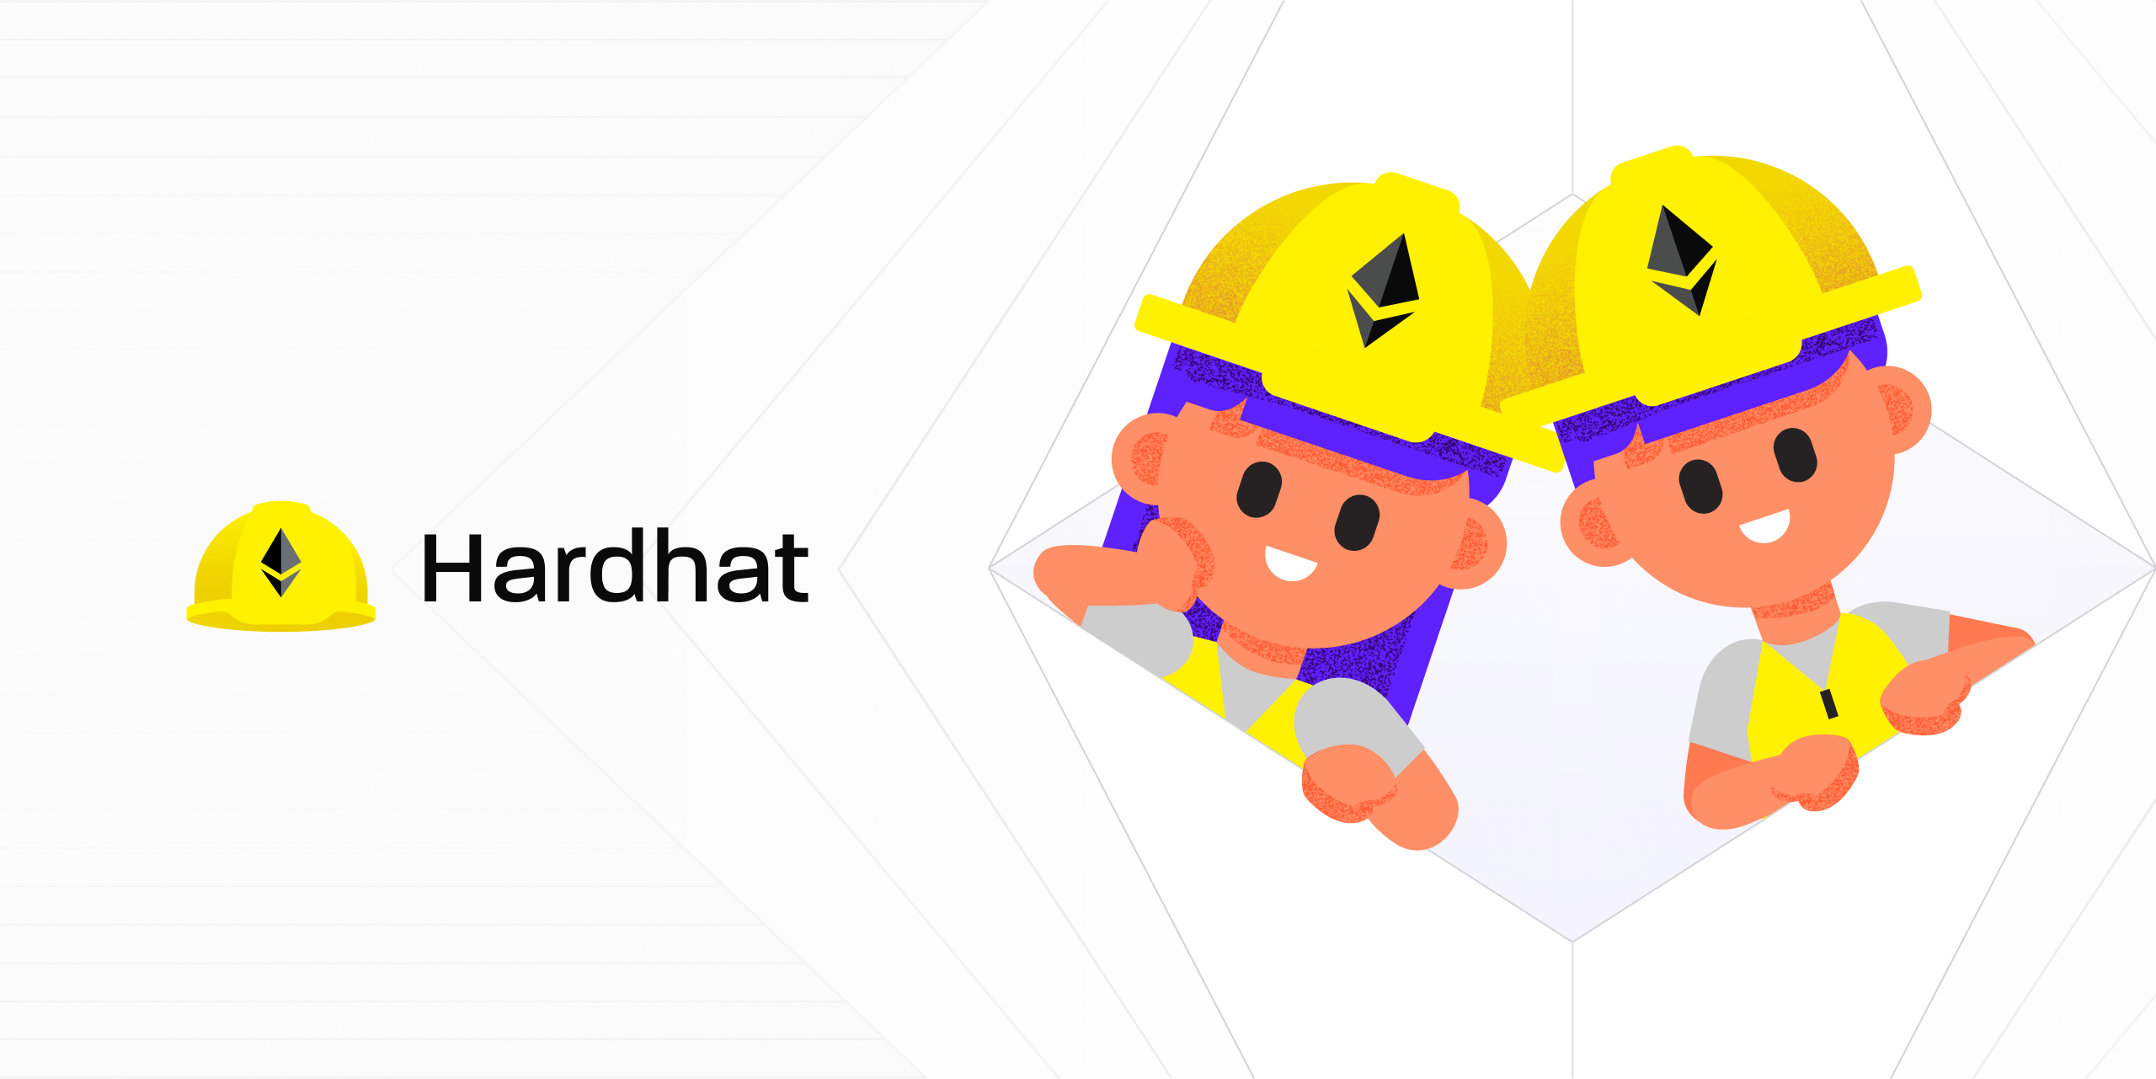
Notes:
So Hardhat.
Hardhat is a development system for smart contracts.
The first commits went down seven years ago, starting as a node task runner that wrapped solc.
Letting you compile contracts, deploy to a locally running eth node, and then brining test capabilities in JS.
Over the years it expanded with new capabilities…

Slide 4
Extensibility
Ease of use
Reliability
Principles
Notes:
Over all that time we have had guiding principles.
Hardhat is intended to be extended. To let teams adapt it to their needs. This is done through our plugin system and API - which has lead to a flourishing ecosystem of third party plugins.
We have focused on making Hardhat easy to use: that it will meet developers where they are, whether your coding a front end to a smart contract system, and so buried in a complex JS mono repo, hardhat will work, or doing a pure Solidity project and trying to understand why this contract reverted and you need comprehensible stack traces.
Reliability and consistency – we take semver and not breaking the API between major versions seriously. Hardhat 2’s API has been rock solid.
But spoiler alert, as the title of the talk gives away … we need to make some breaking. But why?

Slide 5
Ethereum
Node
Solidity tooling
Changes
Notes:
Ethereum changed - the Rollup centric roadmap means L2s have become a key target for new development and deployment.
The Node ecosystem has gone through its Python 2 to Python 3 stage and swapped from CommonJS to Ecmascript modules and deeply embraced Typescript - bring massive improvements in development experience.
Solidity tooling changed with new frameworks, with new capabilities - including Solidity tests. To take one big example the community has solidified around the importance of writing tests in Solidity (as opposed to js or python).

Slide 6
Why Hardhat 3?
Comprehensive Testing Support
Highly performant
Multi-chain support
Easy deployments
Notes:
Hardhat 3 answers the changing needs of while still delivering on our principles of extensibility, ease of use and reliability.
Hardhat 3 brings a comprehensive approach to testing. Javascript or typescript are still here and key, if you have a large mocha test suite please bring it to the Hardhat 3 party. But if you want to write unit tests Solidity you now have 1st class support in Hardhat 3.
In the last few years we have rewritten our core runtime in Rust (that is the EDR team I spoke about before), improving performance for both tests and scripts. And we have lots more improvements planned.
Hardhat 3 explicitly sets out to support L2s, allowing your local development network to precisely simulate the network your developing for. Currently, that simulation supported is limited to Optimism stack based chains, with more L2s planned.
Finally, Hardhat has always been strong on deployment, but with our Ignition smart contract deployment system, we are doubling down on supporting you through the complete development lifecycle.

Slide 7
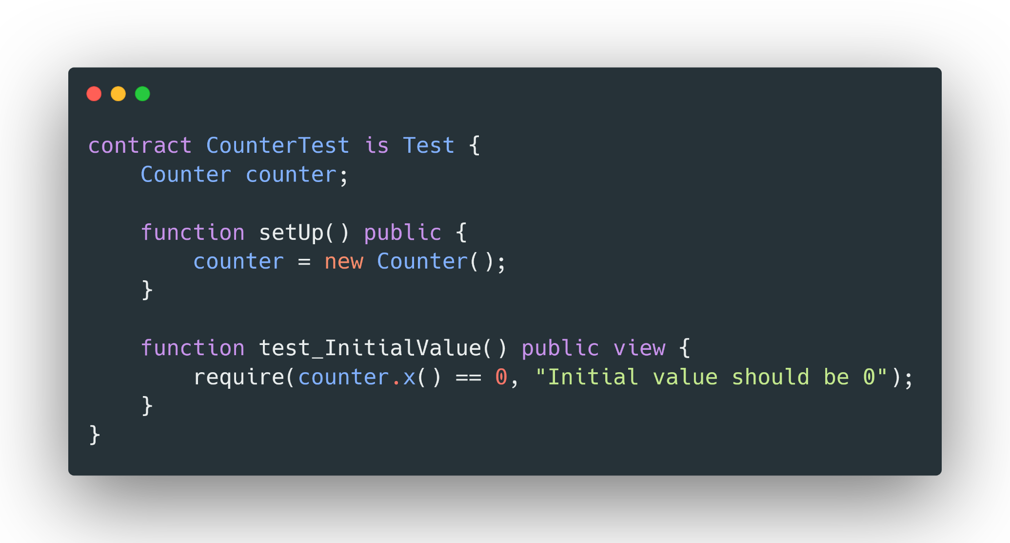
Solidity Tests
Notes:
Lets jump in detail - Solidity Tests.
Tests written in Solidity have the advantage that Hardhat doesn’t need to simulate a full Node to run - to run a test we only need to execute the EVM. Solidity Tests can just run faster.
You also don’t have the context switching and concept translation between two different languages.
This is ideal if you want to write a unit test against smart contract logic, putting some conditional under test.
And if you need a fuller simulation, with multiple transactions or the network layer, you have JS/TS integration tests as you always did.
We have intentionally pulled across the structure and indeed many of the cheat codes of Foundry’s Solidity Test.
Our goal is to build on what works, but also that a Solidity Test suite from a Foundry project should be runnable under Hardhat with ideally none, or minimal changes.
As I said, most cheatcodes are supported, those that aren’t tend to be around scripting - and Hardhat has different solutions for those use cases, indeed scripting is one of those places where having access to a scripting language is useful.
Fuzz tests and invariant tests are supported as well.

Slide 8

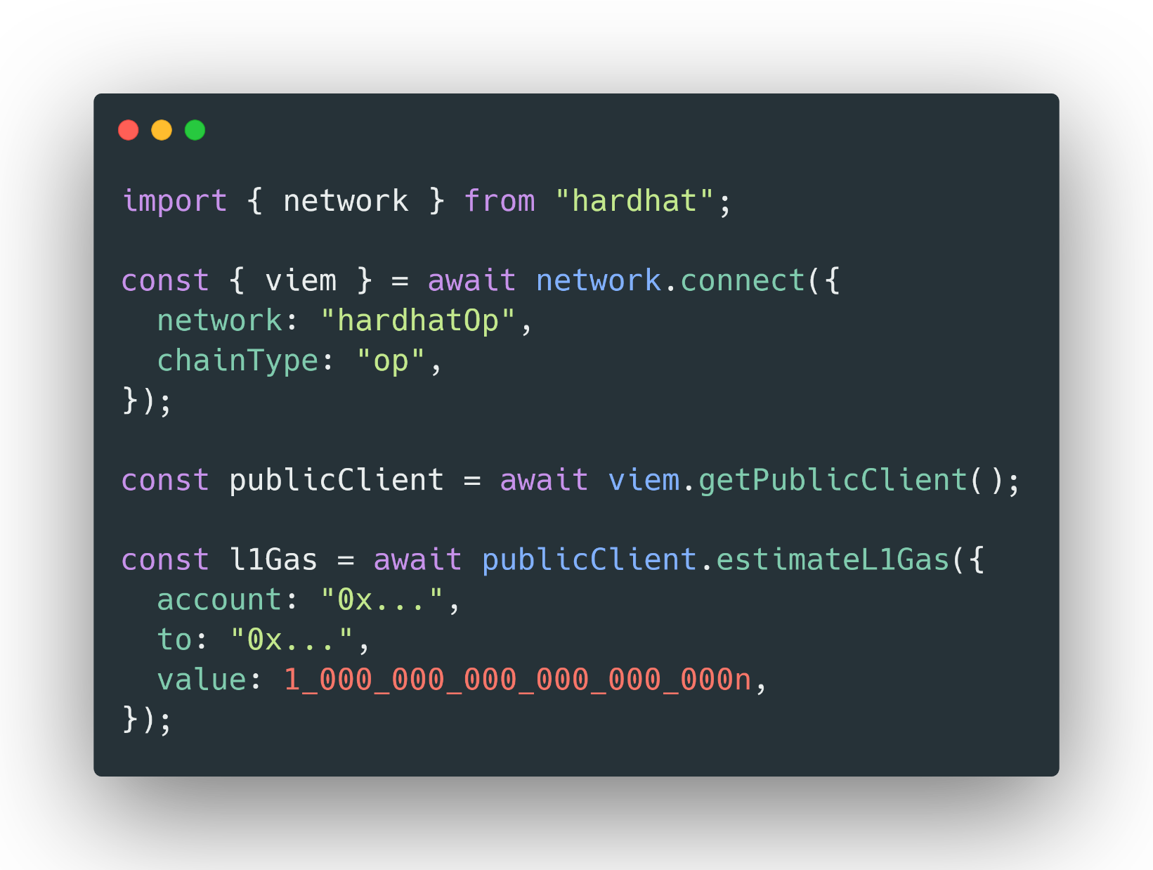
Multi-chain support
Notes:
L2s are now a key part of the Ethereum.
Hardhat 3 aims to give a precise simulation of the network being developed against. For the moment that is main net and Optimism chains. But we want to support additional l2s.
What does like. Well we have reworked the network API in Hardhat 3. And introduced the concept of chainType.
So you can see here, we have pulled in Hardhat, creating a connection with the named network confirmed “hardhatOp” that will be read from your hardhat.config file, but also this chain type property, here set to “op” or optimism.
That lets Hardhat flow additional type information, here we flow into viem. That means that the RPC calls the viem client supports includes those specific to OP chains, for instance `estimateL2Gas`. If I changed the chainType here to `l1`, you would immediately see the red squiggly of a type error on the `estimateL1Gas` call.
Enhances types - particularly view
Tells EDR to simulate Optimism - that will affect:
Predeploys
Gas costs and estimations
JSON-rpc level changes
Get a more precise simulation - rather than just testing against L1 and hoping for the best, we are aiming to get you closer to reality.

Slide 9
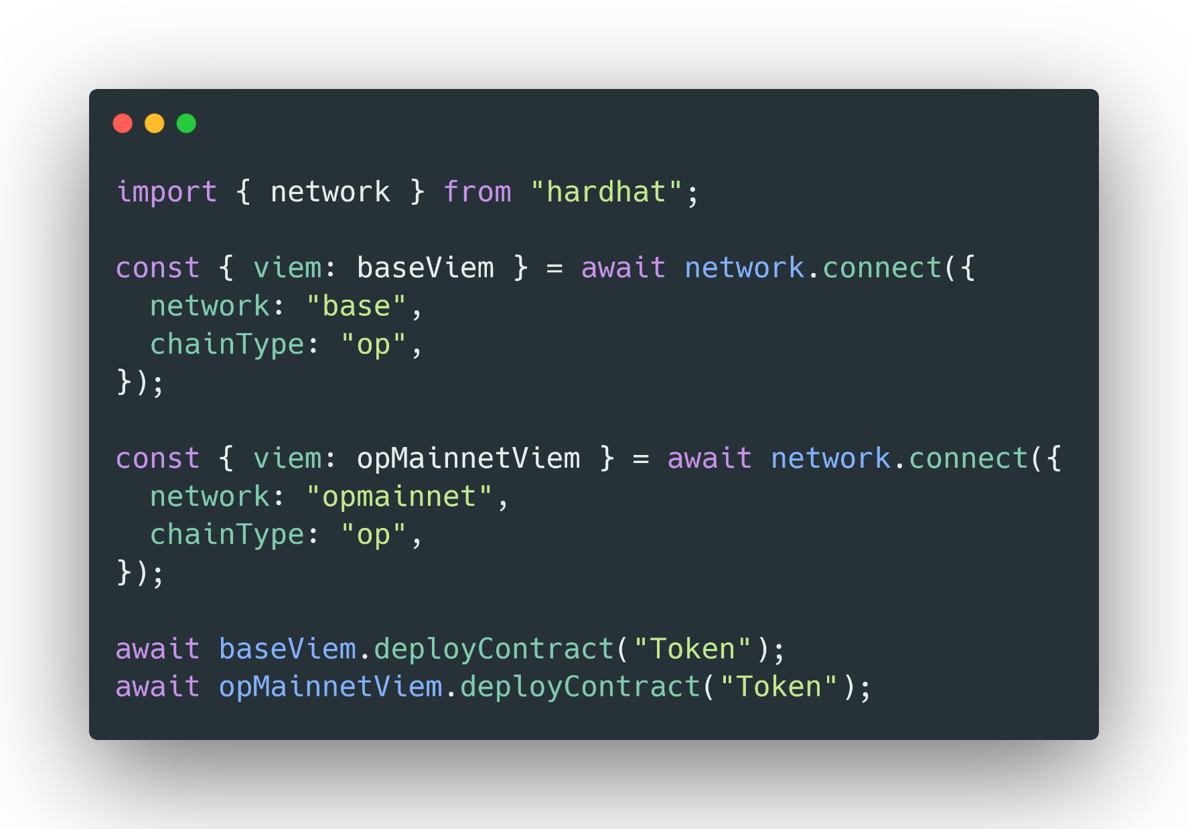
Simultaneous network connections
Notes:
In a world of multiple L2 networks, you need to be deal with more than one network at once.
In Hardhat 2, the network connection was implicit and there could be only one in a running process. Leading to a range of hacked workarounds.
In Hardhat 3 connecting to a network is explicit - giving you the control you need. At the same time we have looked to minimise the change by providing a default connection that roughly matches how Hardhat 2 behaves.
Just to re-iterate. You can now handle multiple network connections in your scripts and in your tests. Those connections can be against L1s or L2s. For optimism based L2s you can expect better type support and more precise simulation in local hardhat nodes.

Slide 10


Deployment
Notes:
Hardhat 3 comes by default with Ignition, Hardhat’s smart contract deployment system.
It allows you to declaratively describe a complex deployment.
You describe your deployment, Ignition will then build an execution plan, validate it looking for problems before you start sending transactions, then co-ordinate the transactions that need to be sent and monitoring them. The state of the transactions are journaled locally, letting Ignition restart a failed or interrupted deployment without having to write the error handling code yourslef.
To take an example:

Slide 11
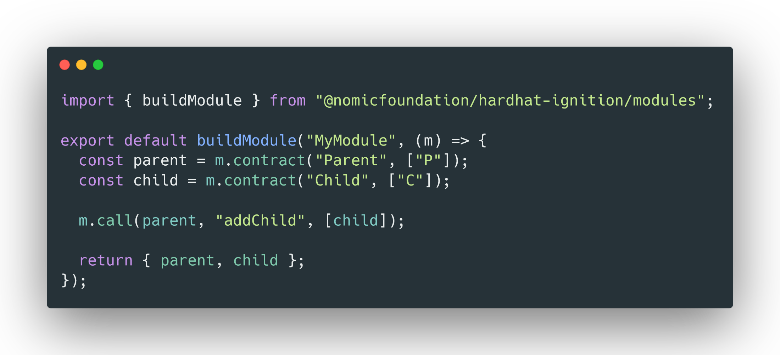
Ignition Module
Notes:
Ignition is a powerful and featureful deployment system – it has many additional features supporting running as test fixtures or deterministic deployments with `create2` - you should take a look.

Slide 12
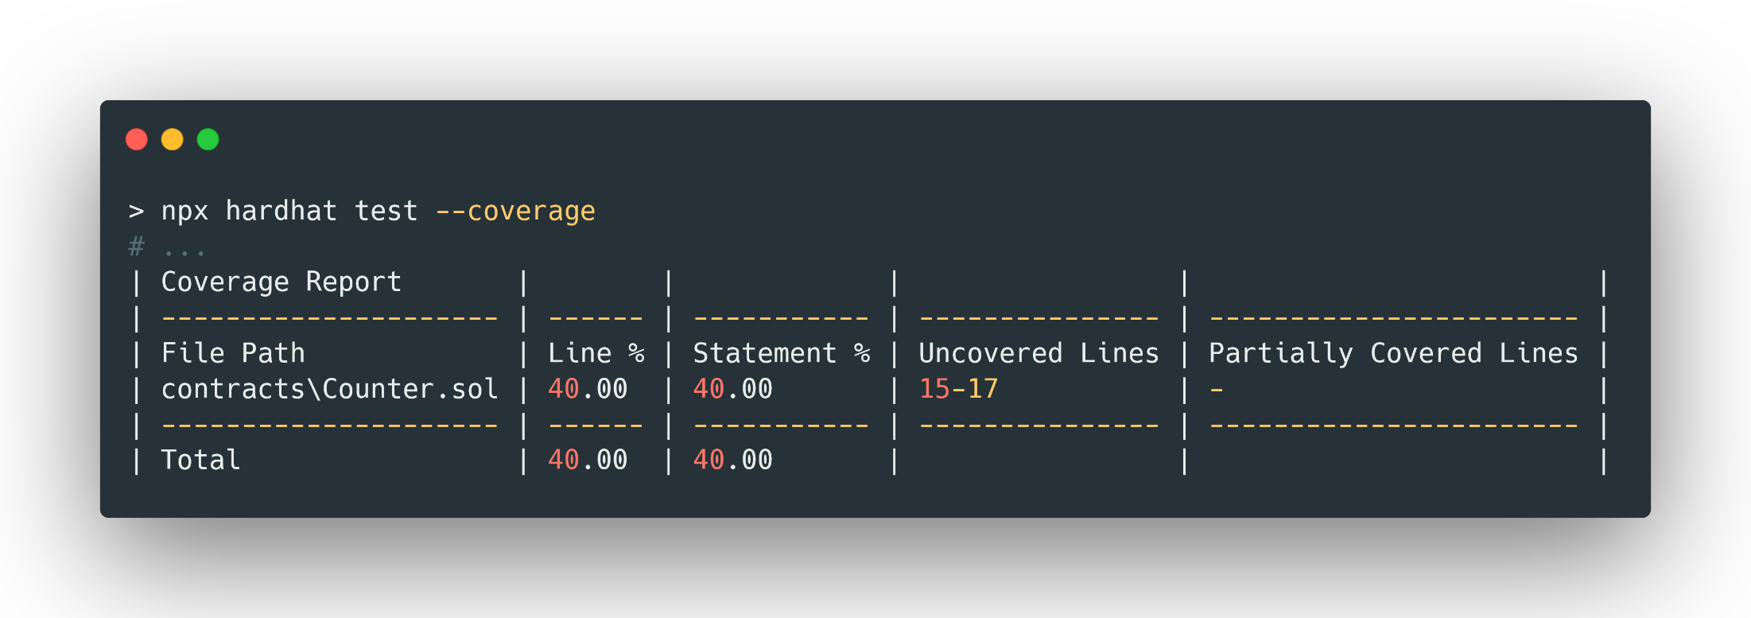
Batteries included
Code Coverage
Notes:
Hardhat retains its philosophy of extensibility – the plugin API has had to be updated to allow for ESM. But many many plugins have already ported across to HH3.
We made the call though to ensure a strong batteries included feel for new Hardhat projects from the outset.
Code coverage is now baked into Hardhat whether you are running Solidity or integration tests - with coverage results being combined if you include both in the same run.

Slide 13
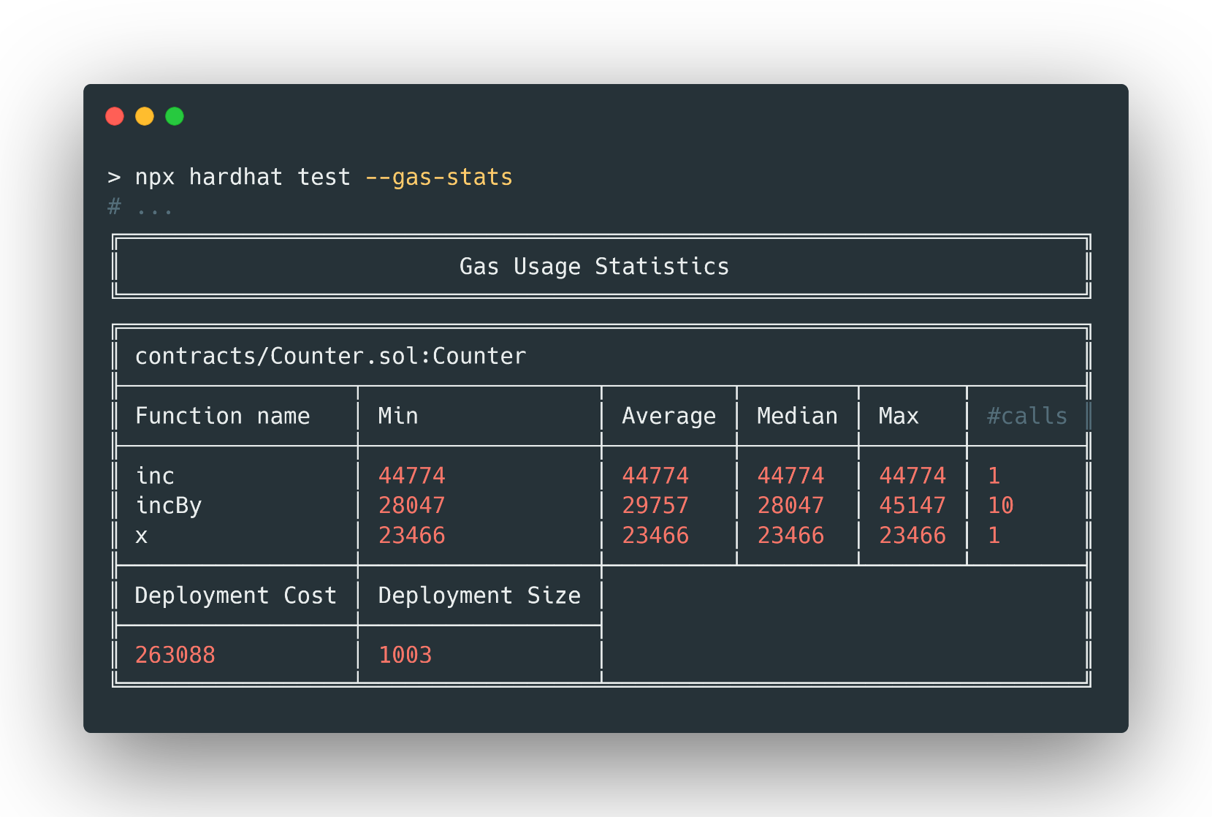
Batteries included
Gas Statistics
Notes:
Similarly reporting statistics on gas usage in a test suite is part of core - no need for an additional plugin.

Slide 14
Keystore
Encrypted secrets by default
No need for .env files
Notes:
Keystore - no more private keys in .env files, the keystore plugin lets you keep secrets in an encrypted file in your home directory, and outside of the repo.
For deployments you the option of pulling in `hardhat-ledger` for hardware wallet support.

Slide 15
Improved Performance
Notes:
The swap over to the EDR runtime written in Rust, significantly improved the speed of many JS/TS test suites.
Solidity tests are on par with Foundry 1.3.
Having both options lets you partition your test suite, for optimal performance.

Slide 16

Production ready
Notes:
Hardhat 3 is production ready. Major projects have switched already.
But for the moment we have the Beta tag.
We don’t expect user facing breaking changes in the API.
Keeping the Beta tag while we built equivalents to the features set current available in the Hardhat toolbox, things like code coverage and gas statistics
We will keep the Beta tag until that core experience is fully available.
There may still be changes to the plugins API
If you are a plugin author, we have published docs on creating plugins. As we add more extension points, so we are keen to hear from anyone writing a plugin from scratch or migrating an existing plugin. Please get in touch.

Slide 17
Migrating your Project
Notes:
A few tips on migrating a Hardhat 2 project.
To be clear, while Hardhat 3 has breaking changes – particularly the plugin api, ESMified hardhat config, and the new network API.
We have attempted to minimize the amount of change an established codebase will need.
Projects have already migrated and we have been working with and investigating the migration paths for major defi projects – every project is different, but for many this will be at the scale of days of engineering effort rather than weeks.
Your starting point should be the Migration guide on the hardhat.org website. It goes into depth.
But to give you a sense of whats involved.

Slide 18
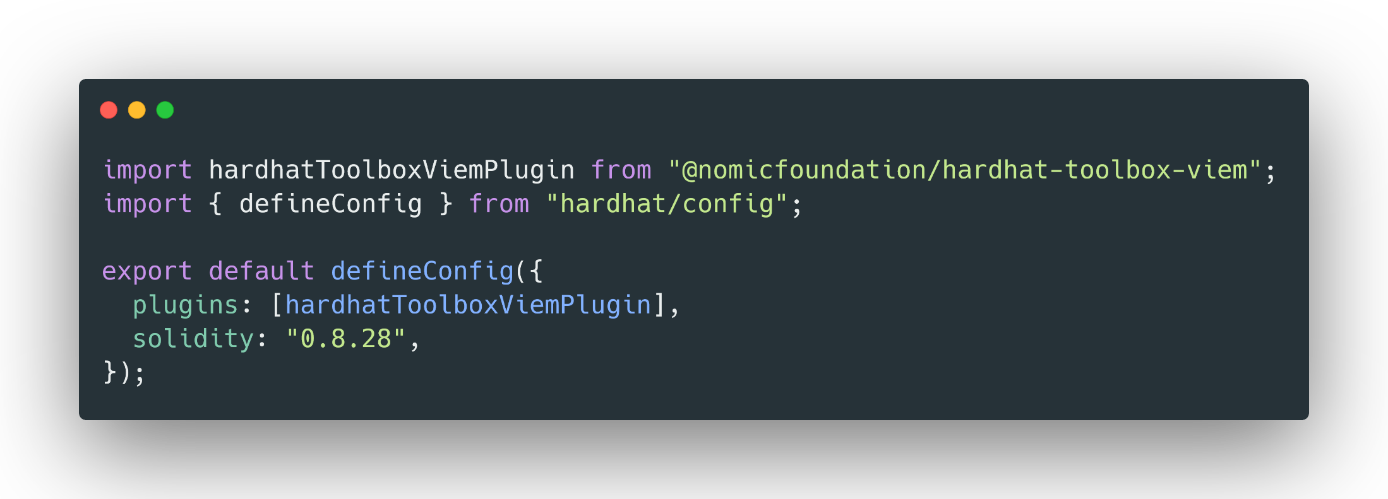
MIGRATION
Adapt your hardhat.config.ts
Notes:
Firstly you will need to update the versions of hardhat and the nomic plugins in your package.json to 3.x version range.
Hardhat 3 is ESM first, at a minimum the hardhat.config needs to a an Ecmascript module.
Most of the structure of the config object will be able to come across from Hardhat 2 unchanged.
But you will definitely need to update Plugins, tasks which previously where registered by side effects when your required or imported the plugin, and now are passed as config.

Slide 19
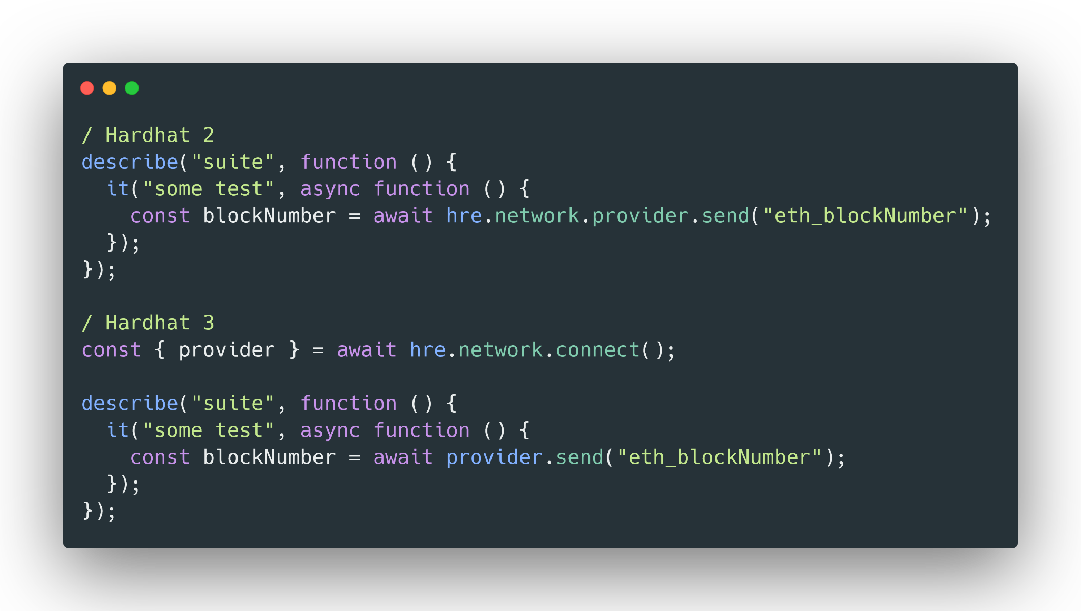
MIGRATION
Adapt your network connections
Notes:
* The likely largest area of code change is in your test suite. Previously the network was created implicitly, as you can see here at the top with the provider sending an JSON rpcs call.
* Now the network must be created explicitly – letting you have multiple connections or to change the chain type - but along with that you will need to decide your isolation level, are you creating a single in-memory network instance for the entire test suite? One per file? One per test. That is for a project to decide.
* This is likely to be the biggest change in your codebase – requiring updates in many test files. But we have found in projects that are migrating it is in large part a repetitive but mechanical change.

Slide 20
What’s next?
Notes:
Okay, Hardhat 3 provides a base we are going to continue building on, what features are coming down the pipeline in the next few months?

Slide 21

Roadmap
Gas Snapshots
Gas statistics are available today
Take Gas snapshots and test gas usage regressions
Notes:
Gas statistics are available today.
But we want to add support for Gas snapshots where the gas usage of a test run is stored to file, and subsequent test runs are compared against that baseline, giving you a regression test you can use in your CI.

Slide 22

Roadmap
Vyper Support
Bring `hardhat-vyper` to Hardhat 3
Support projects with vyper contracts

Slide 23

Roadmap
Bun support
Notes:
Run your Hardhat project from bun.
We have seen projects already successfully using Hardhat 3 and Bun
Make sure it works well with across all the features of Hardhat and their combinations – we won’t give it the official stamp of approval until then.

Slide 24
Roadmap
More Performance
Notes:
Hardhat 3 is faster, but we are not going to rest on our laurels.
EDR delivered in some cases 10x performance improvements in JS test suites, in test execution for Solidity tests we are on par with Foundry,
However, we have identified improvement we can make in our build pipeline
Continue improving performance on real world usage

Slide 25

Learn more
Notes:
Hardhat 3 delivers on our principles of extensibility, ease of use and reliability while:
Improving performance
Adding solidity testing
And taking Hardhat multi-chain
Give it a go, the best starting point is our docs at hardhat.org, we have recently revamped the entirety of the docs, and tell us what you think.

